Slide 1
Geoportal
Server
January 4, 2012
Christine White, Esri

Slide 2
A long time ago in a galaxy far, far away....
Geoportal
Server
became a viable tool many
others desired. Soon it was
A NEW HOPE
What began as a project
for the federal government
clear that the tool should be free
and open. This is the continuing story.

Slide 3
(Sidenote: Space-ial Data Infrastructure?)

Slide 4



Universe of challenges
How to comply with Open Government directives to share data?
Technical and administrative challenges to sharing?
How to discover data?
How to distribute authoritative datasets?
Metadata…

Slide 5
Geoportal Server Completes the SDI Platform
Inventory and Catalog
Search and Discovery
Providers
Access and Distribution
Consumers

Slide 6
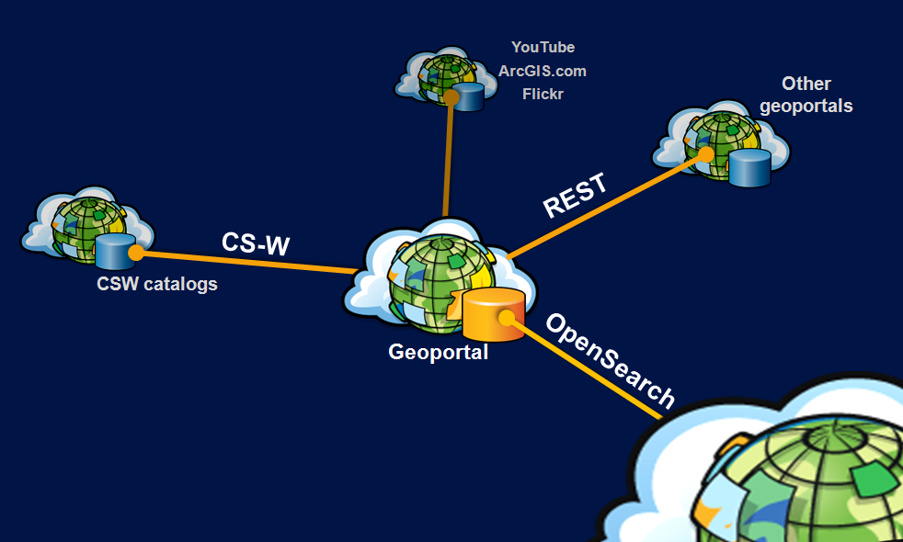
Creating connections across the data life cycle

Slide 7


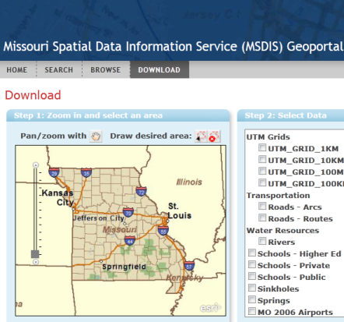














2005-2010

Slide 8
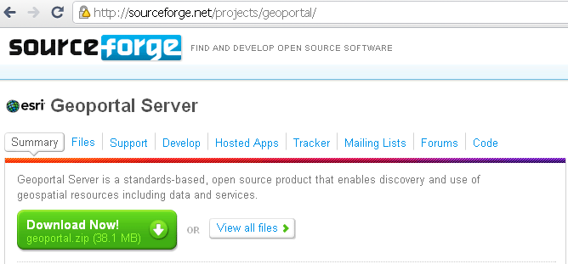
October 2010: “Esri Geoportal Server”
http://esriurl.com/geoportalserver
Apache 2.0 license

Slide 9
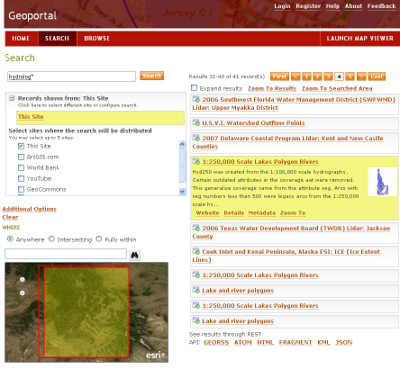
No-cost system setup
Apache Directory Server for authentication
Geoportal Server application
Flex-based map viewer with Geoportal search widget
Tomcat or GlassFish to serve web application
PostgreSQL database, metadata indexed by Lucene
OpenStreetMap, WMS, or ArcGIS Services for basemap

Slide 10

Popular Features
(e.g., why do folks choose this tool?)
  Open Source, yet supported and tested with other Esri products
  Support for multiple metadata standards
  Support for standards-based discovery protocols
  Highly customizable web interface
  Federated search
  Accessible documentation

Slide 11
Version 1.2 (released Dec. 21)
  Support for MySQL db
  Use WMS, WMTS, or OSM for Search map
  Ability to set an initial extent on Search map
  CSV format for search results
  Native publishing support for ISO 19115-2
  Schematron validation
  Harvest THREDDS
  Collections

Slide 12
Links
  Download Esri Geoportal Server
    http://esriurl.com/geoportal
  Public beta site
    http://gptogc.esri.com/geoportal
  Questions
    cwhite@esri.com

