Slide 1
Earth Science Information Partners (ESIP) Meeting Frisco, CO July 9, 2014
Agricultural Research Service
The Long-Term Agro-Ecosystem Research (LTAR) Network: Current Status and Future Trends
Dr. Mark R. Walbridge
National Program Leader
Water Availability & Watershed Management Program
LTAR Coordinator

Slide 2
The top 100 questions of importance to the future of global agriculture (Pretty et al. 2010. Int. J. of Ag. Sustainability 8:219-236)
In light of:
Growing impacts of climate change.
Concerns over energy security.
Regional dietary shifts.
And the Millennium Development target of a 50% reduction in world poverty and hunger by 2015:
“Rather than simply maximizing productivity, the goal for the agricultural sector is to optimize productivity across a far more complex landscape of production, rural development, environmental, social justice and food consumption outcomes.”

Slide 3
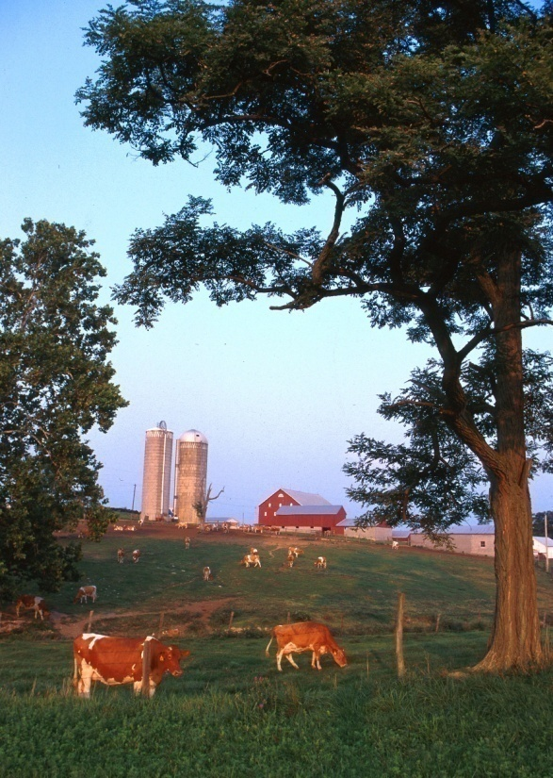
Meeting these challenges will require transformative changes to agriculture (NRC 2010)
Production systems and agricultural landscapes that:
Represent a significant departure from the dominant systems of present-day agriculture.
Capitalize on synergies, efficiencies, and resilience characteristics associated with complex natural systems and their linked social, economic, and biophysical systems.
Integrate information about productivity, environmental, economic, and social aspects of farming systems to understand their interactions.
Address issues of resilience and vulnerability to changing climatic and economic conditions.

Slide 4
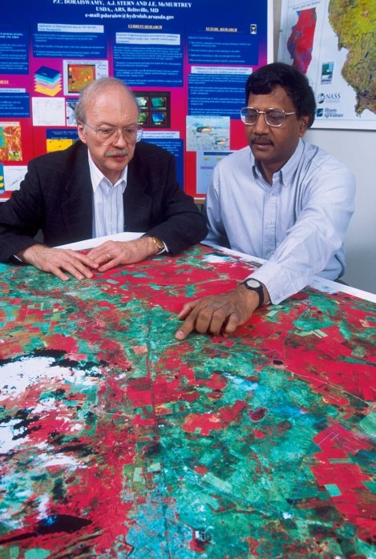
USDA Research, Education, and Extension Action Plan 2012
“…in light of the many pressing challenges we face, it is time to renew our Nation's commitment to maintaining and growing a progressive and innovative system of agricultural science.”
“…….priorities are clearly linked—in science, nature, and through the multitude of goods and services produced on our Nation’s working lands.”
“These linkages between priority areas reflect the inherent complexity of agricultural systems and highlight our need for even more interdisciplinary investigations as we move forward.”
. . . REE Under Secretary and USDA Chief Scientist Dr. Catherine Woteki

Slide 5
How Will a Long-Term Agro-Ecosystem Research (LTAR) Network Help Us Meet These Challenges?
By helping us understanding how key agricultural system components interact at larger scales (e.g., watershed; landscape);
By helping us anticipate the environmental effects of shifting agricultural practices;
By helping us improve the effectiveness of conservation programs;
By helping us identify the broader societal benefits of modern agriculture (e.g., bio-energy production; carbon sequestration; improved water quality & water-use efficiency; wildlife habitat).

Slide 6
Shared Research Strategy (www.ars.usda.gov/ltar)
Four Priority Areas of Concern
Agro-ecosystem Productivity;
Climate Variability and Change;
Conservation and Environmental Quality;
Socio-economic Viability and Opportunities.
Four Key Products
New knowledge of processes & systems;
New technologies & management practices;
Improved agro-ecological models;
Comprehensive, accessible data.

Slide 7
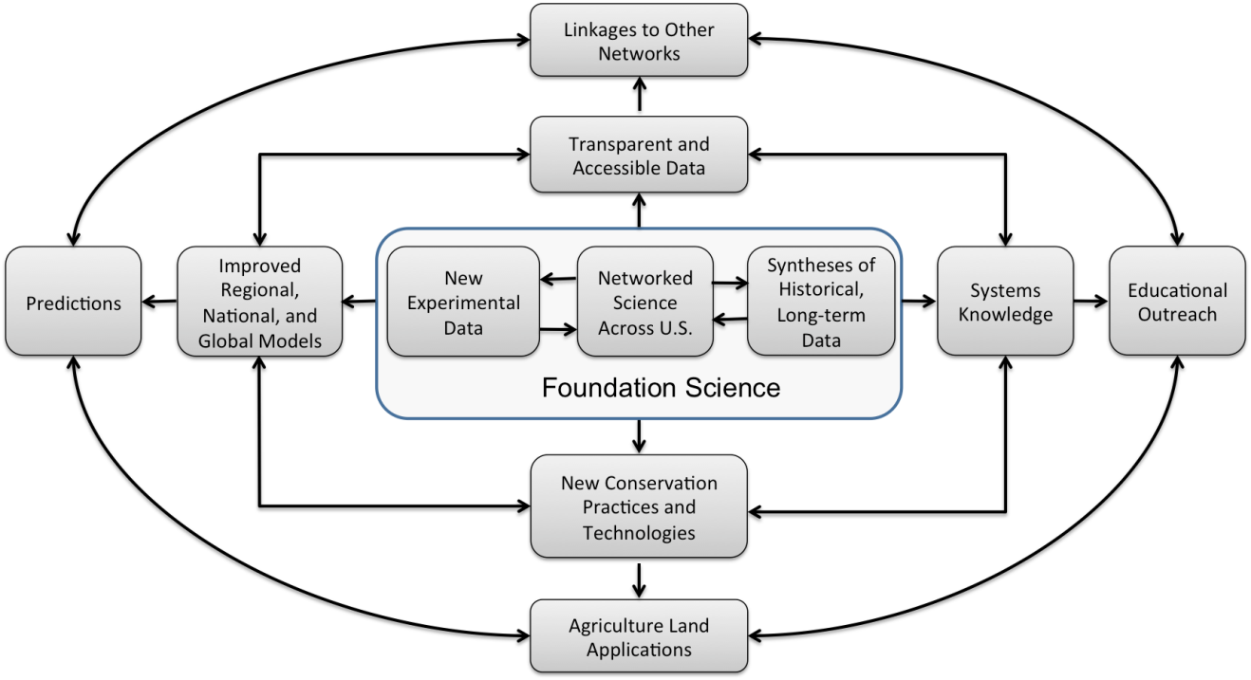

Slide 11
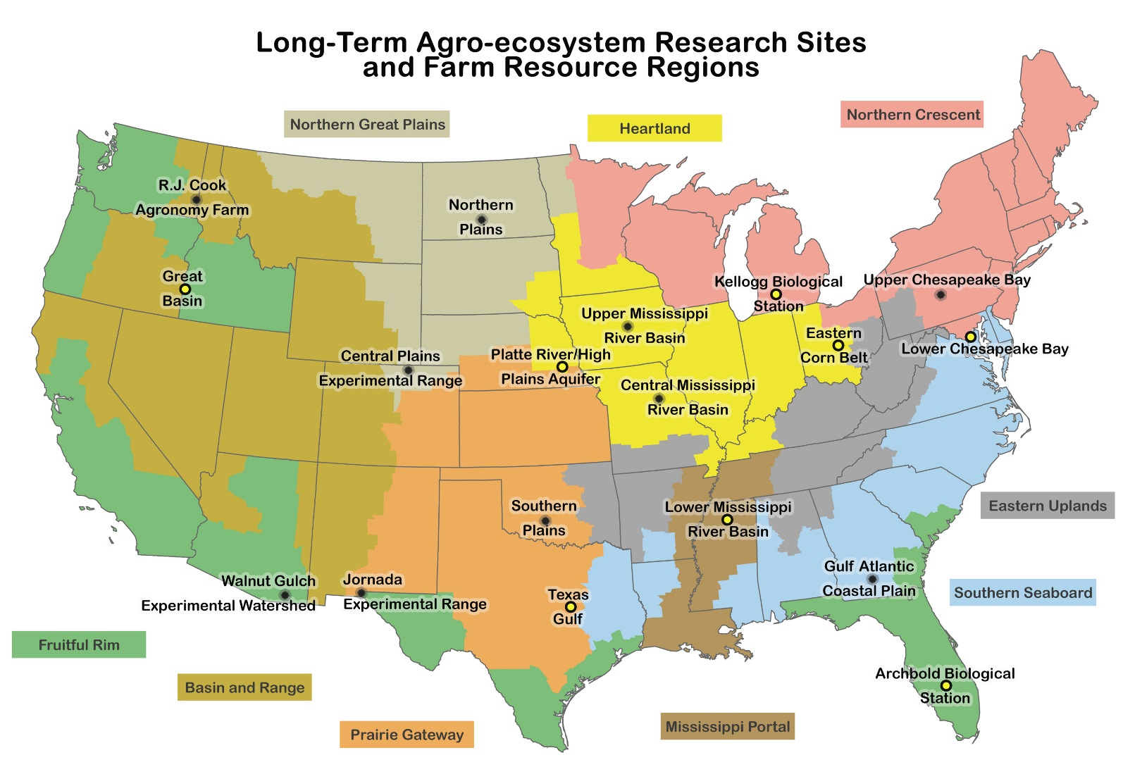
The Long-Term Agro-ecosystem Research (LTAR) Network

Slide 12
Six New LTAR Sites
Fill critical gaps in the current network
Lower Chesapeake Bay
Florida
Great Lakes
Ohio River Basin
Texas Gulf
Great Basin
Extend the LTAR network to partner sites outside ARS and USDA.
Expand LTAR site coverage to the
Critical Zone Observatory (CZO) Network
The National Network of Biological Field Stations

Slide 13
LTAR Sites Will
Collect a core set of common measurements;
Participate in an annual LTAR network meeting or workshop;
Encourage partnerships;
Seek extramural funding to support long-term research;
Undergo a site review every 5 years.

Slide 14
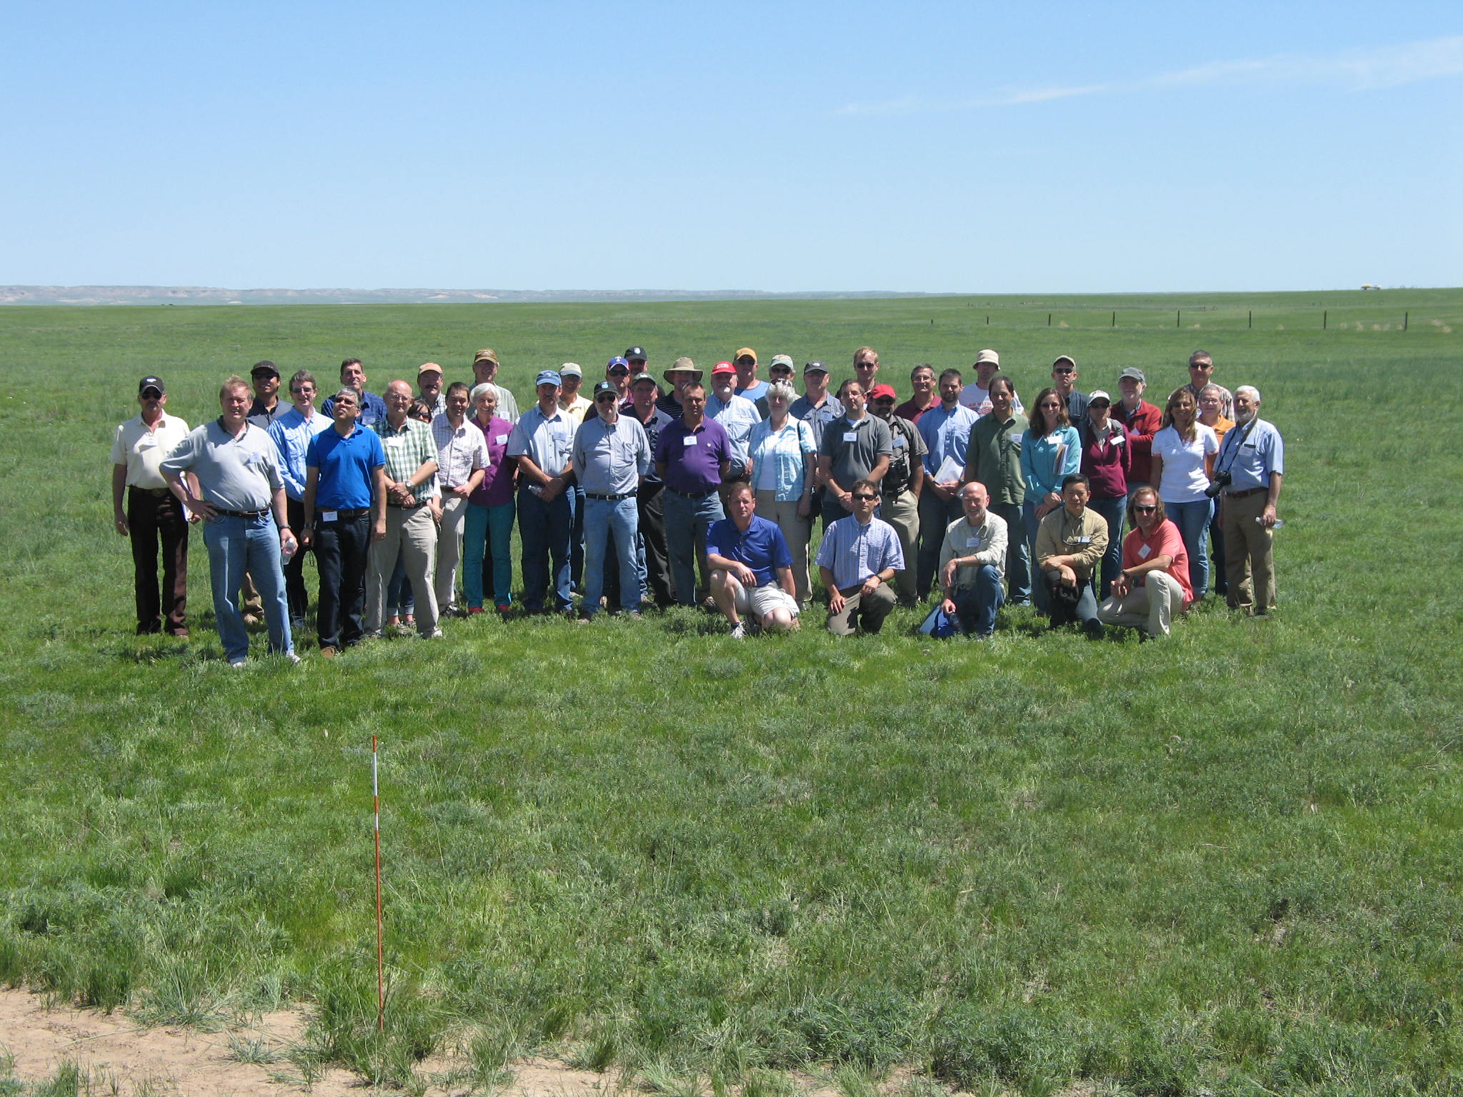
May 28-29, 2014 LTAR Network Meeting in Nunn, CO
ARS FY14 Budget added $10 for the LTAR network.

Slide 15
What Is the Central Question That the LTAR Network Addresses?
How Do We Sustain or Enhance Productivity, Profitability, and Ecosystem Services in Agro-ecosystems and Agricultural Landscapes?

Slide 16
Next Steps – Site Partners
Pair new and existing LTAR sites--each of the 10 original LTAR sites would ‘adopt’ one of the new sites for the purposes of
sharing information and resources;
providing background on the earlier organization and development of the LTAR network.

Slide 17
Next Steps – Site Partners
OLD SITE NEW SITE
Cook Agronomy Farm (CAF) Kellogg Biological Station (KBS)
Central Mississippi River Basin (CMRB) Lower Mississippi River Basin (LMRB)
Central Plains Experimental Range (CPER) Archbold Biological Station (ABS)
Gulf Atlantic Coastal Plain (GACP) (denitrification proposal)
Jornada Experimental Range (JER) Texas Gulf (TG)
Northern Plains (NP) Platte River/High Plains (PRHP
Southern Plains (SP) (denitrification proposal)
Upper Chesapeake Bay (UCB) Lower Chesapeake Bay (LCB)
Upper Mississippi River Basin (UMRB) Eastern Corn Belt (ECB)
Walnut Gulch Exp. Watershed (WGEW) Great Basin (GB)

Slide 18
Next Steps (cont.)
Cross-Site Denitrification Research
Design the Observatory Component of LTAR
NEON-comparable infrastructure (i.e., sensors)
Linked across LTAR sites (and with the Forest Service’s Smart Forests network) and accessible via the web

Slide 19
Next Steps – Short-Term Products
Four Key Products to be produced over the next two years:
A revision of the Shared Research Strategy to update information regarding the 8 new LTAR sites;
A BioScience article—about LTAR (follow up to Robertson et al.);
A paper on rainfall intensity/soil erosion, based on existing data across the LTAR sites;
A review paper on inter-annual productivity variations across LTAR sites.

Slide 20
Next Steps (cont.)
Design a ‘Cross-Site Sustainability Experiment’ that addresses LTAR’s central question.
Implement GRACEnet across all LTAR sites within the next two years.
Sponsor a symposium at the AGU Annual Meeting in San Francisco, CA (Dec. 2014)

Slide 21
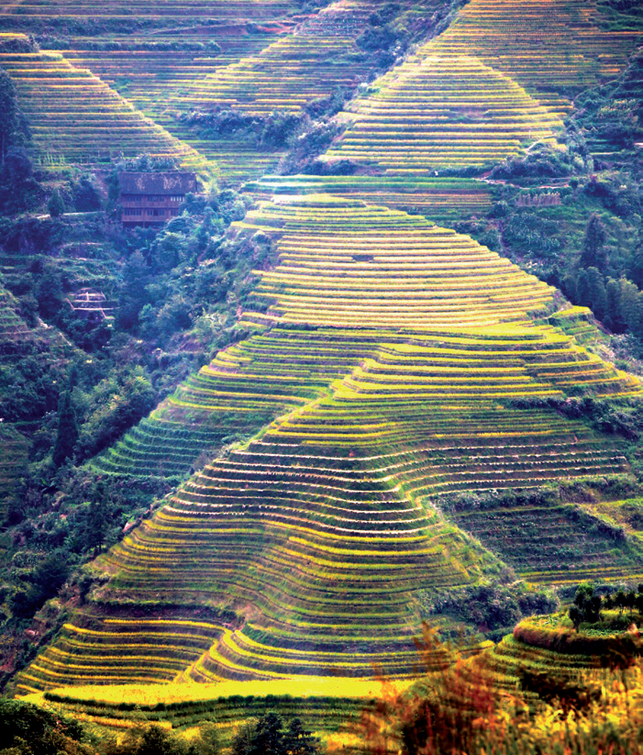
Terraced Fields in China Where Researchers Are Pushing Crop Yields Close To Their Biophysical Limits
From Zhang et al. (2013) An experiment for the
world. Nature 497:33-35
China’s scientists are using a variety of approaches to boost crop yields and limit environmental damage, say Fusuo Zhang, Xinping Chen and Peter Vitousek.
Using farm designs informed by modeling, Chinese agricultural researchers are increasing yields in experimental plots and in farm studies while reducing the amount of resources used and nutrients lost.

Slide 22
Satellite Data and LTAR
NASA
Ongoing ARS/NASA interactions
Evaporative Stress Index/Drought Monitoring/Lower Chesapeake Bay LTAR
Soil Moisture/Various ARS Locations
TRIM Satellite/Walnut Gulch LTER
Potential Future NASA interactions
Jet Propulsion Lab
Dave Schimel and others
Work With Kate Scow/UC Davis
Other potential Future Interactions
Other
NOAA

Slide 23
Technological Issues That LTAR Will Likely Need to Address in the Future
Data Archiving, Storage, & Management
Big Data
Dealing With Sensor-Driven Observatory Data Streams
Moving From Individual Site Data Base Management Issues to Network-Wide Data Base Management Issues

Slide 24
