Slide 1
Promising data analytics technologies
Tiffany Mathews

Slide 2
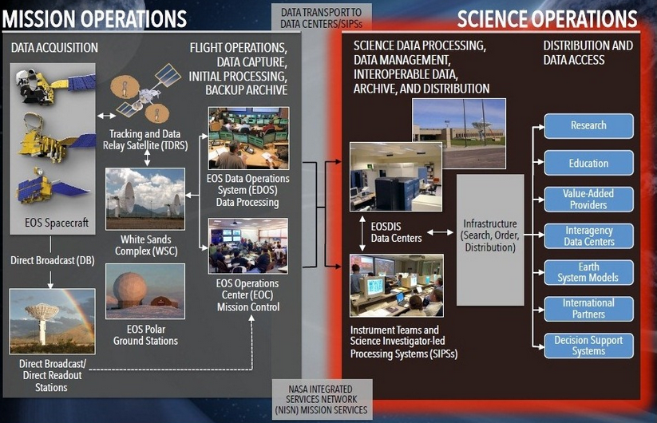
Intro to NASA
Earth Science Data Operations
https://earthdata.nasa.gov/about-eosdis
Notes:
The point of this slide is to show that there are many different stakeholders when it comes to NASA Earth science data.
This can be found at EarthData.nasa.gov, see the link in the bottom left corner
Basically, this shows, at a high level, the process of NASA Earth science data from Acquisition to Distribution
Broken down by Operations (Mission and Science)
Mission Ops is where data is acquired from satellite missions and sent to ground stations where it can be received by EDOS Data Processing Centers and sent onward)
Science Ops is where data is sent to one of the 12 EOSDIS Data Centers and is made available to Science Teams then released to the public
Depending on what part of the process someone is aligned will determine what analytics goals and tools are most relevant or important to them

Slide 3
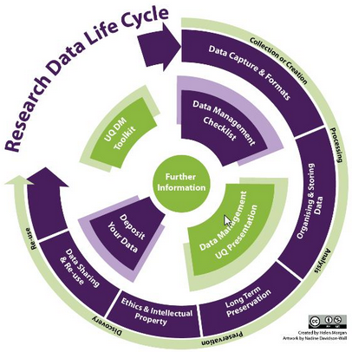
Research Data Lifecycle
Mission Operations
Data transport to data centers/SIPS
EOSDIS Data Centers
Distribution and Data Access
Infrastructure (Search, Order, Distribution)
http://guides.library.uq.edu.au/research-data-management
Notes:
This is from Australia’s University of Queensland and shows the range of processes that Research data goes through
Similar to the last slide but providing more information on the actions taken versus the players involved.
The red arrows indicate where each part of the NASA Earth Science Data Operations pieces fir into the research data lifecycle.
These processes can include (but are not limited to):
Experimental or laboratory produced data; Simulations generated from test models (Earth Science Models); derivations or compilations such as text and data mining, databases, 3D models;
collections of peer reviewed and published datasets (such as literary research) and other published research (such as the satellite/airborne or other derived data itself). Depending on who the stakeholder is and what their role is in the research data lifecycle, the scope of their work will be different and different analytics tools will be more valuable to them than others –

Slide 4
Analytics Types
Descriptive
What happened?
Prescriptive
What’s the best course of action?
Diagnostic
Why did it
happen?
Discovery
What is the best approach to learn
from the data?
Predictive
What is likely to happen?
Notes:
There are different analytics technologies that meet the needs of different analytics types

Slide 5

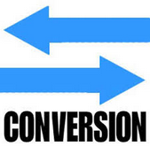

Descriptive Analytics Technologies
Data Conversion Tools:
Tools that help to get data in a readable format are critical to to be able to describe what happened.
Examples include:
HDF Tools
  HDUMP, a utility program to read in any gridded MISR data that is written in the HDF-EOS grid format
  HDFView for converting images from GIF, JPG, BMP, and PNG to the HDF format and back; HDF to NetCDF; and more.
Descriptive
What happened?

Slide 6
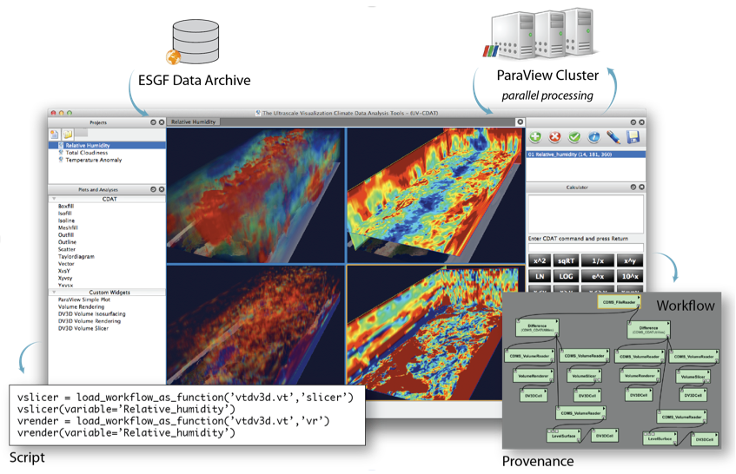
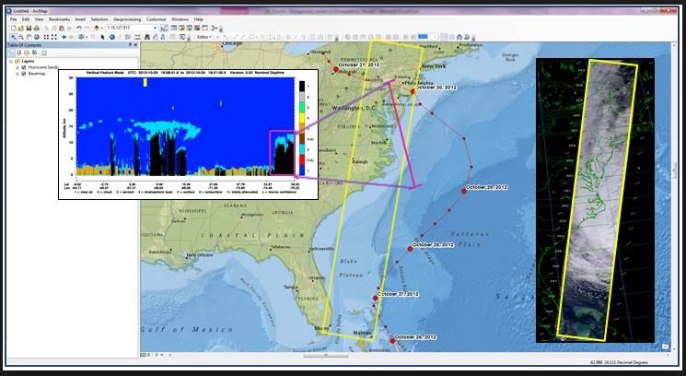
Diagnostic Analytics Technologies
Visualization Tools
Tools that enable data users to consolidate data, whether from the same project or different projects measuring the same parameters, into one visualization that helps people to quickly diagnose what has happened and why.
Examples include :
UV-CDAT: An open source tool that performs parallel processing, data reduction and analysis to generate 3-D visualizations.
(http://uvcdat.llnl.gov)
ArcGIS: a tool developed by Esri that enables maps, models, and tools to be distributed within and outside of an organization.
(http://www.arcgis.com)
Diagnostic
Why did it happen?

Slide 7


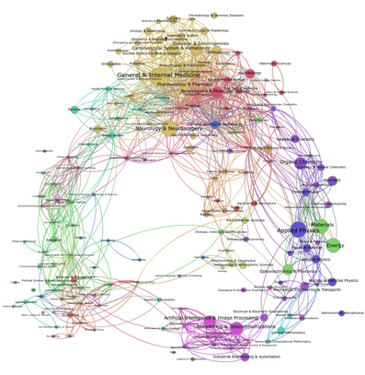
Discoverative Analytics Technologies
Data Discovery, Semantic Web, and Subsetting Tools
Tools that offer a centralized location to search for data; provide more dynamic search options so researchers at any experience level can decide what is the best data to use for their research; and tools to enable users to refine their data orders to only include the data that they need for their research all enable users to decided the best approach to take (what data to use) to learn from the it.
Examples include:
Order tools
  NASA’s ECHO | Reverb (central location for all new NASA Earth science data)
  OpenDAP
Semantic Web Tools
  Ontology-Driven Interactive Search Environment for Earth Science (ODISEES)
  Semantic Web for Earth and Environmental Terminology (SWEET)
Subsetting Tools
  ASDC Search and Subset Web Applications
  Simple Subset Wizard (SSW)
Discovery
What is the best approach to learn
from the data?

Slide 8

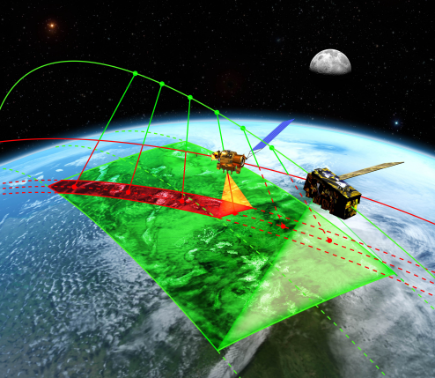
Predictive Analytics Technologies
Data Modeling Tools
Tools that enable data users to model specific events, based on what has happened in the past under certain circumstances, to better predict future Earth science phenomena.
Examples include:
GRid Analysis and Display System (GrADS): an interactive desktop tool that offers easy access, manipulation, and visualization of earth science data. It offers two data models for handling gridded and station data and supports many data file formats (NetCDF, HDF4, HDF5, etc.).
Multi-Instrument Inter-Calibration (MIIC II): A software framework that provides better access to distributed data for inter-calibration by finding and acquiring matched samples for instruments on separate spacecraft. It offers support for both low Earth orbiting (LEO) Geosynchronous (GEO) satellite instruments.
Predictive
What is likely to happen?

Slide 9
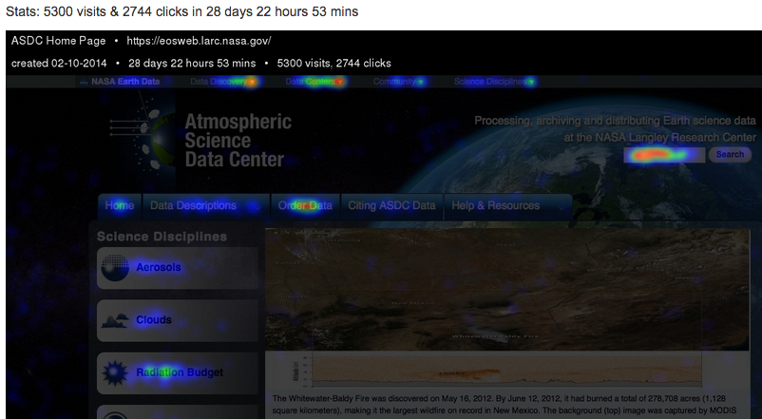
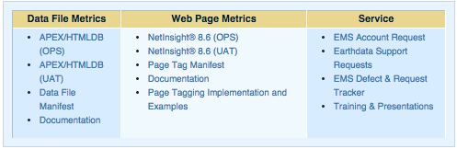
Prescriptive Analytics Technologies
Metrics Tools:
By collecting and organizing various metrics project management can gain a better understanding of the number of users, type and amount of data archived and distributed, and other related information needed to determine how to best apply resources to support the science community and determine the best course of action for future data ingest, archive, and distribution processes.
Prescriptive
What’s the best course of action?
Examples include:
ESDIS Metrics System (EMS)
CrazyEgg/Heat Maps:

Slide 10
Additional Analytics Opportunities
2014 AGU Session: Near Real Time Integration of Satellite and Radar Data for Probabilistic Nearcasting of Severe Weather it was said that when NRT Satellite Data could be added to Numerical Weather Predication and Radar data the probability of accurate readings increased from 40% to 93%
Juniper Pollen Project- researchers use NASA satellite data to see how juniper cones develop each year and adapt the dust model to predict when their pollen will be released to better inform those affected by pollen.http://scistarter.com/blog/2013/09/nasa-meets-public-health-juniper-pollen-project/#sthash.LKOwbkpo.dpbs
The CDC leverages NASA satellite data on the Earth’s environment by translating and using it to help public health officials anticipate the outbreak and spread of infectious diseases. For example flood areas are good breeding grounds for mosquitoes and by closely monitoring the vegetation in the region affected by increased rainfall, scientists can identify the actual areas affected by outbreaks of Rift Valley Fever, a mosquito-borne disease that can be fatal to humans and animals. http://www.nursezone.com/nursing-news-events/devices-and-technology/NASA-and-CDC-team-up-to-predict-infectious-diseases_24004.aspx

