Slide 1
Planetary data survey: ASSESSING PLANETARY DATA ACCESS AND USE
Rose borden, Dr. Wade Bishop
rborden4@vols.utk.edu, @rborden16
School of information sciences
University of Tennessee, knoxville

Slide 2
Motivation
To understand where and how planetary data users are finding planetary data
To find out what issues are preventing users from finding and using data in the ways they want

Slide 3
Background: planetary data
Many different missions
Many different instruments
Many different space agencies and institutions
Many different search tools

Slide 4
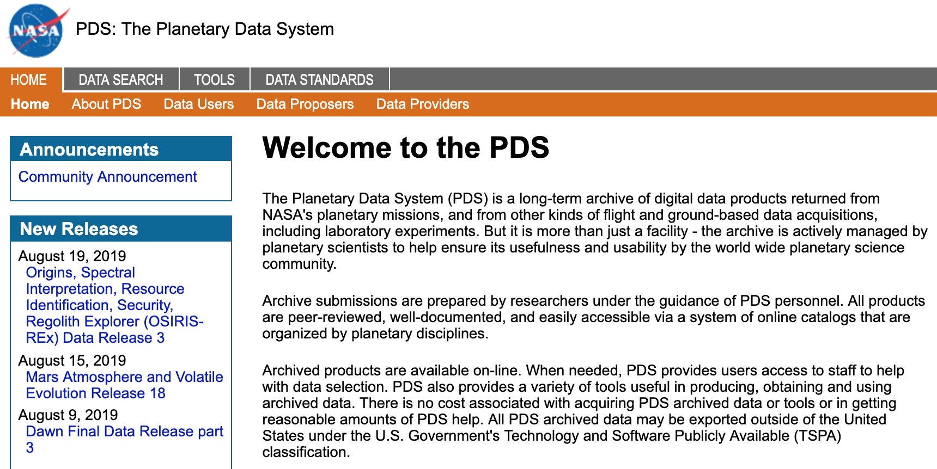
Background: finding planetary data

Slide 5
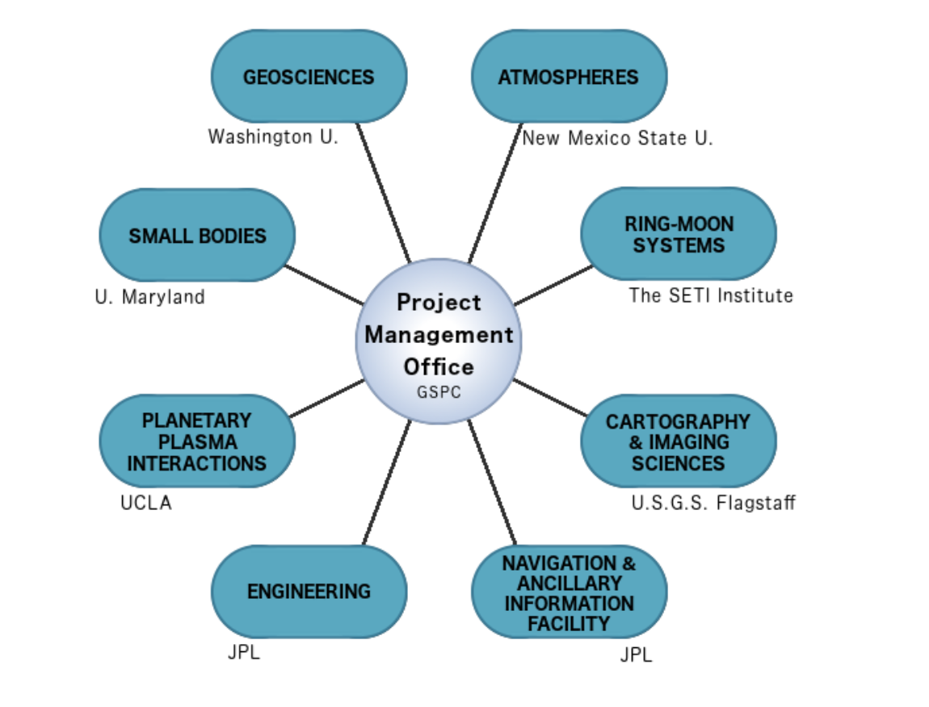
Background: finding planetary data

Slide 6
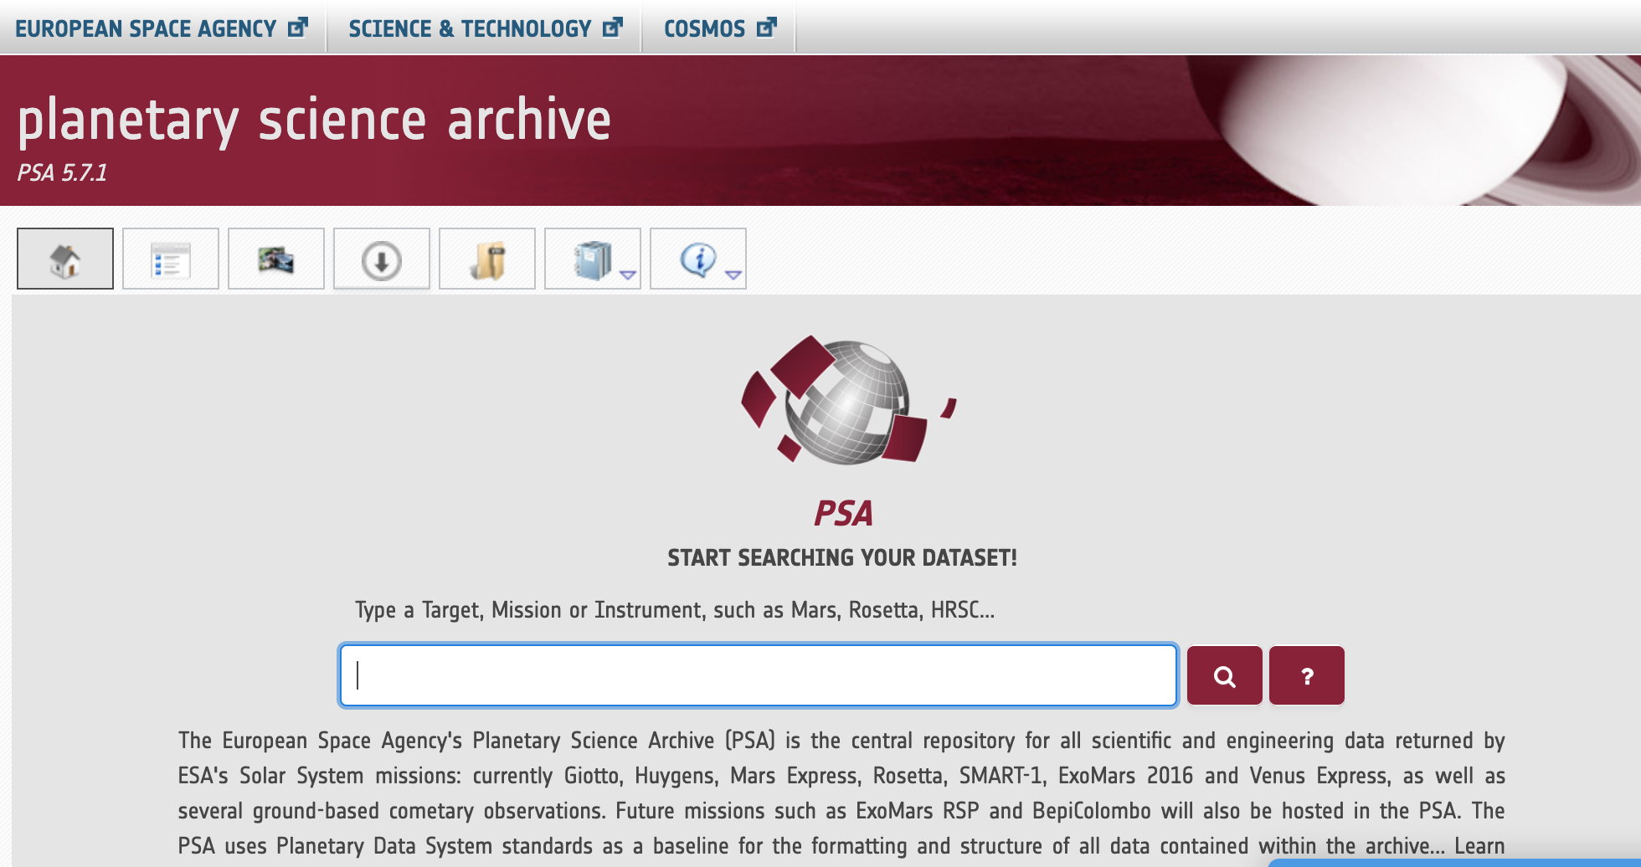
Background: finding planetary data

Slide 7
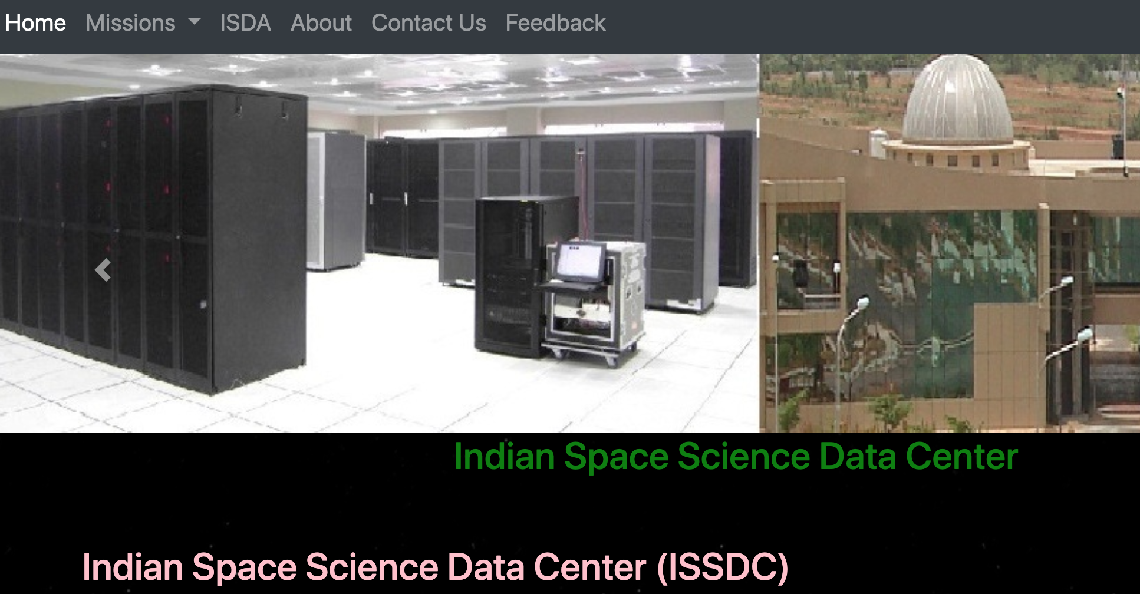
Background: finding planetary data

Slide 8
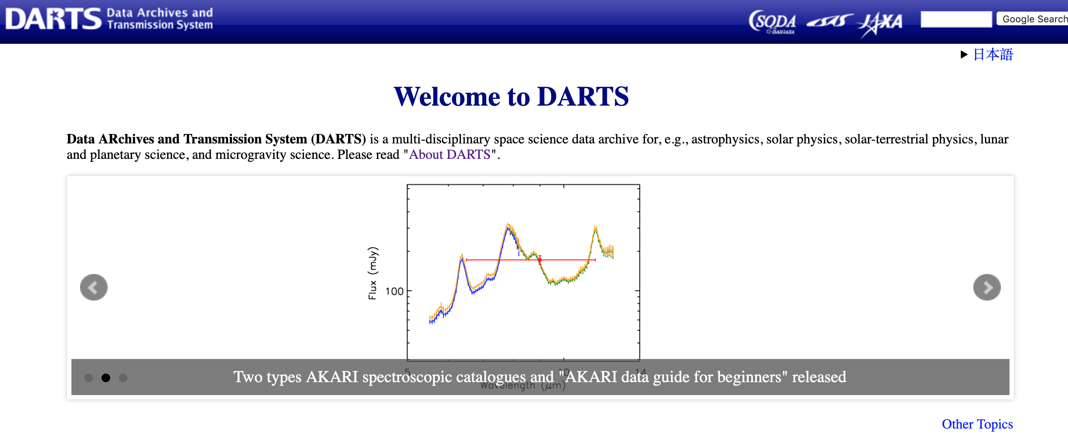
Background: finding planetary data

Slide 9
Methods
Online survey with 26 questions
Based on a set of questions used for recent interviews of scientists working with data
Survey on QuestionPro
Promoted in LPI Planetary News, Planetary Exploration Newsletter, Young Scientists for Planetary Exploration Facebook group, and Twitter
Open for 2 months, received 63 responses

Slide 10
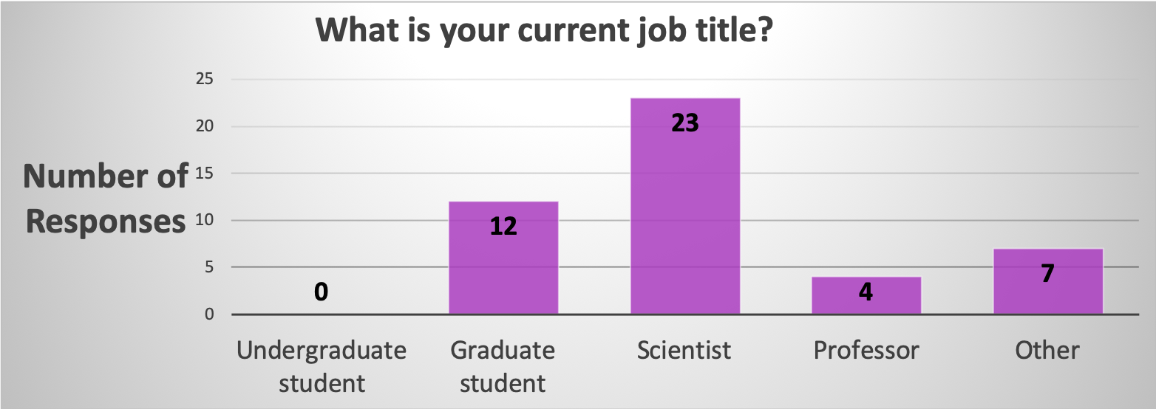
results

Slide 11
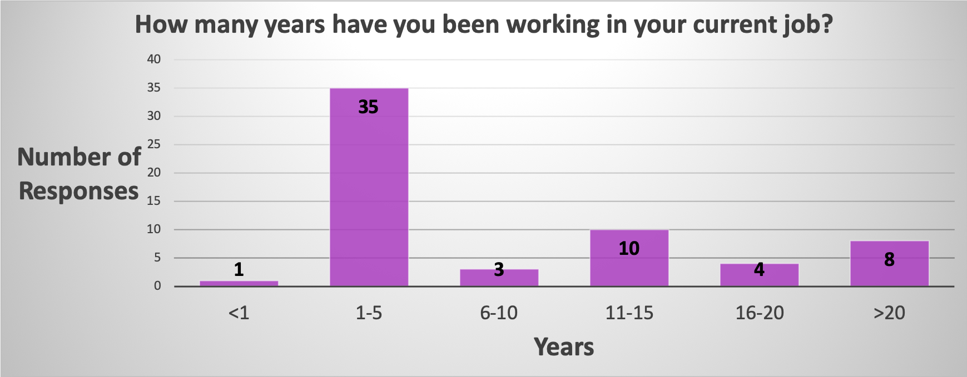
results

Slide 12
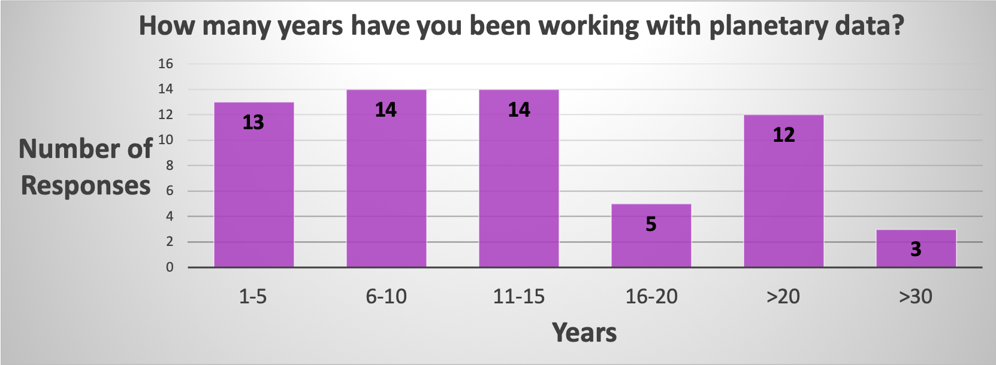
results

Slide 13
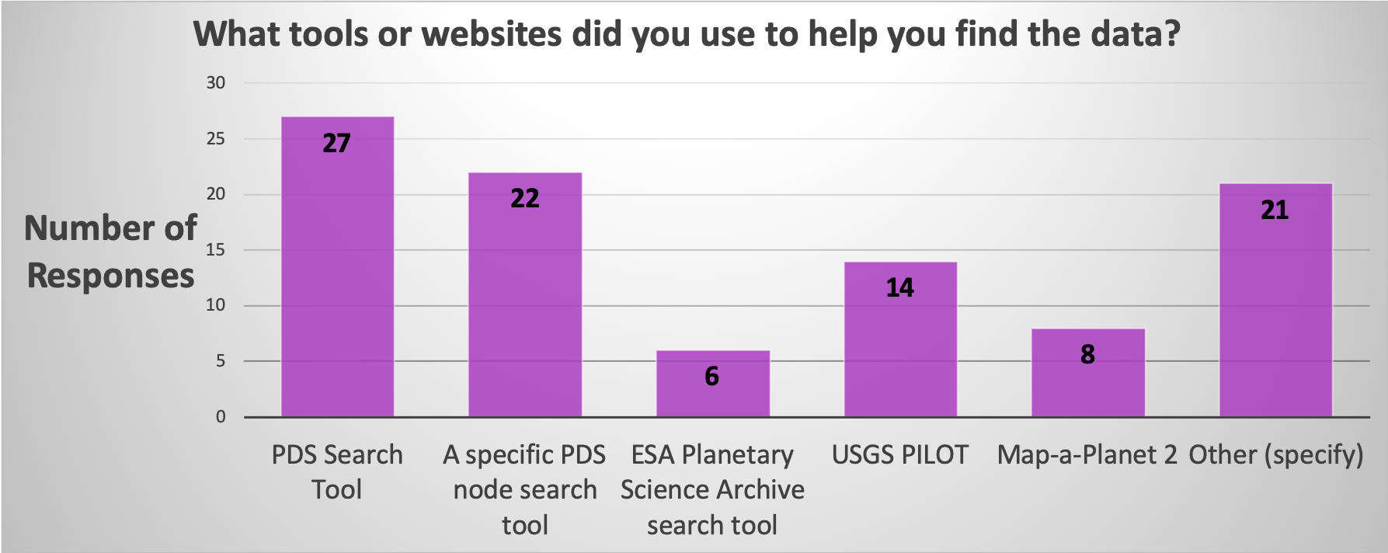
results

Slide 14
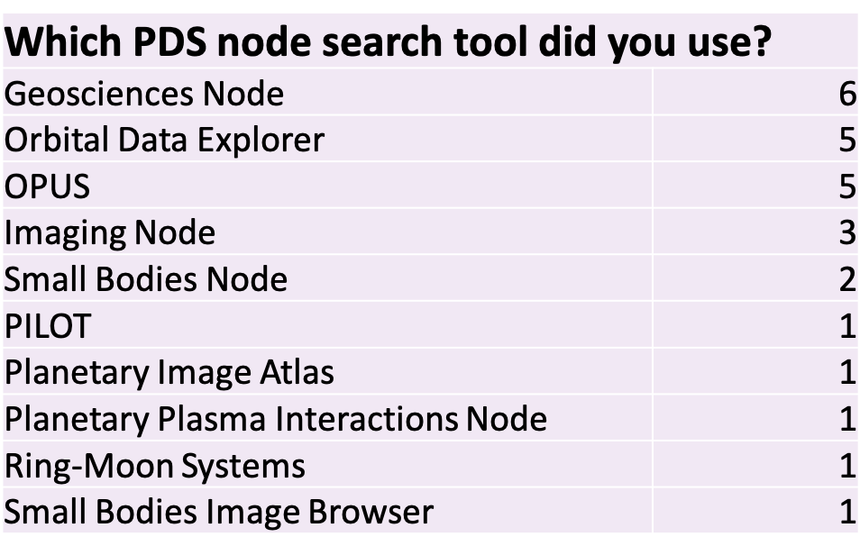
results

Slide 15
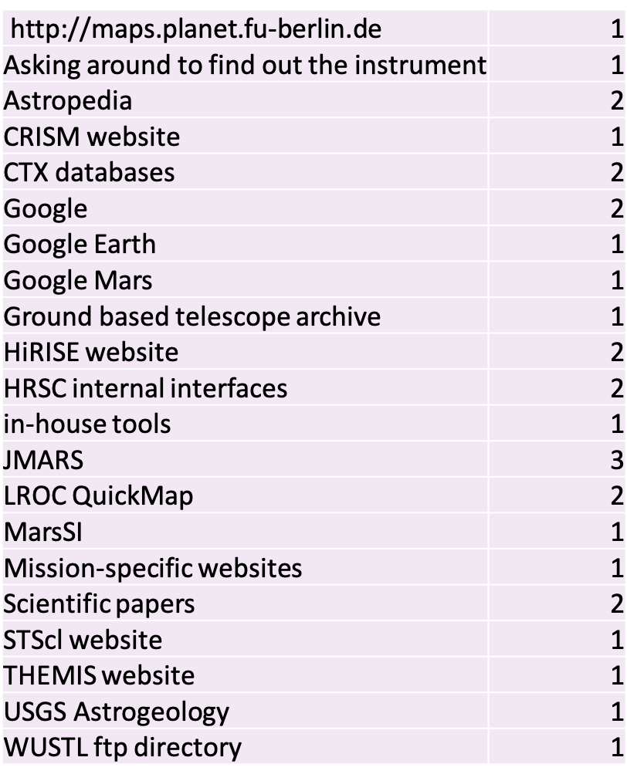
results

Slide 16
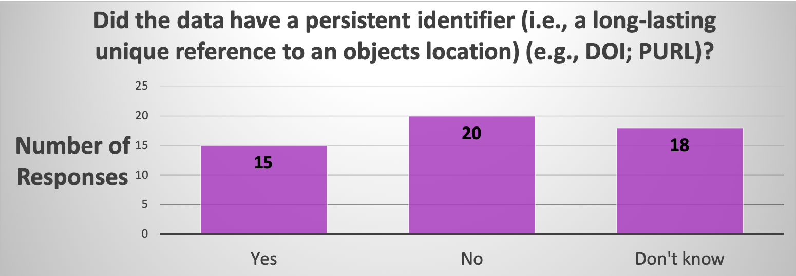
Results

Slide 17
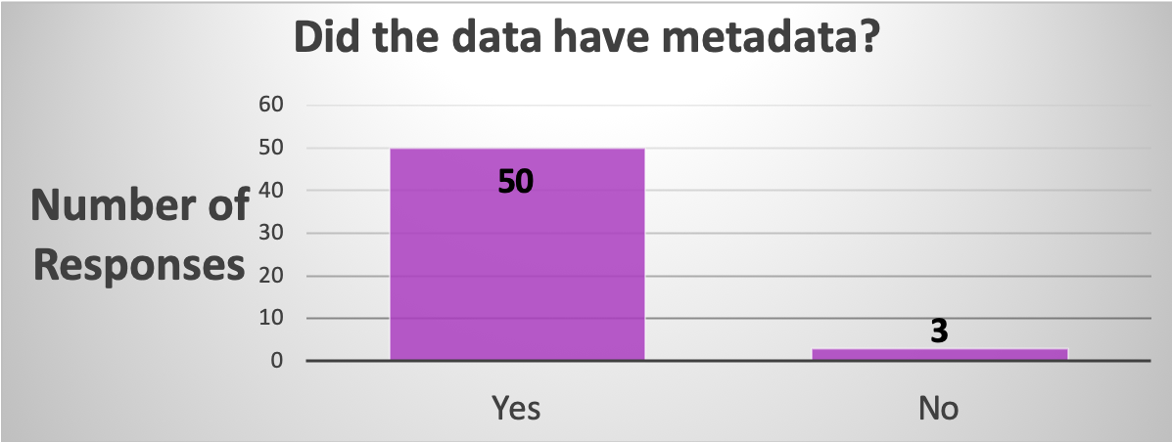
Results

Slide 18
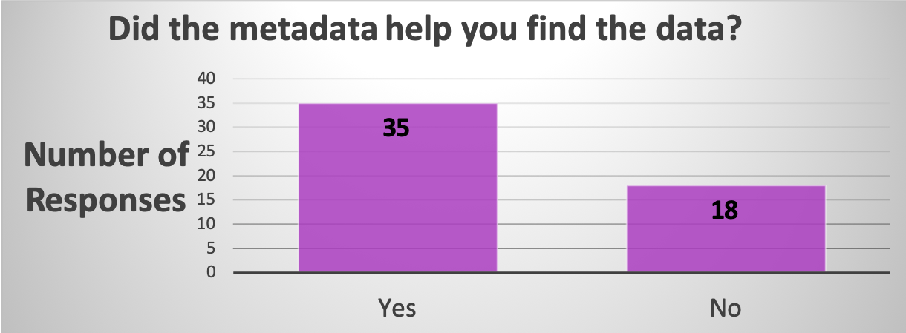
Results

Slide 19
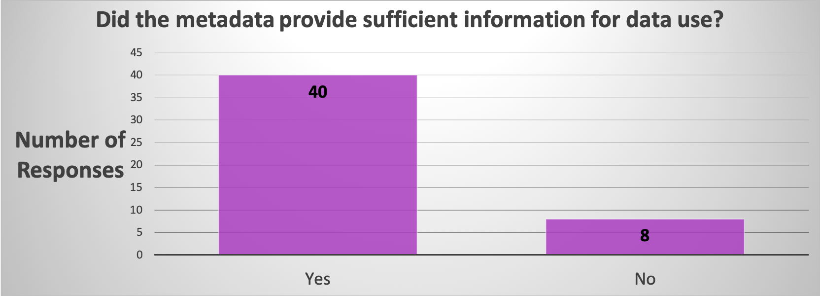
Results

Slide 20
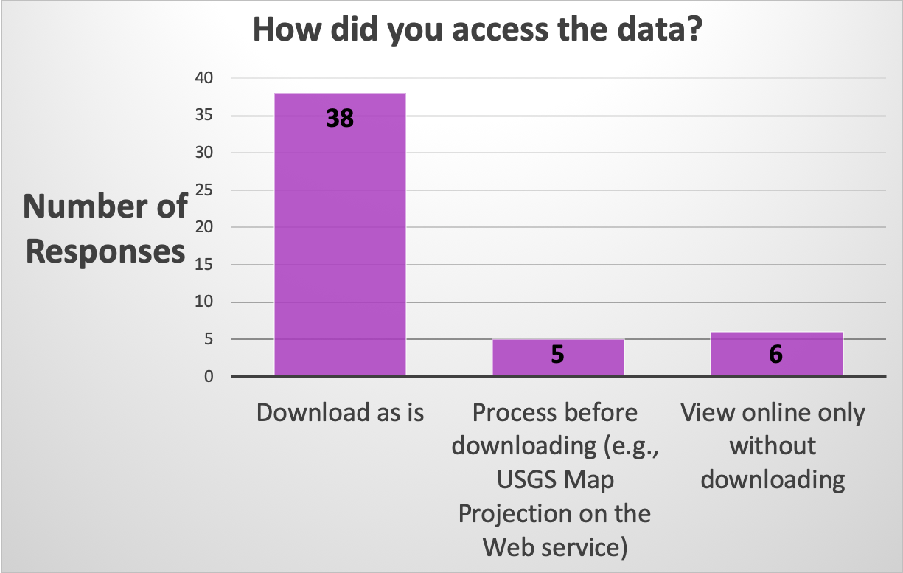
Results

Slide 21
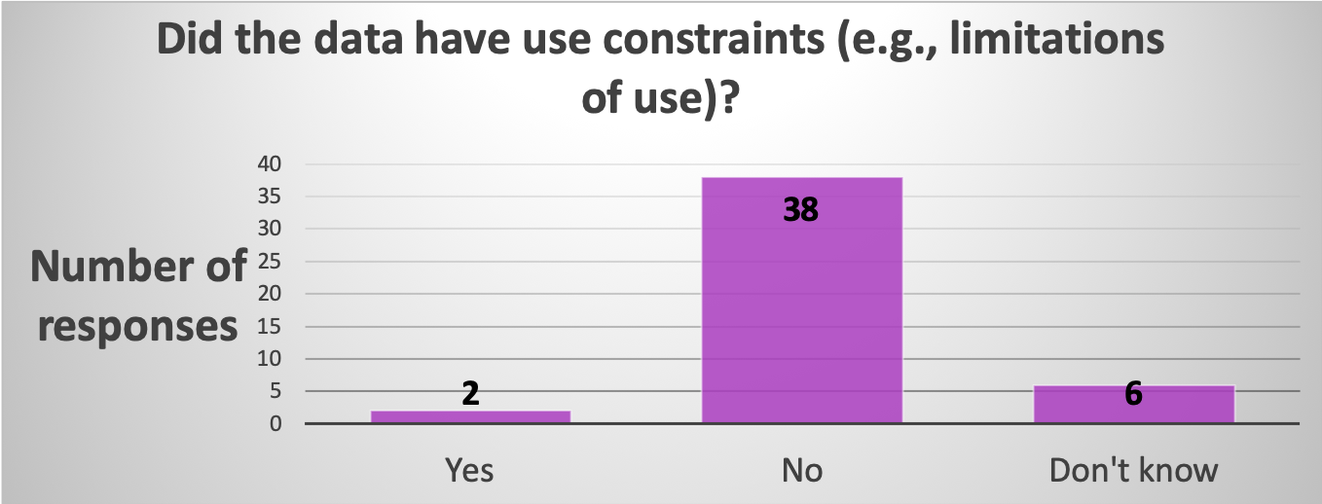
Results

Slide 22
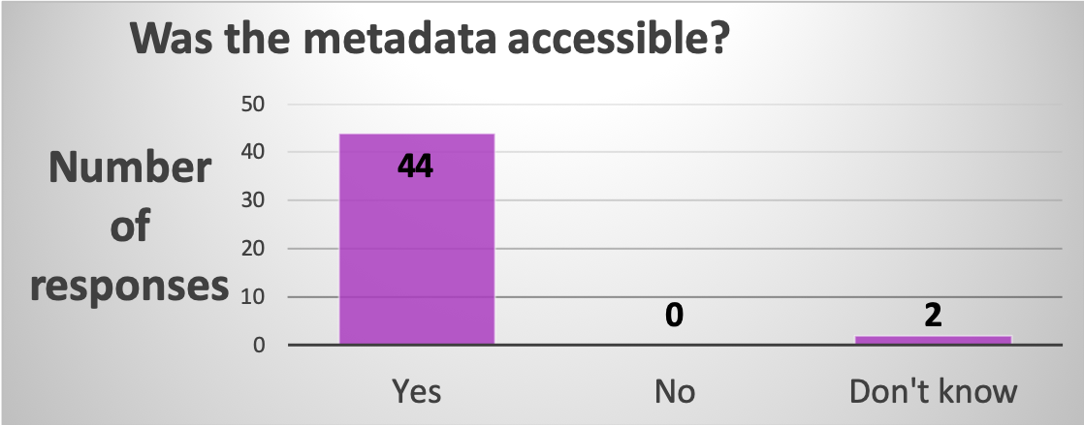
Results

Slide 23
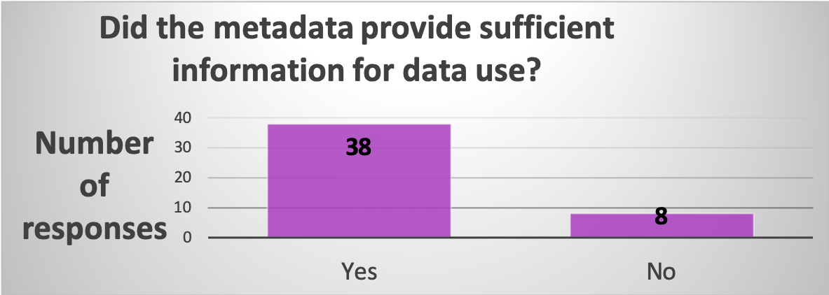
Results

Slide 24
Results – general feedback
“First, the data is not usually well registered to other data, i.e. it is not controlled to a known reference system or frame at a known level of accuracy (i.e. it is not photogrammetrically, radargrametrically, or altimetrically controlled). This makes it hard to locate and hard to use with other data (even in the same dataset). Second, it is difficult to access multiple datasets at the same place. E.g. I was thinking in my replies above of looking for Phobos data, which exists over many missions and instruments, and there is no one source to collect such data (images, metadata, exterior orientation (SPICE) data, etc.). “

Slide 25
Results – general feedback
“Unlike the PDS or equivalent archives, models and telescope data have no community-wide standard. Yet, making the "public" via the PDS is always a necessary part of the NASA funding for planetary scientists. The time and effort overhead involved with PDS submission and review is not always justified for small projects without a wide user base, and so it's rarely done.“
“Not all missions are well supported for processing in USGS tools and not all data was made available in a GIS-ready state. Cassini SAR data using Oblique Cylindrical project was hard to use in any mapping application.”
Several comments about how data in PDS are not always easy to find or use in their current state
“Need greater use of World Coordinate System in planetary images”

Slide 26
Results – general feedback
“I prefer to work with higher-order data products that are georeferenced, over data in the PDS or PSA.”
“The ROSETTA data archive, both on the ESA and PDS sites, is very complicated to use without a lot of hands-on exploring. No easy way to search for data on a given feature, for instance.”
“If I didn't have a good advisor, none of this would've been accessible or able to be processed without advanced computer science knowledge and my answers to this survey would've been very different”
“I really like the USGS processing feature, but unfortunately, they do not have all the data sets available on their site. On PDS it is sometimes difficult to match the available data with those published by the groups that produced the data.”

Slide 27
Results – general feedback
“The USGS's ISIS3 software barely works on any ROSETTA data.”
“ISIS processing is difficult to learn and published guidance is insufficient. I had to contact a member of the instrument team for help”
“Resorted to JMARS to interactively render footprints in place (essential functionality!)”

Slide 28
Future work
Finish analyzing and publish results
However…
This project currently has no funding
Would like to make question set more applicable to the ways people use planetary data
Would like to make dataset able to be openly distributed

Slide 29
Future work
Why do users choose to look for data in particular places?
What are the specific issues preventing users from looking for or accessing data where they want?
Are there issues preventing users from using specific datasets they would like to and what are they?

Slide 30
Future work
If you are interested in knowing more, send me an e-mail or find me on Twitter
rborden4@vols.utk.edu
@rborden16

