Slide 1
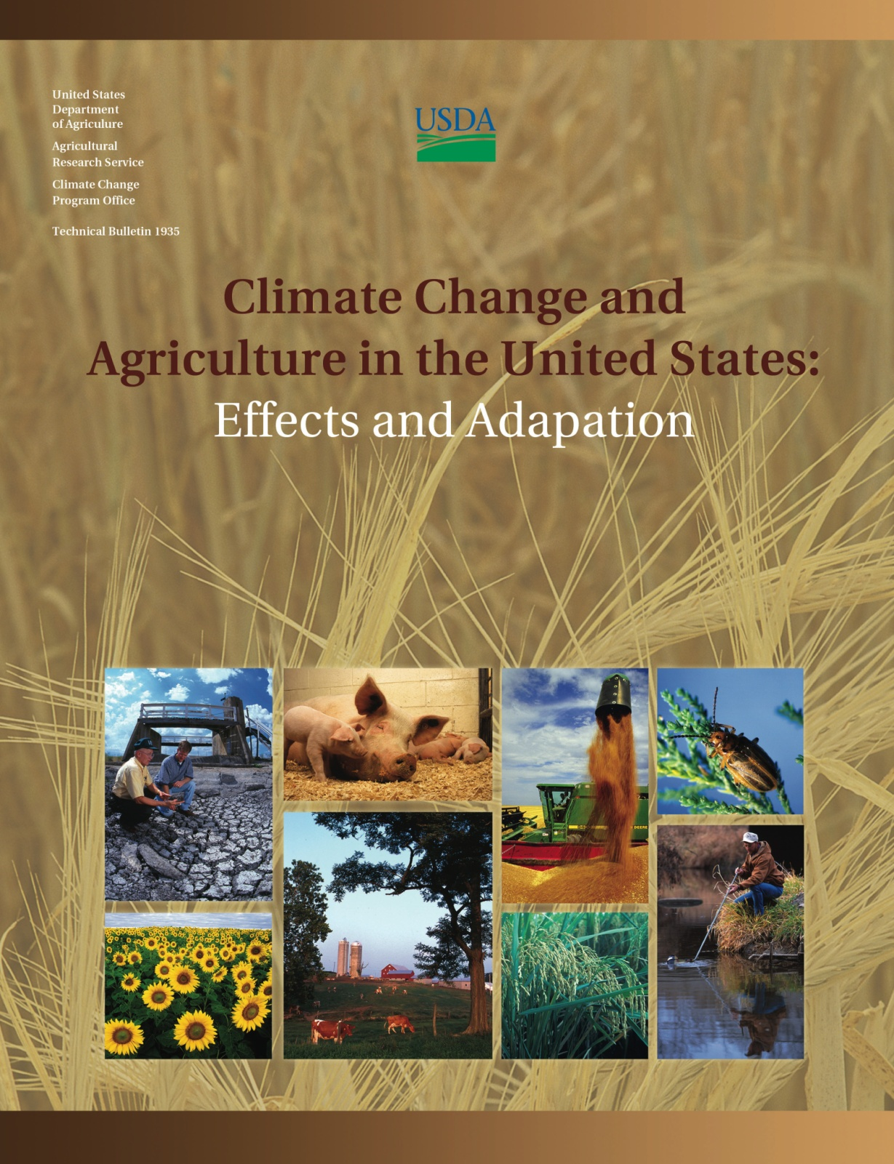



USDA
Climate Change Program Office

Slide 2
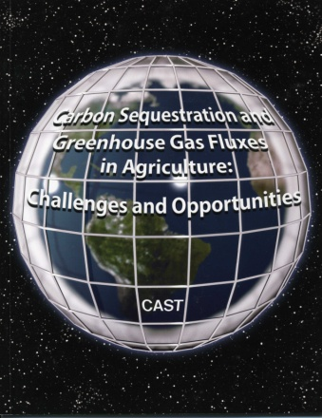
Climate Change and Agriculture: Effects & Adaptation
Reference document for 8 page NCA agriculture section
Science literature synthesis update (2009-2012: 1500+ references)
Foundation for risk analysis, future NCA
Peer reviewed
Created Community of scientists
No Mitigation: see CAST Report

Slide 3
S. Adkins, USDA-ARS
M. Aillery, USDA-ERS
E. Ainsworth, USDA-ARS
C. Ammann, NCAR
C. Anderson, IA State Univ.
I. Bartomeus, Rutgers Univ.
L. Baumgard, IA State Univ.
D. Blumenthal, USDA-ARS
F. Booker, USDA-ARS
B. Bradley, Univ. MA
J. Bunce, USDA-ARS
K. Burkey, USDA-ARS
S. Dabney, USDA-ARS
J. Delgado, USDA-ARS
J. Dukes, Purdue Univ.
A. Funk, USDA-ARS
K. Garrett, KS State Univ.
M. Glenn, USDA-ARS
D. Grantz, Univ. CA Riverside
D. Goodrich, USDA-ARS
S. Hu, NC State Univ.
C. Izaurralde, PNNL-Univ. MD
R. Jones, Dept. Ag & Food W. Australia
S-H. Kim, Univ. WA
A. Leakey, Univ. IL Urbana-Champaign
M. Nearing, USDA-ARS
D. Oosterhuis, Univ. AR
D. Ort, USDA-ARS
C. Parmesan, Plymouth Univ., UK
W. Pettigrew, USDA-ARS
W. Polley, USDA-ARS
R. Rader, Stockholm Univ.
K. Lewers, USDA-ARS
T. Mader, Univ. NE
J. Morgan, USDA-ARS
L. Morton, IA State Univ.
D. Muth, ID National Laboratory
C. Rice, KS State Univ.
M. Rivington, J. Hutton Inst., Scotland
E. Rosskopf, USDA-ARS
W. Salas, Applied Geosolutions, LLC
L. Sollenberger, Univ. FL
R. Srygley, USDA-ARS
C. Stöckle, WA State Univ.
E. Takle, IA State Univ.
D. Timlin, USDA-ARS
J. White, USDA-ARS
R. Winfree, Rutgers Univ.
L. Wright-Morton, IA State Univ.
L. Ziska, USDA-ARS
Author Team
C. Walthall, USDA-ARS
J. Hatfield, USDA-ARS*
L. Lengnick, Warren-Wilson College**
E. Marshall, USDA-ERS*
P. Backlund, NCAR
M. Walsh, USDA-OCE
Support
R. Hauser, NCAR
M. Rangel, NCAR
P. Robinson, NCAR
C. Ford, USDA-FS/USGCRP
NCA FAC Liaisons
D. Gustafson, Monsanto
M. Howden, CSIRO
D. Wuebbles, Univ. IL
D. Liverman, Univ. AZ
R. Lal, OH State Univ.
*NCA Report Writing Team **On sabbatical with USDA-ARS ONP

Slide 4
Agriculture and Climate Change
Agriculture has been and will continue to be significantly affected by changes in climate conditions - quantity, quality, cost of production
Existing adaption strategies can help offset many – but not all –effects over the next 20-30 years; effects are very likely to worsen significantly beyond then, especially if GHG emissions remain high
Improving the resilience of agricultural systems to climate change requires protection of the natural resource base (water & soil) and development of new strategies, tools, and practices for adaptation

Slide 5
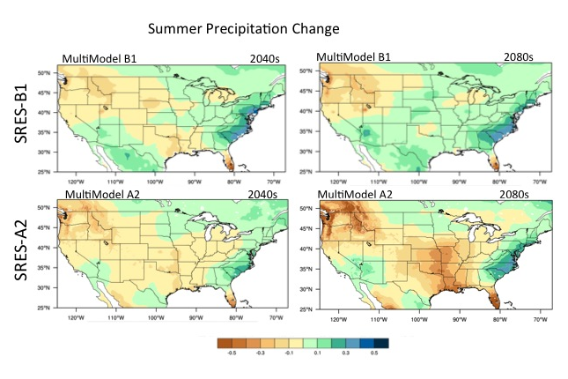
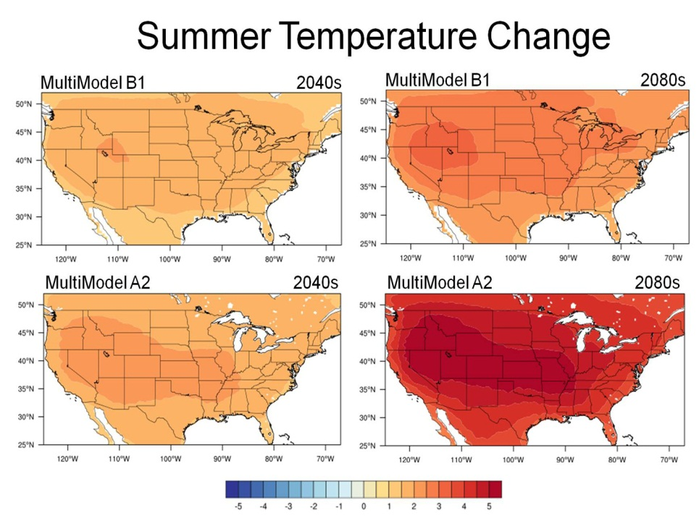
Changing Climate Conditions
Temperature increases: longer growing seasons, less frost, warmer nights
Precipitation changes: deficits, excesses, timing shifts, changing mix of rain/snow
Increased intensity of precipitation events: more flooding and more droughts
Increasing carbon dioxide concentrations

Slide 6
National Climate Assessment Process
National Climate Assessment every four years to evaluate the effects of climate on U.S. sectors
USDA asked to lead development of peer-reviewed technical document to summarize climate effects on agriculture
Assembled writing team of USDA, university, industry scientists to compile & synthesize information
Document serves as technical reference for agriculture section of 2013 National Climate Assessment report for Congress
Report has undergone external, independent peer-review

Slide 7
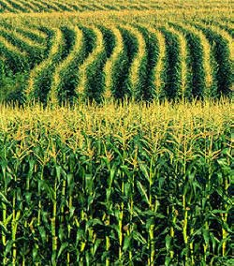
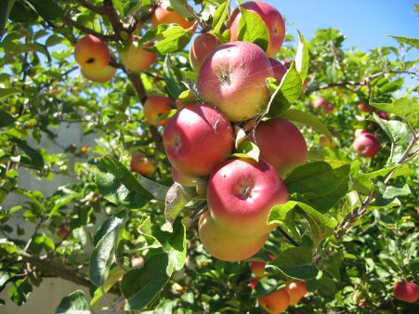
Effects and Sensitivity Vary by Commodity
Corn: high nighttime temperatures, high temperatures during pollination, water stress
Soybean: water stress, high temperatures
Wheat and small grains: extreme events, frost during flowering, water stress
Rice: temperature extremes during pollination, water management
Cotton: high temperatures during boll fill
Pasture and rangeland: water stress
Fruit trees: chilling requirements not met, high temperatures during fruit development
Specialty crops: water stress, high temperatures

Slide 8
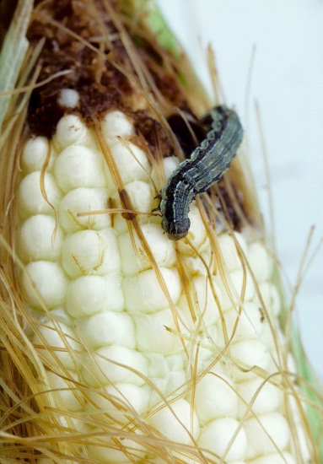
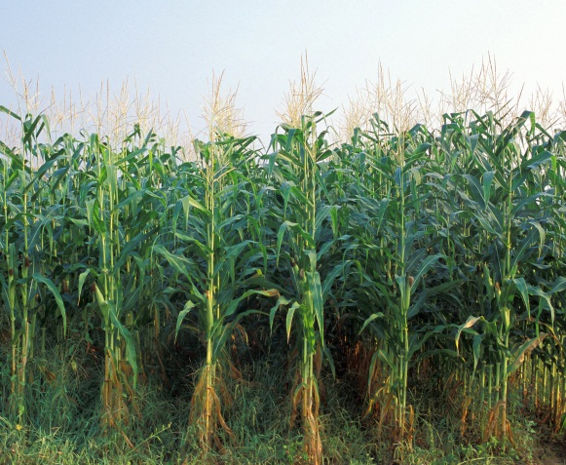
Increased Biotic Stresses
Will Significantly Affect Agriculture
  Insect pests
    Greater numbers, increased insecticide resistance
    Geographic ranges increases & decreases
    Imports from foreign sources
  Pathogens
    Host-pathogen response changes (plants, insects, non-crop reservoirs)
    Cultural control measures may be less reliable
    Extreme events can spread
Weeds
  Increased vigor, herbicide resistance
  Geographic range increases & decreases

Slide 9
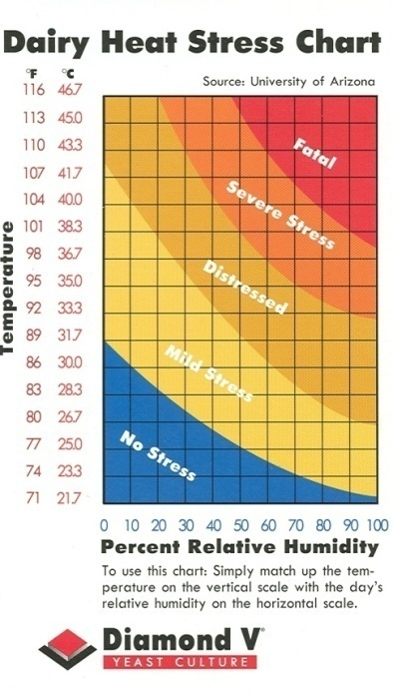
Livestock Production is Vulnerable
Feed Grain & Forage
  Quantity & Quality Decrease
  Production Cost Increase
Animal Heat & Humidity Stress
  Reduces growth, reproduction,
  production (meat, dairy, eggs)
  -- Climate control costs increase
Disease & Pests
  Frequency, intensity, distribution
  Abundance and/or distribution of competitors, predators, & parasites of vectors themselves

Slide 10
Responses of Agricultural Systems
Changes in farmer behavior
Changes in production, consumption, prices, and trade patterns
  Domestic and global market response
  U.S. impacts depend on global response
Economic effects depend on domestic and global adaptive capacity
  Impacts vary by region, by sector, and by stakeholder group

Slide 11
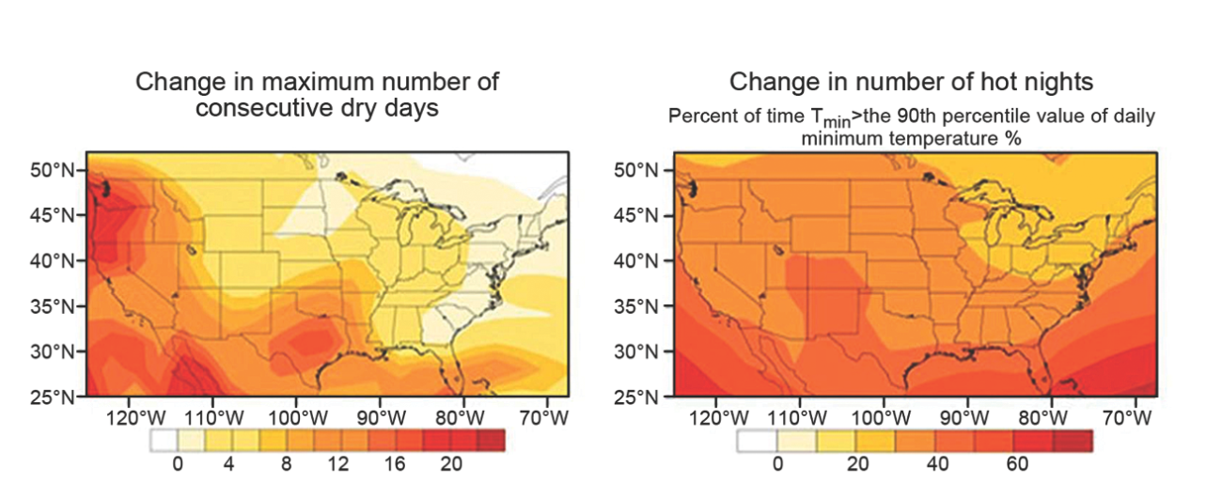
Extreme Events*
Change in Dry Periods and Hot Nights by 2100 (high emissions, “SRES A2”)
Year | Event | Location | Economic Impact
2011 | Missouri River Flooding | Upper Midwest (MT, ND, SD, IA, KS, MO) | $2.0 Billion
2011 | Mississippi River Flooding | Lower Mississippi River (AR, TN, LA, MS, MO) | $1.9 Billion
2011 | Heat/Drought | Southern Plains, Southwest | $10 Billion
2009 | Drought | Southwest/Great Plains (CA, TX, GA, TN, NC, SC) | $5.3 Billion
2008 | Flooding | Upper Midwest (IA, IL, IN, MO, MN, NE, WI) | $15.8 Billion
NCDC 2011
Currently, NCDC estimates that the cost of the 2012 drought that affected much of the U.S. had an economic impact of $12B. This estimate was not reviewed or available prior to publication of this report, however, and may change.
* Extreme events have been shown to be more probable than 40–50 years ago. However, one cannot attribute any single event to climate change alone.
Notes:
Can affect any stage of growth

Slide 12
Building Agricultural Resilience
  Enhanced understanding of the role of natural resource base (water and soil)
  Understand Potential Exposures
    Focus on extremes as well as mean changes
  Understand Sensitivities
    Define critical thresholds & interactions
  Enhance Adaptive Capacity
    Resilient systems: Climate-ready crops & production systems
Improved treatment of uncertainty and risk in climate and adaptation decision-making and policy
    Potential impacts are real but inherently uncertain

Slide 13
Agriculture and Climate Change
Agriculture has been and will continue to be significantly affected by changes in climate conditions
Existing adaption strategies can help offset many – but not all –effects over the next 20-30 years; effects are very likely to worsen significantly beyond then, especially if GHG emissions remain high
Improving the resilience of agricultural systems to climate change requires protection of the natural resource base (water & soil) and development of new strategies, tools, and practices for adaptation
For more information, please visit http://www.usda.gov/oce/climate_change/effects.htm

Slide 14
Research Needs
Better near-term & long-term climate projections
  Improved representation of processes, events
  Regional & national
Updated models and ecosystem manipulation capacity
  Biophysical + economic + social
Understand basic processes
  Interactions
  Systems perspectives
Resilient production systems
  Climate – ready crops and livestock
  Best practices for soil and water conservation
  Manage to enhance adaptive capacity at field, farm and landscape scales
**Data Intensive
Notes:
Duration of temperature & precipitation events, intensity of events
Studies of interacting direct & indirect effects, extreme events, role of policy, international connections, physical & social scales (producer to communities to regional to national to international) including agribusiness, infrastructure

Slide 15
Charlie Walthall charlie.walthall@ars.usda.gov
301-504-4634
Jerry Hatfield
jerry.hatfield@ars.usda.gov
515-294-5723

