Slide 1

Defining “At Risk” and Rescuing Data in a Government Agency
ESIP Interagency Data Stewardship Meeting
November 19, 2018
Tara Bell and Lance Everette, U.S. Geological Survey

Slide 2
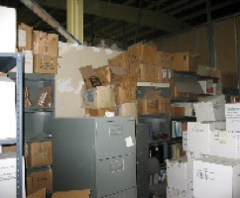

Outline
Defining risks
Scientific Data Rescue
USGS Data Rescue
Evaluating Risk - Early and Current Efforts
Legacy Data Inventory Reporting System
Closing Thoughts
Technical Details
A USGS warehouse

Slide 3
Defining Risks
(a) Media degradation such as fading ink or magnetic fields,
(b) Obsolescence of devices to read such data from old media [and many early magnetic tapes lack metadata or format information],
(c) Environmental catastrophes such as fires and floods,
(d) The retirement of individuals who know how to access these data or know the metadata associated with these data that make the data useable to other scientists,
(e) Simple neglect.
To these we must add another very important consideration:
(f) Both analogue and early digital records that are rarely accessed tend to be dubbed ‘unwanted’, and risk getting thrown away.
(Source: “When are Old Data New Data?” R.Elizabeth Griffin https://doi.org/10.1016/j.grj.2015.02.004 Creative Commons Attribution-NonCommercial-No Derivatives License (CC BY NC ND))
Notes:
TMB: Transition - “This is how we define “at risk” data.”

Slide 4
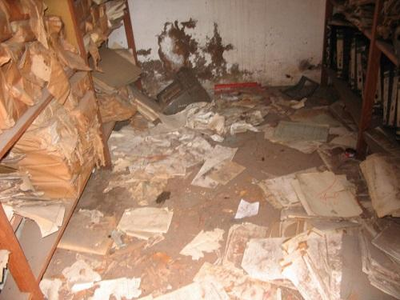
Scientific Data Rescue
International Efforts
ICSU CODATA
Raise Awareness
Develop Inventory
Seek Support
Research Data Alliance
Similar Activities (+) establish an advisory system for 'digitizing'
National Efforts
NOAA
Climate Database Modernization Program
Over 50M image and key paper and microfilm (multi-year, multi-$Ms)
Source: http://www.codata.org/task-groups/data-at-risk
Notes:
International Council for Science (ICSU)
Committee on Data (CODATA)
TMB: Transition - “There are a number of organizations all over the world trying to tackle this issue.”

Slide 5
U.S. Geological Survey Legacy Data
Over 100 years worth of data...and over 100 years worth of technology changes
Bureau reorganization has caused “orphaned” data and records
Went from being primarily mapping and geology focused to also encompassing water, ecosystems, hazards
Challenges associated with merging bureaus into USGS
Highly specialized employees
Records management challenges
Importance of legacy data to our science
Notes:
Original Text
Department of the Interior ~ 70,000 Employees
U.S. Geological Survey ~ 9,000 Employees
Created in 1879
Science Agency for the Department
World leader in the natural sciences
Nation's largest water, earth, and biological science agency
Collect, monitor, analyze, and provide science about natural resource conditions, issues, and problems
TMB: Transition - “As the science agency of the Department of Interior, the U.S. Geological Survey has over 100 years worth of data.” In addition to talking about who we are, this could be a good opportunity to also talk about how the changing role of USGS has contributed to legacy data in our bureau. We could make the following points:
We have over 100 years worth of data...and over 100 years worth of technology changes to deal with
Bureau reorganization has caused “orphaned” data and records
Went from being primarily mapping and geology focused to also encompassing water, ecosystems, hazards
Merging bureaus into USGS (i.e. FWS and ecosystems mission area) has resulted in some data losing its context. Also creates challenges for data integration.
As a science agency, we have employees that are highly specialized and that transfer of knowledge hasn’t always happened
Due to all of the agency changes, it has been difficult to enforce records management practices. Besides that, records management and data management haven’t had much overlap in the past so you don’t see the level of consistency with data that you would for traditional records
From former challenges slide:
Magnitude of Need
Loss of Corporate/Deep Knowledge of Collections
Lack of Complete/Quality Metadata
Continued Support
Perception Question
How Valuable/Useful are Old Data?

Slide 6
USGS Data Rescue - Early Efforts
Effort Began in 2006
Following Internal Scientific Information Management Workshop
“Rotting Records” “Lost Files” “Don’t Ask”
Pre-Workshop Survey Concerns
Data Preservation (40%)
Data Access (30%)
Support from 2006 through 2013
417 Requests
113 Requests Supported
Notes:
Estimated level of support needed for 417 requests to be several million dollars.
Requests supported totaled over $2M over the 2006-2013 period.
Project ended in 2014 due to a lack of support.
Applied for USGS Grants in 2015 and 2016. New approaches taken such as building a central skills center vs. sending funding to requestor.
TMB: Transition “In 2006, the USGS made its first effort to rescue data.”

Slide 7
Evaluating Risk
Key Factor in Determining Highest Need/Value/Usefulness
Original Approach (2006-2013)
Record Series
Temporal Extent
Geographic Extent
Media
Format
Alignment to Mission Objectives
Need/Issue
Coop Funding
Notes:
“During this project we used the following factors to evaluate the entries.” This approach was workable, but challenging to rank. In hindsight, a more automated approach, with appropriate weighting would have made the ranking process easier.

Slide 8
Evaluating Risk
Latest Approach, Data at Risk Project (2015-2018)
Legacy Data Inventory Reporting System (LDIRS)
First - geospatial extent, temporal extent, species extent, significance to USGS efforts/themes, risks related to the loss or destruction of the legacy product
Second, those 5 categorical scores are then used to generate 3 scores:
Summary Score = Simply total
Risk Weighted Average = Summary Score times the Risk Score
Significance Weighted Average = Sum of previous two times Significance Score
Third, a Sum Calculation Score (sumCALC) is generated by adding the 3 calculated scores together
Notes:
1st bullet: It’s a calculated score. For geospatial extent you get 1 for each state and additional for each county; species has something similar; temporal extent also has some math - might be subtotal of years
Need Significant Risk Factors
Need Significance Score (how is this derived)
Can we add a summary chart of scores w/o showing submittors?
TMB-Yes, I think so! Lance has said that the reports are pretty customizable. Also, I don’t think there’s a big problem with showing the science center.
TMB: Transition - “The second iteration took a different approach.”
-Since I wasn’t a part of the first iteration it’s hard for me to say, but it seems to me like a major goal of this 2nd project was to increase communication channels between science centers and MA leads. LDIRS was not only a way of documenting legacy data, it was a way of communicating to MA leads the data that exists in their purview. I think the new model also worked towards demonstrating the value of the data by showing the number of endangered species, the breadth of the data, the number of USGS priorities, etc.
-One of the greatest challenges with legacy data is knowing where to start. LDIRS gives people the ability to rank according to factors that are valuable to them.
-We should also add in something about the process of deciding how to weight these categories. I think the audience would find that process interesting. .How/why did we decide that digital obsolescence is a greater risk than paper records? I remember we had a big conversation in the meeting about how to weigh geographic extent. Just because a data set has a large geospatial extent doesn’t mean it’s more important. Data that was collected in a small geographic area but involves a rare species could be just as valuable. So we tried to balance that out with different categories.

Slide 9
Risk Categories
Category 1 Risks
No public access to original data
Damaged/deteriorating paper or photos
Digital media/format 11-15 years old
Physical samples damaged/deteriorating
Category 2 Risks
Digital media/format >15 years old
Film negatives/positives
Lack/Loss of storage space
video, analog
Category 3 Risks
Direct or potential exposure to hazardous conditions
Eminent loss of institutional knowledge
Unsupported media or format (e.g. Zip250 or WB3)
Unsupported media or format requirements (e.g. OS, hardware)
Notes:
After we figured out how to evaluate the subjects of the data we moved towards figuring out how to categorize risks.
Everything gets minimum score of 1 b/c it’s not usually publicly accessible

Slide 10
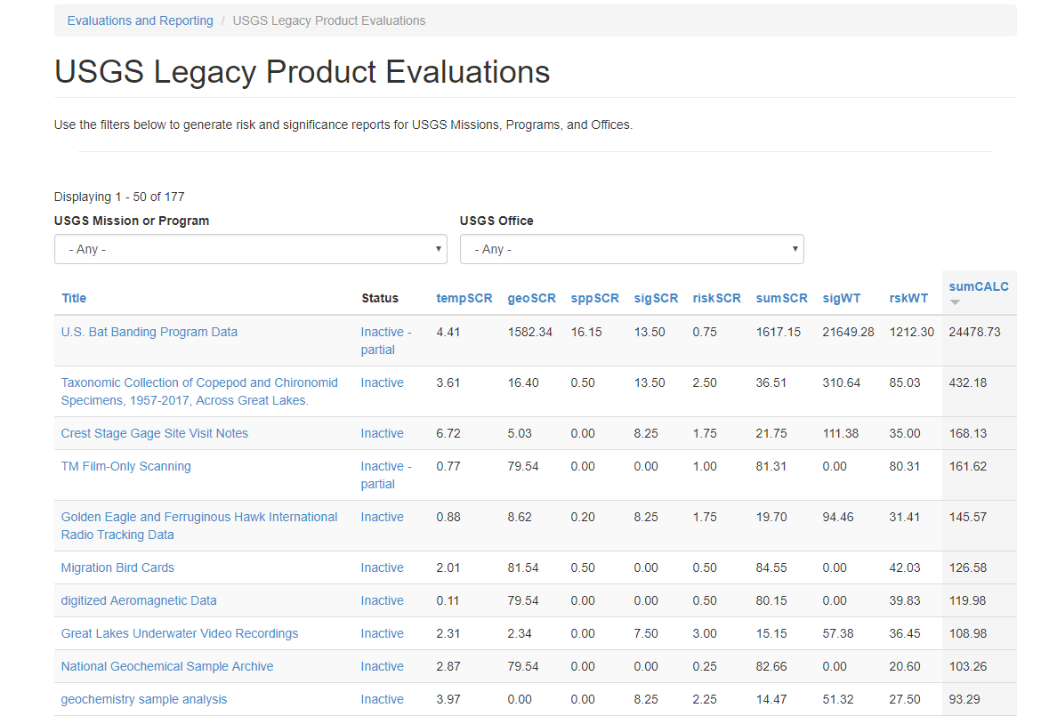

Slide 11
Closing Thoughts
Other groups in USGS discussing legacy data
Trusted Digital Repositories
Science Records Management Liaison Group
Web Reengineering Team (WRET)
National Geological and Geophysical Data Preservation Program (NGGDPP)
As systems become more integrated, conversations about legacy data are becoming more common
Federal data release requirements becoming the norm
Support from the Top Critical
DaR Project is ending - what’s next?
WRET expanding the inventory
“If what is badly needed is also ‘old’, it takes more than a mere data-rescue effort to translate the records or images into the electronic formats that modern research demands; it also means that certain priorities need to be re-ordered, new skills acquired and taught, resources redirected, and new networks constructed.”
-R.Elizabeth Griffin
Notes:
TMB: This quote from the Griffin paper stood out to me - “If what is badly needed is also ‘old’, it takes more than a mere data-rescue effort to translate the records or images into the electronic formats that modern research demands; it also means that certain priorities need to be re-ordered, new skills acquired and taught, resources redirected, and new networks constructed.”
-We could consider structuring our closing thoughts around this quote. The DaR project is ending but there are other projects working that are bringing legacy data into the conversation, including TDR, Science Records Management Group, WRET, systems becoming more integrated, growing awareness of legacy data. We’re operating in a “new” world of data releases and as it becomes the norm people are becoming more comfortable with freeing their data. As you said, support from the top is critical and we’re working towards getting that.

Slide 12
USGS Data at Risk Scoring Algorithms and Reports
https://apps.usgs.gov/ldi
Notes:
Text from Lance’s slide: Scoring metrics are based on the METADATA TOTALS fields in the legacy product record. If those fields are not completed scoring can not be completed. Scoring metrics were designed and tested to generate a score that adequately differentiates between similar legacy data records and enables prioritization that matches logical expectations.
TMB: Transition - “The second iteration took a different approach.”
-Since I wasn’t a part of the first iteration it’s hard for me to say, but it seems to me like a major goal of this 2nd project was to increase communication channels between science centers and MA leads. LDIRS was not only a way of documenting legacy data, it was a way of communicating to MA leads the data that exists in their purview. I think the new model also worked towards demonstrating the value of the data by showing the number of endangered species, the breadth of the data, the number of USGS priorities, etc.
-One of the greatest challenges with legacy data is knowing where to start. LDIRS gives people the ability to rank according to factors that are valuable to them.
-We should also add in something about the process of deciding how to weight these categories. I think the audience would find that process interesting. .How/why did we decide that digital obsolescence is a greater risk than paper records? I remember we had a big conversation in the meeting about how to weigh geographic extent. Just because a data set has a large geospatial extent doesn’t mean it’s more important. Data that was collected in a small geographic area but involves a rare species could be just as valuable. So we tried to balance that out with different categories.

Slide 13
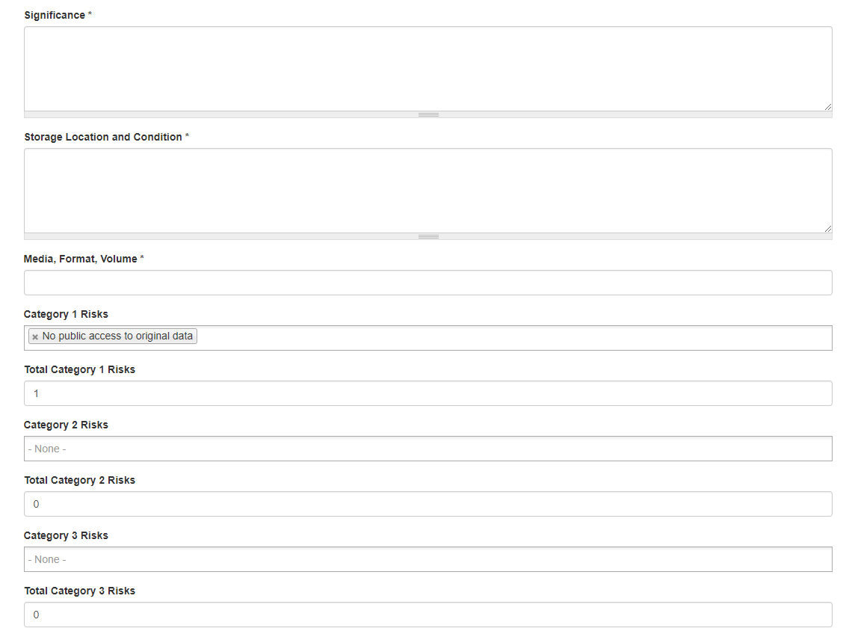

Slide 14
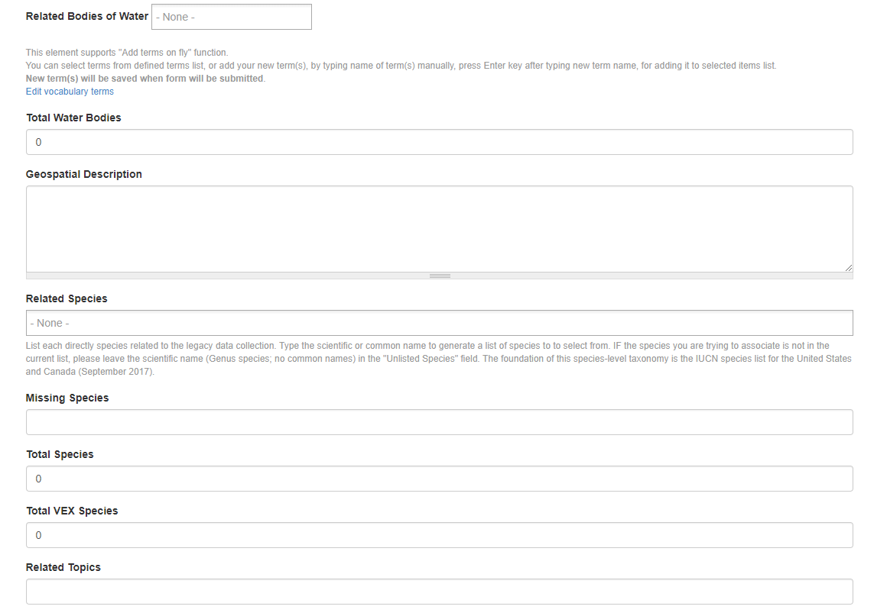

Slide 15
Evaluation Algorithms: 5 Scoring Metrics
Geospatial Extent (Ge) | (([total_us_counties]/31.43)*[total_states])+[total_foreign_ctry]
Temporal Extent (Te) | ([total_data_years]+((([data_year_end]-[data_year_start])+1)*0.1))*0.1
Species Extent (Se) | (([total_species]-[total_vex_species])*0.1)+([total_vex_species]*0.75)
USGS Extent (Ue) | ([total_usgs_significant]+[total_pub_lands]+[total_wtr_bodies])*0.75
Risk Factors (Rf) | ([total_cat1_rsks]*0.25)+([total_cat2_rsks]*0.5)+([total_cat3_rsks]*0.75)
Notes:
Text from Lance’s slide: Scoring metrics are based on the METADATA TOTALS fields in the legacy product record. If those fields are not completed scoring can not be completed. Scoring metrics were designed and tested to generate a score that adequately differentiates between similar legacy data records and enables prioritization that matches logical expectations.
TMB: Transition - “The second iteration took a different approach.”
-Since I wasn’t a part of the first iteration it’s hard for me to say, but it seems to me like a major goal of this 2nd project was to increase communication channels between science centers and MA leads. LDIRS was not only a way of documenting legacy data, it was a way of communicating to MA leads the data that exists in their purview. I think the new model also worked towards demonstrating the value of the data by showing the number of endangered species, the breadth of the data, the number of USGS priorities, etc.
-One of the greatest challenges with legacy data is knowing where to start. LDIRS gives people the ability to rank according to factors that are valuable to them.
-We should also add in something about the process of deciding how to weight these categories. I think the audience would find that process interesting. .How/why did we decide that digital obsolescence is a greater risk than paper records? I remember we had a big conversation in the meeting about how to weigh geographic extent. Just because a data set has a large geospatial extent doesn’t mean it’s more important. Data that was collected in a small geographic area but involves a rare species could be just as valuable. So we tried to balance that out with different categories.

Slide 16
Evaluation Algorithms: 4 Scoring Calculations
Sum of Scores (sumSCR) | Ge+Te+Se+Ue+Rf
Significance Weighted Average (Swt) | (Ge+Te+Se+Rf)*Ue
Risk Weighted Average (Rwt) | (Ge+Te+Se+Ue)*Rf
Sum of Calculations (sumCALC) | sumSCR+Swt+Rwt
Notes:
Scoring calculations are based on the SCORING METRICS generated from the METADATA TOTALS fields. If those fields are not completed, scoring, and subsequently calculations, can not be completed. Scoring calculations were designed and tested to generate a score that adequately differentiates between similar legacy data records and enables prioritization that matches logical expectations.

