Slide 1







SURFACE OZONE IN URBAN, SEMI-RURAL AND RURAL SITES IN ISTANBUL, TURKEY
Ulas Im¹, Selahattin Incecik², Sema Topcu², Yurdanur S. Unal², Tayfun Kindap³, Meltem Guler⁴, Orhan Yenigun⁴, Adil Tek⁵, Mehmet T. Odman⁶, Mete Tayanc⁷
¹ University of Crete, Department of Chemistry, Environmental and Chemical Processes Laboratory, Greece
² Istanbul Technical University, Department of Meteorology, Istanbul, Turkey
³ Istanbul Technical University, Eurasia Institute of Earth Sciences, Istanbul, Turkey
⁴ Bogazici University, Institute of Environmental Sciences, Istanbul, Turkey
5 Bogazici University, Kandilli Observatory and Earthquake Research Institute, Laboratory of Meteorology, Istanbul, Turkey
⁶ School of Civil and Environmental Engineering, Georgia Institute of Technology, USA
⁷ Marmara University, Department of Environmental Engineering, Istanbul, Turkey

Slide 2
Tropospheric Ozone Chemistry
Reactions involving NO₂, NO and O₂ produce and destroy O₃.
Photodissociation of NO₂
NO₂ + hv → NO + O (1)
and ozone formation
O + O₂ + M → O₃ + M (2)
and depletion
NO + O₃ → NO₂ + O₂ (3)

Slide 3
Radical formation in the atmosphere from NMVOCs
most important here are the reactions with the hydroxyl radical and more generally the peroxy radical
HO*₂ + NO → NO₂ + HO* (4)
RO*₂ + NO → NO₂ + RO* (5)
Thus when NO molecules are consumed, ozone is spared and it accumulates.

Slide 4
NO reacts with ozone destroying it (rapidly) and regenerating NO₂, so the presence of NO will prevent the build up of ozone
Daylight hours: NO, NO₂ and O₃ equilibrate (photostationary state)
Evening time:fresh inputs of NO from rush-hour traffic without photochemical reactions –depletes ozone-

Slide 5
O₃ production
Net O₃ production is expressed as a function of NOx(= NO + NO₂) and NMVOC concentrations

Slide 6
under NOx – sensitive conditions, ozone formation is almost entirely governed by NOx and largely independent of VOCs,
under VOC – sensitive conditions, ozone formation is related to the increase in VOCs and not to NOx changes.

Slide 7
Understanding of Photostationary State and Impact of NO₂ over NOx
j : rate of NO₂ photolysis
(solar radiation-angle of sun)
k₂ : rate coefficient for the reaction of NO with O₃
(ambient temperature)
[Seinfeld and Pandis, 1998; Mazzeo, (2005)]
[O₃] = j [NO₂]/k₂[NO]

Slide 8
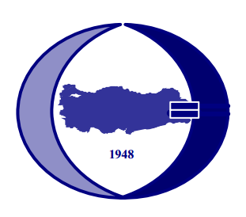

OZONE MEASUREMENTS IN ISTANBUL
INTRODUCTION METHODS RESULTS CONCLUSIONS
Ozone (O₃) measurements conducted by Metropolitan Municipality of Istanbul (IBB) since 1999
All urban/traffic stations
Data has been statistically evaluated for different periods in a number of studies (Topcu and Incecik, IJEP, 2002 and FresEnvBull, 2003; Im et al., WASP, 2006; Im et al., AtmRes, 2008)
Generally low O₃ levels (mean=~20 ppb) have been reported (Kanakidou et al., AtmEnv Review, 2011)

Slide 9
MOTIVATION
INTRODUCTION METHODS RESULTS CONCLUSIONS
All stations are urban with low O₃ levels due to anthropogenic emissions from traffic in particular
Urban sites may not represent the general O₃ profiles in the extended area of a city
Precursor emissions lead to O₃ formation downwind of the sources (Kanakidou et al., AtmEnv, 2011, Im et al., ACP, 2011)
O₃ levels in non-urban sites should also be investigated
Continuous O₃ measurements at different sites with different characteristics (geography, emissions , etc…) are needed
COST728 Action (Incecik et al., COST728 Technical Report, 2010) and TUJJB projects

Slide 10
SCOPE OF THE STUDY
INTRODUCTION METHODS RESULTS CONCLUSIONS
Establish new measurement sites to monitor non-urban levels of O₃ and NO_{x} in Istanbul to investigate:
seasonal and diurnal variations of surface O₃ and NO_{x}
the weekday-weekend differences
the regional influences by applying cluster analysis

Slide 11
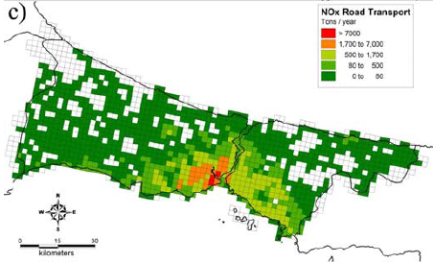
STUDY AREA
INTRODUCTION METHODS RESULTS CONCLUSIONS
Istanbul is a megacity with a population of about 15 million
Urban/industrial/traffic emissions
About 2.8 million motor vehicles
More than 80% of CO and NO_{x} emissions and 45% of NMVOC emissions are originated by traffic emissions (Markakis et al, APR, 2012)
Dominant wind direction is southerly in winter and northerly in summer
Annual traffic NO_{x} emissions

Slide 12
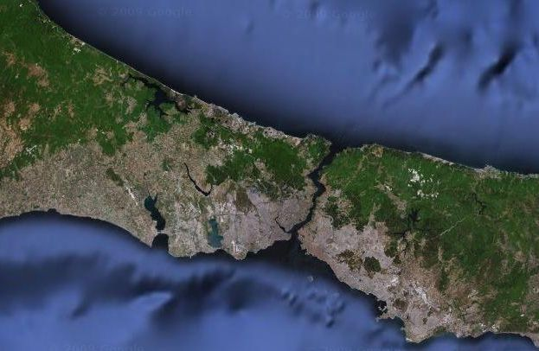
NEW MEASUREMENT SITES
INTRODUCTION METHODS RESULTS CONCLUSIONS
3 new measurement sites have been established in frame of the COST728 Action and TUJJB projects
Goztepe site (urban/traffic): O₃ and NO_{x} measurements
Kandilli site (semi-rural): O₃ measurements
Büyükada site (rural/island): O₃ and NO_{x} measurements
Büyükada
Kandilli
Goztepe

Slide 13
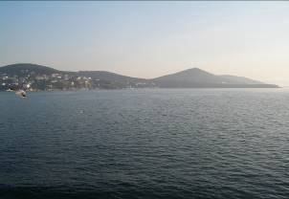
Büyükada-Prince’s Island
Island station, at the crest (156 m)
No traffic and industry
Shipping and biogenic emissions only
Emission transport from mainland

Slide 14
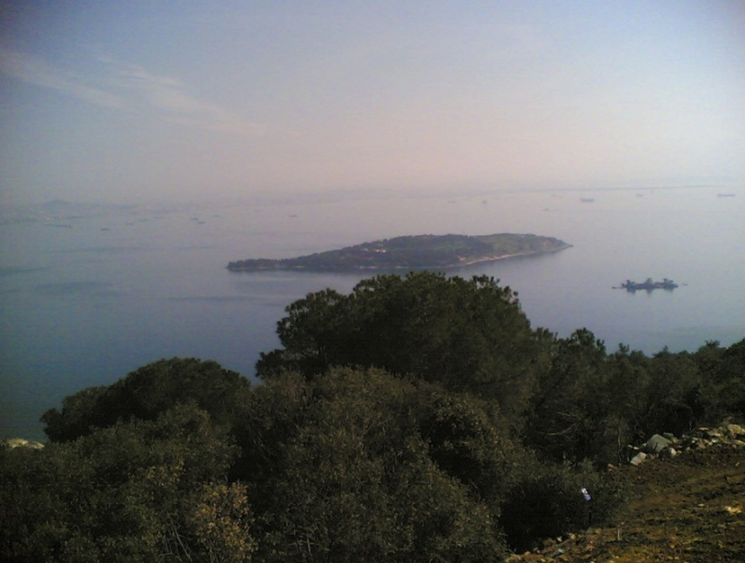
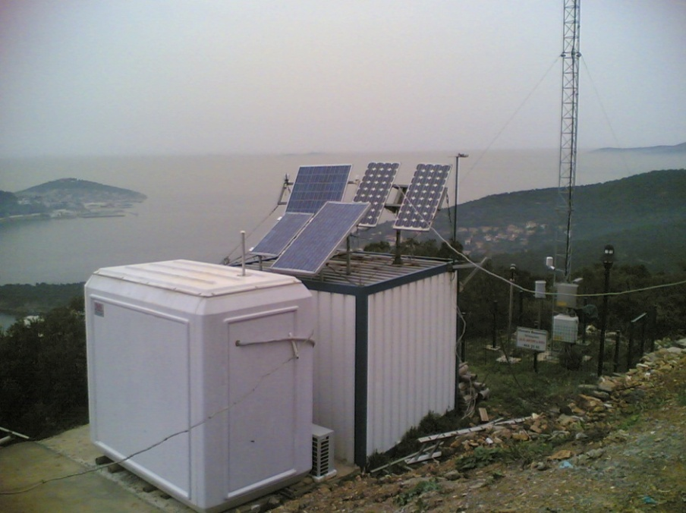
Princes’ Island (Büyükada)
The Island has an area of 5,42 km² with a population of 7320 inhabitants in winter.
no traffic,
the only transport being horse and cart. Motorized vehicles except service vehicles are forbidden.
Measurements of background NO/NO₂/NO_{x} and O₃ concentrations at the crest of the island. Operated since October 2007

Slide 15
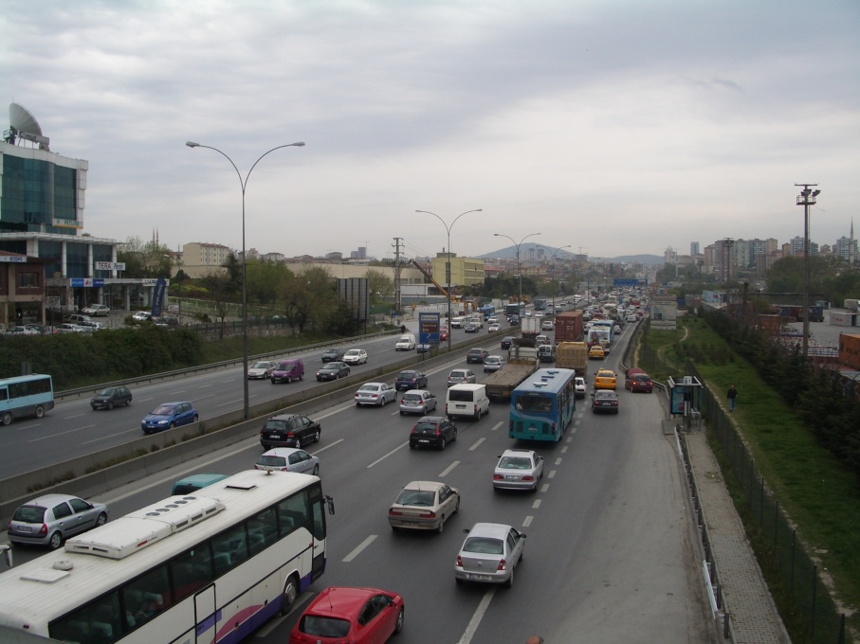
Göztepe (on Highway)
Represents traffic emissions on one of the major highways.
07:00-21:00 hrs very dense traffic
Connected to the two Bosphorus Bridges
Operated since October 2007

Slide 16
Kandilli (Bosphorus)
Operated since: 07.09.2007
Low traffic
Semi - urban
Shipping from Bosporus strait

Slide 17
CLUSTER ANALYSIS
INTRODUCTION METHODS RESULTS CONCLUSIONS
HYSPLIT back-trajectory model
Total of 805 days for the Kandilli station
72-hour periods
1000 m starting height

Slide 18
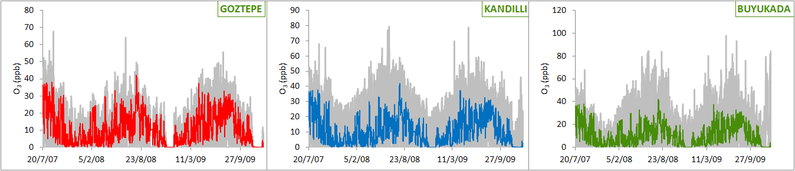
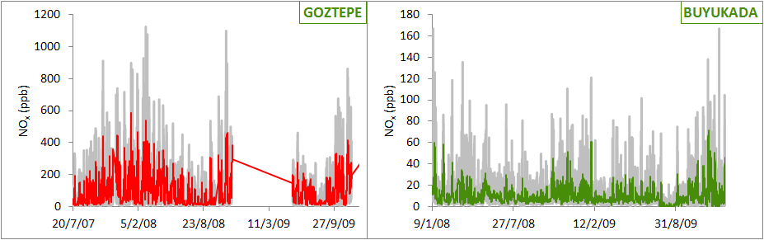
HOURLY O₃ & NO_{x} VARIATIONS
INTRODUCTION METHODS RESULTS CONCLUSIONS
Surface O₃
Surface NO_{x}

Slide 19
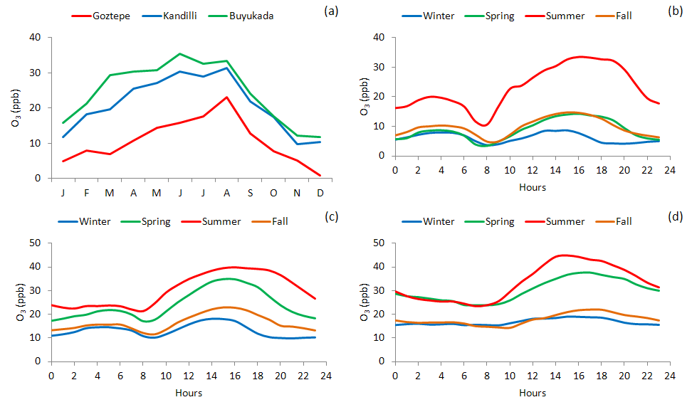
SEASONAL AND DIURNAL O₃ VARIATIONS
INTRODUCTION METHODS RESULTS CONCLUSIONS
GOZTEPE
KANDILLI
BÜYÜKADA

Slide 20
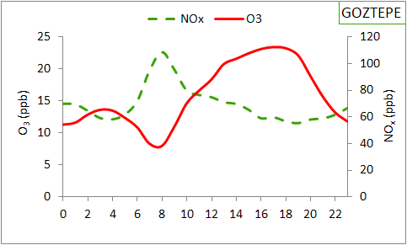
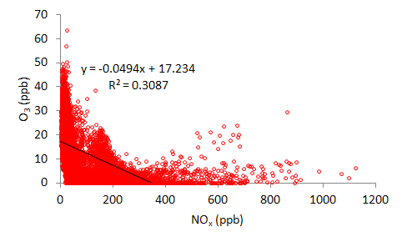
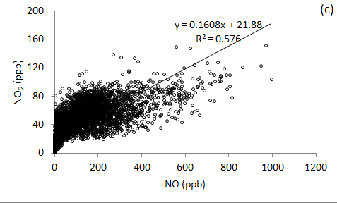
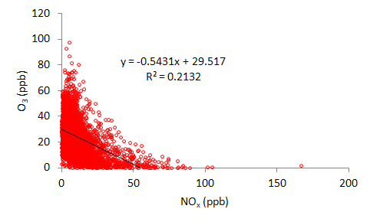
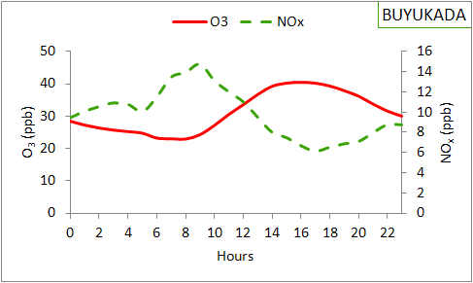
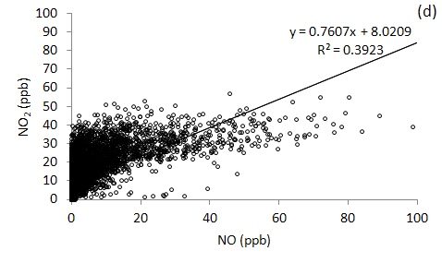
DIURNAL O₃ vs. NO_{x} VARIATIONS
INTRODUCTION METHODS RESULTS CONCLUSIONS
BUYUKADA GOZTEPE
Correlation (r) = -0.64 (p=0)
Correlation (r) = -0.54 (p=0)

Slide 21
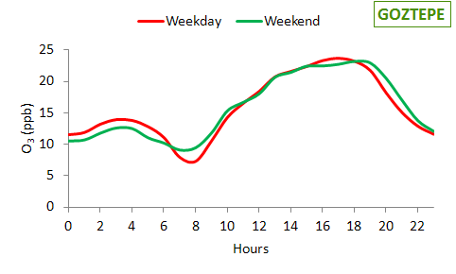
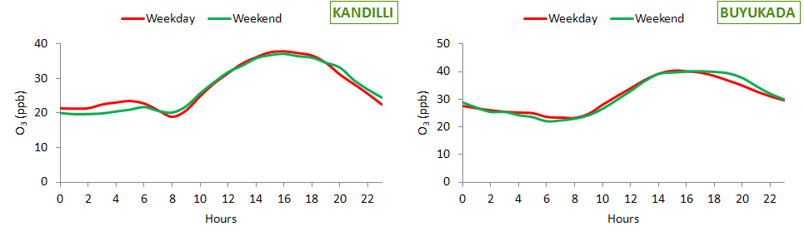
WEEKEND EFFECT
INTRODUCTION METHODS RESULTS CONCLUSIONS
Differences are calculated for the ozone-season
Slightly higher O₃ levels at weekends at Goztepe (14%)
Opposite pattern at Kandilli (2%) and Buyukada (7%) sites
Differences are not significant
Delay of peak O₃ levels at weekends (~1 hr)
Largest difference at Goztepe due to traffic emissions
Differences between weekend and weekday did not exceed 9 ppb at any station

Slide 22
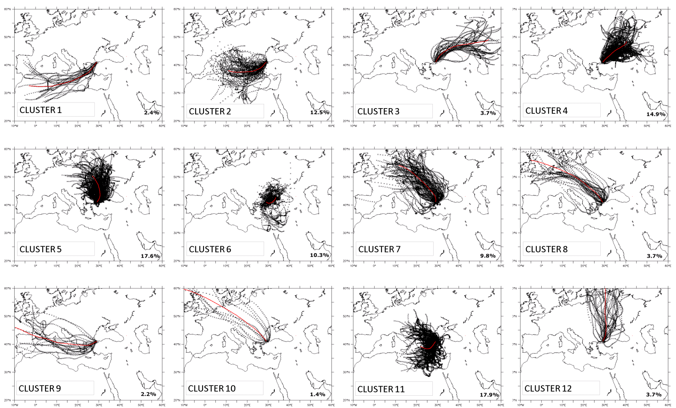
CLUSTER ANALYSIS
INTRODUCTION METHODS RESULTS CONCLUSIONS
The largest contributions originate from the East Mediterranean and northern Black Sea (~17% each)
Northeasterly and easterly transports contribute by >10%, originating from Eastern Europe and Eastern Mediterranean.
Clusters 11 and 6 represent short range transport and circulating patterns over Istanbul area
Much smaller contributions (<4% ) originate from Eastern Europe, but also from eastern borders of Turkey, North Africa and Balkan region.

Slide 23
CONCLUSIONS
Clear seasonal variation exhibiting a maximum in summer and a minimum in winter.
Highest monthly and daily O₃ mixing ratios were observed during spring and summer.
Higher O₃ levels at the rural site compared to the semi-rural and the traffic sites.
The lowest O₃ mixing ratios measured at the traffic site (titration effect of local high NO_{x} emissions).
O₃ mixing ratios for the weekend days were slightly higher than that on weekdays at the Göztepe site, while opposite holds at the semi-rural and rural sites.
Differences in the time of observed peak O₃ and the variability during the rush hours were notable, particularly at the traffic site.
The sharp decrease in the morning rush hour O₃ levels during weekdays were not observed in weekends.
Transport is mainly from Europe, Balkans and the Black Sea to Istanbul.
Elevated levels of O₃ might be attributed to a mix of transport and local production.

Slide 24
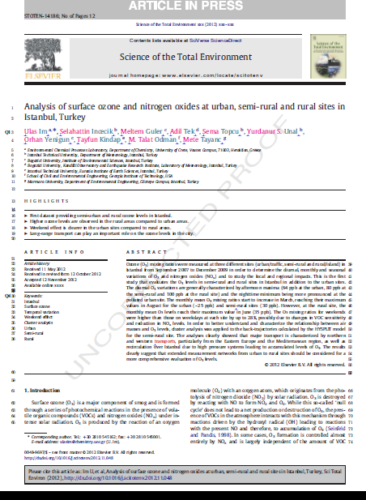

Slide 25

THANK YOU
Acknowledgements

