Slide 1



Data Stewardship Maturity Matrix (DSMM)
– Application Update
Ge Peng, Ph.D.
North Carolina State University
Cooperative Institute for Climate and Satellites, North Carolina (CICS-NC)
at NOAA’s National Centers for Environmental Information (NCEI)
2018 ESIP Winter Meeting,
9–11 January 2018, Bethesda, MD, USA
NOAA Satellite and Information Service | National Centers for Environmental Information

Slide 2
What Is the DSMM?
A Unified Framework for Measuring Stewardship Practices Applied to
Individual Data Products
Developed by CICS-NC/NCEI & By Domain Subject Matter Experts,
Leveraging
Institutional Knowledge
Community Best Practices and Standards
Notes:
It is jointly developed by CICS-NC/NCEI and by Subject Matter Experts in science, data management, and technology;
Vetted with Earth Science Community feedback.

Slide 3
DSMM Follows CMMI Level Structure
Level 5
Optimal/Well Managed
Measured, Controlled, Audit
Level 4
Advanced/Well Managed
Community Best Practices
Level 3
Intermediate/Managed
Community Good Practices
Recommended level for
operational digital products
stewarded by
National Data Centers
Level 2
Minimal
Limit Managed
Reference Maturity Level Structure
Capability Maturity Model Integration (CMMI)
Levels of Maturity of Digital Repository
Level 1
Ad Hoc
Not Managed
Notes:
Progressive

Slide 4
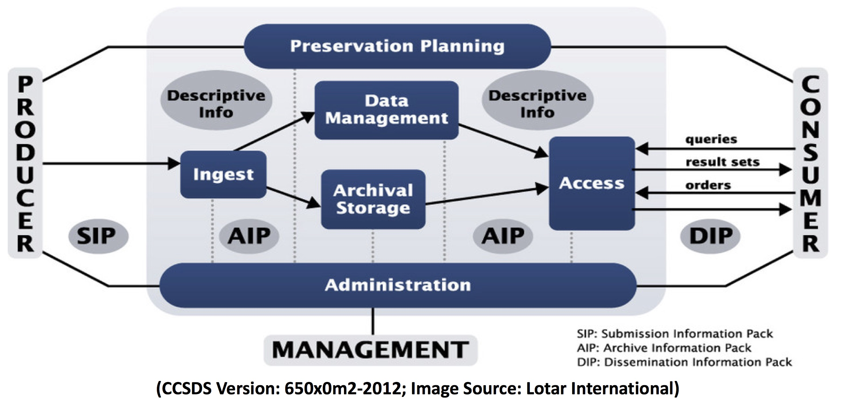
Scope of DSMM
Functional Entities of the Open Archival Information System (OAIS)
Notes:
DSMM assesses measureable practices associated with the Functional Entities of the Open Archival Information System (OAIS)
(within the shaded box)

Slide 5

DSMM – Key Components
Measureable Practices in Nine Quasi-Independent Key Components
Preservability
Accessibility
Usability
Production Sustainability
Data Quality Assurance
Data Quality Control/Monitoring
Data Quality Assessment
Transparency/Traceability
Data Integrity
Notes:
DSMM Defines Measureable, Five-Level Progressive Practices in Nine Quasi-Independent Key Components

Slide 6
DSMM Vetting Process
Community Engagement: Feedback and Collaboration
  Internal (Domain SMEs from NOAA Data Centers: NCDC, NGDC, and NODC –> NCEI)
  External (SMEs from ESIP Data Stewardship Committee; ESIP, AMS and AGU meetings)
Notes:
DSMM and paper drafts reviewed SMEs; NCDC National Climate Data Center; NGDC – National Geophysical Data Center; NODC – National Oceanographic Data Center; ESIP – Earth Science Information Partners; DSC – Data Stewardship Committee; AGU – American Geophysical Union; AMS – American Meteorological Society

Slide 7
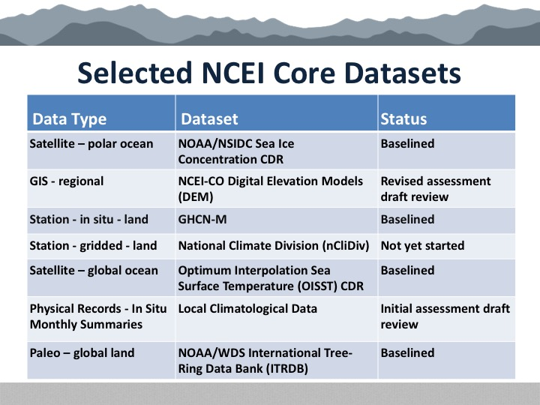
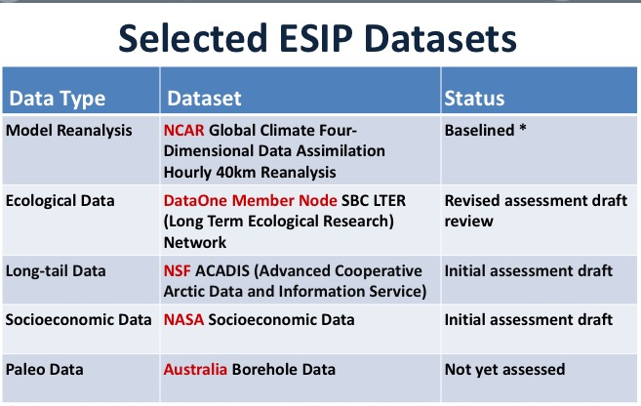
DSMM Vetting Process
Community Engagement: Feedback and Collaboration
  Internal (Domain SMEs from NOAA Data Centers: NCDC, NGDC, and NODC –> NCEI)
  External (SMEs from ESIP Data Stewardship Committee; ESIP, AMS and AGU meetings)
Use Case Studies
  NCEI Core Datasets – Different data types managed by same organization
  ESIP DSC Datasets – Different disciplines managed by different organizations
Notes:
NCEI use case study – demonstrate its utility and develops implementation best practices;
ESIP DSC use case study – generalize and potentially improve DSMM.

Slide 8
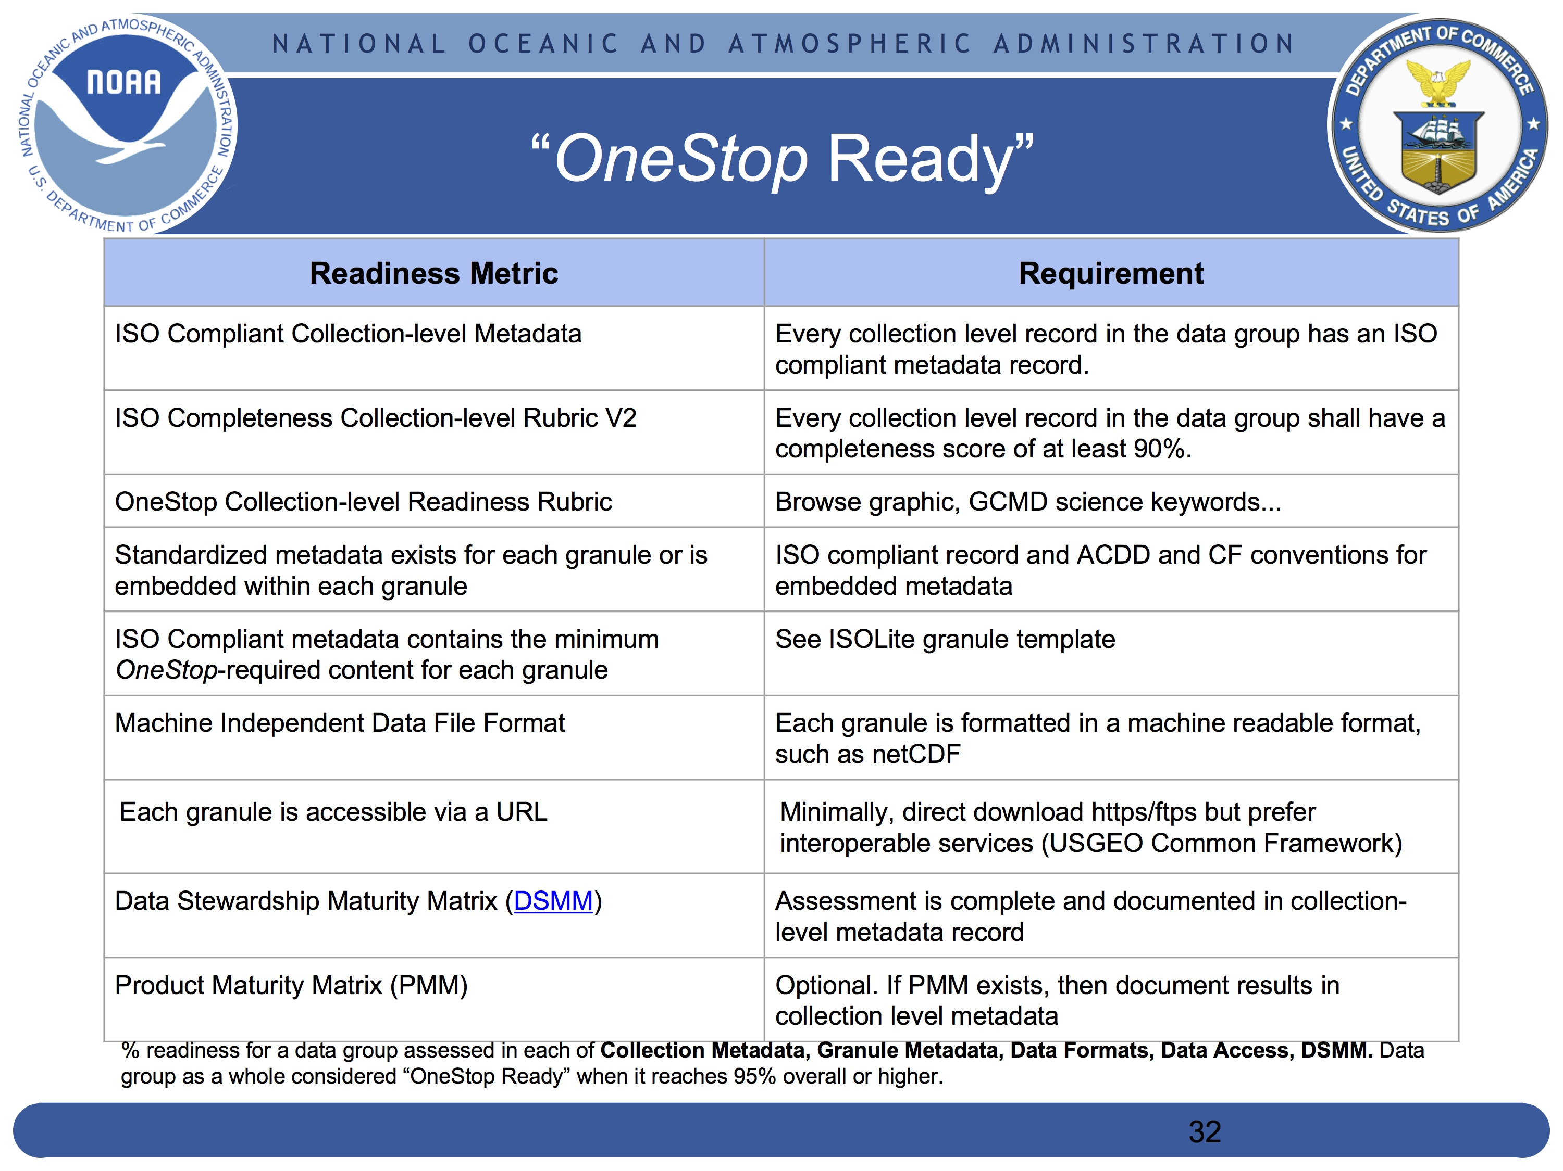
DSMM Applications & Implementation
OneStop Ready
OneStop DSMM Implementation
Best practices,
Workflows,
Tools
DataOne User Group Meeting Poster:
tinyurl.com/DSMM-OneStop-Poster
800+ NOAA Datasets Archived by NCEI (as of 1/8/2018), done by OneStop Metadata Team
Courtesy of Kenneth Casey, OneStop Program Manager
Notes:
Develop best practices, workflows, and tools to automate the DSMM assessment results curation and integration process
OneStop – NOAA path finding project to increase discoverability and accessibility of NOAA data; currently managed by NCEI.
DataOne – Data Observation Network for Earth supported by NSF

Slide 9
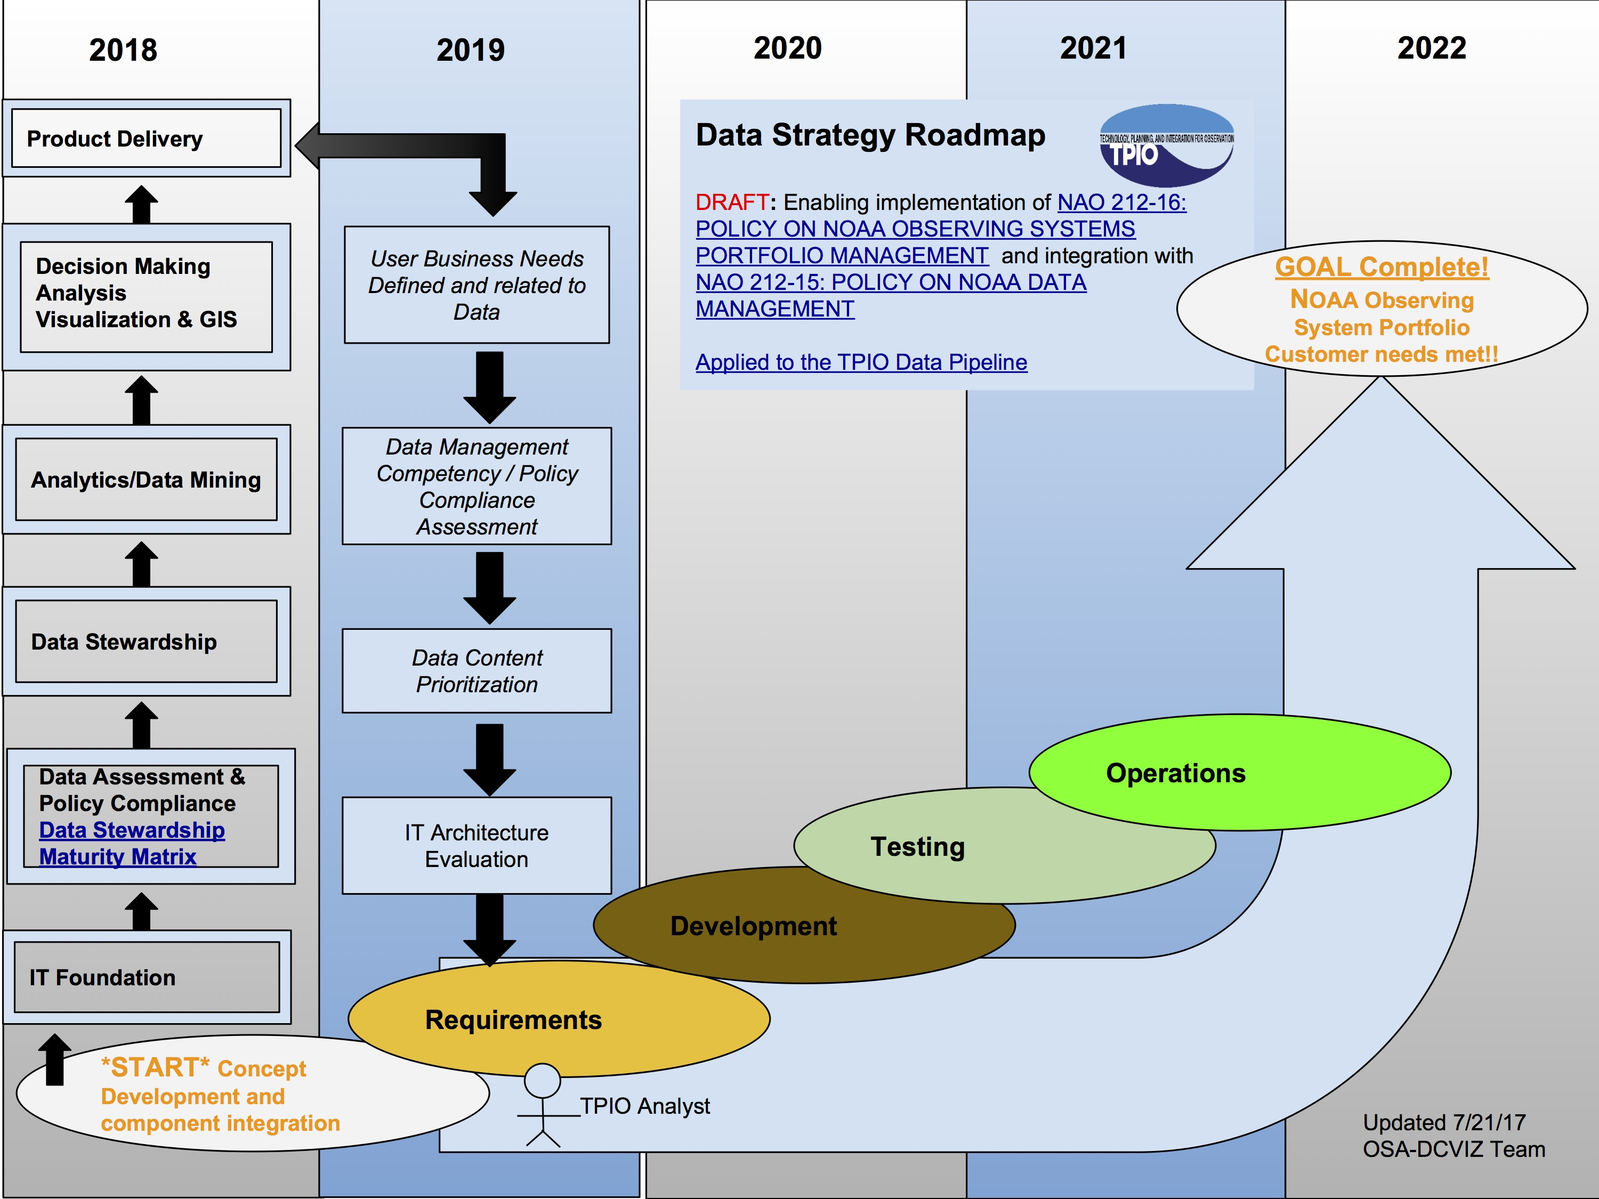
DSMM Applications & Implementation
DSMM
NOAA TPIO Data Strategy Roadmap
(Courtesy of Matthew Austin, Team Lead)
Notes:
As of last week – over 800 datasets; TPIO – NOAA Technology, Planning and Integration for Observation program (manages the development of NOAA's Integrated Environmental Observation and Data Management System Architecture);
ESA – The European Space Agency; GEO – Group on Earth Observations

Slide 10
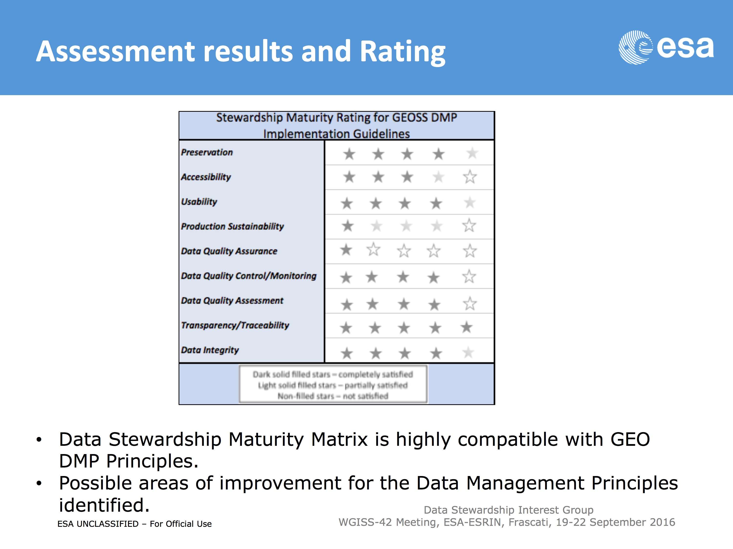
DSMM Applications & Implementation
Evaluation of the GEO Data Management Principles by the GEOSS Data Stewardship Interest Group
Integration into the WGISS Data Management and Stewardship Maturity Matrix
Based on Albani (2016)
Notes:
ESA – The European Space Agency; GEO – Group on Earth Observations
GEOSS – the Group on Earth Observations System of Systems
WGISS – The Working Group on Information Systems and Services

Slide 11
DSMM Applications & Implementation
Support WMO Commissions for Basic Systems and Climatology:
Capturing DSMM ratings and supporting documents for high-quality datasets including the GCOS (Global Climate Observing System) Datasets
Sea Ice
Sea Level
Ice-sheet
Glaciers
Hydrology
(Courtesy of Christina Lief)

Slide 12
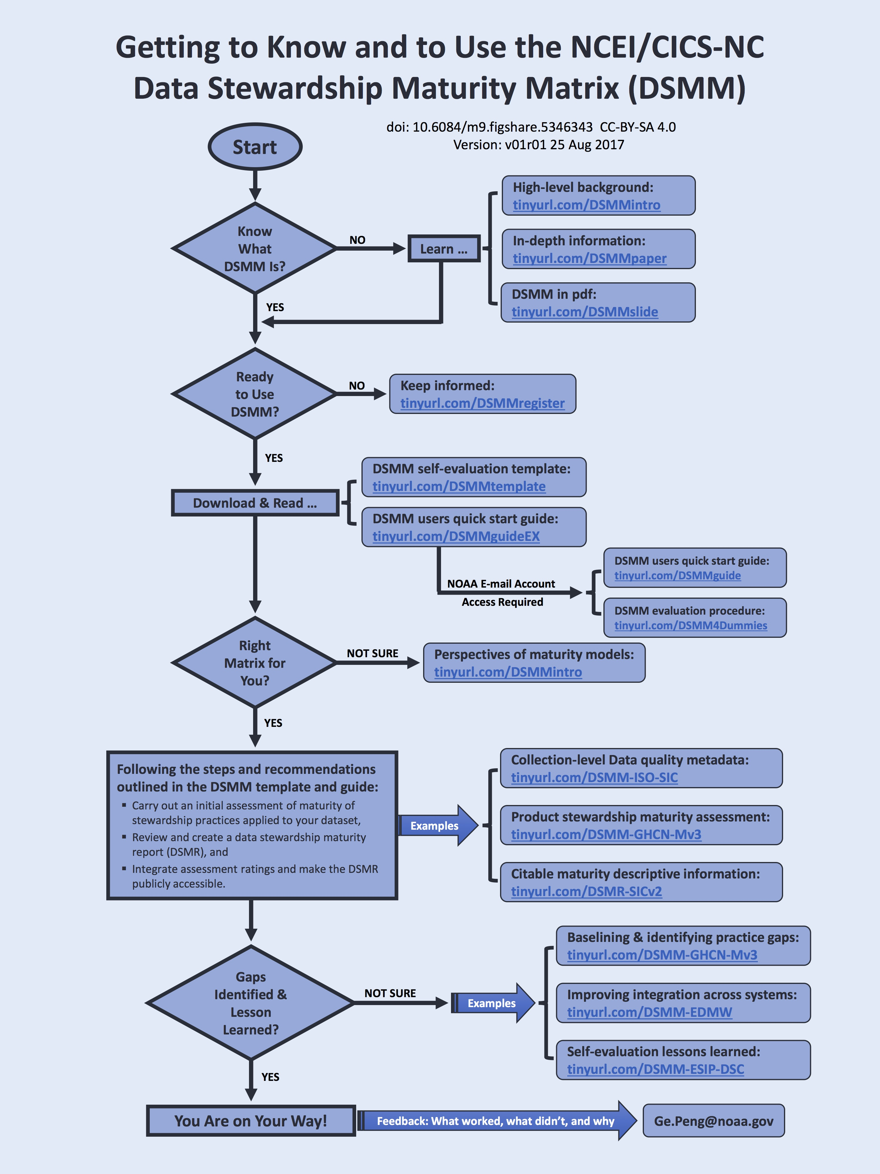

Getting to Know & to Use DSMM
Published on figshare – A gradual way to get relevant information with clickable links
Download: tinyurl.com/DSMM-FlowChart
Contact me
Ge.Peng@noaa.gov
ORCID: orcid.org/0000-0002-1986-9115
Notes:
Including examples of DSMM use case study; DSMR; ISO Collection-level Metadata Record, etc.

Slide 13
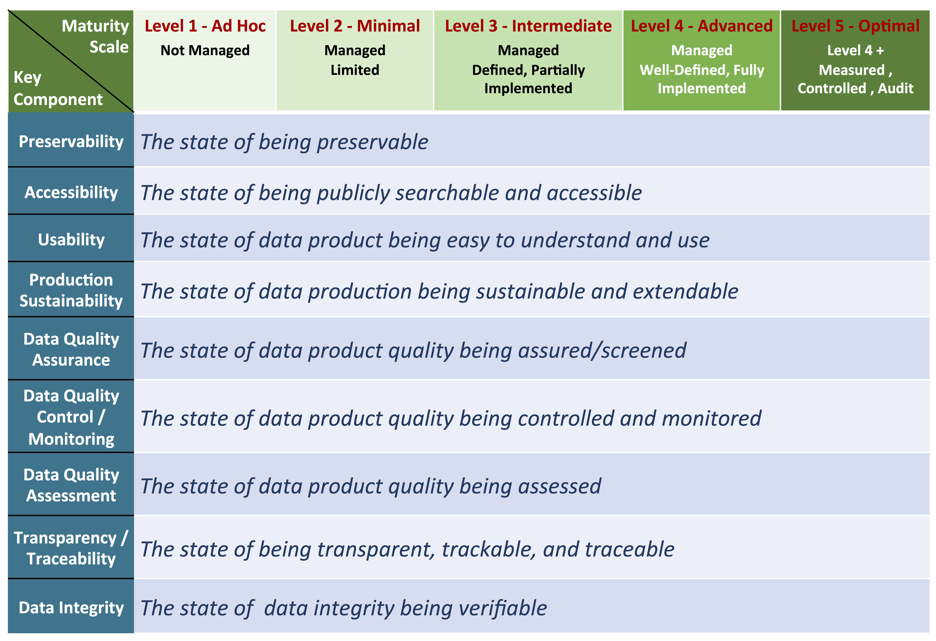
DSMM Defines Measureable, Five-Level Progressive Practices
in Nine Quasi-Independent Key Components

Slide 14
