Slide 1

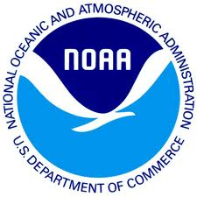
The Case for Data Stewardship: Preserving the Scientific Record
Version 2.0
[Review Date]
Matthew Mayernik
National Center for Atmospheric Research
Notes:
Modules should be 3-7 minutes long

Slide 2
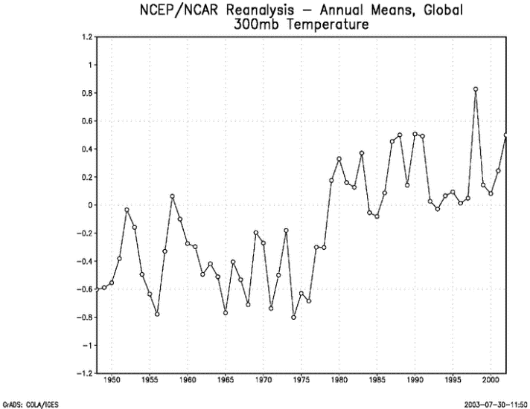
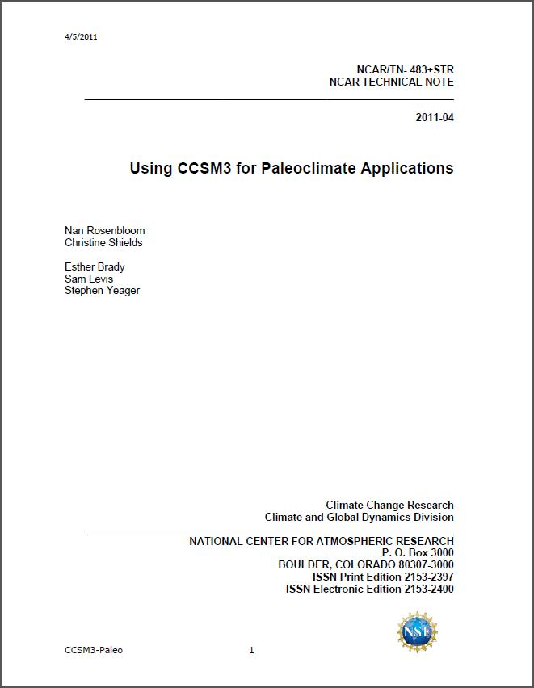
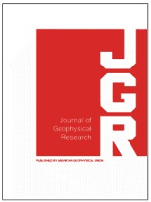

The Scientific Record
The scientific record is an aggregation of
scientific journals
conference presentations and proceedings
technical reports and pre-prints
the underlying data, software, and other evidence to support published findings
This aggregation is highly distributed across
Libraries
Archives
Museums
Data Centers
Academic publishers
Investigator web sites

Slide 3
Purpose of the Scientific Record
Communicating findings, hypotheses, and insights from one person to another, across space and time
Organizing scientific communities
establishing common nomenclature and terminology
connecting related work
developing disciplines
Documenting, managing, and resolving controversies and disagreements
Establishing precedence for ideas and results
Offering evidence for the quality and significance of scientific work through bibliometrics

Slide 4
Challenges to the Scientific Record - 1
Increasing complexity of experiments and data cause the linkages between evidence and writings to become more complex and elusive
Data sets are often extractions or compilations of other data sets
Tracking the provenance of digital resources is very difficult
Example* – computation-based scientific research
Many data sets are now created through computational methods
Different software packages (or custom-built code) might also be used to access, analyze, deposit, format, compile, and/or filter data.
Metadata required to execute scientific software, including the libraries, compilers, operating system, and hardware description, might be orders of magnitude larger than the software itself.
* Example based on Stodden, Mitchell, & LeVeque, 2012.

Slide 5
Challenges to the Scientific Record - 2
Increasing rate of the growth of the literature and data
Disciplines and sub-specialties branch and evolve continuously
Example* – Most schools of Meteorology have been renamed in the past few decades. New names include:
Atmospheric and Ocean Sciences
Earth and Atmospheric Sciences
Geological and Atmospheric Sciences
Earth, Ocean, and Atmospheric Sciences
Environmental Sciences
Earth, Atmospheric, and Planetary Sciences
Tools and practices that help manage literature are either non-existent or just beginning for data
Specialized journals
Citations
Indices
Controlled vocabularies and taxonomies
* Example from Ramamurthy, 2012.

Slide 6
Preservation of the Scientific Record
Tenets of the scientific record
That scientific products are trustworthy
That scientific products enable results to be reproducible and/or transparent
Preserving the scientific record: Data considerations
Are data stored in a trustworthy institutional setting?
Are data documented in a way that ensures understandability, reproducibility, and transparency over time?

Slide 7
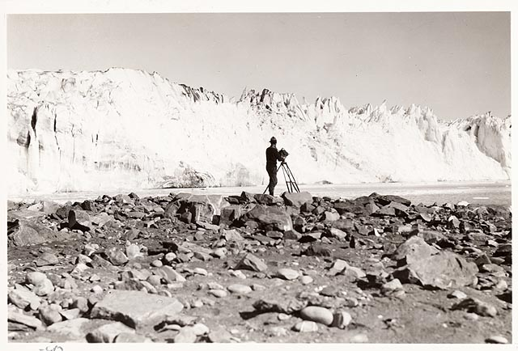
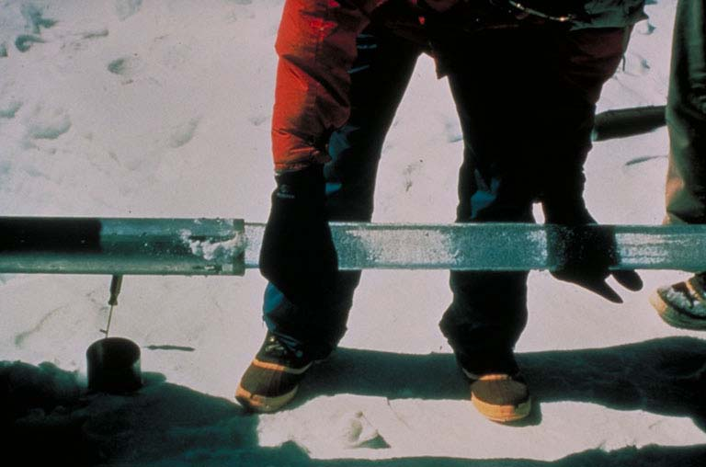
Further Preservation Modules
Establishing relationships with archives
Preserving a record of environmental change
Case studies
National Snow & Ice Data Center Glacier Photos
Arctic Temperature Variability Data
Image: Field, William Osgood. 1931 Columbia Glacier: From the Glacier Photograph Collection. Boulder, Colorado USA: National Snow and Ice Data Center/World Data Center for Glaciology. Digital media.
http://nsidc.org/cgi-bin/gpd_deliver_jpg.pl?columbia1931090612
Image from: http://www.ncdc.noaa.gov/paleo/about-collage.html

Slide 8
References
Hanson, B., A. Sugden, and B. Alberts. 2011. “Making data maximally available.” Science 331(6018): 649. http://dx.doi.org/10.1126/science.1203354
Lynch, C. 2009. “Jim Gray’s Fourth Paradigm and the Construction of the Scientific Record.” In The Fourth Paradigm: Data-Intensive Scientific Discovery, edited by T. Hey, S. Tansley, & K. Tolle,137-146. Redmond, WA: Microsoft. http://research.microsoft.com/en-us/collaboration/fourthparadigm/4th_paradigm_book_part4_lynch.pdf
Ramamurthy, M. 2012. "Data Management: Progress, Opportunities and Challenges." Presentation at 2012 Unidata Users Workshop, 12 June 2012, Boulder, CO. http://www.unidata.ucar.edu/events/2012UsersWorkshop/#schedule
Stodden, V., I. Mitchell, R. LeVeque. 2012. "Reproducible Research for Scientific Computing: Tools and Strategies for Changing the Culture," Computing in Science and Engineering 14(4): 13-17. http://doi.ieeecomputersociety.org/10.1109/MCSE.2012.38
Uhlir, P.F. and P. Schröder. 2007. “Open data for global science.” Data Science Journal 6. https://www.jstage.jst.go.jp/article/dsj/6/0/6_0_OD36/_pdf

Slide 9
Resources
Data Journals
Earth System Science Data - http://www.earth-system-science-data.net/
Geoscience Data Journal - http://www.geosciencedata.com
Data Citations
Earth Science Information Partners (ESIP) - Interagency Data Stewardship/Citations/provider guidelines http://wiki.esipfed.org/index.php/Interagency_Data_Stewardship/Citations/provider_guidelines
DataCite – http://datacite.org
Thomson Reuters Data Citation Index (announced) - http://thomsonreuters.com/content/press_room/science/686112
Controlled vocabularies and taxonomies
Global Change Master Directory - http://gcmd.nasa.gov/
NetCDF Climate and Forecast (CF) Metadata Convention - http://cf-pcmdi.llnl.gov/
Open Geospatial Consorium - Observations and Measurements http://www.opengeospatial.org/standards/om
Semantic Web for Earth and Environmental Terminology (SWEET) http://sweet.jpl.nasa.gov/ontology/

Slide 10
Other Relevant Modules
Modules about data management plans
Data Management Plans: Why do a data management plan
Data Management Plans: Elements of a plan
Modules about documentation and metadata
Local Data Management: Introduction to metadata and metadata standards
Local Data Management: Recording provenance and context
Modules about preservation strategies
Preservation Strategies: Options for archiving your data
Preservation Strategies: Emerging standards for preservation

