Slide 1


Understanding and Elevating Data and Information Quality in Citizen Science
Anne Bowser, PhD
Woodrow Wilson International Center for Scholars
24 September 2019
Notes:
Title slide

Slide 2
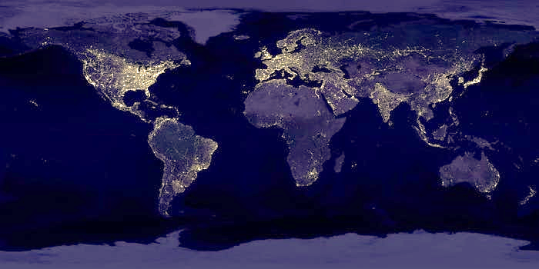
2019
People
1,543,554
World Water Monitoring Day Volunteers
Diversity
1,000+ Projects
7 continents
Value
$2.5 billion
Biodiversity monitoring
alone
Public Participation in Scientific Research
Notes:
[Anne] Too bad it’s all in silos. Missed opportunity.

Slide 3
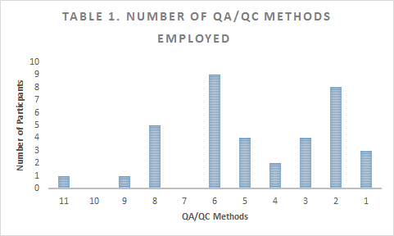
State of the Data in Citizen Science
Schade, Tsinaraki, & Roglia (2017)
Survey with 121 projects
Focus on data access, standardization, preservation
Data and metadata standards are evolving but limitations to data access (including licensing) remain, especially in the longer term
Bowser et al. (2019)
Interviews with 37 projects
Focus on data collection/ quality and data management
Significant investments in data quality, but data management and access less advanced
All projects used at least one QA/QC method, while 34 (92%) used more than one method, and 20 (54%) utilized five methods or more
Notes:
[Anne] Too bad it’s all in silos. Missed opportunity.

Slide 4
Data Quality in Citizen Science
Bowser et al. (2019)
Human Aspects
Targeted recruitment, volunteer training, volunteer testing
Instrument control
Standardized instrument, calibration
Data collection
Standardized protocol, disciplinary standard, cross-domain standard
Data verification
Voucher collection, expert review, automated review, contacting volunteers, removing bad data, replication or calibration
Documentation
QA/QC plan, other
Kosmala et al. (2016)
Iterative development of task and tool design
Volunteer training and testing
Use of standardized and calibrated instruments
Expert validation
Replication and calibration across volunteers
Skill-based statistical weighting of volunteer capability
Accounting for random error and systematic bias
Notes:
[Anne] Too bad it’s all in silos. Missed opportunity.

Slide 5
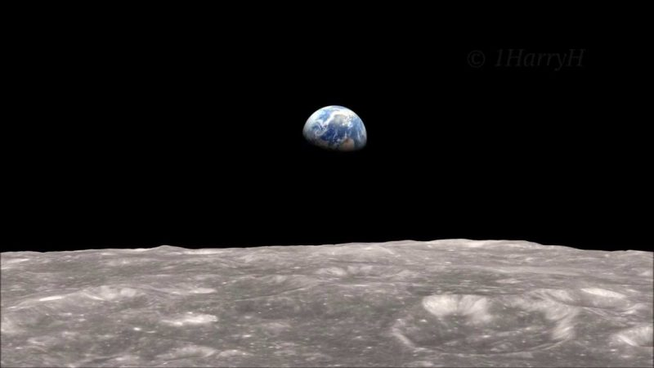


Practical Application/ Pilot
Earth Challenge 2020
Notes:
Earth Challenge 2020 has many partners, but it’s being spearheaded by the Wilson Center, Earth Day Network, and the U.S. Department of State. The Wilson Center is responsible for ensuring that this project produces good research, good data, and works WITH the existing citizen science community (we wrote that last requirement in). Earth Day Network is a leader in the environmental movement responsible for education and outreach. The folks working with us from State are NOT on the policy side, but work to maintain the U.S. Embassies and help make them green. State has a lot of sensor/ IoT expertise, and is the technical lead. We have a lot of other great partners– check out: https://earthchallenge2020.earthday.org/

Slide 6
Goal 1
Goal 2
Help coordinate existing citizen science
Build capacity for new citizen science
Advance Knowledge
Drive Action
Notes:
This project has two goals. First, we want to help work with citizen science projects to coordinate and document the awesomeness that is already happening. Second, we want to build capacity for new citizen science to happen anywhere in the world. Our ultimate goal is to enable people to use citizen science to solve local problems, while also being part of a global movement.
To facilitate this we have two cross cutting themes– advancing knowledge, and driving action. To advance knowledge, we are working with the research community and Standards Development Organizations to make sure that the data are useable and used. We are also working on getting the data aligned with the U.N. Sustainable Development Goals (SDGs) and used in SDG reporting.
Earth Day Network is leading the “Drive action” piece. They are creating educational materials, and also a “what you can do” toolkit that will share actionable information related to a volunteer’s geographic location and research domain.

Slide 7
6 Research Areas
From a crowdsourcing call
Our April 2020 campaign will focus on these 6 research areas
2
How does air quality vary locally?
1
What is in my drinking water?
3
Is my food supply sustainable?
4
6
How are insect populations changing?
What are the local impacts of climate change?
5
What is the extent of plastics pollution?

Slide 8

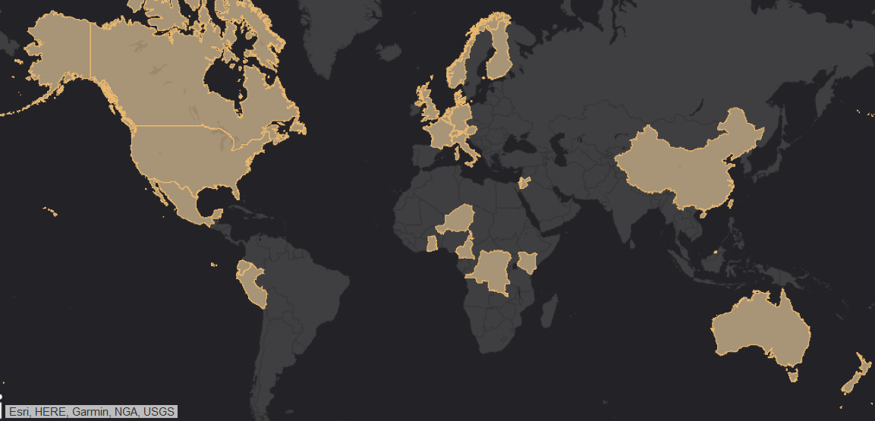
193 People 34 Countries
Notes:
Super happy about where the research teams are coming from ☺ this is just a fun, FYI slide.

Slide 9
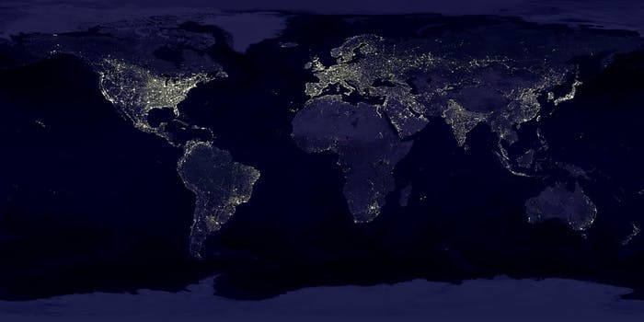
Data and metadata standards
Data catalogue
Mobile application with data collection widgets
Links to partner platforms
Platform for data access
Tools for data analysis/ visualization
Educator and “What you can do” resources
Other cool stuff
(LIKE A DATA CUBE)
Tech Stack
Notes:
This slide breaks down the resources we are developing to support the two goals of coordination and capacity building.

Slide 10
Data and metadata standards
Data catalogue
Mobile application with data collection widgets
Links to partner platforms
Tools for data analysis/ visualization
Data Quality: Cross Cutting
Notes:
This slide breaks down the resources we are developing to support the two goals of coordination and capacity building.

Slide 11
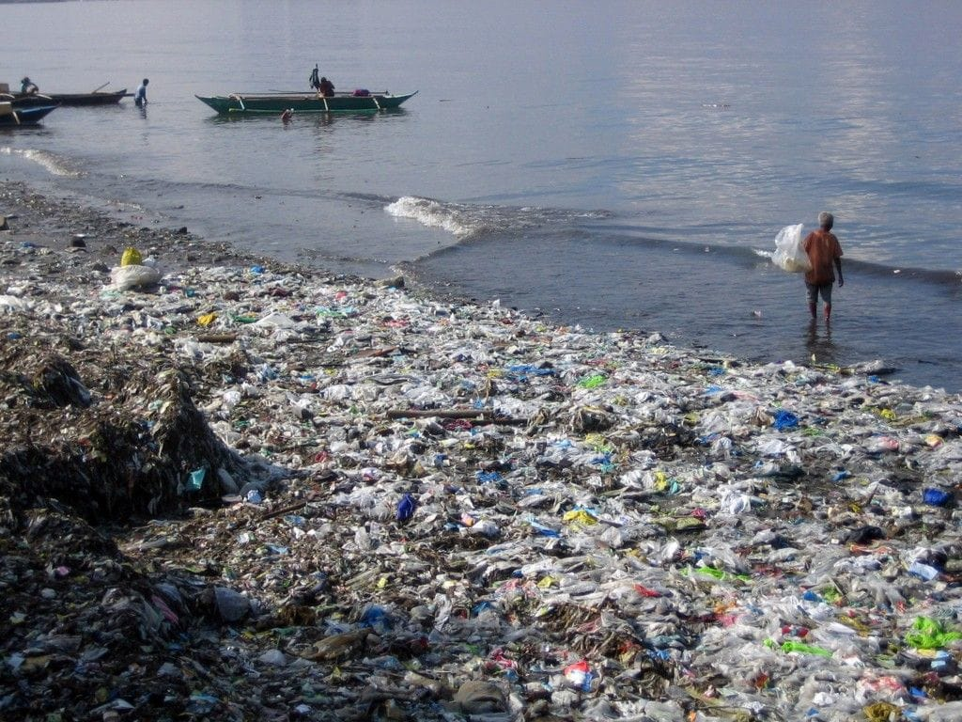
Collect
Standardized data collection (2 apps)
Interoperable data integration
Assure
Use of Picture Pile for validation
ML-based approaches
Describe
Agreed-upon metadata (ESA)
Deposit & Preserve
Documentation in data catalogue (license, DQ)
Scalable data storage in AWS (++)
Longer-term partnership(s) needed
Data Quality: Plastics Pollution
Notes:
This slide breaks down the resources we are developing to support the two goals of coordination and capacity building.

Slide 12
2020
Army of Experts
(EC2020…)
Low resource environment
Controlled Vocabularies
(OGC…?)
Need to be rooted in reality
Standardized DQ Label
(Trusted Party)
Necessary for, e.g., SDG reporting
Data Quality: Open Questions
Notes:
[Anne] Too bad it’s all in silos. Missed opportunity.

Slide 13
Understanding and Elevating Data and Information Quality in Citizen Science
Anne Bowser, PhD
anne.bowser@wilsoncenter.org
24 September 2019
Notes:
Title slide

