Slide 1


Preserving the Scientific Record:
Preserving a Record of Environmental Change
Version 1.0
[Review Date]
Matthew Mayernik
National Center for Atmospheric Research
Notes:
Modules should be 3-7 minutes long

Slide 2
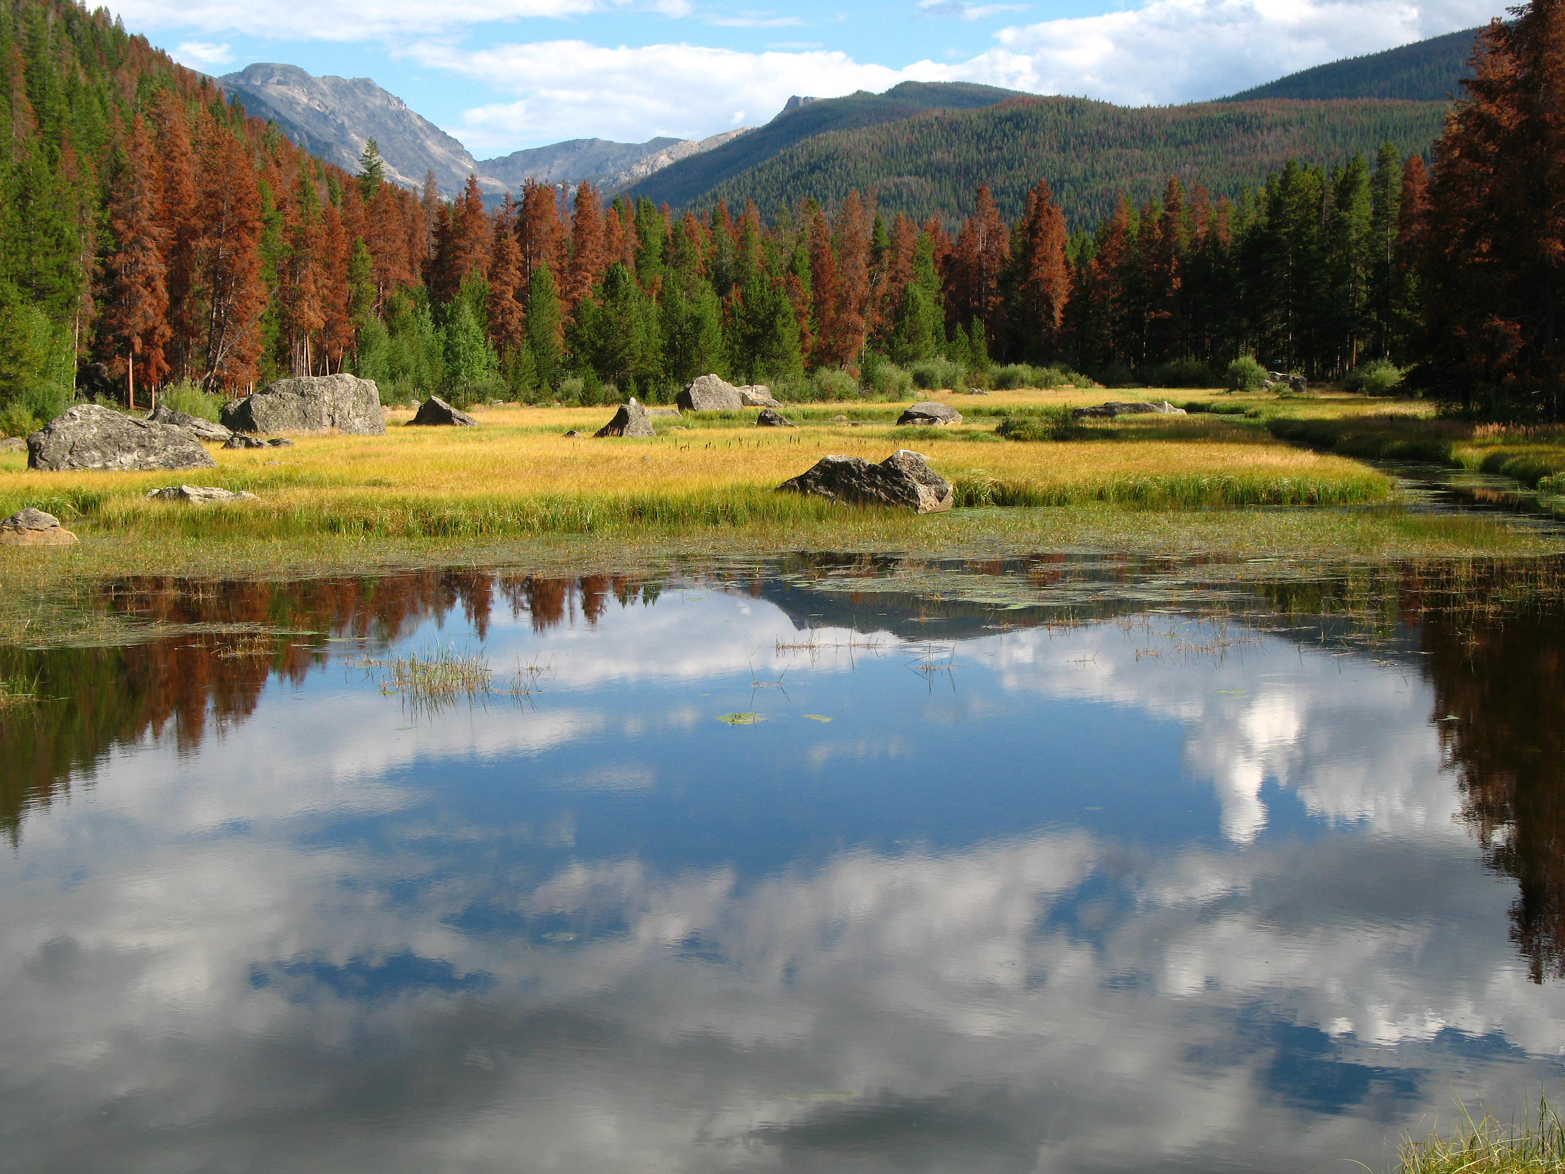
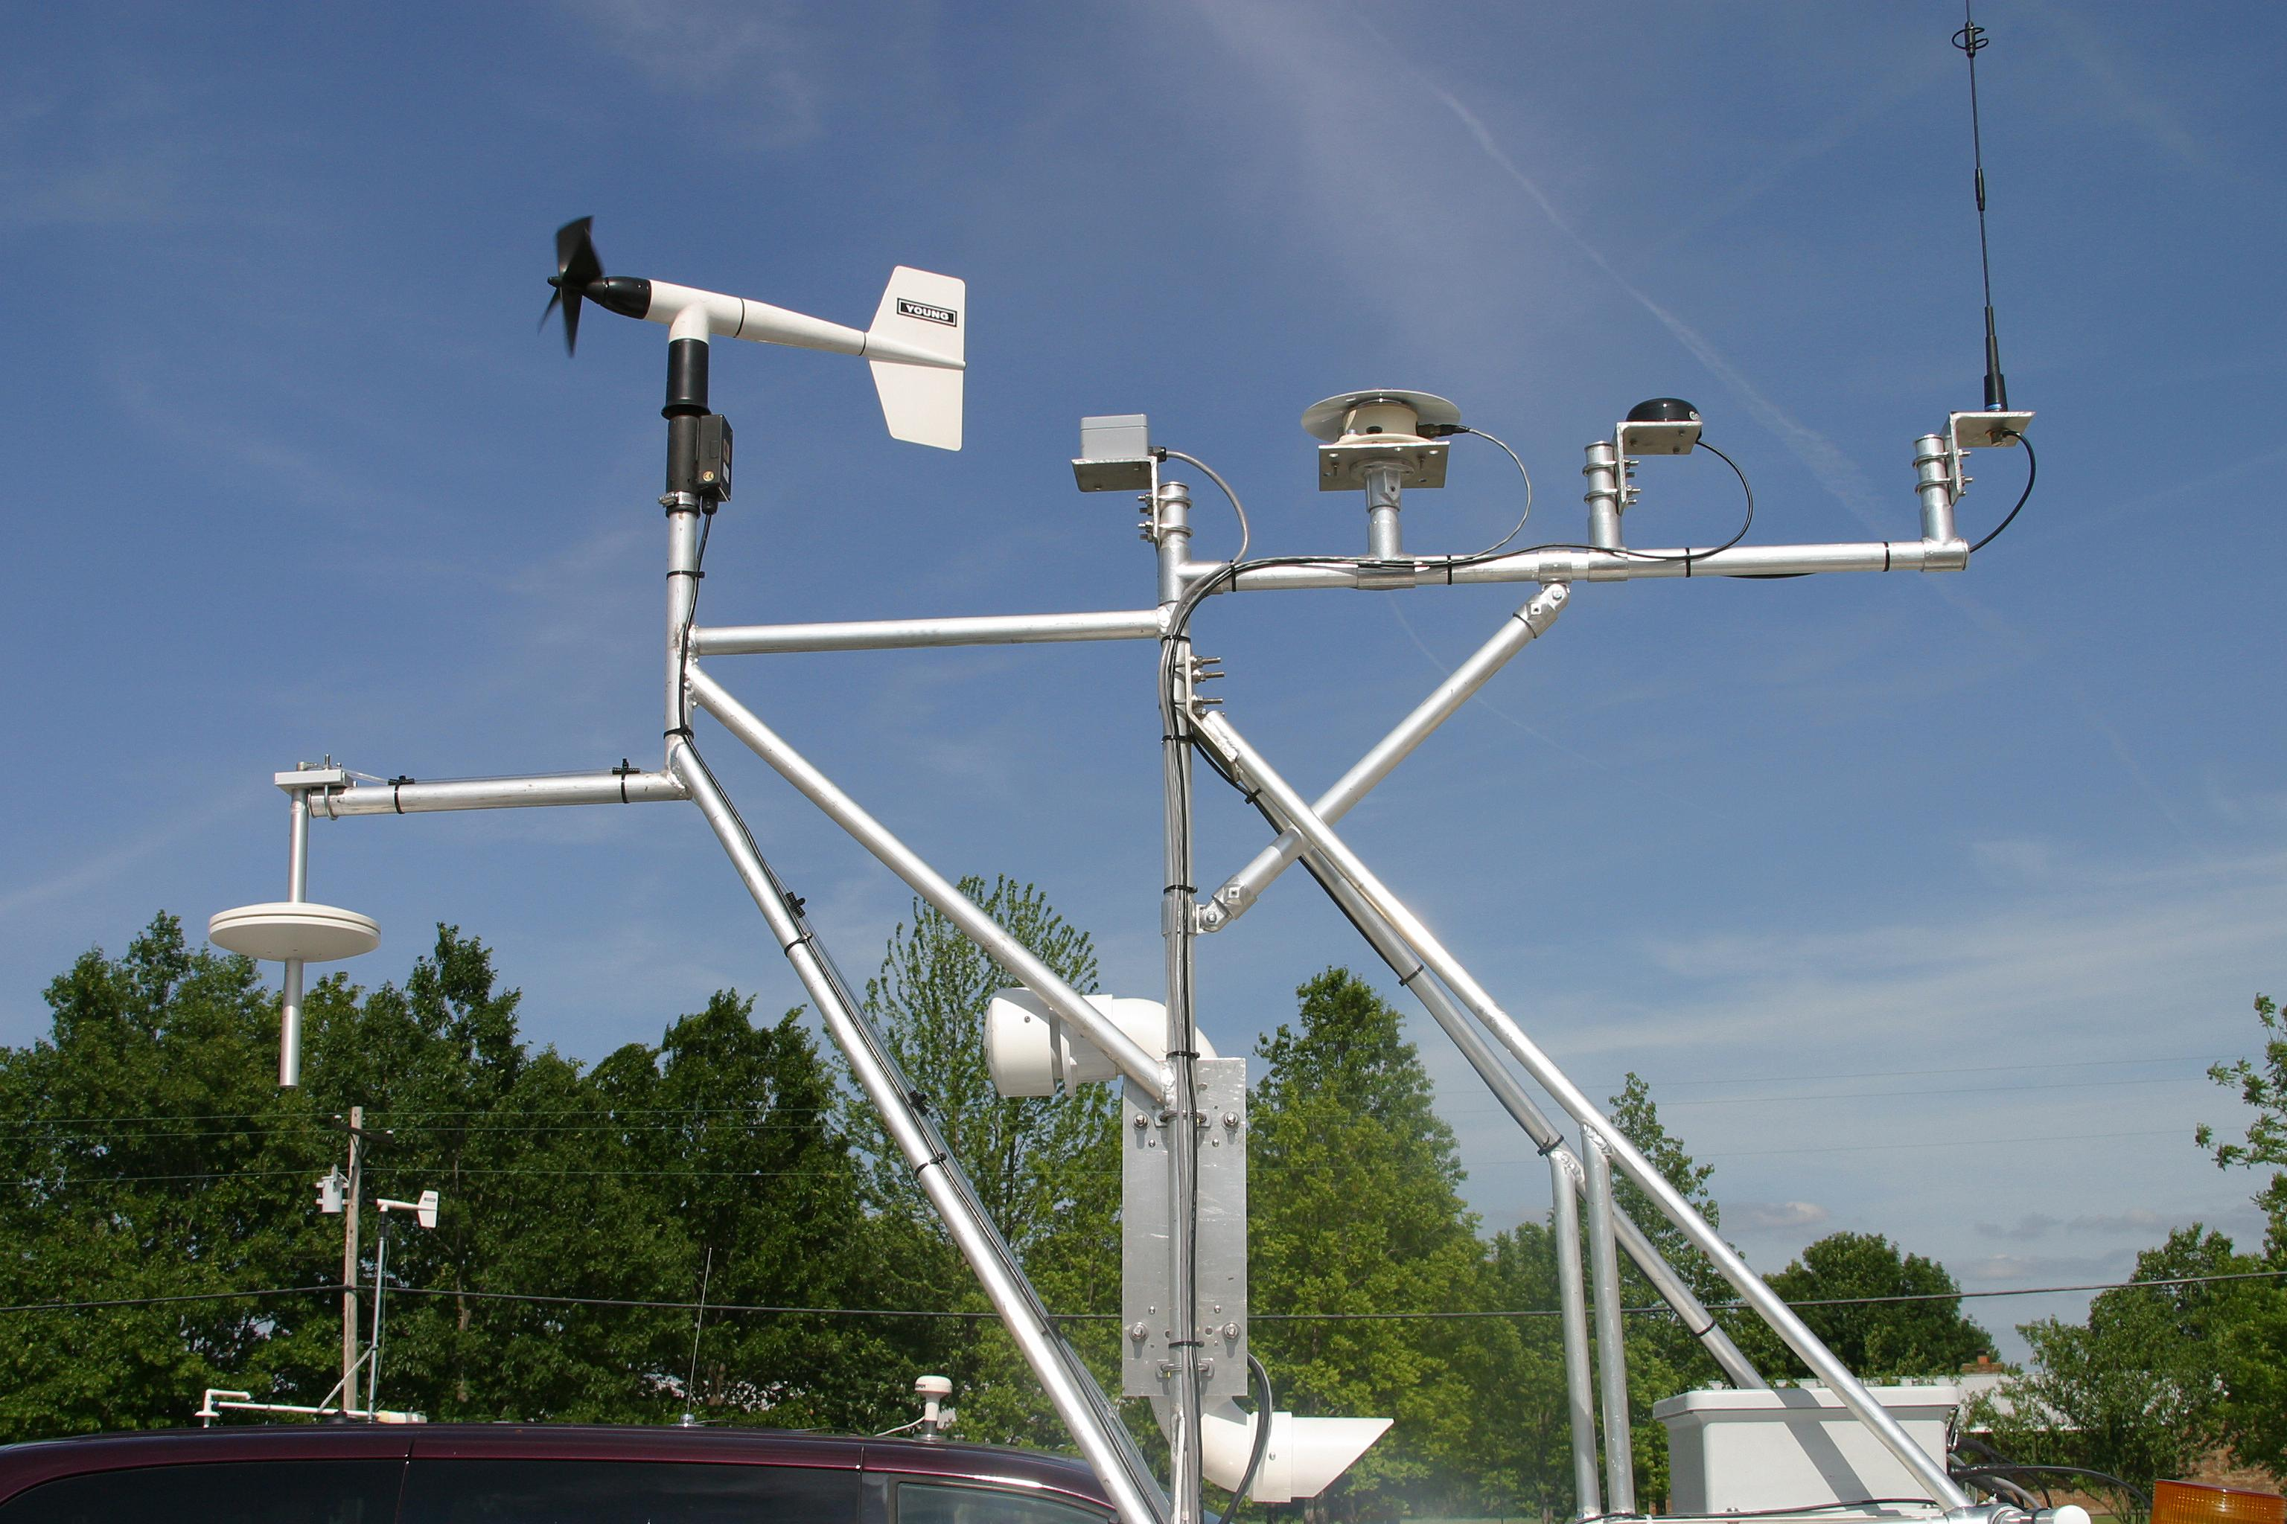
Environmental Change
Environmental change is well documented
  Climate observations
  Proxy data: ice cores, pollen analysis, tree ring dating
  Plant and animal species shifts
  Evaluation of biological specimen collections
  Many other measurement types
Preserving those records is essential
  To understand trends
  To prepare for changing conditions
  To recommend courses of action
  To provide a base for future scientific
  work
Images: Copyright University Corporation for Atmospheric Research

Slide 3
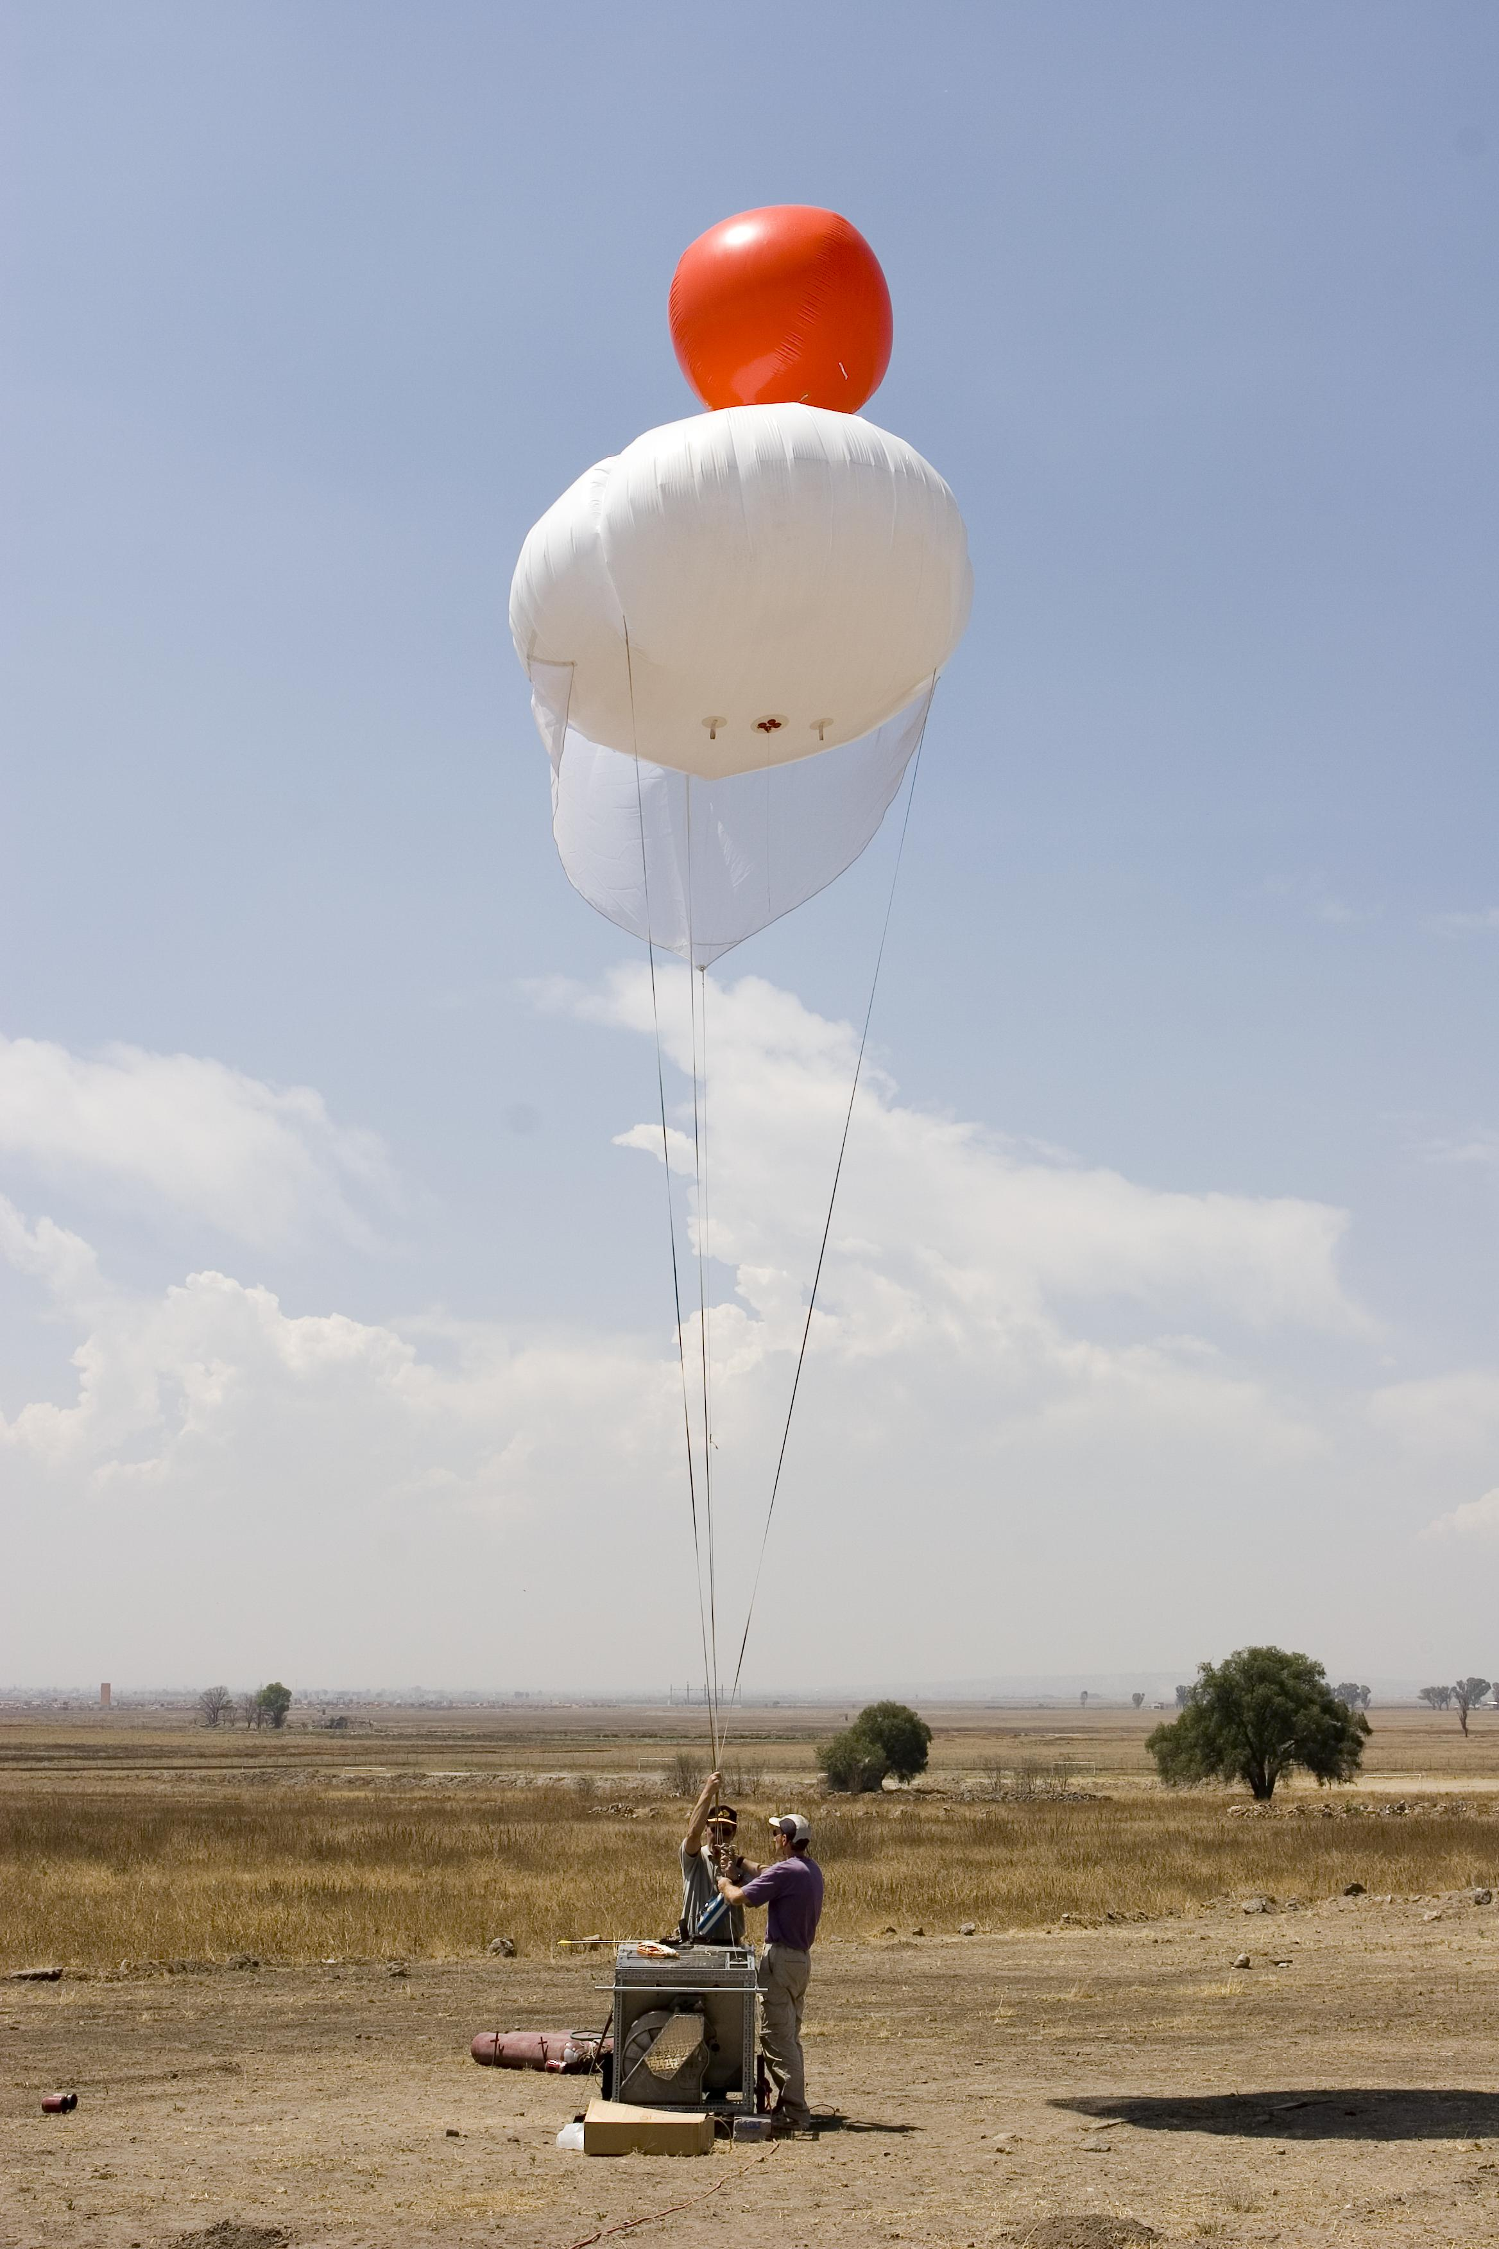
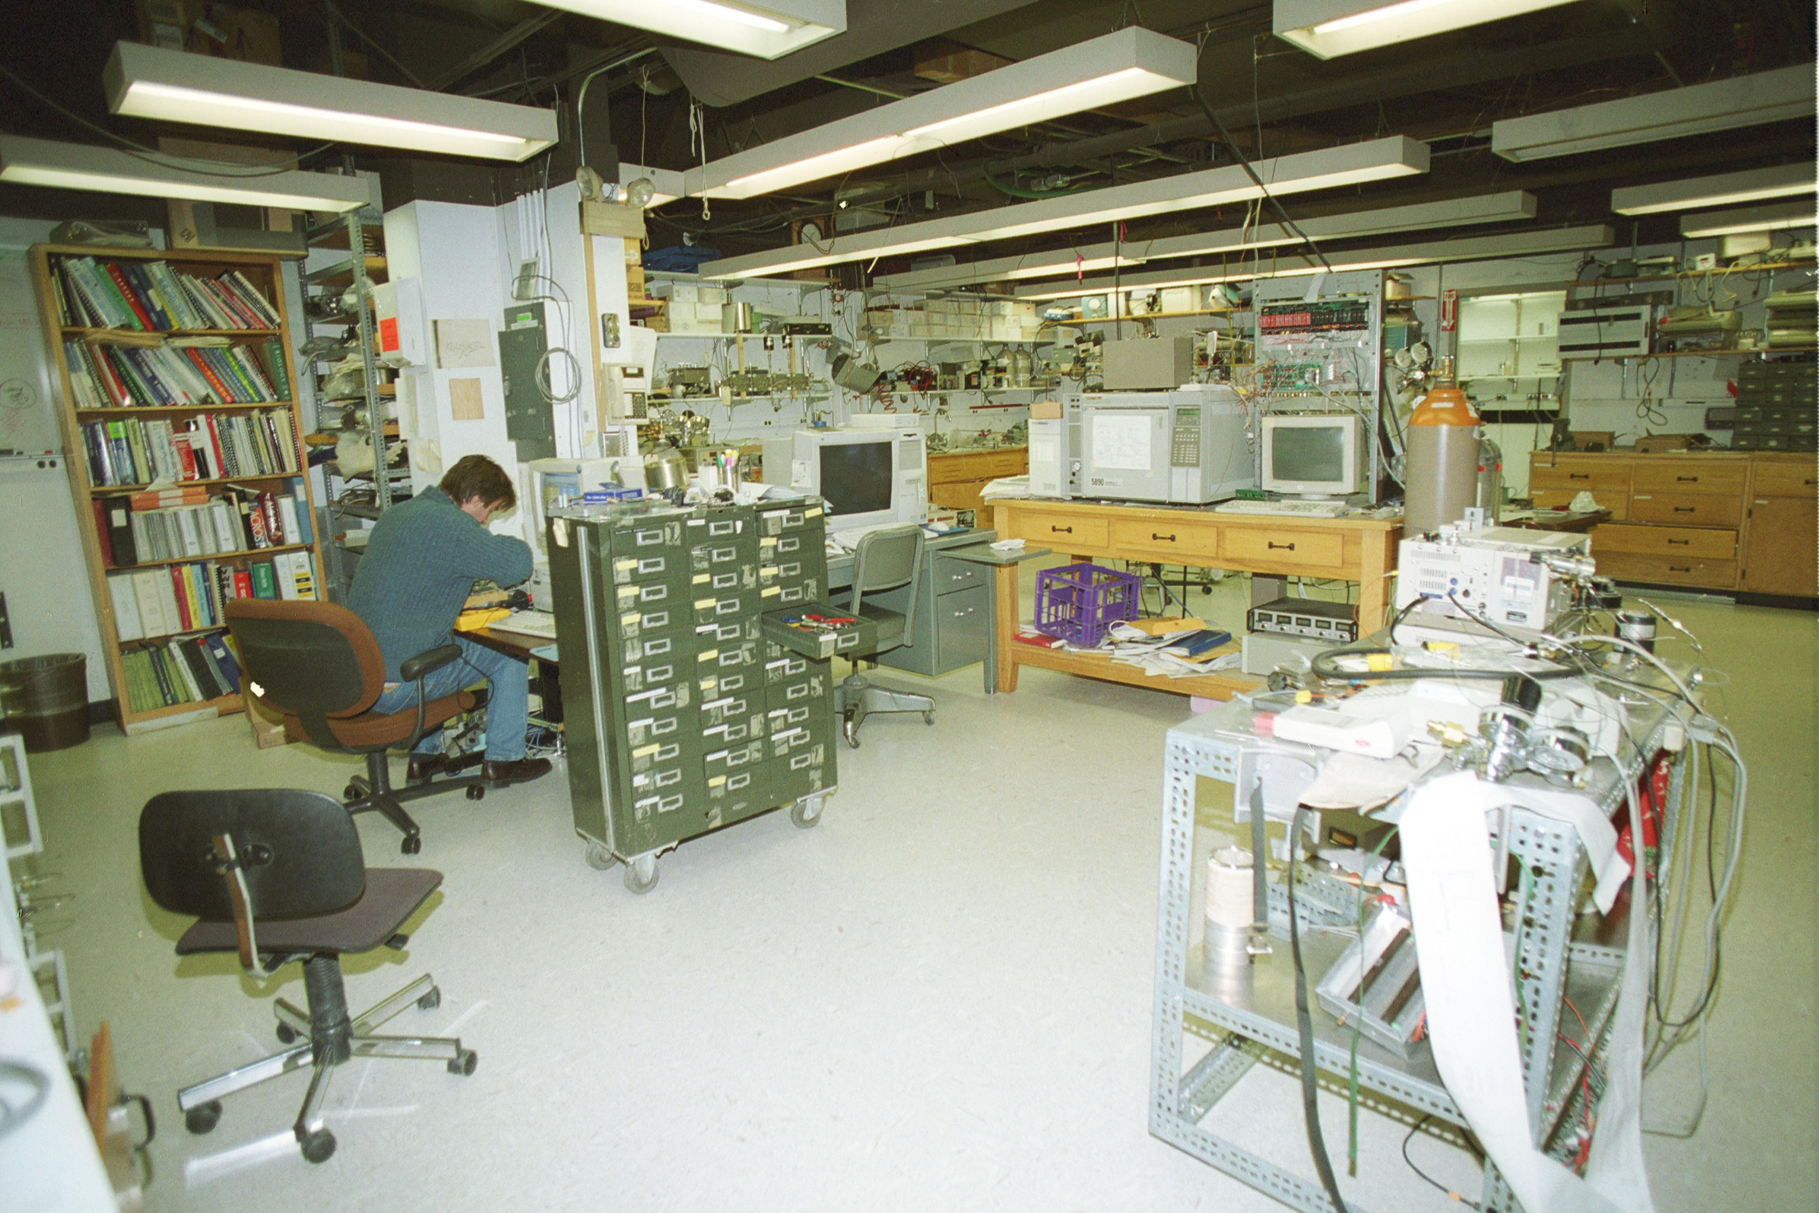
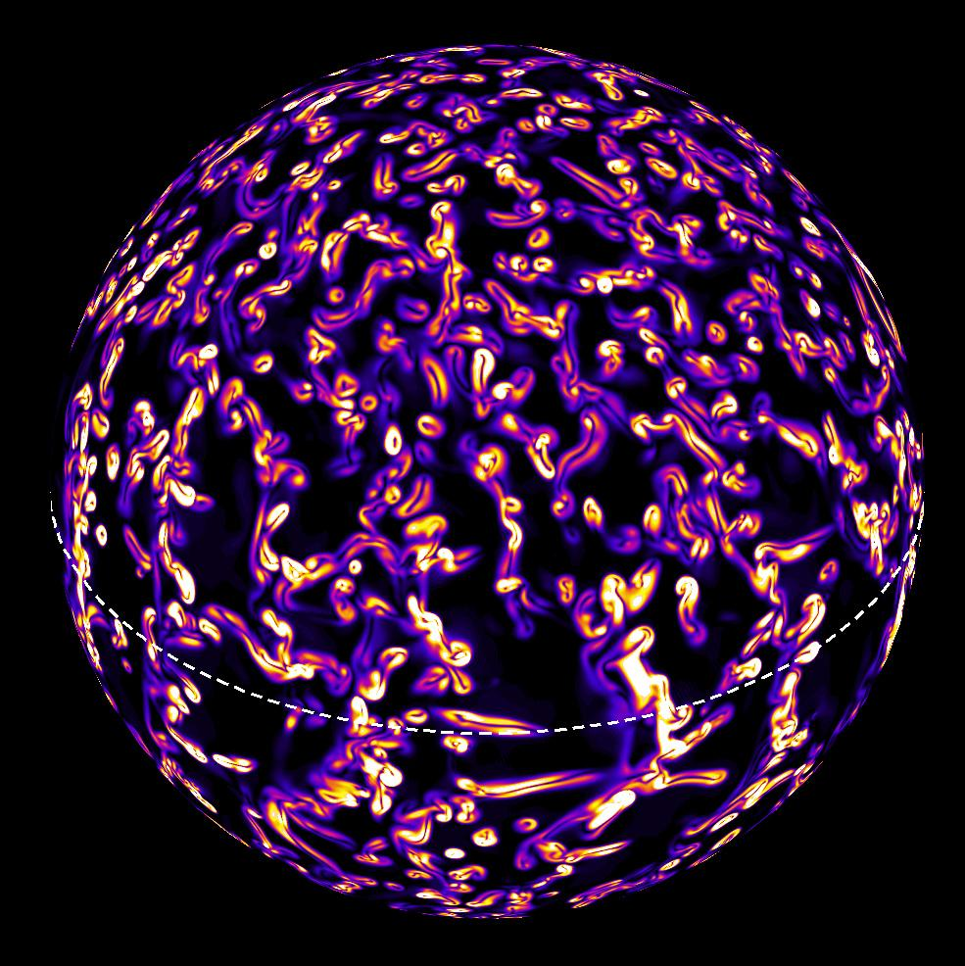
Kinds of Data
Different kinds of data document environmental change in different ways.
Laboratory Experiments
Computational Models
Observations
Images: Copyright University Corporation for Atmospheric Research

Slide 4
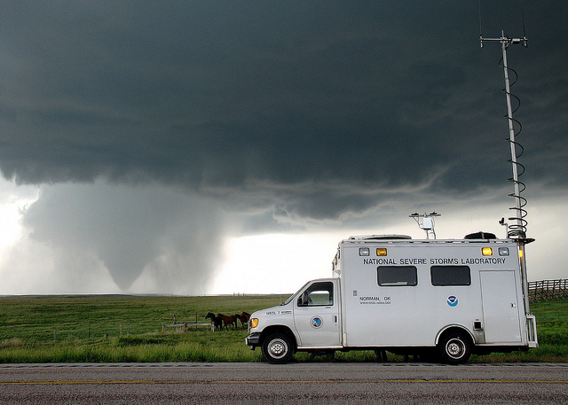
Observational Data
Observational data are historical records that were collected at a unique place and time, which renders them:
  Irreplaceable
  Very critical to archive
Documenting data collection methods and equipment is critical to enable:
  Understanding
  Evaluation
  Transparency
  Reproducibility
  Trust
  Secondary use
Image: http://www.flickr.com/photos/60379061@N03/5509284578/

Slide 5
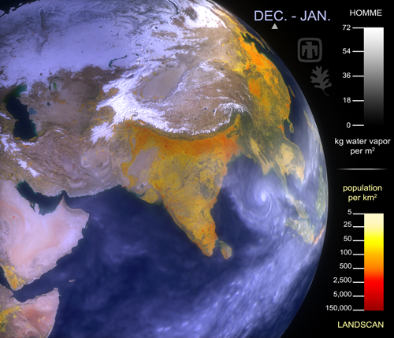
Computational Models and Simulations
Computational models and simulations produce calculations and predictions of phenomena based on physical theory, algorithms, and observations.
  We may not need to archive model outputs, but…
  Archiving the model itself and a robust representation of its metadata (description of the hardware, software, and input data) is essential.
Ex. The Metafor project was created to develop a standard way to describe climate models and the data they produce.
  Metafor worked with climate scientists to create a conceptual information model for climate data
  Tested, developed, and deployed the model for the CMIP5 project
  Metafor: http://metaforclimate.eu/trac
  CMIP5: http://cmip-pcmdi.llnl.gov/cmip5/
Image: http://www.flickr.com/photos/oakridgelab/4101037894/

Slide 6
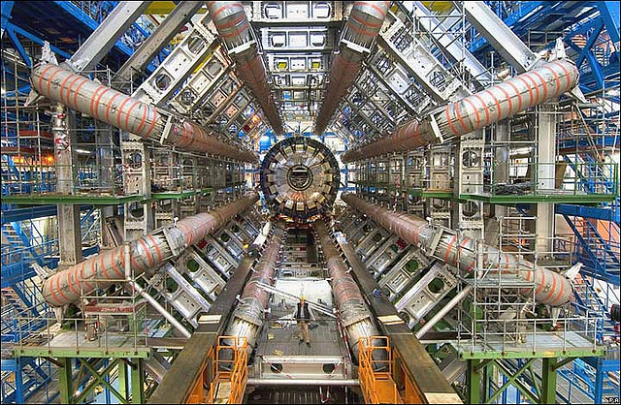
Laboratory Experimental Data
Experimental data test specific hypotheses in a controlled setting.
  In principle, we can accurately reproduce experiments without the need to store data indefinitely.
  However, reproducibility may pose challenges, even with highly controlled lab settings.
    Can we precisely reproduce all the experimental conditions?
    Nobody has been able to reliably reproduce cold fusion
    Who will reproduce the CERN Large Hadron Collider experiments?
Digital “workflow” systems are available for some types of lab work
  Precise step-by-step description of a scientific procedure
  Acts as a script to coordinate research tasks
  Can enable automated metadata collection and provenance tracking
Image: http://www.flickr.com/photos/11304375@N07/2046228644/

Slide 7
Conclusion
Data preservation has many potential benefits:
  Enable longitudinal and synthesis studies
  Leverage investments in data collection
Additional considerations
  Preservation of data in multiple forms - i.e. raw, processed, derived, etc - may be warranted in many circumstances.
    Which version(s) to keep?
    How to make relationships among versions clear?
  Considerations of cost and reproducibility are key in considering policies for preservation of experimental data.
    How to assess the long-term value of data?
    What documentation is necessary to enable data replication?

Slide 8
References
Edwards, P.N. 2010. A vast machine: computer models, climate data, and the politics of global warming. Cambridge, MA: MIT Press.
Goble, C. and De Roure, D. 2009. The impact of workflow tools on data-intensive research. In T. Hey, S. Tansley, & K. Tolle (Eds.), The Fourth Paradigm: Data-Intensive Scientific Discovery (pp. 137-146). Redmond, WA: Microsoft. http://research.microsoft.com/enus/collaboration/fourthparadigm/4th_paradigm_book_part3_goble_deroure.pdf
Long-Lived Digital Data Collections: Enabling Research and Education in the 21st Century. 2005. Washington, D.C.: National Science Foundation, National Science Board. http://www.nsf.gov/pubs/2005/nsb0540/
Michener, W.K., et al. 2009. “Biological Field Stations: Research Legacies and Sites for Serendipity.” BioScience 59 (4): 300–310. http://dx.doi.org/10.1525/bio.2009.59.4.8
Overpeck, J.T., G.A. Meehl, S. Bony, and D.R. Easterling. 2011. “Climate Data Challenges in the 21st Century.” Science 331 (6018): 700–702. http://dx.doi.org/10.1126/science.1197869
Environmental History Resources. 2012. Reconstructing past climate. http://www.eh-resources.org/climate2.html

Slide 9
Other Relevant Modules
The Case for Data Stewardship: Return on Investment
Data Management Plans: Elements of a data management plan
Local Data Management: Introduction to Metadata and Metadata Standards
Preservation Strategies: Options for archiving your data

