Slide 1
Future air quality modeling for sustainable development
R N Singh
INSA Senior Scientist
CSIR-National Geophysical Research Institute, Hyderabad 500007
rnsingh@ngri.res.in

Slide 2
Talk outline
Introduction
Sustainable development: what to optimize?
Reality of Air pollution: System equation?
PDE constrained optimization: heart of mathematical modeling
How much progress? Few cases
Where are we in India?
Concluding remarks

Slide 3
Sustainability
Needs – Brundtland Report
Standard of living – Nobel Laureate Solow
Freedom- Nobel Laureate Sen
Economic- ecological modeling: Neoliberal, mechanics, ordinary differential equation(ODE), constraints
So mathematically optimization of ODE with constraints
Let me show a flavor of it

Slide 4
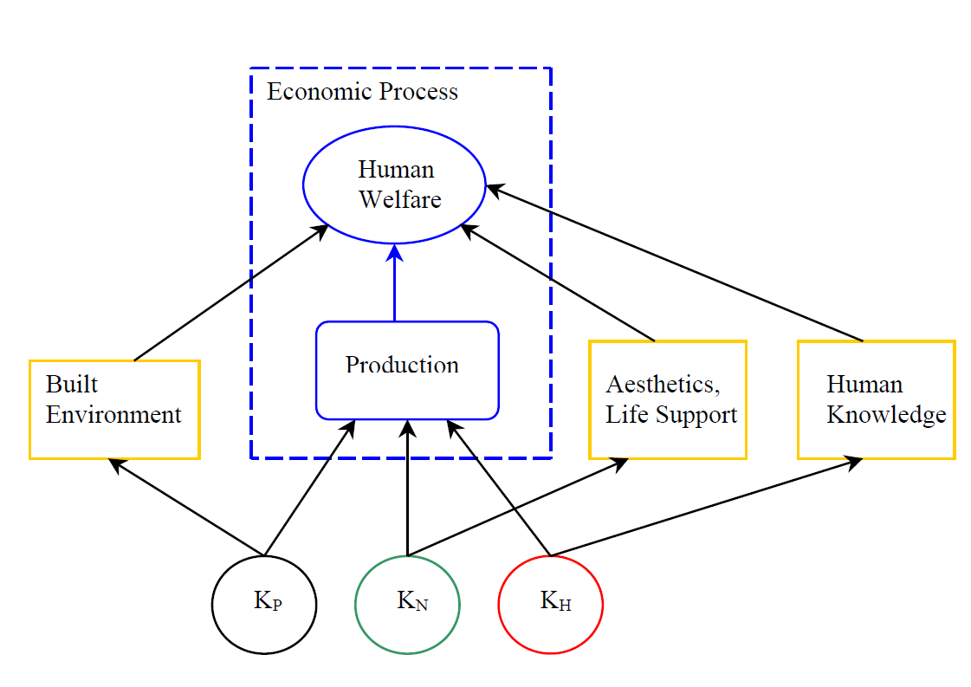
Traditional view: P and H
Now N too
http://www.uwyo.edu/barbier/presentations/fisher%20lecture1.pdf

Slide 5
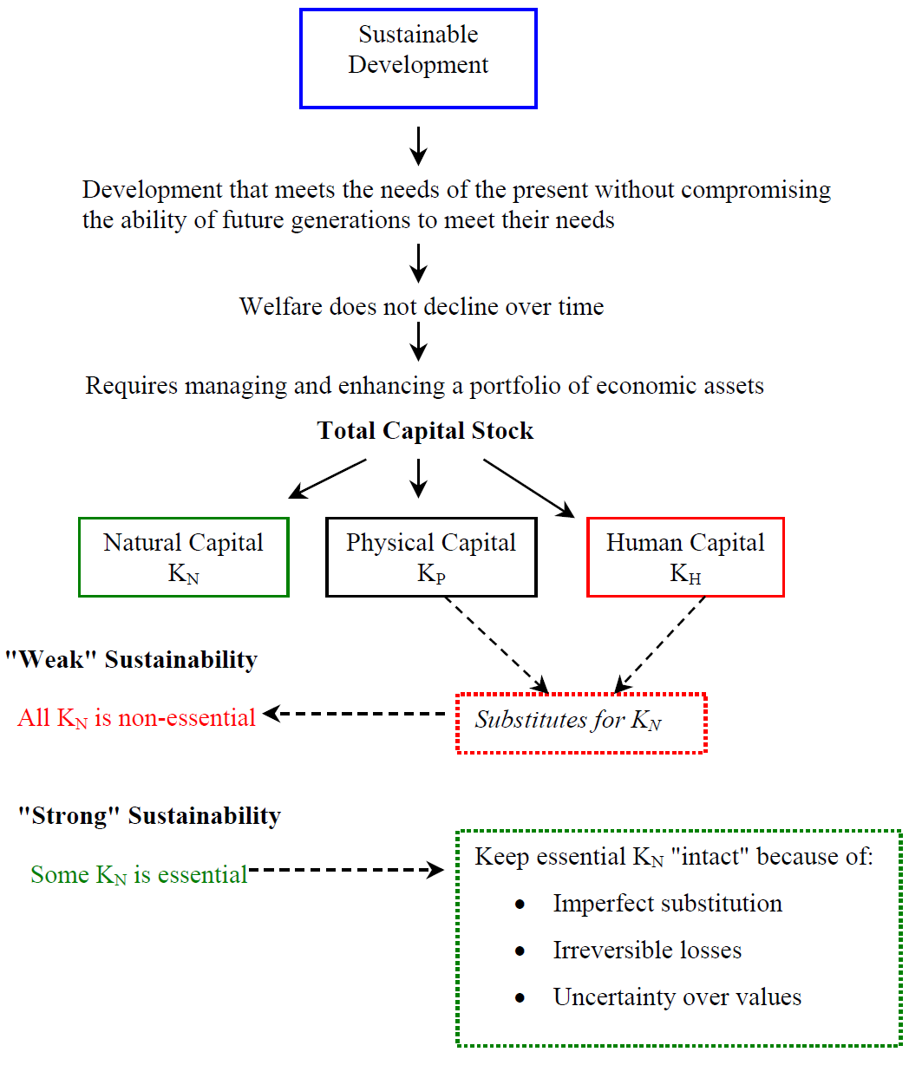
http://www.uwyo.edu/barbier/presentations/fisher%20lecture1.pdf

Slide 6

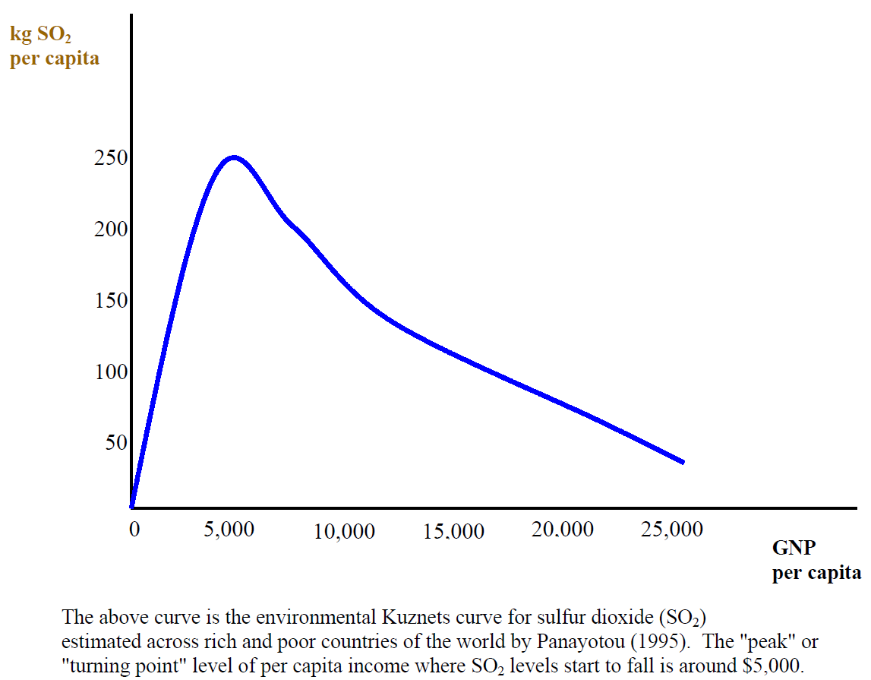
http://www.uwyo.edu/barbier/presentations/fisher%20lecture1.pdf

Slide 8
Solow and beyond
Solow: Technology was exogenous
Now: Technology is endogenous
Natural capital as essential element
Physical constraint in economic analysis like entropy and first law of thermodynamics
Role of innovations in technology: new combination of known

Slide 9
Air quality-Reality
Multiscale – local to planetary scales
Physical aspects : distributed models
Chemical aspects: systems of ODE
Biological aspects: system of ode
How do solve? Reduce to algebraic equations
Complexity, nonlinearity, uncertainty
Indicators

Slide 10
Errors
All instrumental observations have errors due to noises
Observations are insufficient for a given space-time pattern in environmental phenomena
Thus all models of environmental systems which fit the data, have model errors
Since we need to compute, so there are computational errors,
Further, we all are humans, so human errors too occur

Slide 11
PDE constrained optimization
Infinite dimension, large, complex
Forward problem: A(u)y = q
Adjoint problem
Optimize-Discretize (OD)
Discretize-Optimize (DO):

Slide 12
Objective functions
Quadratic criteria
Mathematical programming

Slide 13
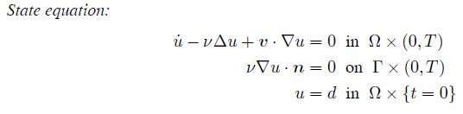
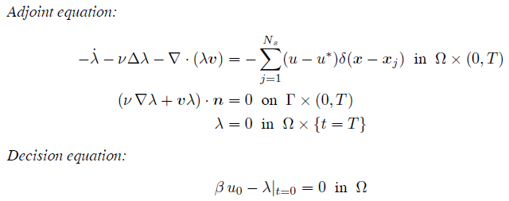
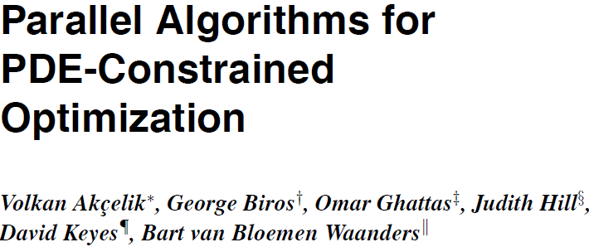
Partial differential equation for air quality

Slide 14
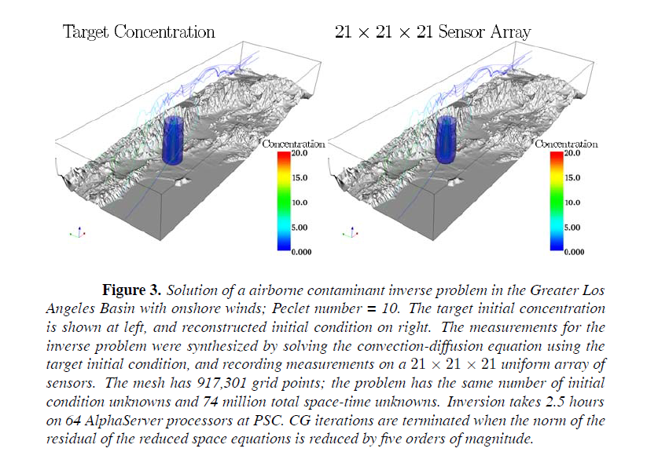

Slide 15
International status
Integrating all sciences by equations (mathematical structures) fitting available observations
Experimenting with equations as it is cheaper and good enough for problems at hand

Slide 16
ICSU – International Council for Science
ISSC – International Social Science Council
2010
Earth System Science for Global Sustainability:
The Grand Challenges

Slide 17
Change needed now:
Research dominated by the natural sciences to research involving the full range of sciences and humanities.
Research dominated by disciplinary studies to a more balanced mix of disciplinary research and research that draws disciplinary expertise into an integrated approach that facilitates inter- and transdisciplinarity.

Slide 18
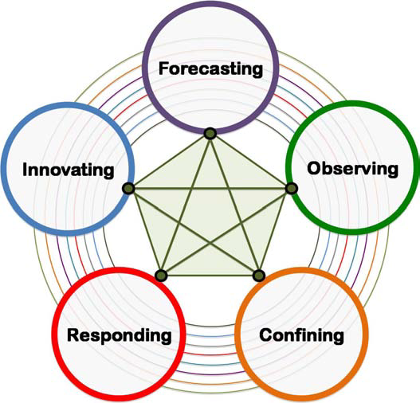
Grand Challenges in Earth System Science for Global Sustainability.
The concentric circles represent the disciplinary research needed in the social, natural, health and engineering sciences and the humanities that must be carried out alongside interdisciplinary and transdisciplinary research in order to address the challenges. The lines linking the grand challenges show that progress in addressing any challenge will require progress in addressing each of the others.

Slide 19
Forecasting:
Improve the usefulness of forecasts of future environmental conditions and their consequences for people.
Observing:
Develop, enhance and integrate the observation systems needed to manage global and regional environmental change.
Responding:
Determine how to anticipate, recognize, avoid and manage disruptive global environmental change.
Confining:
Determine what institutional, economic and behavioural changes can enable effective steps toward global sustainability.
Innovating:
Encourage innovation (coupled with sound mechanisms for evaluation) in developing technological, policy, and social responses to achieve global sustainability

Slide 20
Forecasting first before observing!
Use all available knowledge to get model of the processes. Use this to make forecast
There are various kind of modelers and models

Slide 21
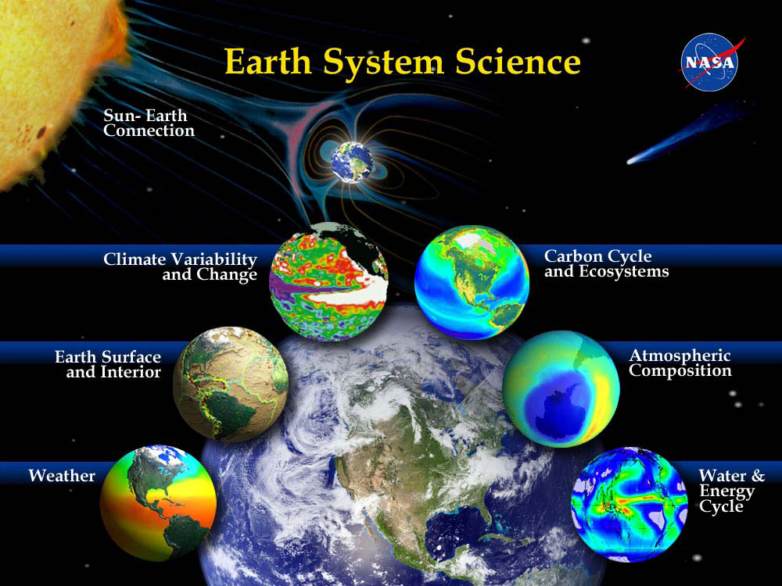

Slide 22
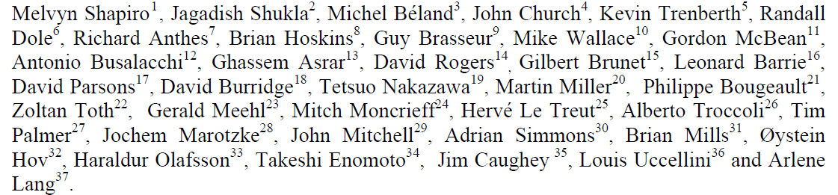
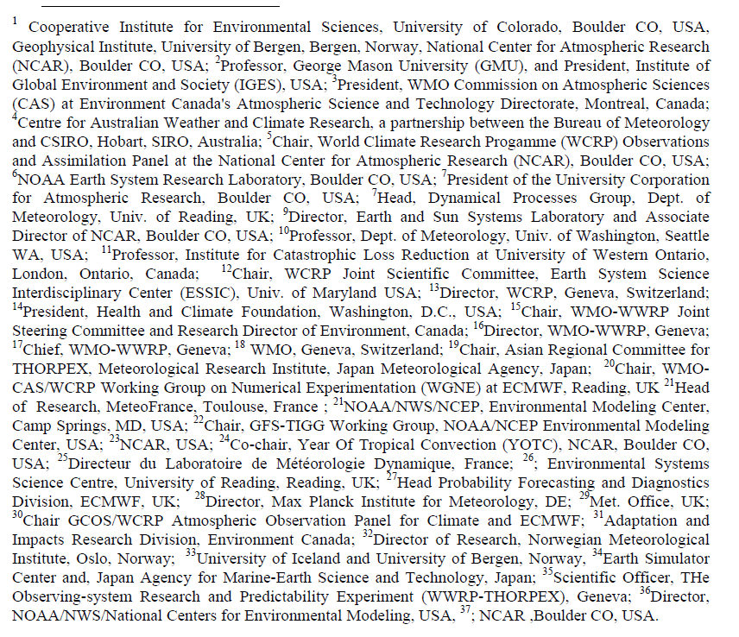

Slide 23
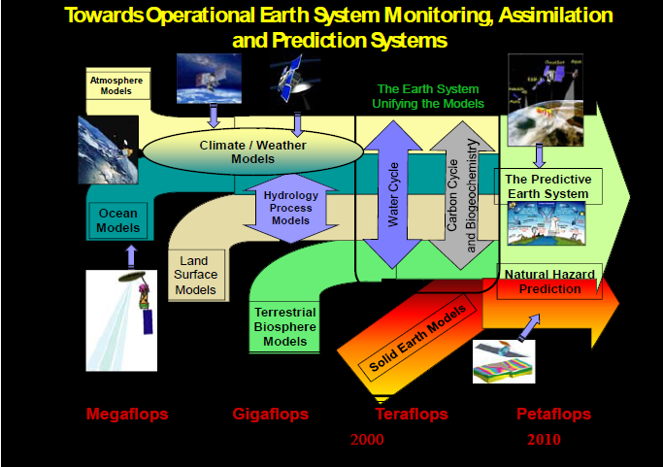

Slide 24
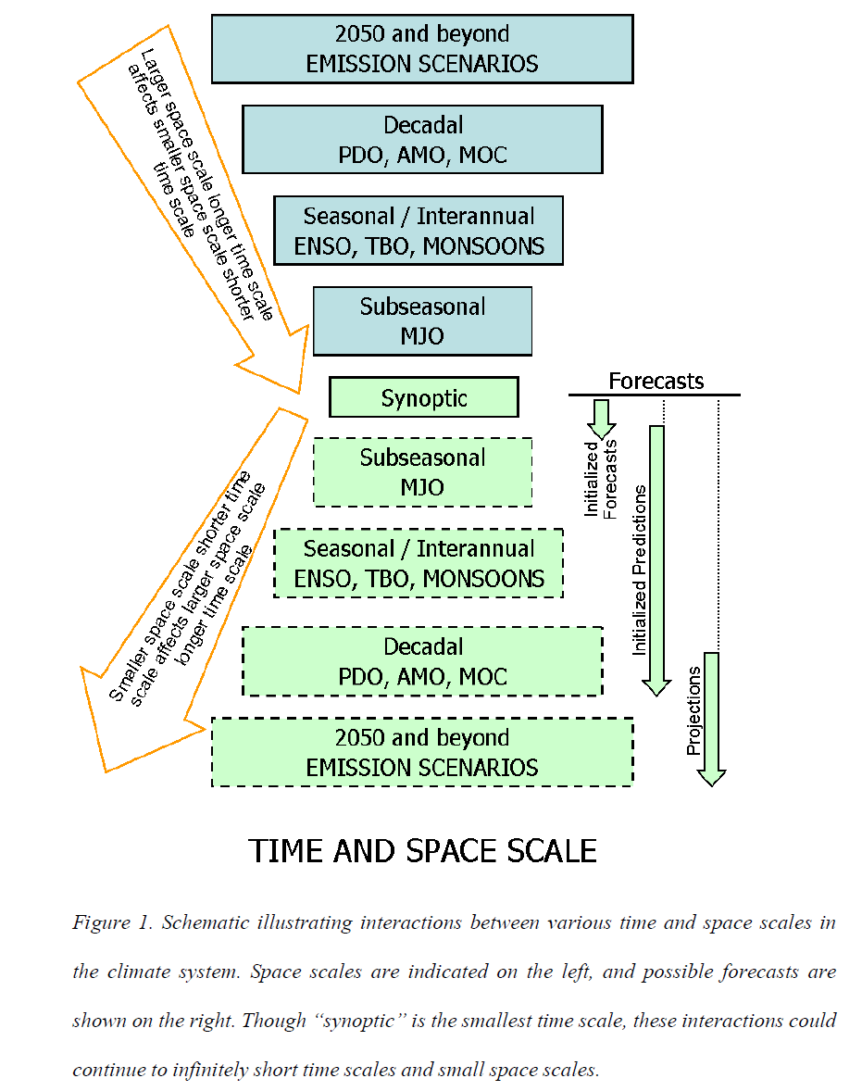

Slide 25
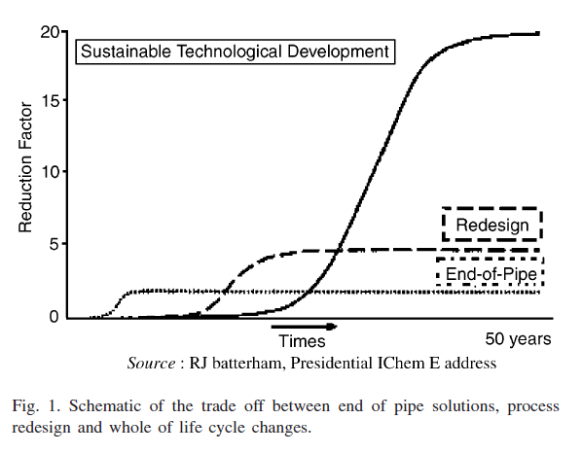
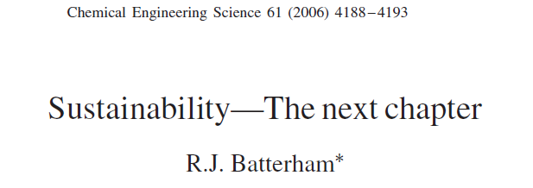

Slide 26
"The high technology celebrated today is essentially a mathematical technology."
(E.E. Davis, president of Exxon R&D)

Slide 27
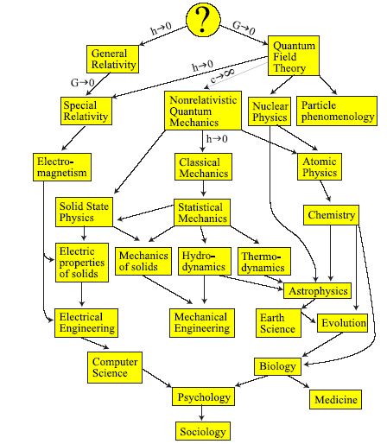
Multi-science
Theories can be crudely organized into a family tree
where each might, at least in principle, be derivable from more fundamental ones above it. For example, classical mechanics can be obtained from special relativity in the approximation that the speed of light c is infinite, and hydrodynamics with
its concepts such as density and pressure can be derived from
statistical mechanics. However, these cases where the arrows
are well understood form a minority. Deriving biology from
chemistry or psychology from biology appears unfeasible in
practice. Only limited and approximate aspects of such subjects are mathematical, and it is likely that all mathematical
models found in physics so far are similarly approximations
of limited aspects of reality.
Tegmark, 2007

Slide 28
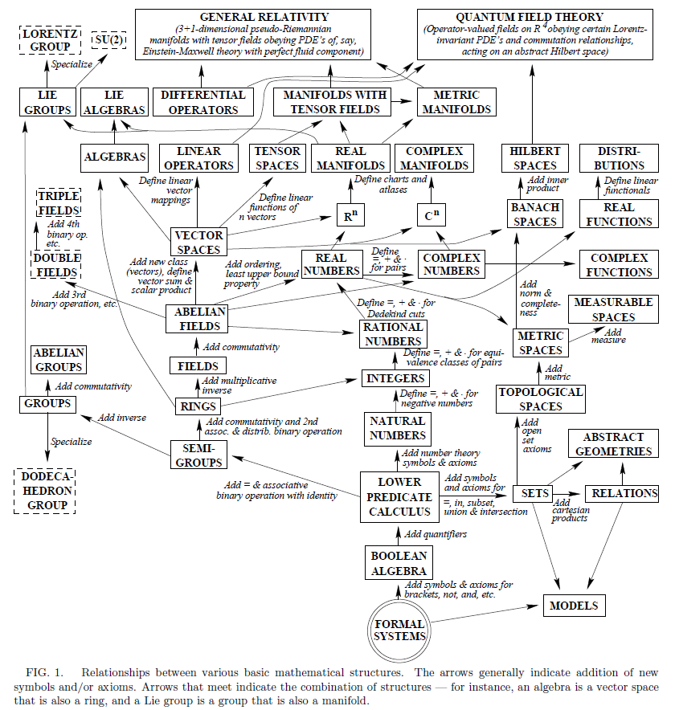

Slide 29
Where are we?
Adoption of technology developed elsewhere
Development here
Both require support
No policy support
Does globalization help?

Slide 30
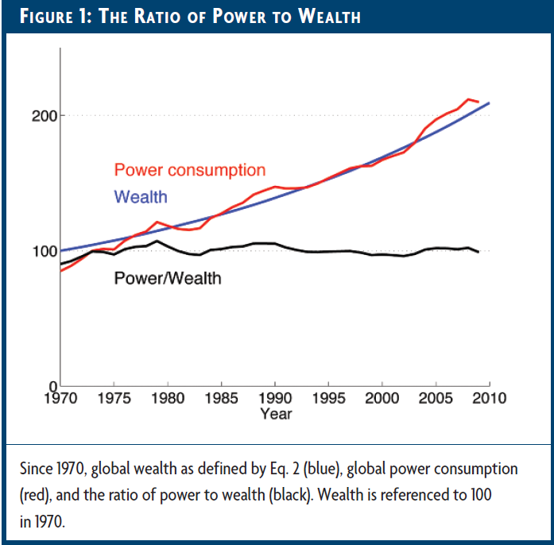
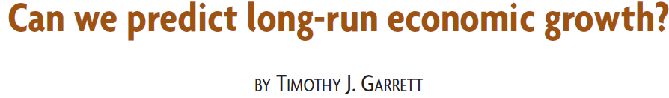

Slide 31
Two views: Bird or frog
Bird: Looking at landscape from above
Frog: Viewing as living in landscape
“Birds fly high in the air and survey broad vistas of mathematics out to the far horizon. They delight in concepts that unify our thinking and bring together diverse problems from different parts of the landscape. Frogs live in the mud below and see only the flowers that grow nearby. They delight in the details of particular objects, and they solve problems one at a time" (Freeman Dyson, 2009)
Frog’s and bird’s intuition: High-level synthesis (Bird's view) as well as empirical problem solving (Frog's view)
“ Calculate and shut up”

Slide 32
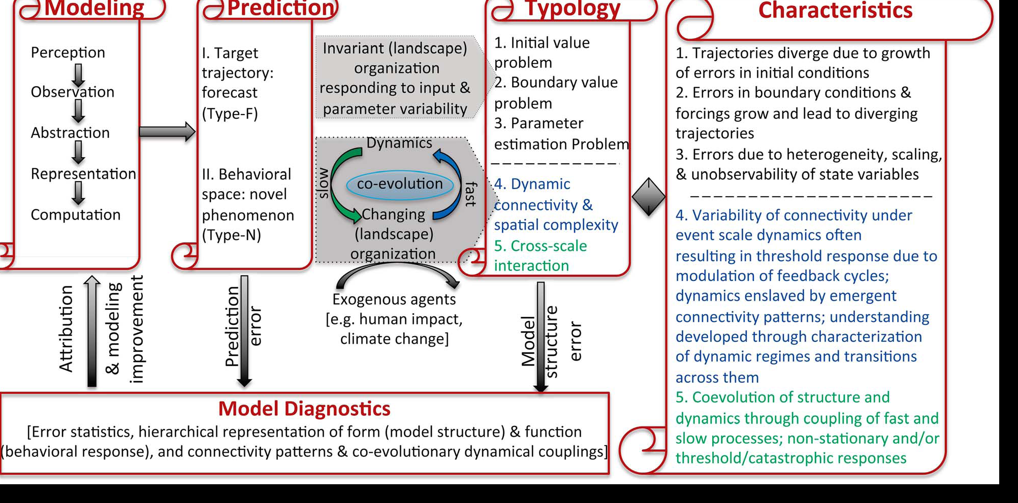
Prediction in water environment
Kumar, Water Res Res 2011

Slide 33
Concluding remarks
Future would be interdisciplinary, coupled, nonlinear, uncertain
Future lies in mastering ODE( economic growth) /PDE( air pollution field) / algebraic( chemical reactions) constrained optimization, numerical way for nonlinear stochastic models
Data driven modeling should be perused – massive data now available
Air pollution community need to interact computational scientists and economists for sustainable developmental issues.

Slide 34
Many thanks for your kind attention

