Slide 1


Slide 2

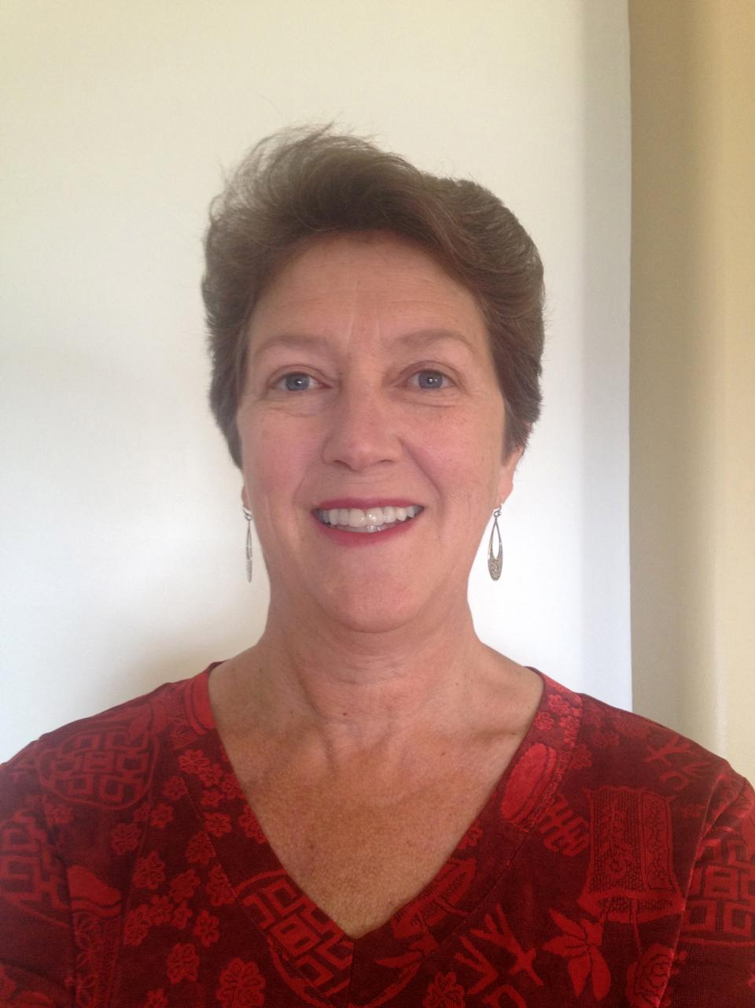
U.S. Climate Resilience Toolkit Climate Explorer
https://toolkit.climate.gov
Out 2 Lunch: 10-minute Webinar
March 8, 2017
LuAnn Dahlman
Science Writer and Editor
Contractor to NOAA Climate Program Office
luann.dahlman@noaa.gov

