Slide 1








Global Change Information System
(GCIS)
Curt Tilmes
ctilmes@usgcrp.gov
www.globalchange.gov

Slide 2
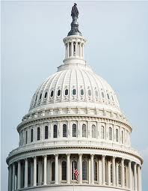
The Global Change Research Act and USGCRP
USGCRP was mandated by Congress in the Global Change Research Act (GCRA) of 1990 (P.L. 101 – 606)
  “To provide for development and coordination of a comprehensive and integrated United States Research Program which will assist the Nation and the world to understand, assess, predict, and respond to human-induced and natural processes of global change.”

Slide 3
USGCRP and Global Change Science
The Program:
USGCRP Agencies and Departments:
Coordinates Federal research to better understand and prepare the nation for global change
Prioritizes and supports cutting edge scientific work in global change
Assesses the state of scientific knowledge and the Nation’s readiness to respond to global change
Communicates research findings to inform, educate, and engage the global community
 | Department of Agriculture
 | Department of Commerce
 | Department of Defense
 | Department of Energy
 | Department of Health and Human Services
 | Department of the Interior
 | Department of State
 | Department of Transportation
 | Environmental Protection Agency
 | National Aeronautics and Space Administration
 | National Science Foundation
 | Smithsonian Institution
 | United States Agency for International Development

Slide 4
The USGCRP Vision and Mission
Vision - “A nation, globally engaged and guided by science, meeting the challenges of climate and global change.”
Mission - “To build a
knowledge base that informs
human responses to climate
and global change through
coordinated and integrated
federal programs of research,
education, communication,
and decision support.”

Slide 5

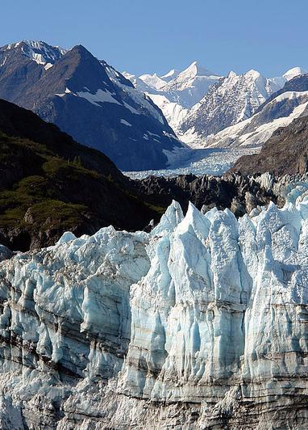
Global Change Research Act (1990), Section 106
…not less frequently than every 4 years, the Council… shall prepare… an assessment which–
integrates, evaluates, and interprets the findings of the Program and discusses the scientific uncertainties associated with such findings;
analyzes the effects of global change on the natural environment, agriculture, energy production and use, land and water resources, transportation, human health and welfare, human social systems, and biological diversity; and
analyzes current trends in global change, both human- induced and natural, and projects major trends for the subsequent 25 to 100 years.

Slide 6
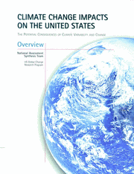

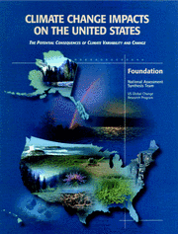
Previous National Climate Assessments
Global Climate Change Impacts in the United States (2009)
Climate Change Impacts on the United States (2000)
Target date for next NCA: 2013

Slide 7
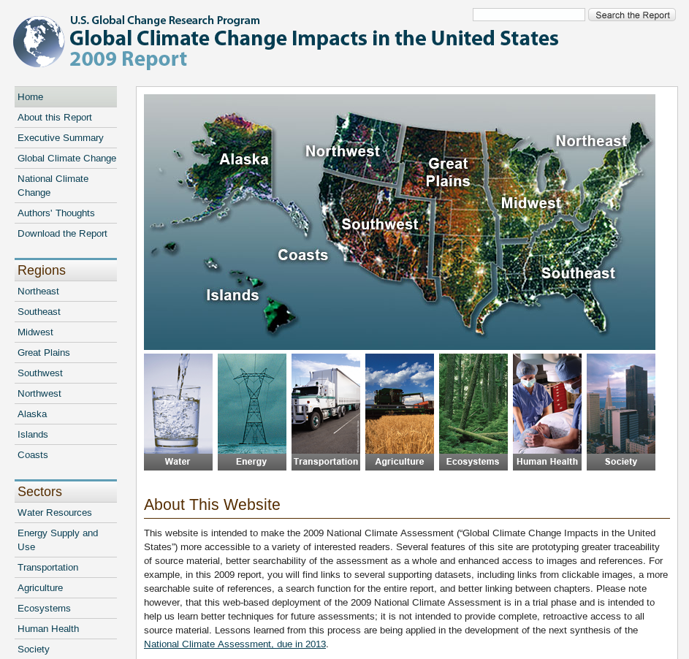
NCA 2009
http://nca2009.globalchange.gov

Slide 8

The “New” National Climate Assessment
Goal
Enhance the ability of the United States to anticipate, mitigate, and adapt to changes in the global environment.
Vision
Advance an inclusive, broad-based, and sustained process for assessing and communicating scientific knowledge of the impacts, risks, and vulnerabilities associated with a changing global climate in support of decision-making across the United States.

Slide 9
The NCA Process
2013
2017
2011
2012
2014
Regional and sectoral assessments and stakeholder engagement
Initiate “topical” and assessment
process reports that will be
completed at a defined date post 2013.
Full draft of report available for public and expert review.
Full assessment reports
Sectors
Regions
Cross-cutting topics
9

Slide 10
What is New About the
2013 National Climate Assessment (NCA)
Sustainable process with multiple products over time
New topics, cross-sectoral studies
Consistent national matrix of indicators
Central coordination, multiple partners
Regional and sectoral networks building assessment capacity
Recognizes international context
Engagement and communications focus
Web-based data and tools for decision support
Process workshops to establish methodologies

Slide 11
Information Quality Act
NCA is classified as ‘A Highly Influential Scientific Assessment’ (HISA) - must meet the highest level of quality in the Information Quality Act (NOAA IQA)
  is a scientific assessment that: (i) has a potential impact of more than $500 million in any one year on either the public or private sector (the economic test); or (ii) is novel, controversial, or precedent-setting, or of significant interagency interest (the narrative test).

Slide 12
Information Sources
Clear that not all useful material for the NCA will be found in the academic literature
  “unconventional” information, - from public health departments, states and tribes, NGO’s, data collected but not yet reviewed

Slide 13
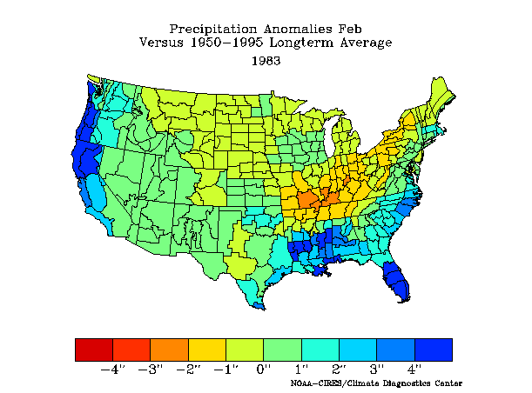
Different types of information:
Original data (such as satellite and in-situ observations)
Synthesized data (such as model data, indicators, GIS application)
Interpreted products
(such as assessments)

Slide 14
NCA Drivers
  Increasing calls for transparency
    Process and product
        Ability to search comments, provenance of and access to datasets
  Increasing range of users
    Increasing need/opportunity for flexibility: applications/ nested scales /different ways ‘into’ the assessment and its data
  Increasing range of source material
      Model data, observational data (physical, societal, economic), historical data, sectoral and regional assessments, scales/resolution
  Increasing need for clear communication and context
  Increasing value of standardization/consistency (e.g. metadata, regional intercomparison)
  Increasing opportunity for (scientific) collaboration

Slide 15
NCA Web Goals
NCA will not host basic data, but will provide central access and consistent, interpretable metadata
  Metadata will adhere to common standards
  Documented uncertainty
  Indicators
Quality and provenance of data will be clear and peer reviewed
Interoperable data system – open interface into data
Narrative assessment and graphics will link to source data and information
Value of Information – how to prioritize different data sets/sources

Slide 16
NCA Web Goals
NCA will not host basic data, but will provide central access and consistent, interpretable metadata
  Metadata will adhere to common standards
  Documented uncertainty
  Indicators
Quality and provenance of data will be clear and peer reviewed
Interoperable data system – open interface into data
Narrative assessment and graphics will link to source data and information
Value of Information – how to prioritize different data sets/sources
  Web Deployment is a game changer!

Slide 17
National Climate Assessment
Development and Advisory Committee
60 member federal advisory committee, including 45 non-federal members and 16 federal ex-officio representatives
Wide variety of expertise and perspectives
Providing advice on both the 2013 Report AND on the ongoing process
62 Convening Lead Authors and 180 Lead Authors have been named for 30 chapters, 240 contributing authors

Slide 18
NCA 2013
Technical Input Process
  Over 250 submissions from over 120 individuals or teams and an additional 200+ collected by NCADAC working groups.
Working on communication and presentation
  content and traceability to inputs and sources

Slide 19
NCAnet: Partners in Assessment
A network of organizations that extend the NCA process and products beyond the federal government
Building long-term capacity to conduct and use assessments
Cultivating partnerships with organizations that will participate in the sustained assessment process
http://ncanet.usgcrp.gov
List of partners: 50+ organizations have already signed up
List of partners’ NCA-related activities
Monthly information sessions for potential members
Monthly conversations among existing partners
Notes:
One of the innovations that we are most excited about is the NCA net…

Slide 20
NCA to GCIS
NCA has a well-defined, limited scope we can focus on in the short term. We have concrete goals and dedicated staff to accomplish them.
The broader GCIS vision will require more agency involvement to integrate global change information from across the program.

Slide 21
Global Change Information System
(GCIS)
A web based source of authoritative, accessible, usable, and timely information about climate and global change for use by scientists, decision makers, and the public.

Slide 22
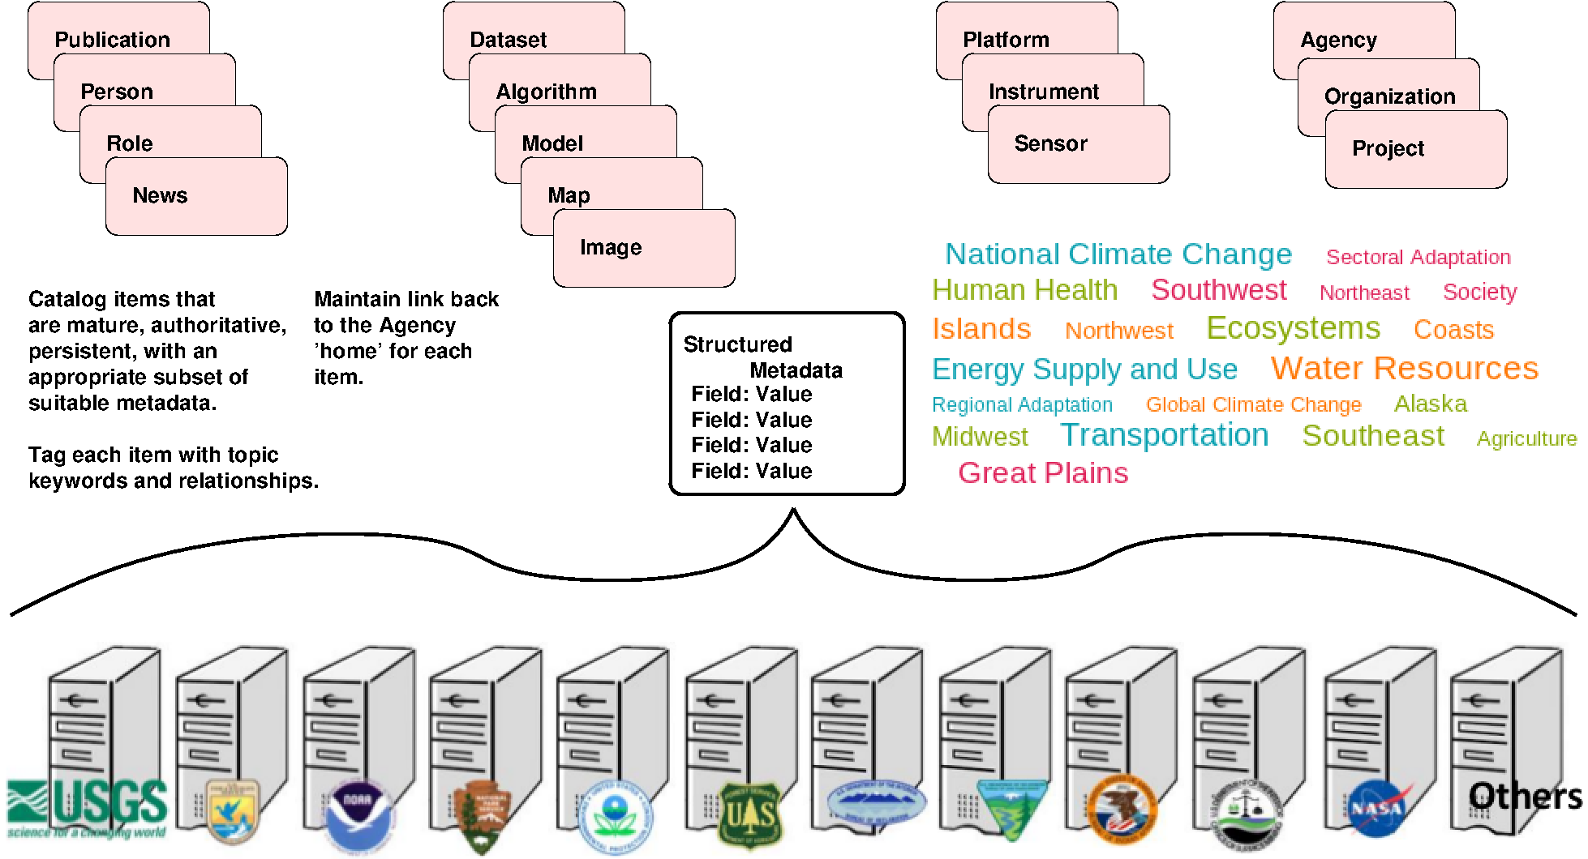
GCIS

Slide 23
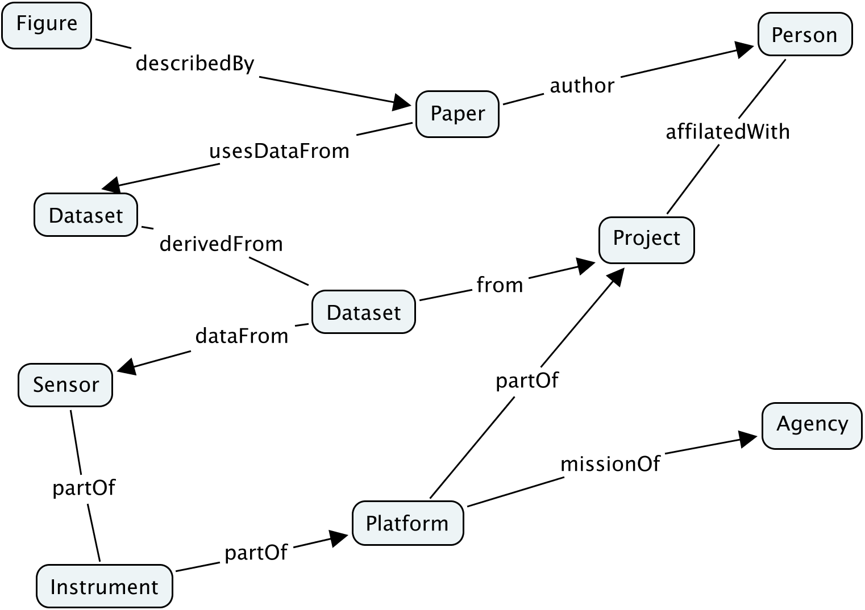
GCIS
Create an entity from the structured metadata about each thing – tag with related concepts.
Identify it with a persistent, controlled identifier.
Present with a human readable web page and a machine interface.
Represent all relationships between items.

Slide 24
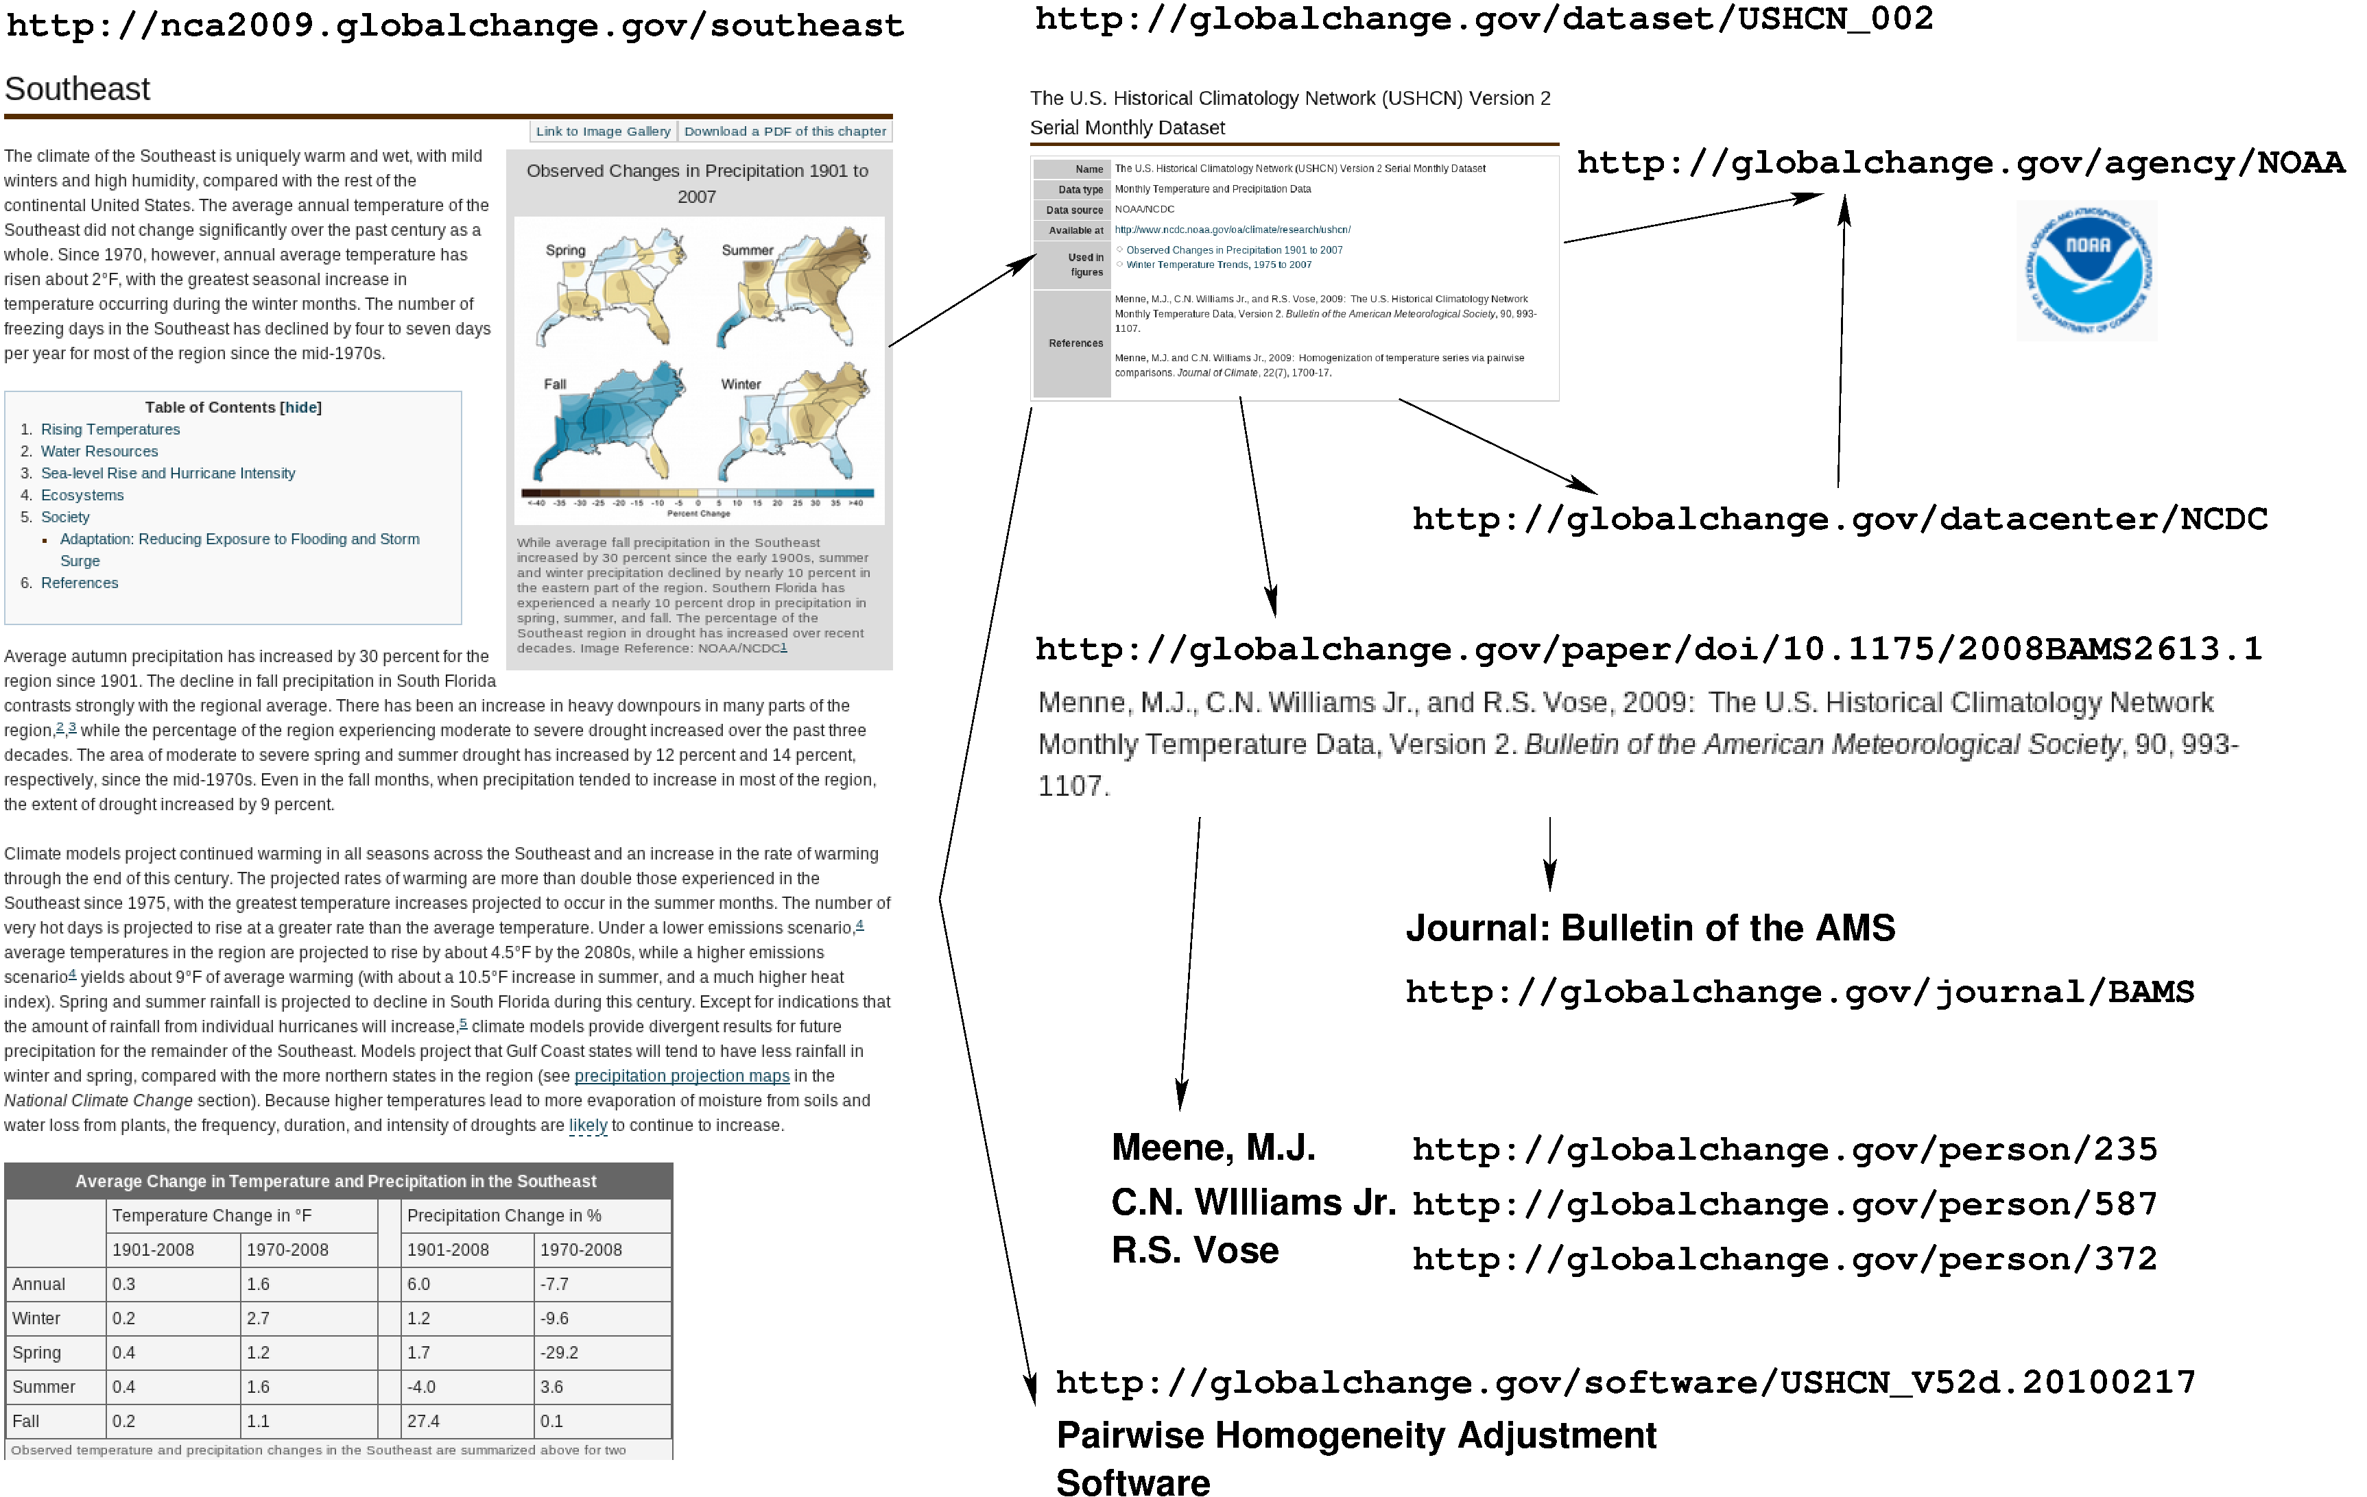
NCA links to GCIS entities

Slide 25



Interagency Information Integration
GCIS can use relationships between all relevant information about global change across the agencies:
  From observations to datasets to research papers to models to analyses to organizations to people to synthesized reports to human impacts...
  Determine agency interdependencies -- An EPA analysis uses a NOAA model dependent on observations from a NASA satellite.
  Can present unique interagency metrics "How many papers referenced datasets from a specific satellite?"
  Direct users back to agency data centers for more detailed information and the actual content and data.

Slide 26
GCIS Data Mining
Structured information with relationships allows integrated data mining, searching, metrics.
  What projects provided data used to produce figures that were referenced in the 2013 NCA section about coastal sea level rise impacts?
  Which data centers hold data referenced by papers related to forests in the midwest?
  Which agencies have people working on projects related to societal impacts of extreme weather events?
  Show me the latest papers about health impacts of air quality in California. Which datasets were used in the analysis of air quality in California?

Slide 27
GCIS Benefits
NCA Web Portal
  NCA content available online
  Searchable, linkable
  Complete provenance traceability
  Links back to agency information sources
  Construct, prototype and test the initial framework
  Use constrained scope and dedicated staff to accomplish a lot in a short time
  Ensure the system design is extensible and able to grow to meet long term GCIS needs
GCIS
  A single web site can lead back to agency global change information across the program
  A friendly, accessible entry into global change information for non-scientists
  Global, persistent, reusable identifiers for each item
  Integrated data catalog provides interagency metrics, data mining, searching, etc.
  Interagency relationships allow discovery of interdependencies and increase collaboration opportunities
  Agency information mapped into a common, consistent model with a standard vocabulary
  Concept tagging and linking improves search results for agency products

Slide 28
GCIS Needs
An information model that can adequately describe the organization/relationships we are trying to represent.
Obtaining and maintaining the content from the agencies, including the metadata for each ‘thing’ and the relationships between the ‘things’.

Slide 29
Multiple Development Paths
Initial deployment of GCIS will support the NCA:
  Engage experts to facilitate initial information model development, focus on content and provenance of the NCA and its technical inputs - mid-2012
  Support review of entire content of the NCA, with online comment capturing system - Dec. 1, 2012
  Links back to all the relevant technical inputs providing traceability to the information sources by NCA 2013 release.
Engage existing agency data centers
  Map and harmonize existing information into a common integrated model
  Harvest large sources of data where they are now – develop process to maintain over time.
Limited crowd sourcing to ‘fill in the gaps’
  Develop process to enable a large community of trusted parties to add/edit information directly in GCIS through a vetted process.
  Capture and present “provenance of provenance” for accountability.

Slide 30
So what can ESIP do?
The GCIS overlaps many areas across the Federation:
  Data Stewardship: Identifiers, Citations, Provenance and Context, Preservation Ontology
  Semantic Web: Vocabularies/Ontologies, Linking entities and relationships, Brokering data/services/tools,
  Information Quality, Geospatial
  Drupal, Visualization
  Societal Benefit Areas, Decisions, Energy/Climate, etc.
  And More!

Slide 31



Questions and Comments
For more information, visit http://www.globalchange.gov

