Slide 1
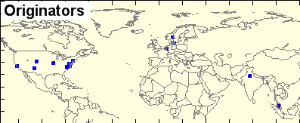
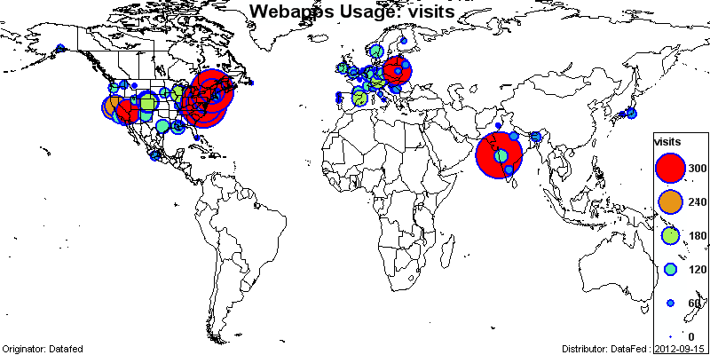
The GEO Air Quality Data Network
AQ Community Catalog
Data Providers
Data Users
Rudolf Husar, Washington University, St. Louis
With GEO AQ CoP members
Presented at the Air Quality Breakout Session
ESIP Winter Meeting, Jan 10, 2013, Washington DC

Slide 2
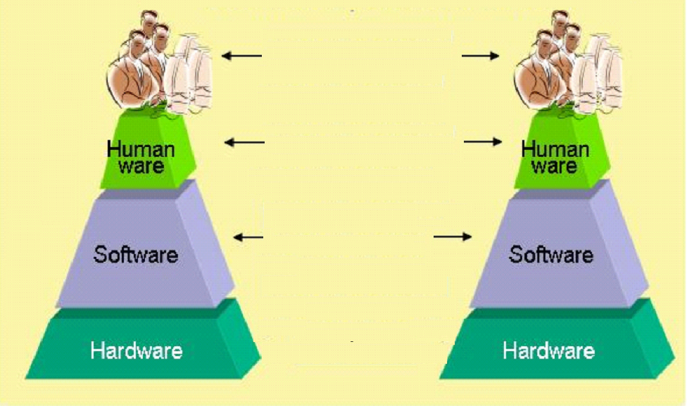
AQ Networking Requires:
Interoperability of People and Machines
People
People
People & People
AQ Community of Practice
People & Machines
Machines & Machines
AQ Community Server

Slide 3
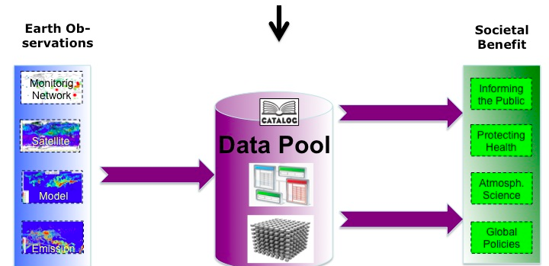
Who are the constituens of AQ CoP?

Slide 4
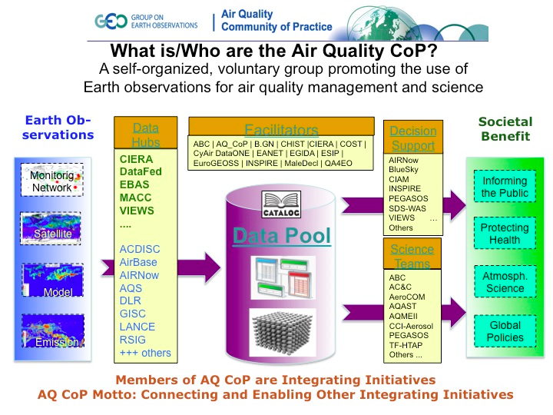

Slide 5
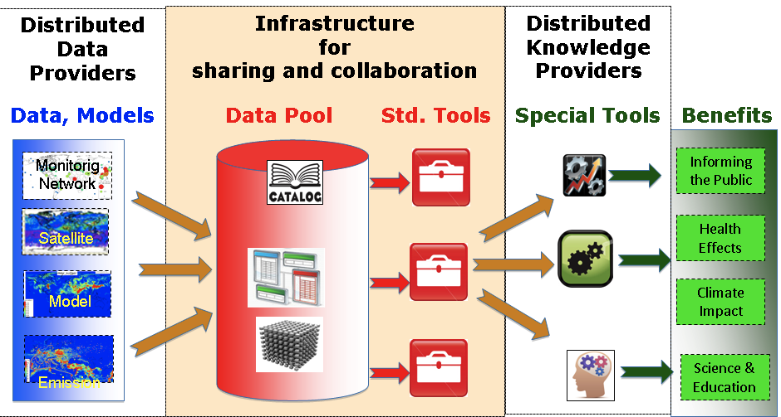
GEO Air Quality Community of Practice
AQ Data Network Architecture
Based on Service Oriented Architecture:

Slide 6
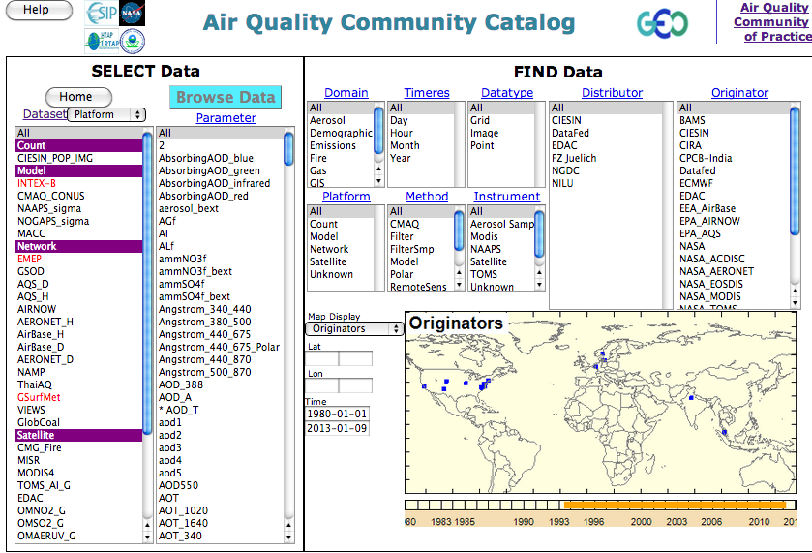

Slide 7
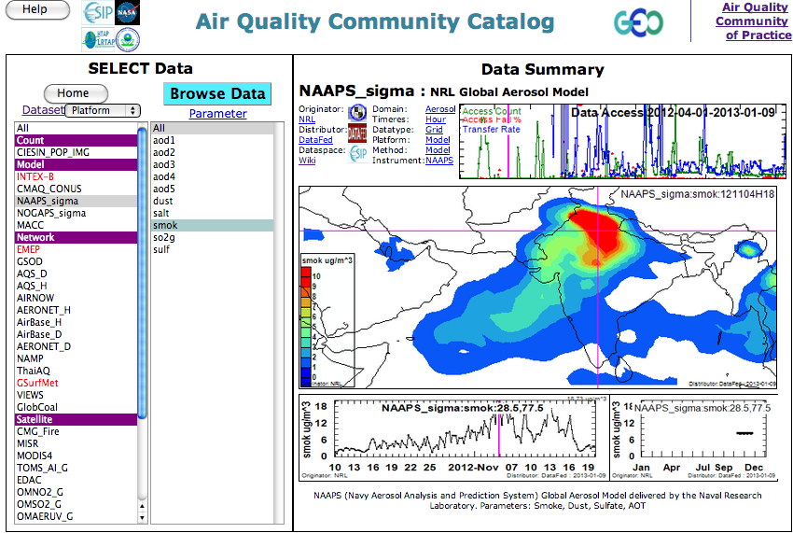
Data Access Stats
Data Preview

Slide 8
AQ Data Network Usage Pattern
AQ Community Catalog
Data Providers
Data Users
Data Types:
Surface Obs: AirNOW, AQS, AirBase
Satellites: MODIS, OMI
Emissions: NAAPS, EDGAR
Models: NAAPS, MACC, CMAQ
Applications:
Forecasting: NE US
AQ Managm.: ESs – EUS,
Atm. Science: IIT Bombai
Inform Public: ?? Web users

Slide 9
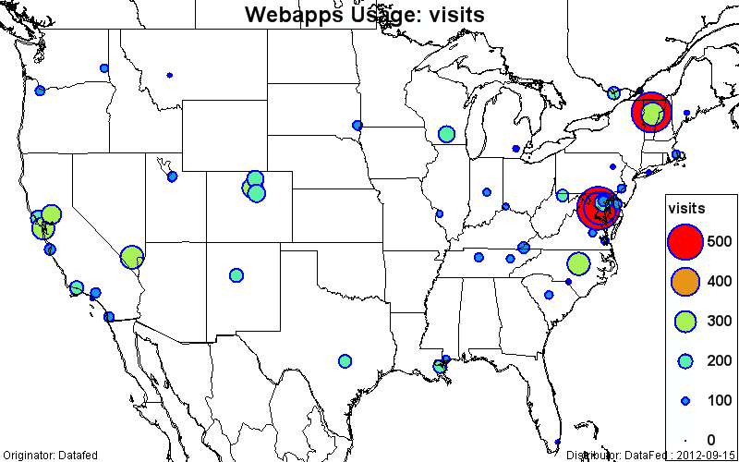
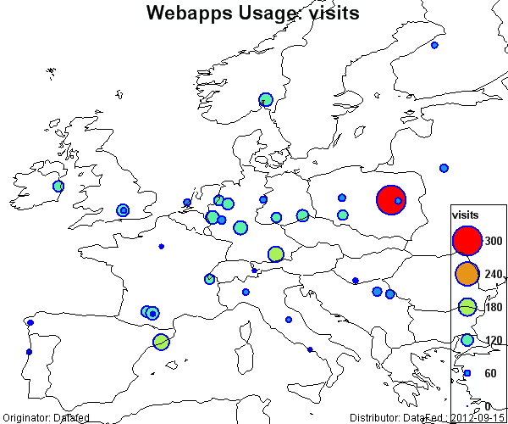
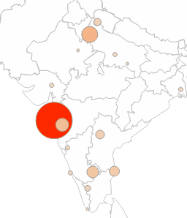
AQ Data Network Users: Top 100
Usage Metric by Google Analytics:
Top 100 user averages: 70 sessions; 6:20 minutes per session; 4.5 pages/session
Top User Sites, Visits
Mumbai, India, 742 : AQ analysis, research
Washington DC, 736: ?
Waterbury, VT, 642: AQ Forecasting, NE
Greenbelt, MD, 429: ?
Warsaw, PL, 242: AQ Analysis, research
Las Vegas, NV, 211: ?
Raleigh, NC, 202: ?
Since 2009, ADN is used globally
India Users

