Slide 1

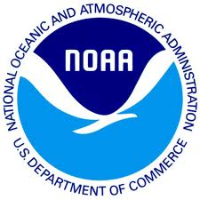
Responsible Data Use:
Copyright and Data
Matthew Mayernik
National Center for Atmospheric Research
Version 1.0
Review Date
Notes:
Modules should be 3-7 minutes long

Slide 2
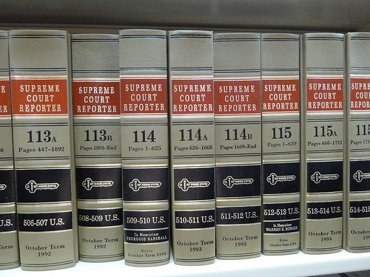
Overview
Copyright and data
  What is copyrightable and what isn’t in the U.S.
  Open copyright license options
Using copyrights (or waiving them)
  Copyright and the public domain
  Establishing non-legal norms of data access and use
Image: http://www.flickr.com/photos/j3net/6685161421/

Slide 3
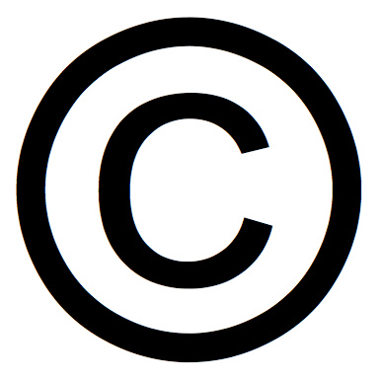
Copyright and Data
Not copyrightable in the U.S.
  Facts: 2+2 = 4
  Measurements: Temperature = 20 C
Copyrightable in the U.S.
  Original selection and arrangement of data
  Metadata: documentation and descriptions of data or processing steps
In the U.S., copyrights are assigned by default, i.e. without having to officially file for them.
  Ex. lab notebooks or dissertations are copyrighted without researchers filing for them.
Through employment contracts and intellectual property agreements, copyrights for research products are often owned by employers (e.g. universities), not creators.
Image: http://www.flickr.com/photos/mikeblogs/3020966666/

Slide 4
Copyright license agreements for data
Through copyright law, license agreements exist for making data public:
  Free/Open Licenses such as GNU General Free Documentation License (GFDL)
  Creative Commons licenses
Such copyright license agreements complicate data sharing and integration efforts
  There is an amorphous line between what can and cannot be copyrighted within databases
  Different license agreements have different usage requirements, e.g. querying across 10 databases may return results with 10 different usage license agreements

Slide 5
Using copyrights (or waiving them)
Possible ways to reduce copyright license complications:
  Use the least restrictive open access licenses
  Putting data in the public domain (waive all intellectual property rights)
    Eliminates data use restrictions
    Enables data integration
    Encourages non-legal means for resolving problems
Scientific communities can develop norms as to how data should be made available, used, and attributed
  Check with data centers for data use and attribution policies
  Work with collaborators to ensure that the usage and attribution of others’ data meets with community accepted practices
  Examples:
    International Polar Year
    Seismology data

Slide 6
Norms of Appropriate Data Use
Ex. International Polar Year (IPY)
  “The IPY Joint Committee requires that IPY data, including operational data delivered in real time, are made available fully, freely, openly, and on the shortest feasible timescale…equitable, non-discriminatory access to all data preferably free of cost, but some reasonable cost-recovery is acceptable.” (IPY Data Policy, 2008, pg. 3)
  “[U]sers of IPY data must formally acknowledge data authors (contributors) and sources. Where possible, this acknowledgment should take the form of a formal citation, such as when citing a book or journal article.” (pg. 4)
Ex. Seismology Data
  “For those programs in which selected principle [sp.] investigators have initial periods of exclusive data use, data should be made openly available as soon as possible, but no later than two (2) years after the data were collected.” (NSF Division of Earth Sciences, 2010, pg. 2)
  “[Federation of Digital Seismograph Networks] Networks and Data Centers appreciate proper acknowledgment when anyone makes use of the data from their organizations.” (FDSN Services website: http://www.fdsn.org/services.htm)

Slide 7
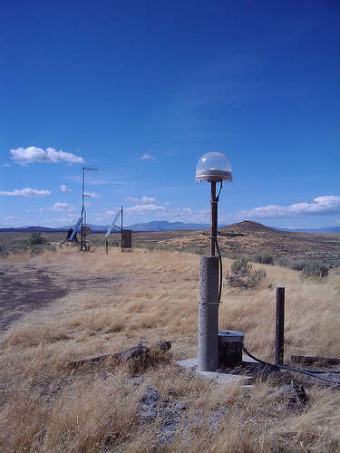
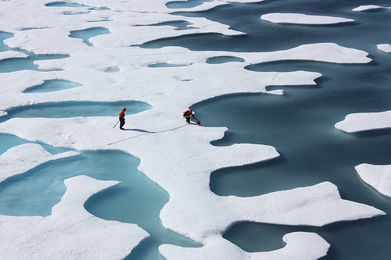
Conclusion
Copyright law has limited application to data
  Data are not copyrightable directly
  Other related research materials are copyrightable
Understand copyright options
  Who has copyrights
  Open licensing schemes
  When public domain might be applicable
http://www.flickr.com/photos/gsfc/6151061573/ http://www.flickr.com/photos/inl/5988483935/

Slide 8
References
Copyright and Data
  Samuelson, P. 2001. “Digital Information, Digital Networks, and The Public Domain.” Conference on the Public Domain, Duke Law School. http://law.duke.edu/pd/papers/samuelson.pdf
  Stodden, V. 2009. "The Legal Framework for Reproducible Scientific Research: Licensing and Copyright." Computing in Science & Engineering 11(1): 35-40. http://dx.doi.org/10.1109/MCSE.2009.19
  Wilbanks, J. 2008. “Public domain, copyright licenses and the freedom to integrate science.” Journal of Science Communication 7(2). http://jcom.sissa.it/archive/07/02/Jcom0702%282008%29C01/Jcom0702%282008%29C04/Jcom0702%282008%29C04.pdf

Slide 9
Resources
Copyright and Data
  Copyright law of the United States. http://www.copyright.gov/title17/
  Creative Commons Licenses. http://creativecommons.org/licenses/
  Science Commons. “Protocol for Implementing Open Access Data.” http://sciencecommons.org/projects/publishing/open-access-data-protocol/
  Cornell University. “Copyright Term and the Public Domain in the United States.” http://copyright.cornell.edu/resources/publicdomain.cfm
  Polar Information Commons. “Appropriate behavior when contributing and using PIC data.”
  http://www.polarcommons.org/ethics-and-norms-of-data-sharing.php

Slide 10
Other Relevant Modules
Providing Access to Your Data: Rights
Providing Access to Your Data: Handling Sensitive Data
Preservation Strategies: Data Transfer and Submission Agreements
Responsible Data Use: Citation and Credit

