Slide 1
NIST Big Data Public Working Group & Standardization Activities
Wo Chang, NIST, wchang@nist.gov
Robert Marcus, ET-Strategies
Chaitanya Baru, UC San Diego
http://bigdatawg.nist.gov
Feb. 10, 2014

Slide 2
Agenda
Why Big Data? Why NIST?
NBD-PWD Charter and Deliverables
Overall Work Plan
Subgroup Charter and Deliverables
Next Steps / Future Activities
ISO/IEC JTC 1 Big Data Study Group
Definitions & Taxonomies
Requirements & Use Case
Security & Privacy
Reference Architecture
Technology Roadmap
2014 ESIP, NIST/ITL, Wo Chang, Feb. 20, 2014

Slide 3
Why Big Data? Why NIST?
Why Big Data?
Why NIST?
There is broad agreement among commercial, academic, and government leaders about the remarkable potential of “Big Data” to spark innovation, fuel commerce, and drive progress.
(a) Recommendation from January 15 -- 17, 2013 Cloud/Big Data Forum and
(b) A lack of consensus on some important, fundamental questions is confusing potential users and holding back progress. Questions such as:
  What are the attributes that define Big Data solutions?
  How is Big Data different from traditional data environments and related applications?
  What are the essential characteristics of Big Data environments?
  How do these environments integrate with currently deployed architectures?
  What are the central scientific, technological, and standardization challenges needed to accelerate the deployment of robust Big Data solutions?
2014 ESIP, NIST/ITL, Wo Chang, Feb. 20, 2014

Slide 4
Why Big Data? Why NIST?
Why Big Data?
Why NIST?
There is broad agreement among commercial, academic, and government leaders about the remarkable potential of “Big Data” to spark innovation, fuel commerce, and drive progress.
(a) Recommendation from January 15 -- 17, 2013 Cloud/Big Data Forum and
(b) A lack of consensus on some important, fundamental questions is confusing potential users and holding back progress. Questions such as:
  NBD-PWG is being launched to address these questions and is charged to develop consensus definitions, taxonomies, secure reference architecture, and technology roadmap for Big Data that can be embraced by all sectors.
2014 ESIP, NIST/ITL, Wo Chang, Feb. 20, 2014

Slide 5
NBD-PWG: Charter and Deliverables
Charter (M0001)
The focus of the (NBD-PWG) is to form a community of interest from industry, academia, and government, with the goal of developing a consensus definitions, taxonomies, secure reference architectures, and technology roadmap. The aim is to create vendor-neutral, technology and infrastructure agnostic deliverables to enable big data stakeholders to pick-and-choose best analytics tools for their processing and visualization requirements on the most suitable computing platforms and clusters while allowing value-added from big data service providers and flow of data between the stakeholders in a cohesive and secure manner.
Deliverables - Working Drafts for:
Big Data Definitions
Big Data Taxonomies
Big Data Requirements & Use Cases
Big Data Security & Privacy Requirements
Architectures Survey
Big Data Reference Architecture
Big Data Security & Privacy Architecture
Big Data Technology Roadmap
Launch Date: June 26, 2013
Target Date: September 27, 2013
2014 ESIP, NIST/ITL, Wo Chang, Feb. 20, 2014

Slide 6
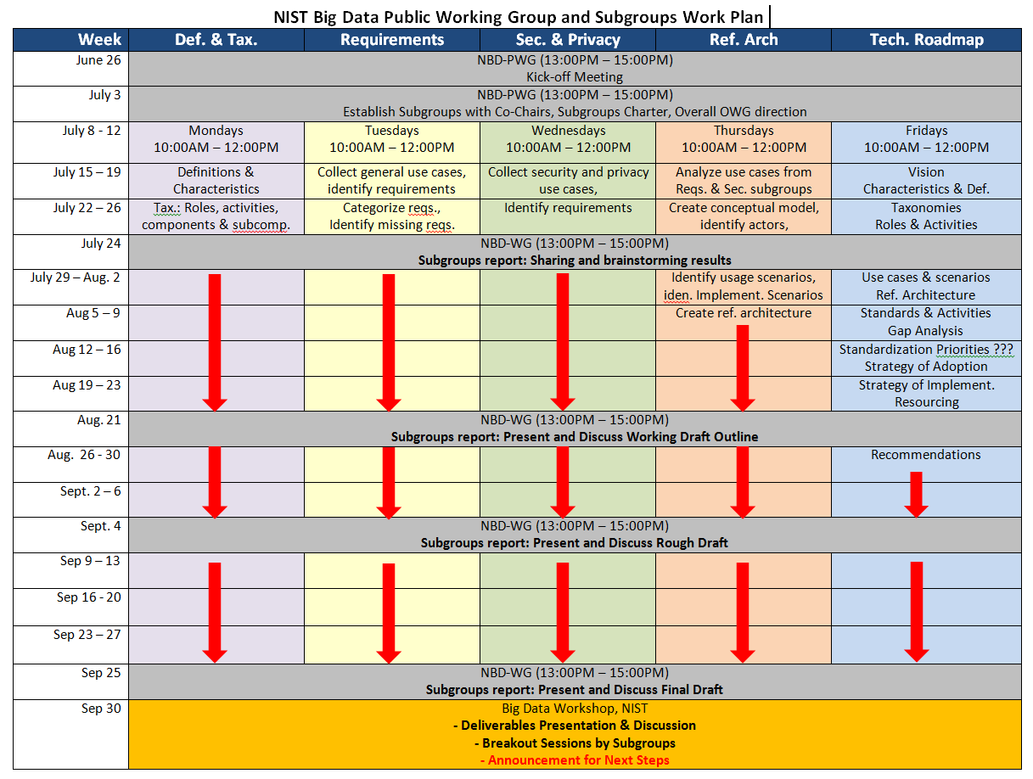
2014 ESIP, NIST/ITL, Wo Chang, Feb. 20, 2014

Slide 7
SUBGROUPS
NBD-PWG
Requirements and Use Cases
Security and Privacy
Reference Architecture
Technology Roadmap
Definitions & Taxonomies
And their scopes and deliverables
2014 ESIP, NIST/ITL, Wo Chang, Feb. 20, 2014

Slide 8

Requirements & Use Cases
Geoffrey Fox, U. Indiana
Joe Paiva, VA
Tsegereda Beyene, Cisco
Subgroup
Scope (M0020)
The focus is to form a community of interest from industry, academia, and government, with the goal of developing a consensus list of Big Data requirements across all stakeholders. This includes gathering and understanding various use cases from diversified application domains.
Tasks
Gather input from all stakeholders regarding Big Data requirements.
Analyze/prioritize a list of challenging general requirements that may delay or prevent adoption of Big Data deployment
Develop a comprehensive list of Big Data requirements
NBD- PWG
Definitions and Taxonomies
Security and Privacy
Reference Architecture
Technology Roadmap
Requirements
2014 ESIP, NIST/ITL, Wo Chang, Feb. 20, 2014

Slide 9
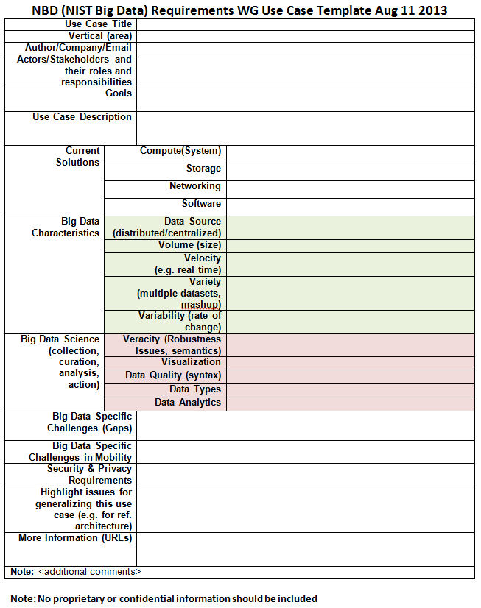
Requirements and Use Case Subgroup
Key documents:
M0105 – Use Cases
M0125 – Requirements
Mo152 – Working Draft
Use Case Template:
Goals, Description
Data Characteristics, Data Types
Data Analytics
Current Solutions
Security & Privacy
Lifecycle Management & Data Quality
System Management & Other Issues
2014 ESIP, NIST/ITL, Wo Chang, Feb. 20, 2014

Slide 10
Requirements and Use Case Subgroup
  51 Use Cases Received (http://bigdatawg.nist.gov/usecases.php)
Government Operations (4): National Archives & Records Administration, Census Bureau
Commercial (8): Finance in Cloud, Cloud Backup, Mendeley (Citations), Netflix, Web Search, Digital Materials, Cargo shipping (e.g. UPS)
Defense (3): Sensors, Image Surveillance, Situation Assessment
Healthcare & Life Sciences (10): Medical Records, Graph & Probabilistic Analysis, Pathology, Bio-imaging, Genomics, Epidemiology, People Activity Models, Biodiversity
Deep Learning & Social Media (6): Driving Car, Geolocate Images, Twitter, Crowd Sourcing, Network Science, NIST Benchmark Datasets
The Ecosystem for Research (4): Metadata, Collaboration, Language Translation, Light Source Experiments
Astronomy & Physics (5): Sky Surveys, Large Hadron Collider at CERN, Belle Accelerator II (Japan)
Earth, Environmental & Polar Science (10): Ice Sheet Scattering, Earthquake, Ocean, Earth Radar Mapping, Climate Simulation, Atmospheric Turbulence, Subsurface Biogeochemistry, AmeriFlux &FLUXNET gas sensors
Energy (10): Smart Grid
2014 ESIP, NIST/ITL, Wo Chang, Feb. 20, 2014

Slide 11
Requirements and Use Case Subgroup
Step 1
Extract requirements and map to reference architecture based on application characteristics:
Data sources (data size, file formats, rate of growth, at rest or in motion, etc.)
Data lifecycle management (curation, conversion, quality check, pre-analytic processing, etc.)
Data transformation (data fusion/mashup, analytics)
Capability infrastructure (software tools, platform tools, hardware resources like storage and networking)
Data usage (processed results in text, table, visual, other formats)
All architecture components informed by Goals and Use Case description
Security & Privacy has direct map
Aggregate all specific requirements into high-level generalized requirements which are
vendor-neutral and technology agnostic
437 requirements were extracted from 51 Use Cases
35 aggregated general requirements divided into 7 categories
Step 2
2014 ESIP, NIST/ITL, Wo Chang, Feb. 20, 2014

Slide 12
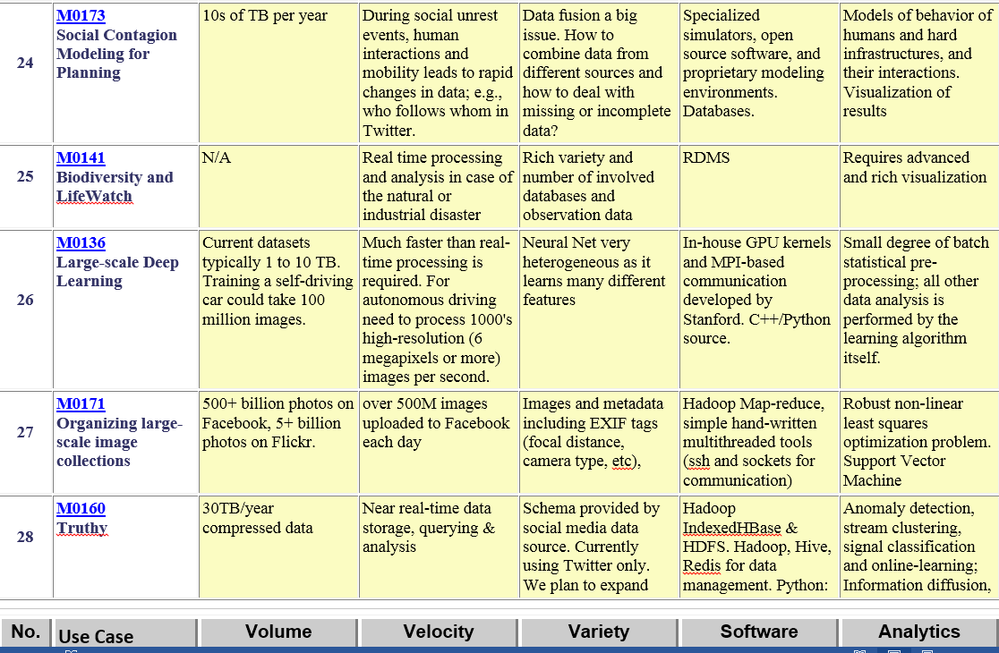
Requirements and Use Case Subgroup
Part of Property Summary Table
2014 ESIP, NIST/ITL, Wo Chang, Feb. 20, 2014

Slide 13
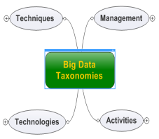
Definitions & Taxonomies
Nancy Grady, SAIC
Natasha Balac, SDSC
Eugene Luster, R2AD
Subgroup
Scope (M0018)
The focus is to gain a better understanding of the principles of Big Data. It is important to develop a consensus-based common language and vocabulary terms used in Big Data across stakeholders from industry, academia, and government. In addition, it is also critical to identify essential actors with roles and responsibility, and subdivide them into components and sub-components on how they interact/ relate with each other according to their similarities and differences.
Tasks
For Definitions: Compile terms used from all stakeholders regarding the meaning of Big Data from various standard bodies, domain applications, and diversified operational environments.
For Taxonomies: Identify key actors with their roles and responsibilities from all stakeholders, categorize them into components and subcomponents based on their similarities and differences
Develop Big Data Definitions and taxonomies documents
NBD- PWG
Definitions and Taxonomies
Security and Privacy
Reference Architecture
Technology Roadmap
Requirements
2014 ESIP, NIST/ITL, Wo Chang, Feb. 20, 2014

Slide 14
Definitions and Taxonomies Subgroup (M0024, M0142)
Key documents:
M0024 – Ongoing Discussion
M0142 – Working Draft
Big Data Definitions, v1 (Developed from Jan. 15-17, 2013 NIST Cloud/Big Data Workshop)
Big Data refers to digital data volume, velocity and/or variety that:
Big Data consists of extensive datasets, primarily in the characteristics of volume, velocity and/or variety, that require a scalable architecture for efficient storage, manipulation, and analysis.
2014 ESIP, NIST/ITL, Wo Chang, Feb. 20, 2014

Slide 15
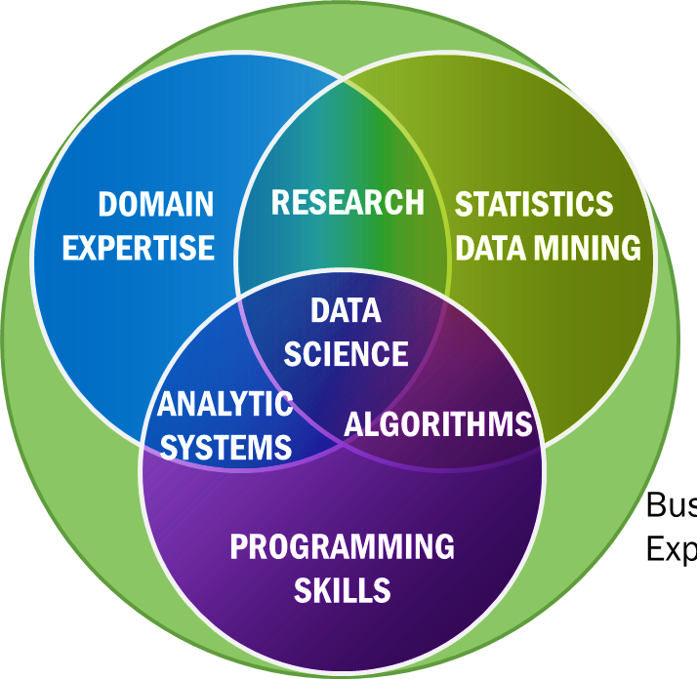
Definitions and Taxonomies Subgroup (M0024, M0142)
Data Science is the extraction of actionable knowledge directly from data through a process of discovery, hypothesis, and analytical hypothesis analysis.
Data Scientists is a practitioner who has sufficient knowledge of the overlapping regimes of expertise in business needs, domain knowledge, analytical skills and programming expertise to manage the end-to-end scientific method process through each stage in the Big Data lifecycle (through action) to deliver value.
2014 ESIP, NIST/ITL, Wo Chang, Feb. 20, 2014

Slide 16
Definitions and Taxonomies Subgroup (M0024, M0142)
Big Data Taxonomies (M0202)
Actors
Sensors
Applications
Software agents
Individuals
Organizations
Hardware resources
Service abstractions
System Roles
Data Provider
> Makes available data internal and/or external to the system
Data Consumer
> Uses the output of the system
System Orchestrator
> Governance, requirements, monitoring
Big Data Application Provider
> Instantiates application
Big Data Framework Provider
> Provides resources
2014 ESIP, NIST/ITL, Wo Chang, Feb. 20, 2014

Slide 17
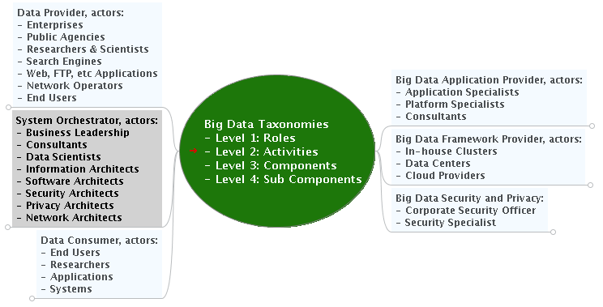
Definitions and Taxonomies Subgroup (M0024, M0142)
Big Data Taxonomies (M0202)
2014 ESIP, NIST/ITL, Wo Chang, Feb. 20, 2014

Slide 18
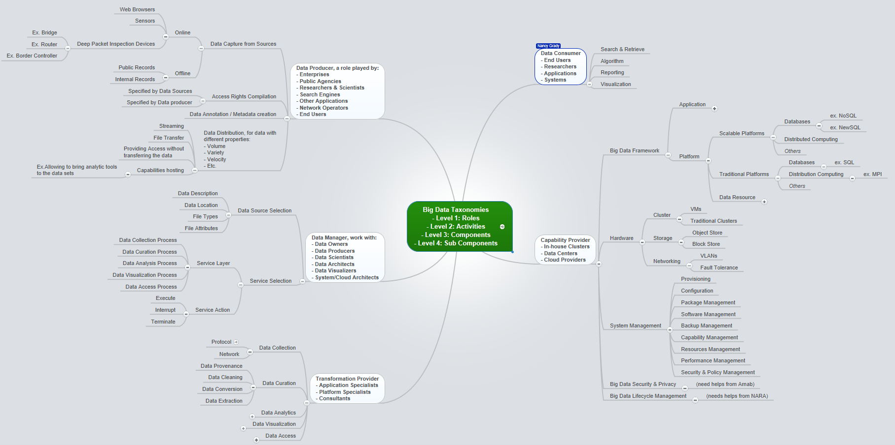
Definitions and Taxonomies Subgroup (M0024, M0142)
Big Data Taxonomies (M0202)
2014 ESIP, NIST/ITL, Wo Chang, Feb. 20, 2014

Slide 19
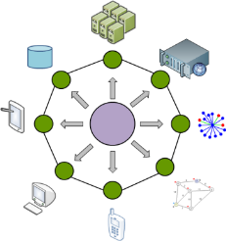
Reference Architecture
Orit Levin, Microsoft
James Ketner, AT&T
Don Krapohl,
Augmented Intelligence
Subgroup
Scope (M0021)
The focus is to form a community of interest from industry, academia, and government, with the goal of developing a consensus-based approach to orchestrate vendor-neutral, technology and infrastructure agnostic for analytics tools and computing environments. The goal is to enable Big Data stakeholders to pick-and-choose technology-agnostic analytics tools for processing and visualization in any computing platform and cluster while allowing value-added from Big Data service providers and the flow of the data between the stakeholders in a cohesive and secure manner.
Tasks
Gather and study available Big Data architectures representing various stakeholders, different data types,’ use cases, and document the architectures using the Big Data taxonomies model based upon the identified actors with their roles and responsibilities.
Ensure that the developed Big Data reference architecture and the Security and Privacy Reference Architecture correspond and complement each other.
NBD- PWG
Definitions and Taxonomies
Security and Privacy
Reference Architecture
Technology Roadmap
Requirements
2014 ESIP, NIST/ITL, Wo Chang, Feb. 20, 2014

Slide 20
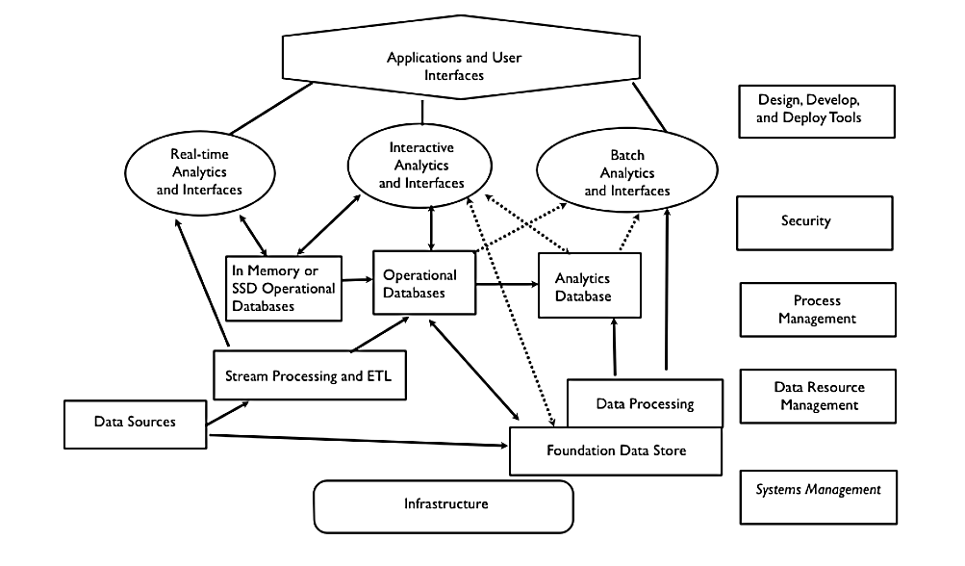
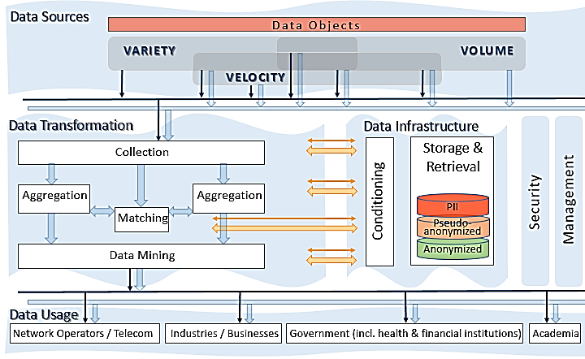
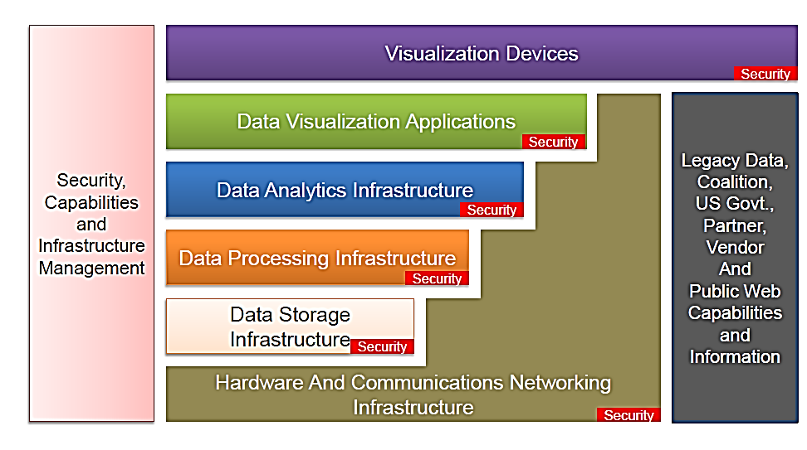
Reference Architecture Subgroup
Key documents:
M0151 – White Paper
M0123 – Working Draft
M0039 | Data Processing Flow
M0017 | Data Transformation Flow
M0047 | IT Stack
2014 ESIP, NIST/ITL, Wo Chang, Feb. 20, 2014

Slide 21
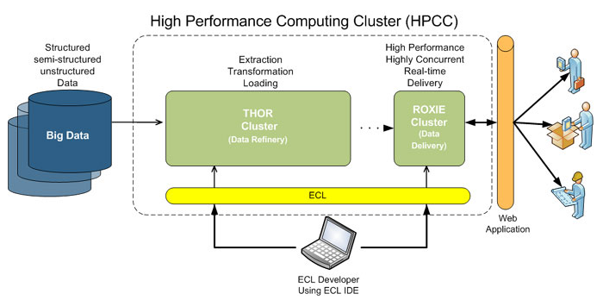
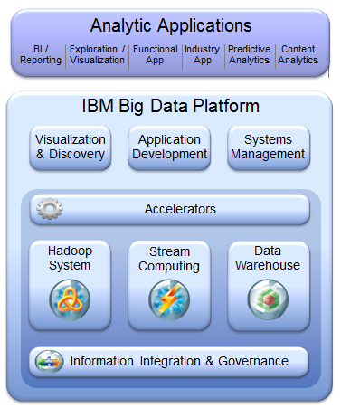
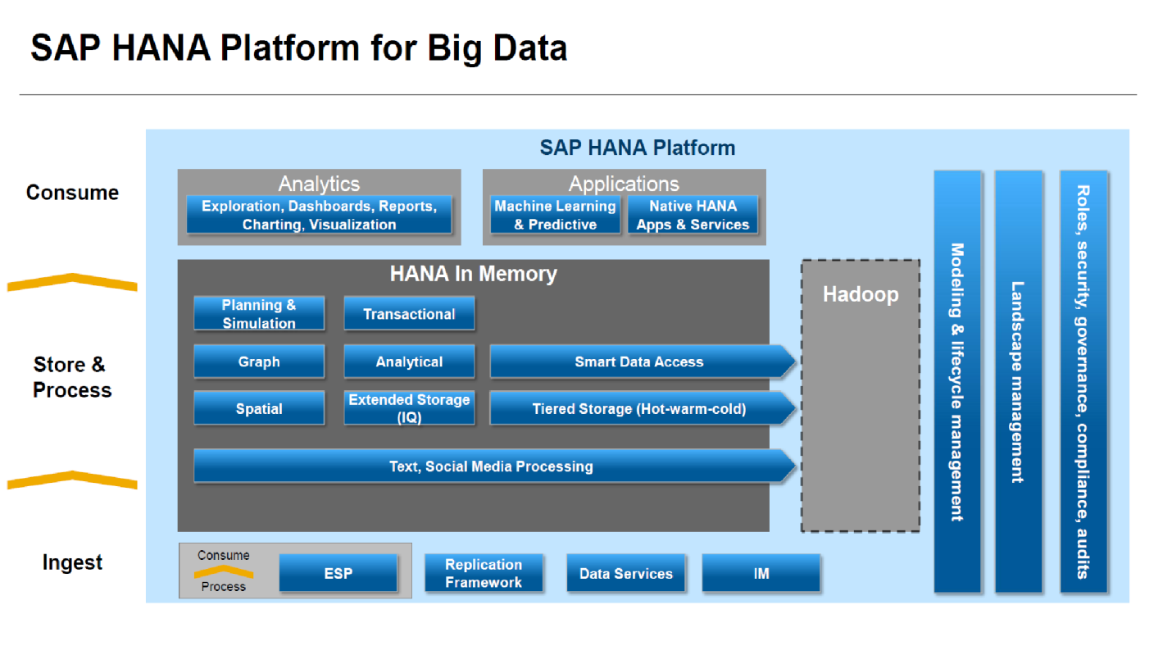
Reference Architecture Subgroup
Vendors Big Data Architectures
9Sights
LexisNexis
IBM
SAP
Oracle
Pivotal
2014 ESIP, NIST/ITL, Wo Chang, Feb. 20, 2014

Slide 22
Reference Architecture Subgroup
IS
A superset of the “traditional data” system
A representation of a vendor-neutral & technology agnostic system
A functional architecture comprised of logical roles
Applicable to a variety of business models:
  Tightly-integrated enterprise systems
  Loosely-coupled vertical industries
What the Baseline Big Data RA
IS NOT
A business architecture representing internal vs. external functional boundaries
A deployment architecture
A detailed IT RA of a specific system implementation
All of the above will be developed in the next stage in the context of specific use cases.
2014 ESIP, NIST/ITL, Wo Chang, Feb. 20, 2014

Slide 23
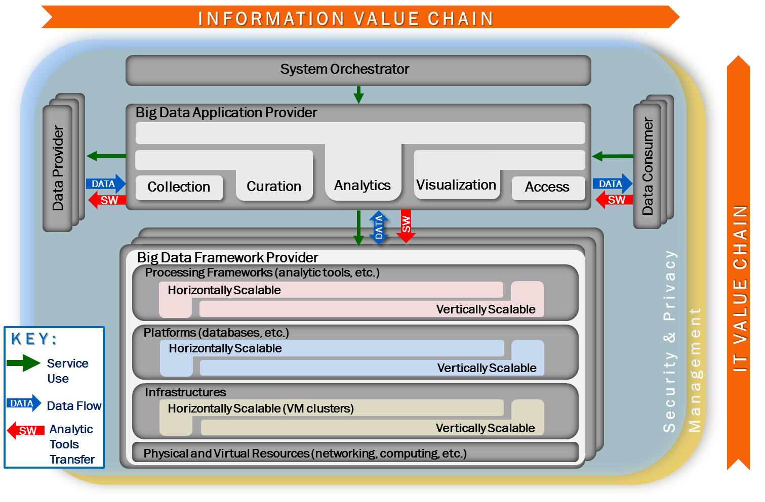
Reference Architecture Subgroup
RA Diagram
2014 ESIP, NIST/ITL, Wo Chang, Feb. 20, 2014

Slide 24
Security &
Privacy
Arnab Roy, CSA/Fujitsu Nancy Landreville, U. MD Akhil Manchanda, GE
Subgroup
Scope (M0019)
The focus is to form a community of interest from industry, academia, and government, with the goal of developing a consensus secure reference architecture to handle security and privacy issues across all stakeholders. This includes gaining an understanding of what standards are available or under development, as well as identifies which key organizations are working on these standards.
Tasks
Gather input from all stakeholders regarding security and privacy concerns in Big Data processing, storage, and services.
Analyze/prioritize a list of challenging security and privacy requirements that may delay or prevent adoption of Big Data deployment
Develop a Security and Privacy Reference Architecture that supplements the general Big Data Reference Architecture
NBD- PWG
Definitions and Taxonomies
Security and Privacy
Reference Architecture
Technology Roadmap
Requirements
2014 ESIP, NIST/ITL, Wo Chang, Feb. 20, 2014

Slide 25
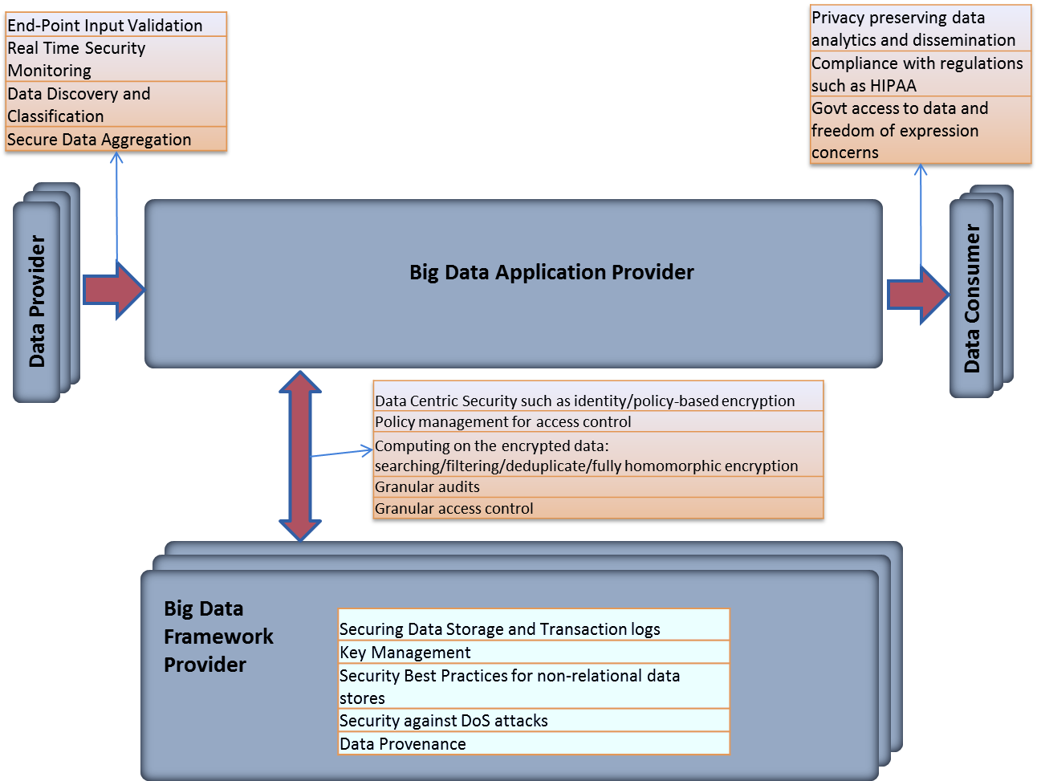
Security and Privacy Subgroup
Key documents:
Google Doc – Ongoing Discussion
M0110 – Requirements Working Draft
M0xxx – Architecture & Taxonomies
Requirements Scope
Infrastructure Security
Data Management
Requirements –
Use Cases Studied
Retail (consumer)
Media
Architecture & Taxonomies
Privacy
Provenance
Data Privacy
Integrity & Reactive Security
Healthcare
Government
Marketing
System Health
2014 ESIP, NIST/ITL, Wo Chang, Feb. 20, 2014

Slide 26

Technology Roadmap
Carl Buffington, USDA/Vistronix
Dan McClary, Oracle
David Boyd, Data Tactic
Subgroup
Scope (M0022)
The focus is to form a community of interest from industry, academia, and government, with the goal of developing a consensus vision with recommendations on how Big Data should move forward by performing a good gap analysis through the materials gathered from all other NBD subgroups. This includes setting standardization and adoption priorities through an understanding of what standards are available or under development as part of the recommendations.
Tasks
Gather input from NBD subgroups and study the taxonomies for the actors’ roles and responsibility, use cases and requirements, and secure reference architecture.
Gain understanding of what standards are available or under development for Big Data
Perform a thorough gap analysis and document the findings
Identify what possible barriers may delay or prevent adoption of Big Data
Document vision and recommendations
NBD- PWG
Definitions and Taxonomies
Security and Privacy
Reference Architecture
Technology Roadmap
Requirements
2014 ESIP, NIST/ITL, Wo Chang, Feb. 20, 2014

Slide 27
Technology Roadmap Subgroup
Key document:
M0087 – Working Draft
Inputs from other subgroups
Potential Standards Group with
Big Data-related activities (M0035)
Capabilities & Technology Readiness
Big Data Decision Framework
Big Data Mapping & Gap Analysis
Big Data Strategies
Definitions & Taxonomies
Security & Privacy
Reference Architecture
Requirements & Use Cases
Adoption
Implementation
Resourcing
2014 ESIP, NIST/ITL, Wo Chang, Feb. 20, 2014

Slide 28
Subgroups Working Draft Outline
 Contact: bigdatainfo@nist.gov
 Website: http://bigdatawg.nist.gov
 Join NBD-PWG: http://bigdatawg.nist.gov/newuser.php
 Documents: http://bigdatawg.nist.gov/show_InputDoc.php
Working Drafts http://bigdatawg.nist.gov/V1_output_docs.php
Big Data Definitions & Taxonomies (M0142)
Big Data Requirements (M0245)
Big Data Security & Privacy Requirements (M0110)
Big Data Architectures White Paper Survey (M0151)
Big Data Reference Architectures (M0226)
Big Data Security & Privacy Reference Architecture (M0110)
Big Data Technology Roadmap (M0087)
☑ NIST Big Data
Workshop Slides: http://bigdatawg.nist.gov/workshop.php
2014 ESIP, NIST/ITL, Wo Chang, Feb. 20, 2014

Slide 29
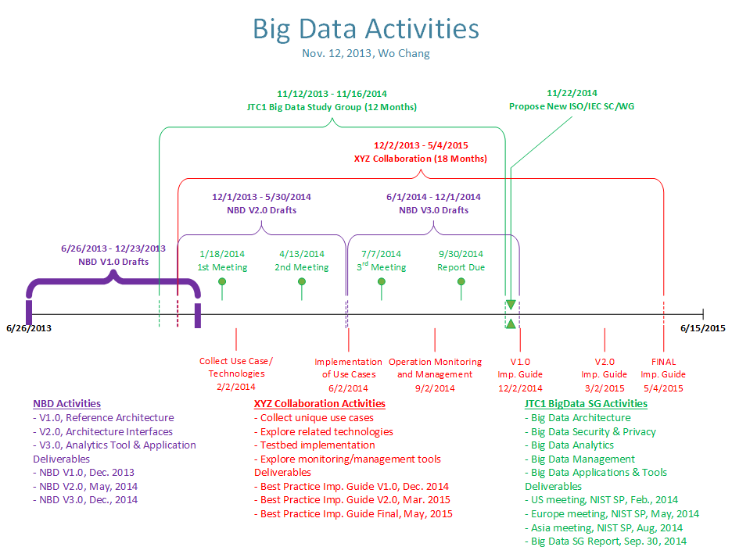

Next Steps
&
Future
Activities
2013 Big Data World Congress, NIST/ITL, Wo Chang, Dec. 3, 2013

Slide 30
ISO/IEC JTC 1 Big Data Study Group
Convener: Wo Chang, NIST
Terms and References:
Survey the existing ICT landscape for key technologies and relevant standards/models/studies/use cases and scenarios for Big Data from JTC 1, ISO, IEC and other standards setting organizations
Identify key terms and definitions commonly used in the area of Big Data
Assess the current status of Big Data standardization market requirements, identify standards gaps, and propose standardization priorities to serve as a basis for future JTC 1 work
Provide a report with recommendations and other potential deliverables to the 2014 JTC1 Plenary
Focus Areas:
Big Data Architecture / Infrastructure
Big Data Security & Privacy
Big Data Analytics
Big Data Applications & Tools
Big Data Management
Meetings (3 face-to-face + teleconferences):
Format – 4 days (2 days workshop + 2 day meetings)
March – U.S.  May – Europe  June – Asia
Additional Notes:
Workshop papers will go into NIST Special Publication
High-quality papers may go into ACM Conference Proceedings (in process)
Report due in September, 2014
2014 ESIP, NIST/ITL, Wo Chang, Feb. 20, 2014

Slide 31
Earth Science Information Partners (ESIP)
“…participation in the ESIP Federation is beneficial because it provides an intellectual commons to expose, gather and enhance in-house capabilities in support of an organization’s own mandate.”
Source: http://www.esipfed.org/
2014 ESIP, NIST/ITL, Wo Chang, Feb. 20, 2014

Slide 32
Earth Science Information Partners (ESIP)
“…participation in the ESIP Federation is beneficial because it provides an intellectual commons to expose, gather and enhance in-house capabilities in support of an organization’s own mandate.”
Source: http://www.esipfed.org/
2014 ESIP, NIST/ITL, Wo Chang, Feb. 20, 2014

Slide 33
RDA Big Data Infrastructure WG (RDA + NIST Big Data PWG)
The focus of the Research Data Alliance (RDA)’s BDI-WG is to establish best practices implementation guidelines for how to deploy and manage big data applications using NIST Big Data Public Working Group’s Reference Architecture and other big data architectures along with best technologies available today to meet the ever challenging big data application demands. The rate at which data volumes, speeds, and complexity are growing requires new forms of computing infrastructure to enable breakthrough discoveries and innovation in ways that enhance economic security and improve quality of life.
2014 ESIP, NIST/ITL, Wo Chang, Feb. 20, 2014

Slide 34
NBD-PWG and BDI-WG Tasks and Deliverables
NBD-PWG Tasks
Select/identify unique Big Data scenarios from the submitted use cases
Work with use case submitters to identify unique Big Data scenarios and requirements for actual implementations. This includes security and privacy concerns and requirements
Work with the BDI-WG to develop high-level interface calls between RA key components by learning how the low-level implementation work
Establish preliminary high-level interface abstraction between RA key components
BDI-WG Tasks
Work with NBD-PWG to understand the RA structure and identified use cases
Identify best Big Data technologies and solutions to implement the identified use cases
Work with the use case submitters to implement their use cases
Document the implementation process
2014 ESIP, NIST/ITL, Wo Chang, Feb. 20, 2014

Slide 35
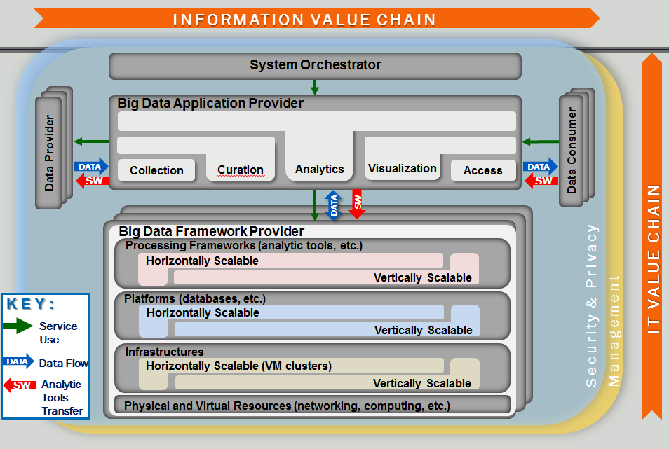
2014 ESIP, NIST/ITL, Wo Chang, Feb. 20, 2014

Slide 36
NBD-PWG and BDI-WG Tasks and Deliverables
NBD-PWG Tasks
Select/identify unique Big Data scenarios from the submitted use cases
Work with use case submitters to identify unique Big Data scenarios and requirements for actual implementations. This includes security and privacy concerns and requirements
Work with the BDI-WG to develop high-level interface calls between RA key components by learning how the low-level implementation work
Establish preliminary high-level interface abstraction between RA key components
BDI-WG Tasks
Work with NBD-PWG to understand the RA structure and identified use cases
Identify best Big Data technologies and solutions to implement the identified use cases
Work with the use case submitters to implement their use cases
Document the implementation process
2014 ESIP, NIST/ITL, Wo Chang, Feb. 20, 2014

Slide 37

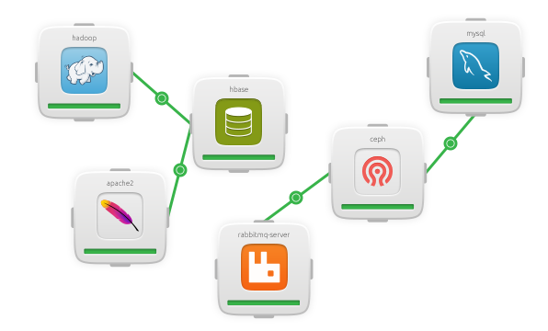
Provisioning Tool: Ubuntu JuJu with Charms
Charms (https://juju.ubuntu.com/)
Scalable application services defined
Charms give Juju its power. They encapsulate application configurations, define how services are deployed, how they connect to other services and are scaled. Charms are easily shared and there are 100s of Charms already rated and reviewed in our Charm store.
2014 ESIP, NIST/ITL, Wo Chang, Feb. 20, 2014
37

Slide 38
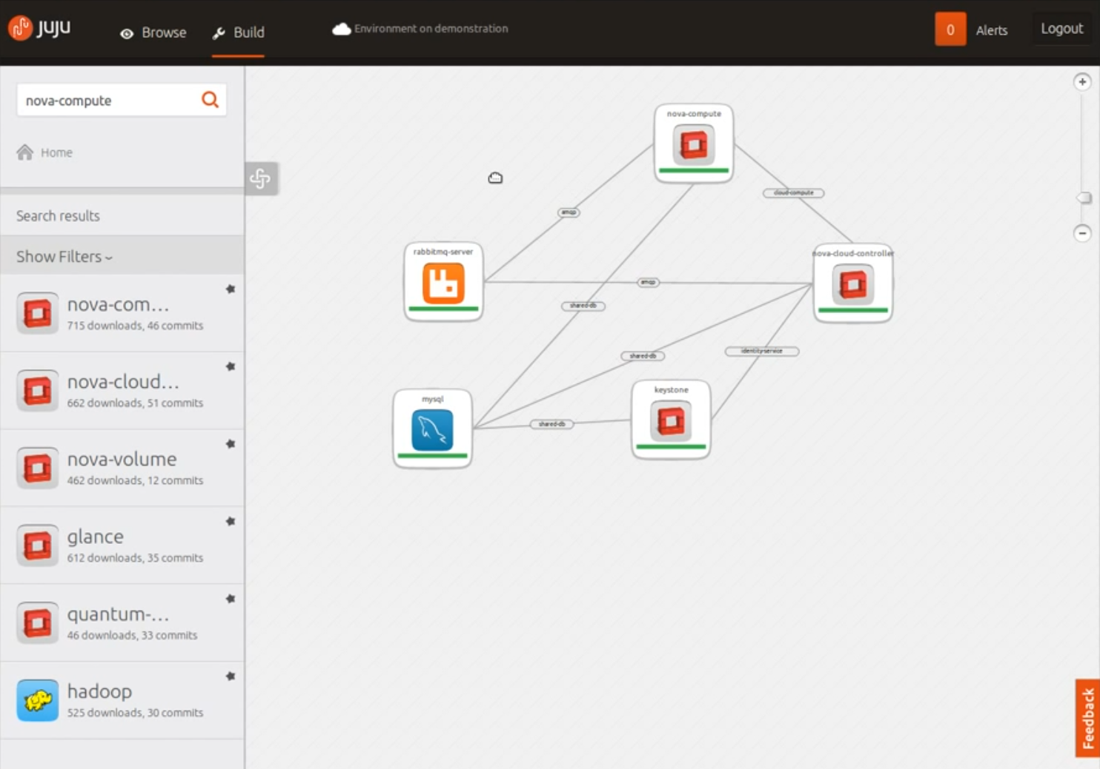
Provisioning Tool: Ubuntu JuJu with Charms using GUI
2014 ESIP, NIST/ITL, Wo Chang, Feb. 20, 2014
38

Slide 39

Provisioning Tool: Dell Crowbar with Barclamps
Modular Design: Barclamps
Dell “Crowbar”
Ops Management
APIs, User Access, & Ecosystem Partners
Nagios
Ganglia
Dashboard
Cloud Infrastructure & Dell IP Extensions
Nova
Swift
Glance
Compellent
EqualLogic
Core Components & Operating Systems
Crowbar
DNS
Logging
Deployer
NTP
Physical Resources
Provisioner
BIOS
IPMI
Network
RAID
Dell Cloud Solutions
* Crowbar has potential to service other programs beyond OpenStack
2014 ESIP, NIST/ITL, Wo Chang, Feb. 20, 2014
39

Slide 40
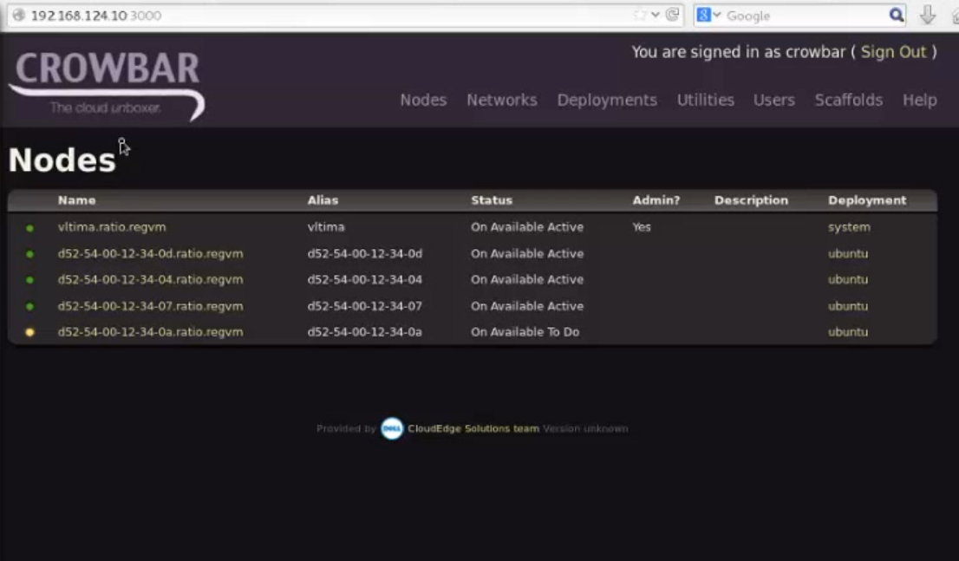
Provisioning Tool: Dell Crowbar with Barclamps using Manager
2014 ESIP, NIST/ITL, Wo Chang, Feb. 20, 2014

Slide 41
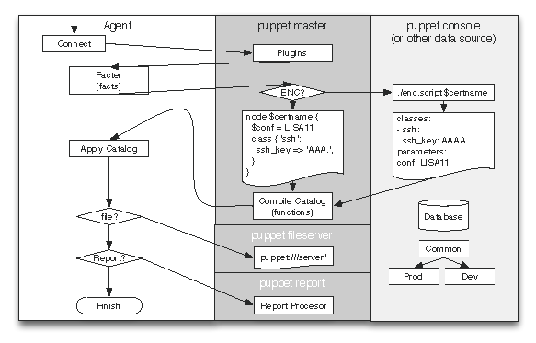

Provisioning Tool: Puppet with the Master/Agent Dataflow
Puppet Dataflow
2014 ESIP, NIST/ITL, Wo Chang, Feb. 20, 2014

Slide 42
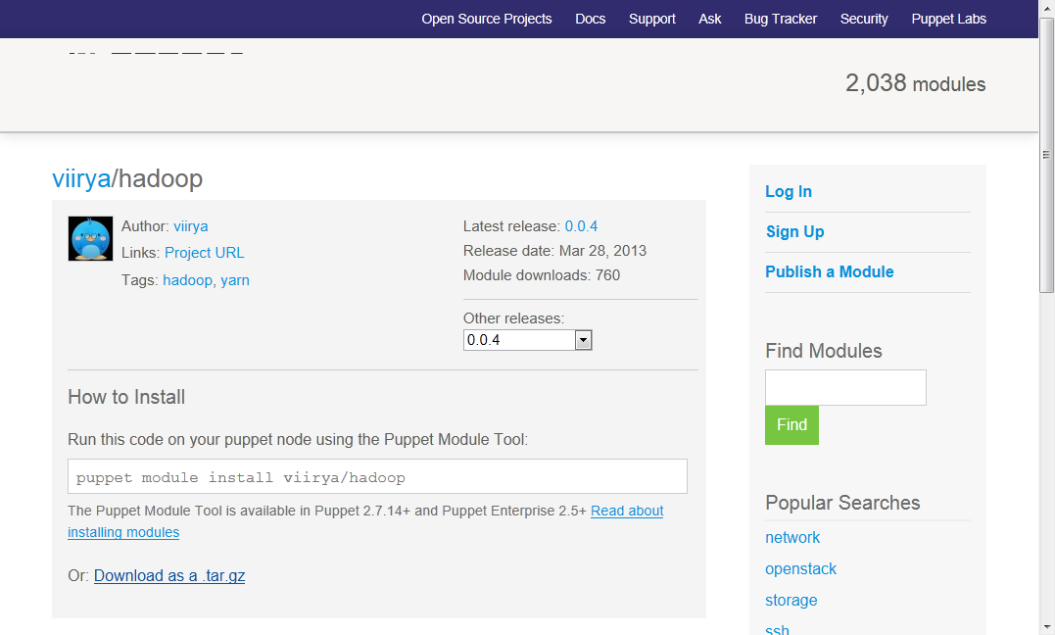
Provisioning Tool: Puppet with the Master/Agent Dataflow
2014 ESIP, NIST/ITL, Wo Chang, Feb. 20, 2014

Slide 43
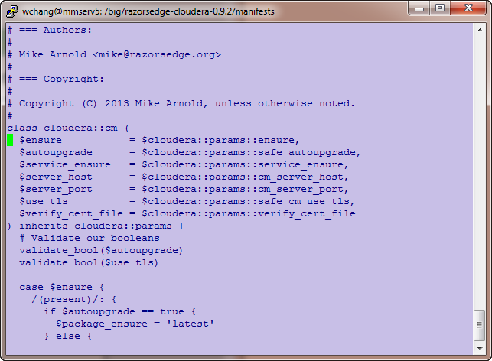
Provisioning Tool: Puppet with the Master/Agent Dataflow
2014 ESIP, NIST/ITL, Wo Chang, Feb. 20, 2014

Slide 44
Questions?
Please contact: wchang@nist.gov

