Slide 1
Digital Object Identifiers Update
ESIP Data Stewardship Committee Meeting
May 16, 2016
Presenters:
Nate James, ESDIS
Lalit Wanchoo, ADNET Systems Inc.

Slide 2
DOI Characteristics
DOI – a unique alphanumeric string used as an identifier for citing digital objects in literature.
  DOI Permanent URL: http://doi.dx.org/10.5067/123
Permanent/Persistent
  Once registered, the DOI never changes
Actionable
  URL Link resolves to actively maintained web page with additional information.
Informative
  Links to detailed descriptions of NASA archived datasets
  Uses “Smart” Landing Pages digitally tagged to enhance search and discovery
  Supports reproducibility and integrity of scientific results
  Encourages citations by crediting data creators and stewards

Slide 3
NASA ESDIS DOI Management
EOSDIS – 12 Active Earth Science Data Archives
ESDIS Project manages the 12 DAACs
ESDIS creates and registers DOIs for products archived and distributed by DAACs
DAACs are the Initiators (Data Providers) and Curators for ESDIS DOIs
DOI Advisory Working Group formed from DAAC Reps
DOI Working Groups help ESDIS shape DOI policy and procedures with DAAC Input

Slide 4
ESDIS DOI Workflow
Step 1: Visit ESDIS DOI wiki Website
(https://wiki.earthdata.nasa.gov/display/DOIsforEOSDIS/)
Step 3: Fill the New/Update Form
(check examples on the wiki)
Step 2: Download DOI Submission Form (https://wiki.earthdata.nasa.gov/display/DOIsforEOSDIS/DOI+Submission+Form/)
Step 4: Submit Form to ESDIS
(ESDIS Contact Team)
Data Provider (DAAC)
Communicate Information to the Provider
Step 5: Review of DOI Information
Step 6: Process DOI Information
Process fully automated (manual review)
Step 7: Reserve/Register/Update DOI Information
Step 8: Post Information on the ESDIS wiki website
ESDIS DOI Registration Team
Notes:
A reserved DOI is one that has been created by the project but not registered or publicly available due to lack of certain requirement metadata. In most cases, the product landing page is missing.
An updated DOI is one that was previously only reserved with ESDIS but has now been registered with EZID.
A registered DOI is one that has been reserved with the project and registered on EZID and is publicly available

Slide 5
NASA ESDIS DOI Working Group
DOI Working Group Activities
DOI Process Review (Implemented)
DOI Landing Page (Recommendations)
Citations and Identifiers (Recommendations)

Slide 6
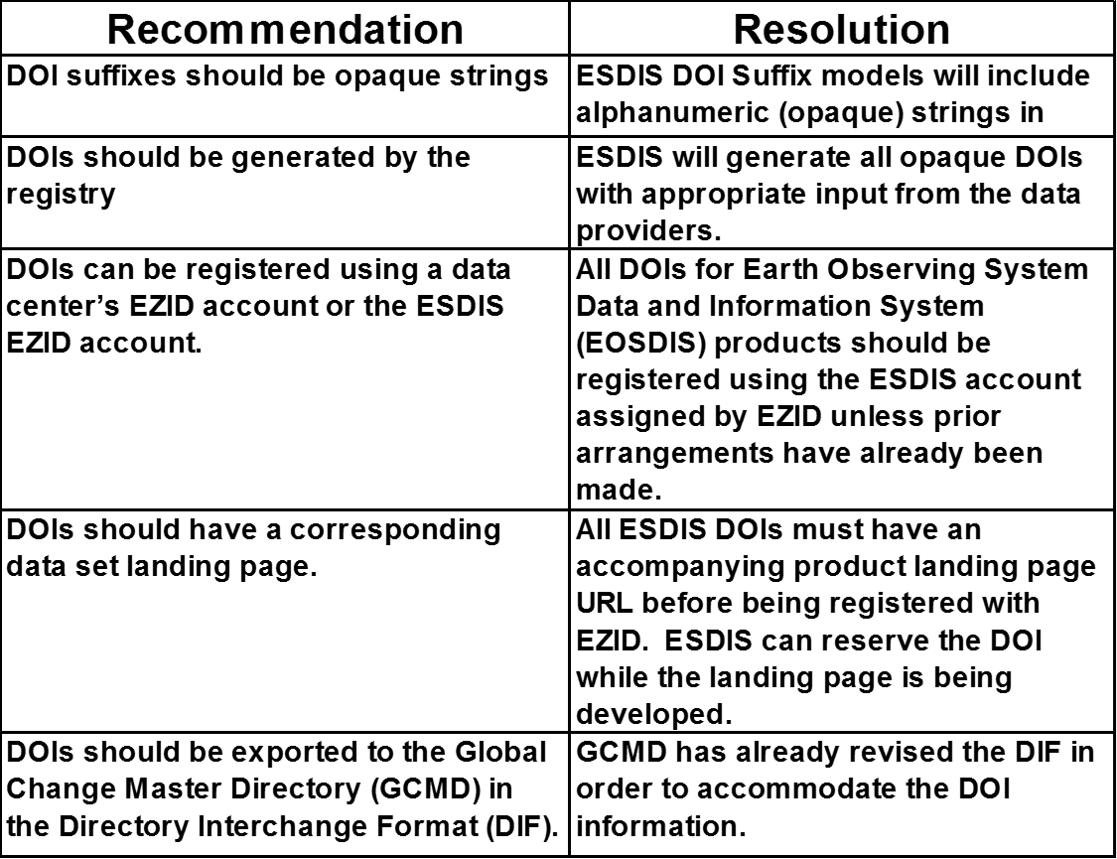
DOI Process Review

Slide 7
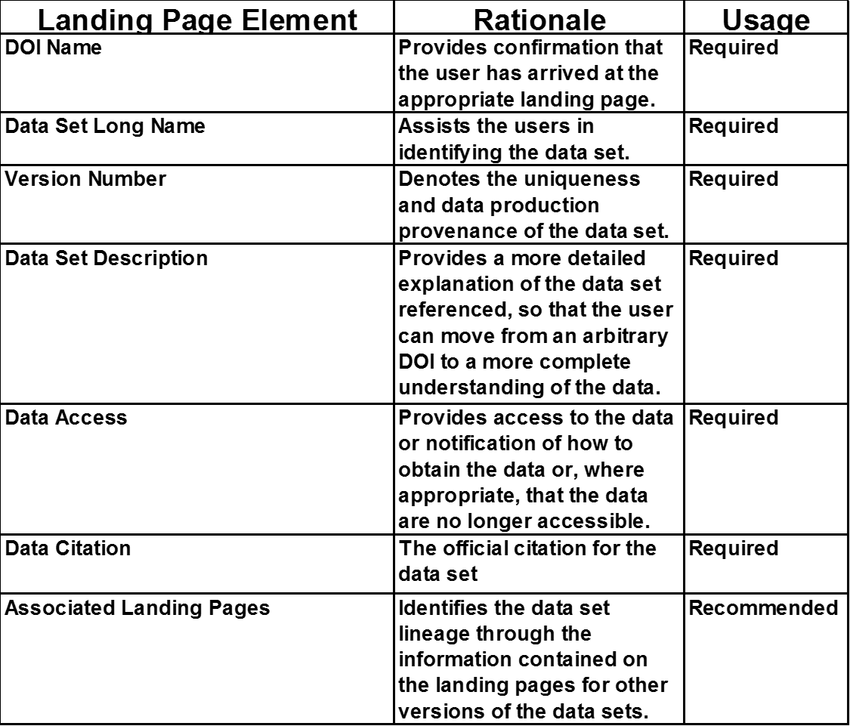
DOI Landing Page

Slide 8
Citation and Identifiers
DOI Field Formatting
Citations reformatting
Identifiers for Non-data Objects: Software

Slide 9
NASA ESDIS DOI Metrics

Slide 10
ESDIS DOIs and Citation of Data Products
Data Citation Formats
1. ESIP recommendations:
Creator, Year, Product Title, Version, Distributor, Date of Data Access, DOI Name
Example: AIRS Science Team/Joao Texeira; (2013): Aqua AIRS Level 3 Standard Daily Product using AIRS and AMSU with HSB V6; NASA Goddard Earth Sciences Data and Information Services Center. May 2014 http://dx.doi.org/10.5067/AQUA/AIRS/DATA302
2. DataCite Citation tool results:
Creator, Year, Product Title, Distributor, DOI Name
Example: AIRS Science Team/Joao Texeira; (2013): Aqua AIRS Level 3 Standard Daily
Product using AIRS and AMSU with HSB V6; NASA Goddard Earth Sciences
Data and Information Services Center.
http://dx.doi.org/10.5067/AQUA/AIRS/DATA302
Version – not currently in ESDIS DOI model but most of the data providers include it in the Title.
Date of Data Access: to be provided by the authors
Resources Type, Version: These are optional

Slide 11
ESDIS DOIs and Citation of Data Products
Data Citation Formats (Cont’d)
3. American Meteorological Society:
Creator, Year, Product Title, Version, Distributor, Date of Data Access, DOI Name
Example: AIRS Science Team/Joao Texeira; (2013): Aqua AIRS Level 3 Standard Daily
Product using AIRS and AMSU with HSB V6; NASA Goddard Earth Sciences
Data and Information Services Center. May 2014
http://dx.doi.org/10.5067/AQUA/AIRS/DATA302
4. The Economic and Social Research Council (ESRC) - United Kingdom Data Services:
Identifier, Creator, Title, Publisher, and Publication year, Resource Type, Version
Example: University of Essex. Institute for Social and Economic Research and National Centre for Social Research, Understanding Society: Wave 1, 2009-2010 and Wave 2, Year 1 (Interim Release), 2010 [computer file]. 3rd Edition. Colchester, Essex: UK Data Archive [distributor], February 2012. SN: 6614,
http://dx.doi.org/10.5255/UKDA-SN-6614-3.
Version – not currently in ESDIS DOI model but most of the data providers include it in the Title.
Date of Data Access: to be provided by the authors
Resources Type, Version: These are optional

Slide 12
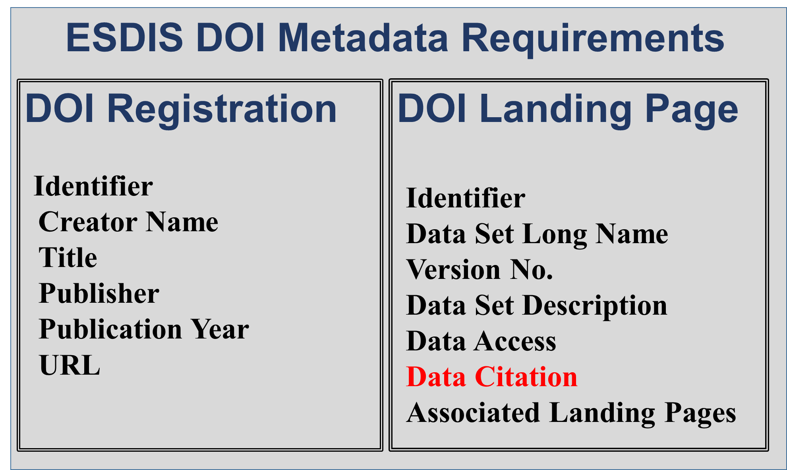
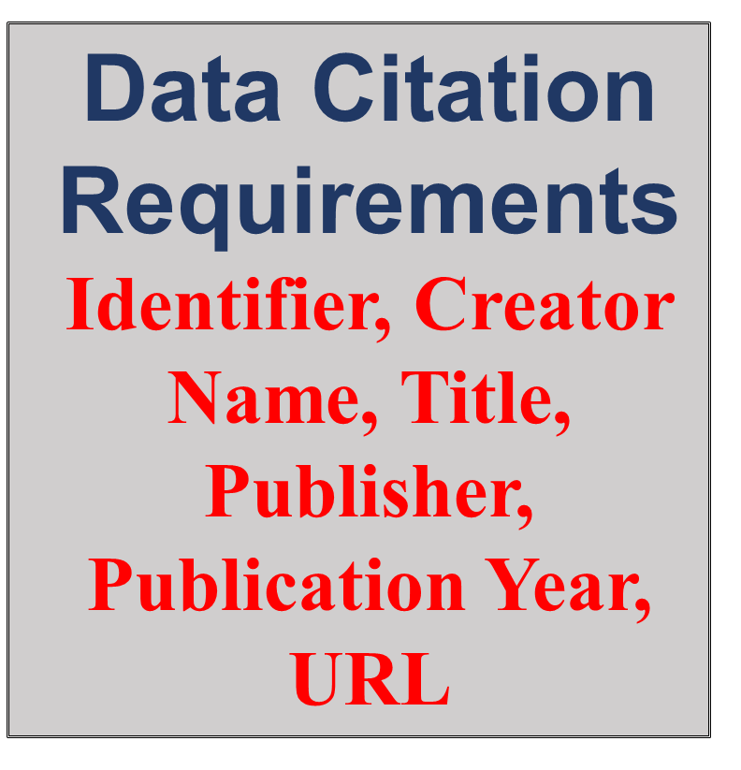
ESDIS DOIs and Citation of Data Products
DOI Requirements vs Citation Requirements

Slide 13
ESDIS DOI Challenges
DOI Requests from non-DAAC entities
PIs requesting DOIs for products before DAAC assignment
Products produced by one DAAC but later sent to another DAAC or non-DAAC

Slide 14
Additional Information
ESDIS DOI Poster –
https://wiki.earthdata.nasa.gov/display/DOIsforEOSDIS
ESDIS DOI Public Wiki https://wiki.earthdata.nasa.gov/display/DOIsforEOSDIS/Digital+Object+Identifiers+%28DOIs%29+for+EOSDIS

Slide 15
QUESTIONS?

Slide 16
BACKGROUND SLIDES

Slide 17
NASA-ESDIS DOI Example
  Product DOI Name:
  DOI:10.5067/MEASURES/GSSTF/DATA302
  DOI System Internet resolution service:
  http://dx.doi.org/10.5067/MEASURES/GSSTF/DATA302
  Leads to DOI landing page for that product
  DataCite citation service (http://crosscite.org/citeproc/) can be used to get well-formatted citations for a given DOI for various publications. For example, above DOI leads to following citation in AGU Journal format:
  Shie, C.-L., K. Hilburn, L. S. Chiu, R. Adler, I-I Lin, E. Nelkin, J. Ardizzone, and S. Gao (2012), NCEP/DOE Reanalysis II, for GSSTF, 0.25x0.25 deg, Daily Drid, V3, (GSSTF_NCEP), doi:10.5067/MEASURES/GSSTF/DATA302.

Slide 18
Identifiers in Product Metadata
Support multiple kinds of identifiers:
  Product level – e.g., one identifier per product; all granules have the same DOI; all files have the same DOI.
  Granule level – e.g., each file has a unique UUID.
Embed DOI as global file-level attribute and as EOSDIS core metadata Product Specific Attributes (PSAs) – two places in the product file:
  Accommodate desire to see DOI using HDF standard tools
  Support for ECS and ECHO to access DOIs from PSAs
Common attribute naming conventions for HDF and netCDF (as much as possible):
  Use legacy structures for adding identifiers to new versions of existing products
  Lower case naming convention to accommodate netCDF CF
  Use ISO 19115 structures for new missions
    Some identifiers have defined ISO attribute names

Slide 19
HDF & netCDF Attribute Names
Attribute Name distinguishes the kind of identifier:
  The attribute name: “identifier_product_doi”
  The attribute value: “10.5067/MEASURES/GSSTF/DATA302”
  The attribute name: “identifier_file_uuid”
  The attribute value: “599740C3-F062-4F49-A756-8A0DA37BC95B”
Attribute Name Authority defines the authoritative service for use with the identifier
  Provides the permanent service for resolving DOIs to their URL
  The attribute name: “identifier_product_doi_authority”
  The attribute value: “http://dx.doi.org/”
Product identifiers can be set in the ECS collection-level metadata through Earth Science Data Type (ESDT) structure (i.e., pre-defined by ECS and then used to ingest products).

Slide 20
Member Institute using DataCite:
California Digital Library and EZID
EZID is a service providing a way to register and maintain DOI’s in the DOI System.
Core functions:
  Create a persistent identifier: DOI
  Add/update object location (URL landing page, separate from citation)
  Add/update citation metadata (DataCite repository, mandatory shown below)
    Creator (person or organization)
    Title (long name of dataset)
    Publisher (holder of the data – organization making it available)
    Publication Year (year when data was, or will be first available)

