Slide 1

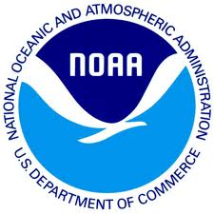
Preserving the Scientific Record:
Establishing Relationships with Archives
Version 1.0
Review Date
Matthew Mayernik
National Center for Atmospheric Research
Notes:
Modules should be 3-7 minutes long

Slide 2
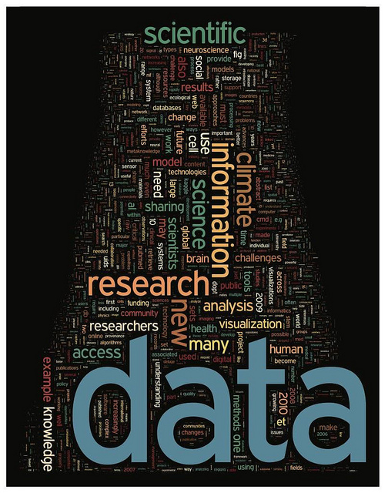
Overview
About data archives
  Data must be formally archived in order to be understandable and usable over long time periods
  Many data archives exist for particular kinds of data, or for particular institutions
Building relationships with archives:
  What data do you have?
  Where will your data go?
  How to get set up with an archive?
Image: http://www.flickr.com/photos/dullhunk/5436262905/ ,
http://www.sciencemag.org/content/331/6018.cover-expansion

Slide 3
About Data Archives
Archives view data resources as having an extended temporal horizon
  Past: Recovering legacy datasets
  Current: Attending to ongoing data collection
  Future: Designing for flexibility, compatibility, and sustainability of data
Archives have extensive data description requirements
  To enable routine and unforeseen data uses
  To enable maintenance and preservation of data over time
Archives continuously update technology
  Small iterative updates more common than large-scale replacements
Archives are highly collaborative
  Work with scientists to ingest and document data
  Work with other archives to share capacity and knowledge

Slide 4
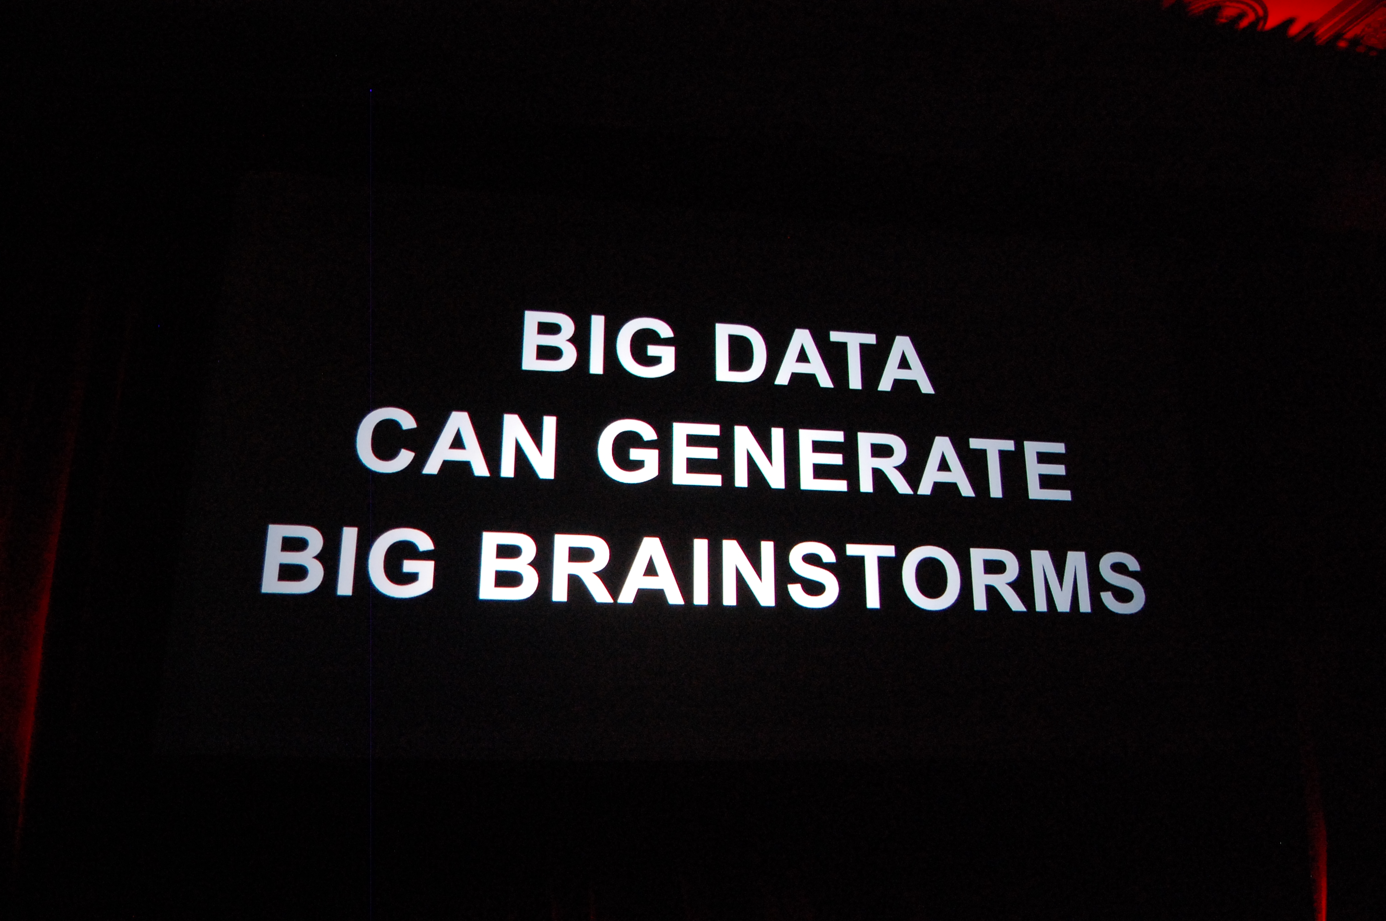
Building Relationships With Archives
What data do you have?
Where will the data go?
How to get set up with an archive?
Image: http://www.flickr.com/photos/kevinkrejci/6259499293/

Slide 5
What data do you have?
What type of data will be produced? Ex. numerical data, image data, text sequences or modeling data?
How much data, and at what growth rate? Are you gathering data by hand or using instrumentation that is able to capture a lot of data at once? Will there be more data as time goes on? If so, you will need to plan for growth.
Will the data change frequently? Keeping track of rapidly changing datasets can be a challenge, so it's imperative you begin with a plan that will carry you through the data management process.
From MIT Libraries, “Evaluate Your Data Needs,” http://libraries.mit.edu/guides/subjects/data-management/evaluate.html

Slide 6
Where will your data go?
Who is your audience for the data? How will they use them? This will tell you how to structure the data and where to distribute the data.
Who controls the data (PI, student, lab, institution, funder) and do any open data mandates exist? Before you spend a lot of time figuring out where to submit your data, you need to know if you have the authority to submit the data at all, and if your funder has any specific open data mandates or requirements that must be met.
How long should the data be retained? Ex. 3-5 years, 10-20 years, permanently? Not all data need to be retained indefinitely. Look at archives’ data policies for retention options and requirements.
From MIT Libraries, “Evaluate Your Data Needs,” http://libraries.mit.edu/guides/subjects/data-management/evaluate.html

Slide 7
How to get set up with an archive
Look at an archive’s data submission policies/procedures. Example procedures are:
  Incorporated Research Institutions for Seismology: http://www.iris.edu/data/#submit_data
  National Snow and Ice Data Center: http://nsidc.org/data/submit.html
  Oak Ridge National Lab DAAC for Biogeochemical Dynamics: http://daac.ornl.gov/PI/pi_info.shtml
  National Space Science Data Center: http://nssdc.gsfc.nasa.gov/nssdc/submitting_data.html
  NASA Planetary Data System: http://pds.jpl.nasa.gov/tools/archiving.shtml
Contact the data archive. Most archives will work with you directly to submit data, as long as the data are within their scope.

Slide 8
References
Hook, L., S.K. Santhana Vannan, T. Beaty, B. Wilson, and B. Cook. 2010. Best Practices for Preparing Environmental Data Sets to Share and Archive. Oak Ridge National Laboratory Distributed Active Archive Center, Oak Ridge, Tennessee. http://dx.doi.org/10.3334/ORNLDAAC/BestPractices-2010
Karasti, H., K. Baker, and E. Halkola. 2006. “Enriching the notion of data curation in escience: data managing and information infrastructuring in the long term ecological research (LTER) network.” Computer Supported Cooperative Work 15(4): 321-358. http://dx.doi.org/10.1007/s10606-006-9023-2
MIT Libraries. 2011. Data Management and Publishing. http://libraries.mit.edu/guides/subjects/data-management/index.html

Slide 9
Resources
MIT Libraries - “Evaluate Your Data Needs” http://libraries.mit.edu/guides/subjects/data-management/evaluate.html
Data submission policies/procedures:
  Incorporated Research Institutions for Seismology: http://www.iris.edu/data/#submit_data
  National Snow and Ice Data Center: http://nsidc.org/data/submit.html
  Oak Ridge National Lab DAAC for Biogeochemical Dynamics: http://daac.ornl.gov/PI/pi_info.shtml
  National Space Science Data Center: http://nssdc.gsfc.nasa.gov/nssdc/submitting_data.html
  NASA Planetary Data System: http://pds.jpl.nasa.gov/tools/archiving.shtml

Slide 10
Other Relevant Modules
Local data management: Managing your data
Local data management: Working with your archive organization
Preservation strategies: Options for archiving your data
Preservation strategies: What data goes into a long-term archive?
Preserving the Scientific Record:
  Establishing Relationships with archives
  Preserving a Record of Environmental Change
  Case Study 1 - NSIDC Glacier Photos
  Case Study 2 - Arctic Temperature Variability Data

