Slide 1





Reconstructing Sea Ice Extent from Early Nimbus Satellites
David Gallaher⁽¹⁾, Garrett Campbell⁽¹⁾
National Snow and Ice Data Center, University of Colorado, Boulder, Colorado, 80303, USA

Slide 2

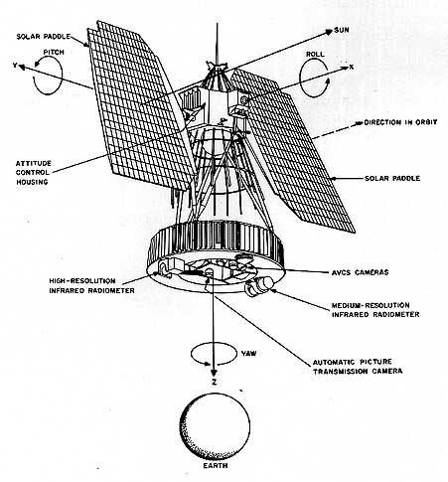
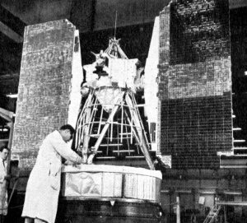
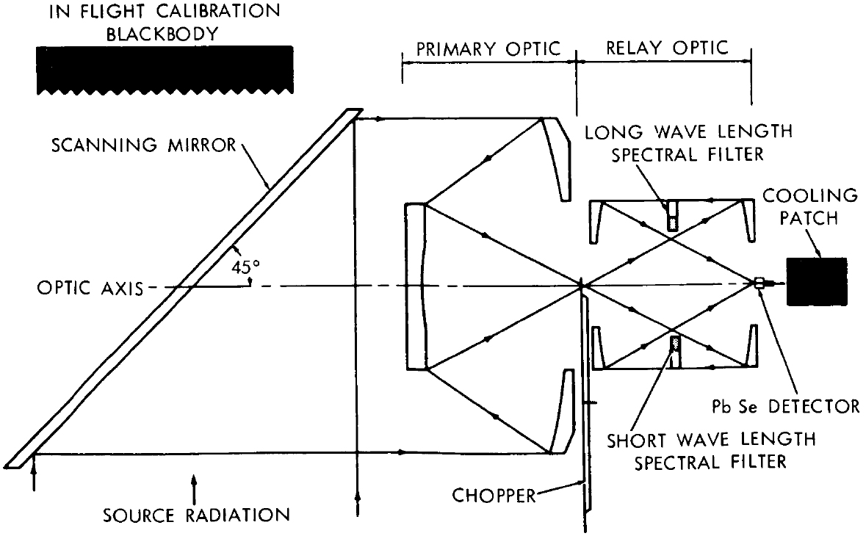
The 1960s NIMBUS Series
HRIR Sensor
Spacecraft Launch date End of Operation Sensors
Nimbus-1 Aug. 28, 1964 Sep 22, 1964 AVCS, HRIR
Nimbus-2 May 15, 1966 Nov 15, 1966 AVCS, HRIR, MRIR
Nimbus-3 Apr. 14, 1969 Jan. 31, 1970 IDCS, HRIR, MRIR
  Advanced Vidicon Camera System (AVCS) to provides visible light images (4-bit, 3km nadir )
  Image Dissector Camera System (IDCS) provides improved visible light images (8-bit, 5km nadir)
  Medium Resolution Infrared Radiometer (MRIR) to measure electromagnetic radiation emitted in five wavelength bands (Nimbus II & III) 50km
  High Resolution Infrared Radiometer (HRIR) to map the Earth at night (7km nadir)

Slide 3
Determining 1960s Sea Ice Extent - Project Impetus
Could 50-year old 1960s satellite data can be used to create polar sea ice extent on a monthly basis?
Except for the original science team, much of the data has likely never been seen or been made available.
The original engineers and researchers are now mostly in their late 70s and 80s, and time was running out to contact them. The tapes were disintegrating and film scanners are becoming obsolete.
The objective was to get this data to earth science researchers in a modern format (NetCDF).
This could extend the satellite sea ice 1979-2014 records by as much as 16 years.

Slide 4
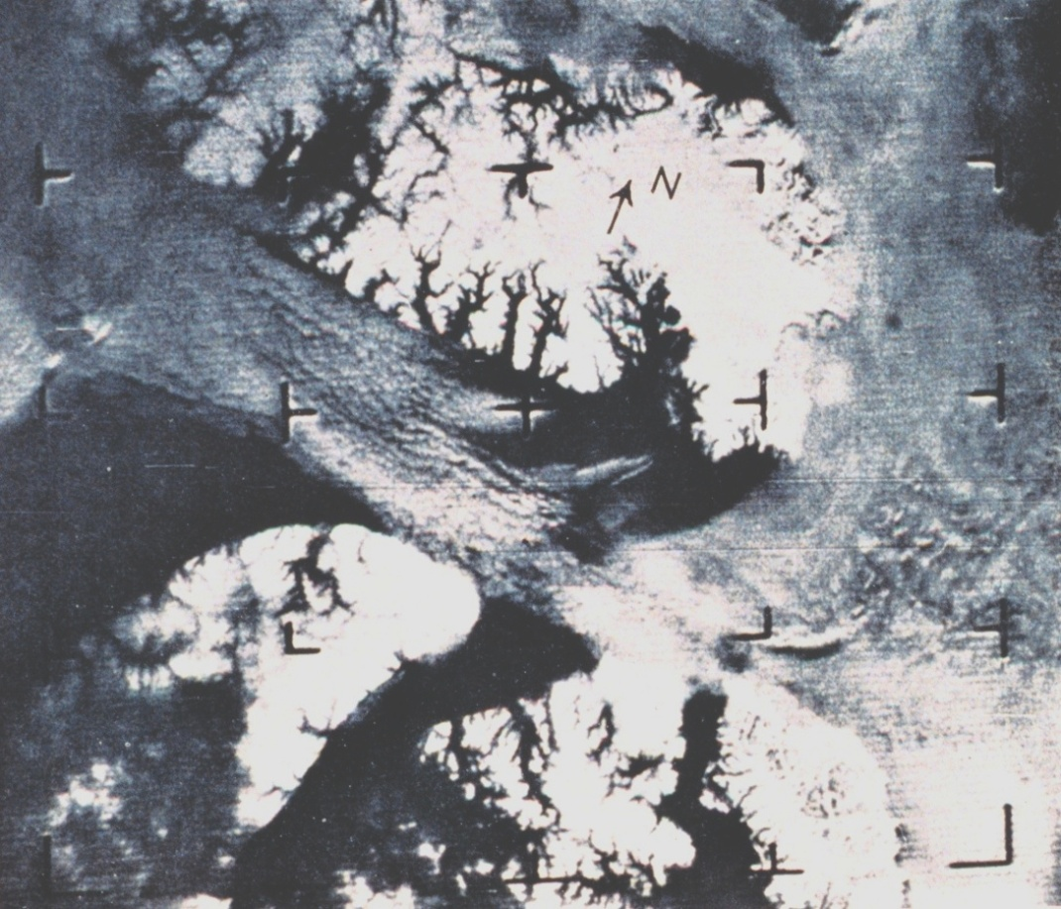
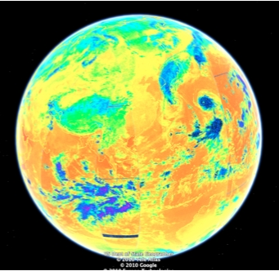
Nimbus Sensors (Visible and Infrared)
Devon and Baffin Islands, AVCS Image September 16, 1964
Nimbus II HRIR Infrared False Color, Asia, September 23, 1966
Ground Resolution as good as 1 km, 250,000 + images
NCDC had the only known copy
Note Himalayan Plateau and Pacific typhoons
National Archives had only tapes

Slide 5
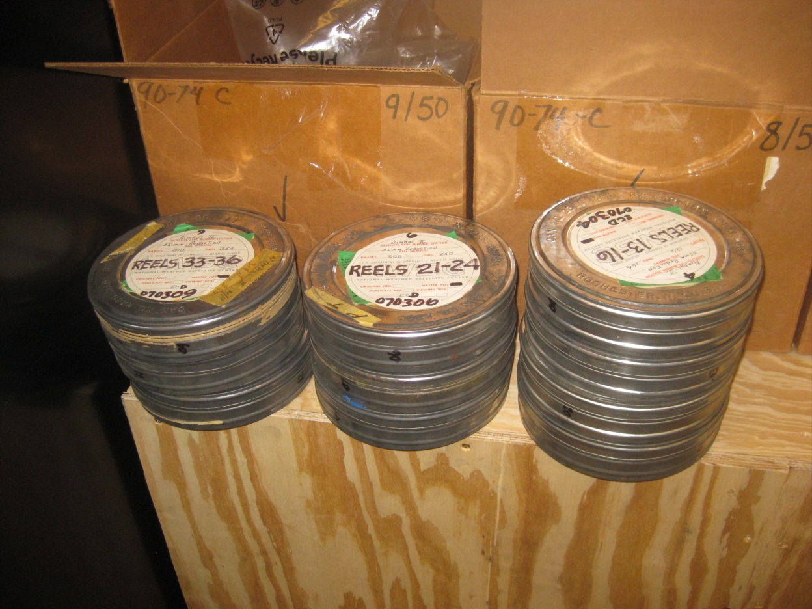
Extraction & Recovery of Nimbus data
Processing of Visible Data: AVCS/IDCS: 0.5-7.5um
Digitizing film 250,000 images
Scanning over 1,000,000 frames
Marking bad data
Navigating
Merge with NORAD ephemeris data
Merging into time composite
Metadata development
Need to enter the time of every image
Need to designate the center
Not possible to automate because some of the information is not readable
We were able to interpolate between good images to guess the times
Improve image location to 20km
(From NCDC Ashville, NC)

Slide 6
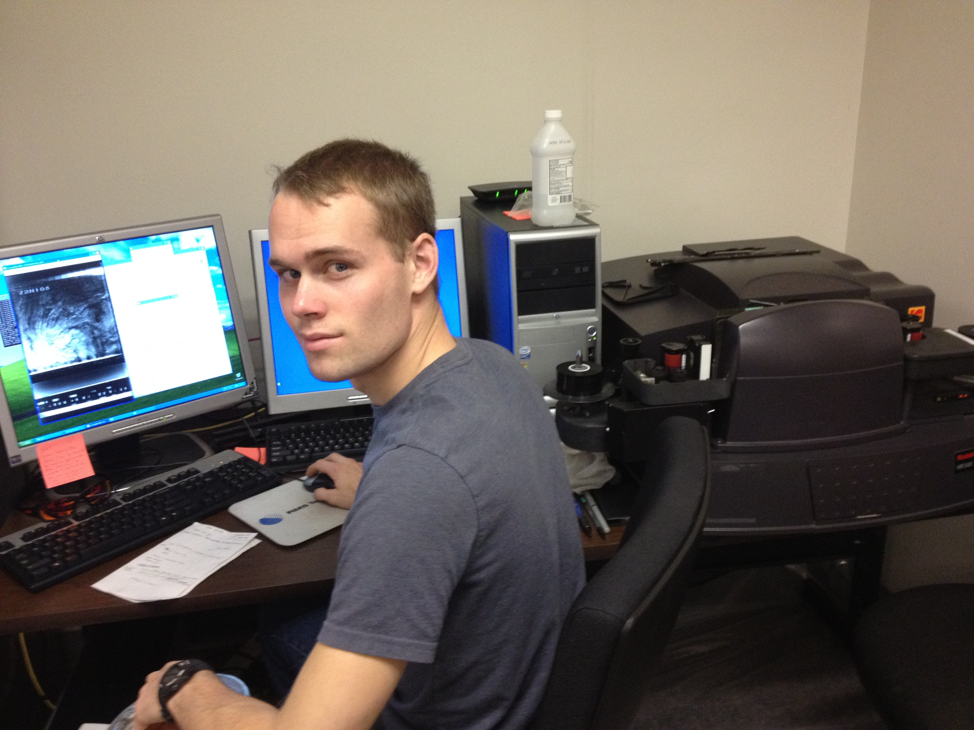
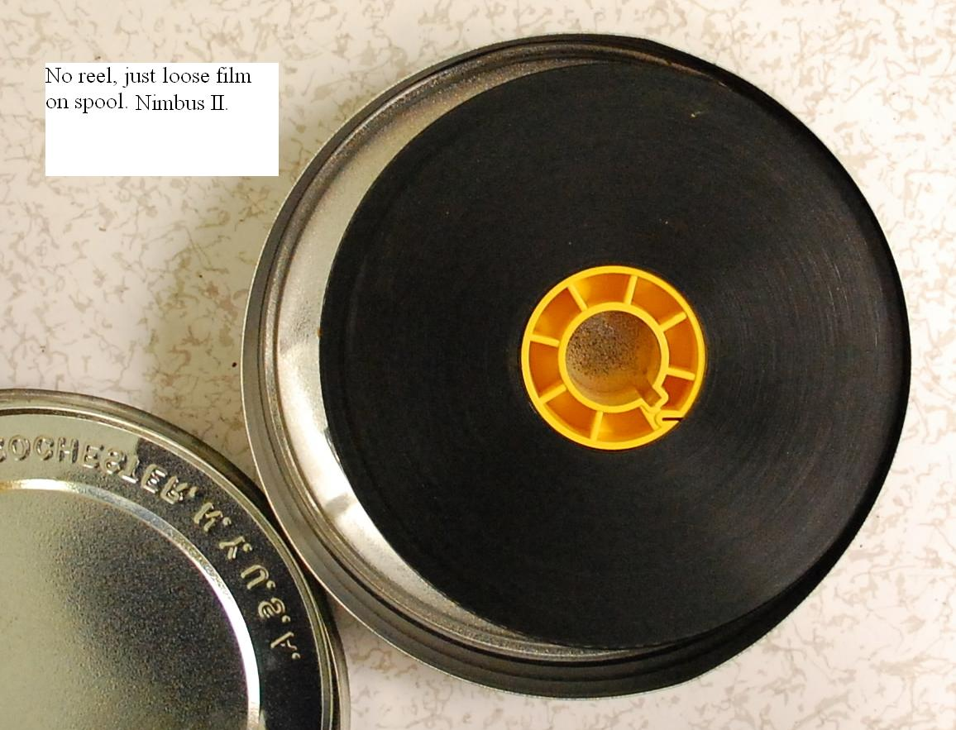
Extracting Data from Nimbus Film Record
(Note: Images were pictures of TV monitor on tape playback)
1960’s Archive = BW Film
Student monitoring of automatic digitizing machine (Kodak HR500) and inspection of every image. They then created the metadate for every image.
The film contains images that were recorded at random locations along the film reel. (ie 4” apart then 7” then 5” etc).
Therefore all the film was scanned and the images were programmatically rebuilt
About 4% of the Nimbus 1 data was rejected

Slide 7
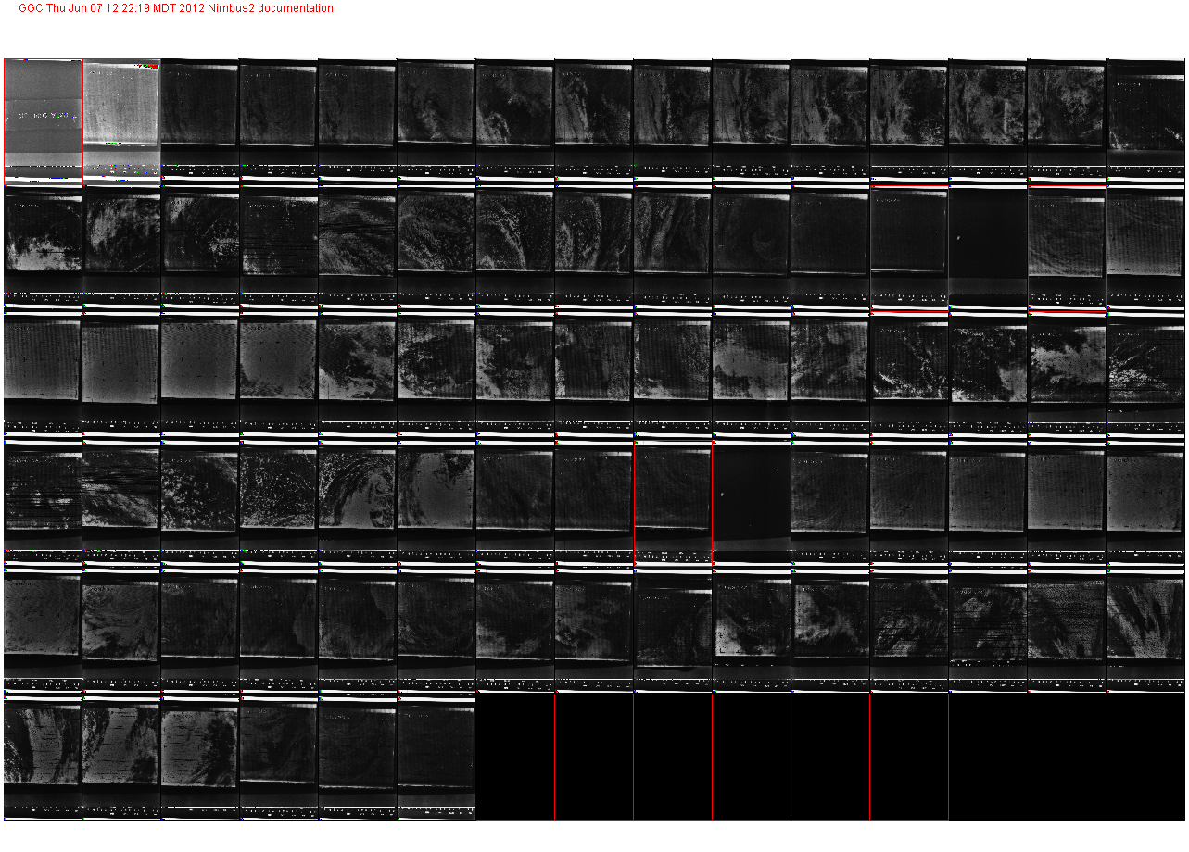
Video Game Like Metadata Development

Slide 8
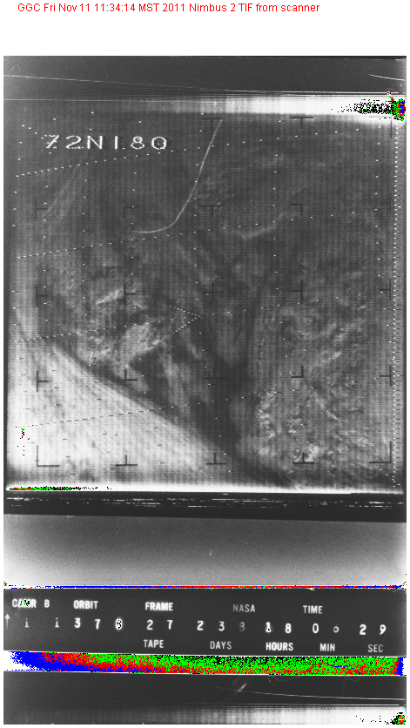
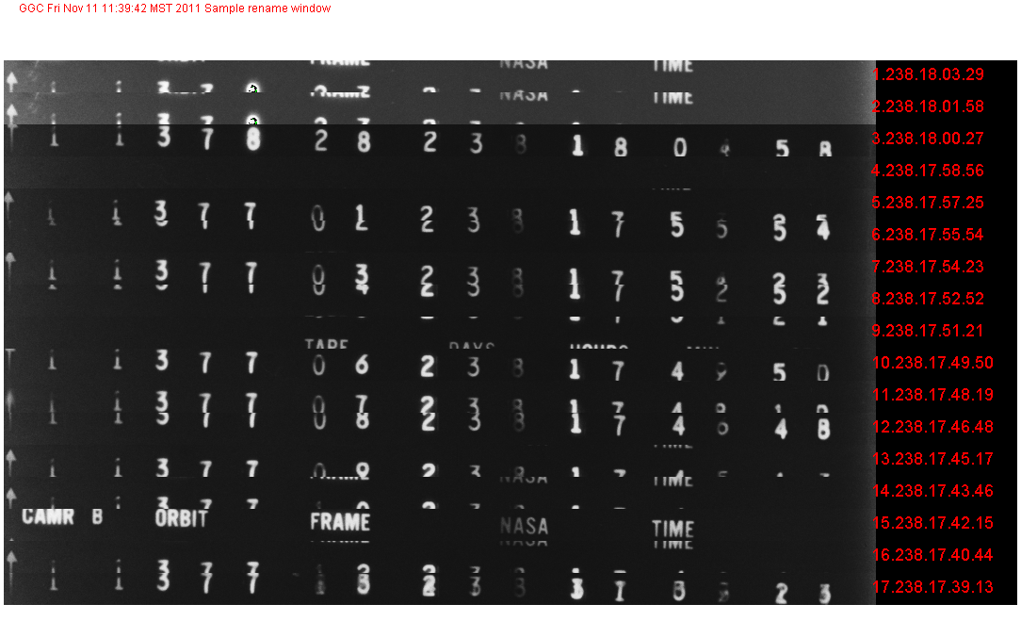
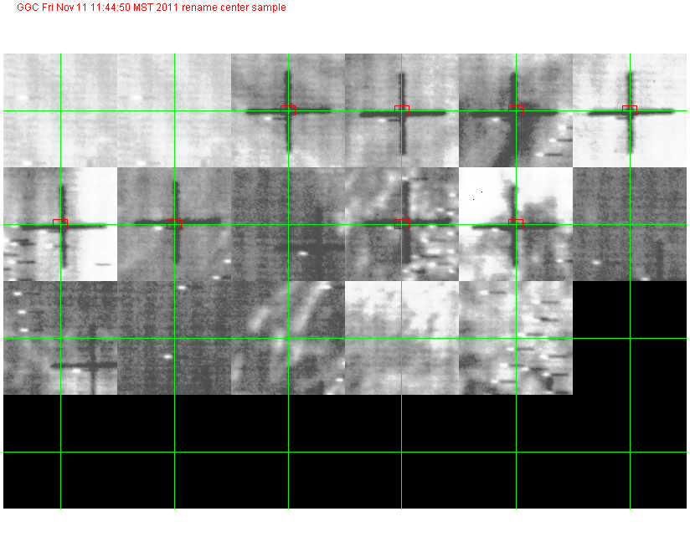
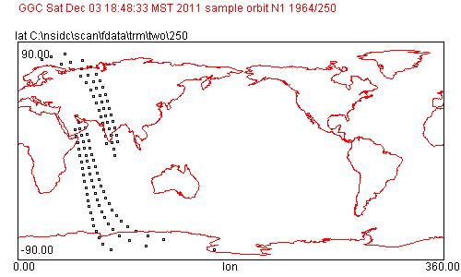
Visible Imagery Process: Scan, Annotate the Time,
Center of Every Image and Check Navigation
Image Scanning The images were acquired 91 seconds apart.
Center Selection
Navigation based on time and camera number

Slide 9
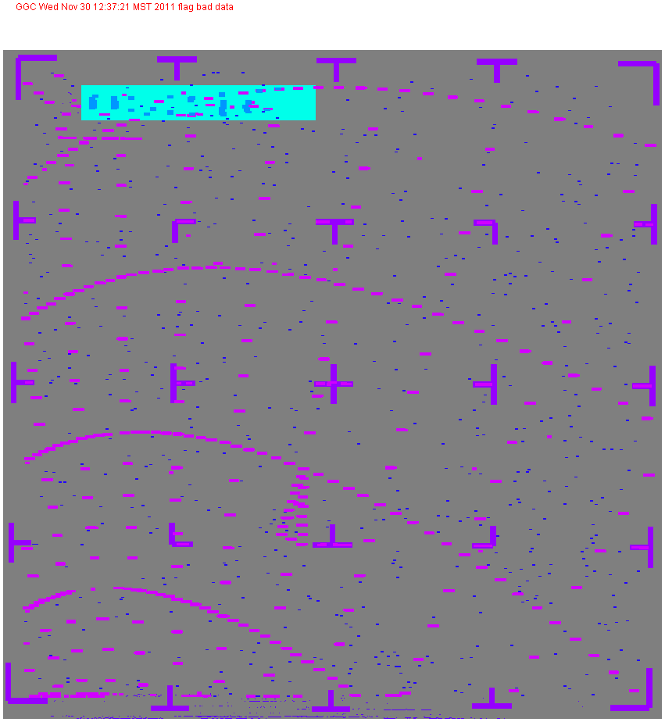
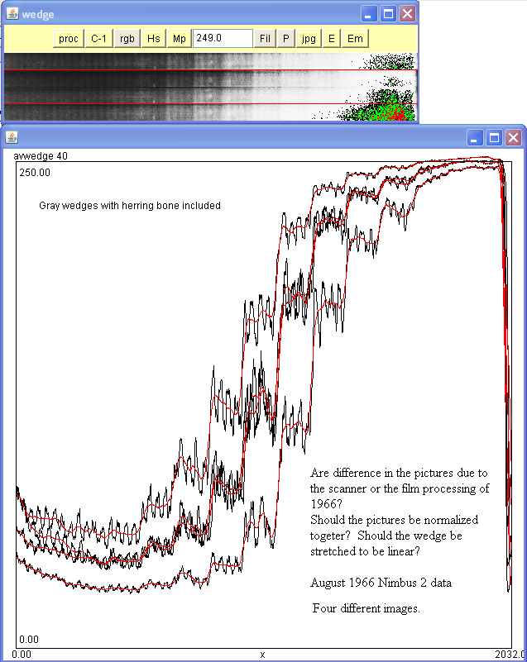
Bad Data Flagging and Calibration
Four different gray wedges, in Nimbus 2 case.

Slide 10
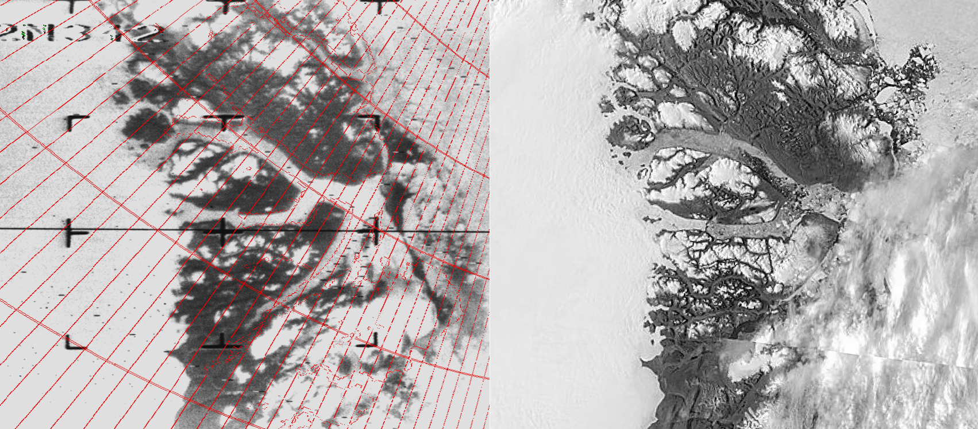
Sept 1964 NIMBUS/AVCS Sept 2011 TERRA/MODIS
Results: Comparing Historic Imagery
Independence Glacier Northern Greenland

Slide 11
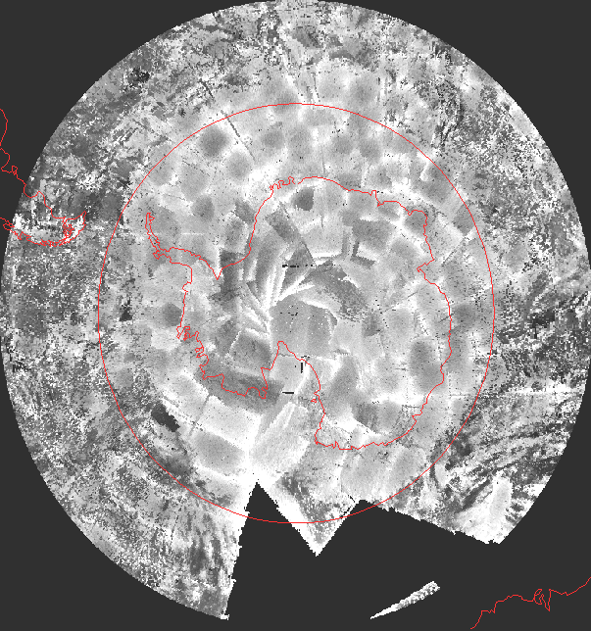
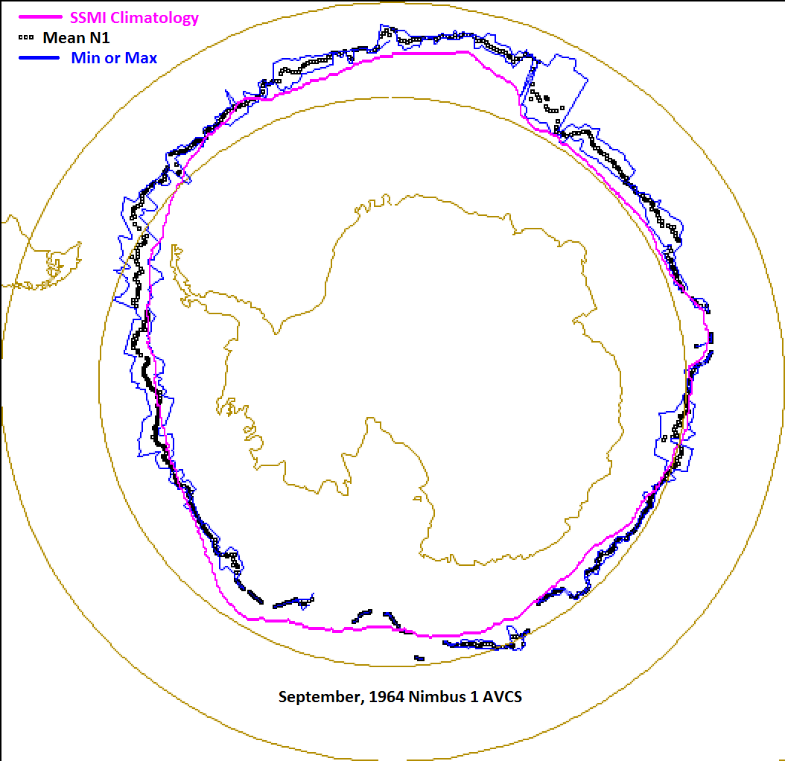
1964 NIMBUS-I Antarctic Sea Ice Extents
Nimbus I Antarctic visual detection analysis. Ice edge determinations are in blue while the 1979-2012 average SSM/I ice extent is in magenta.
AVCS Composite 7-day minimum brightness for September 1964. Note smooth grey extent of sea ice as compared to the noisy open water.

Slide 12
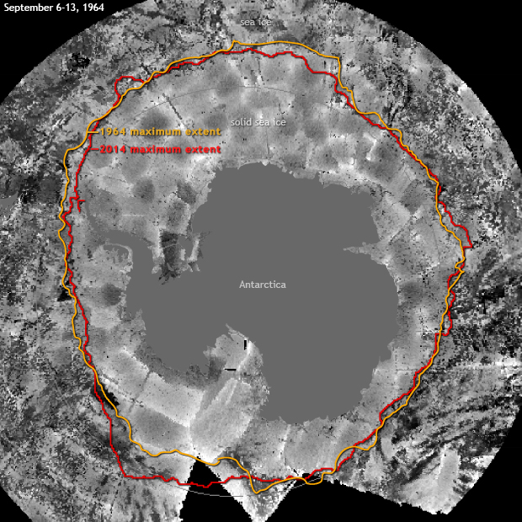
Average Extent Analysis 1964 and 2014 Compared to 1964 time composite minimum brightness
Nimbus I

Slide 13
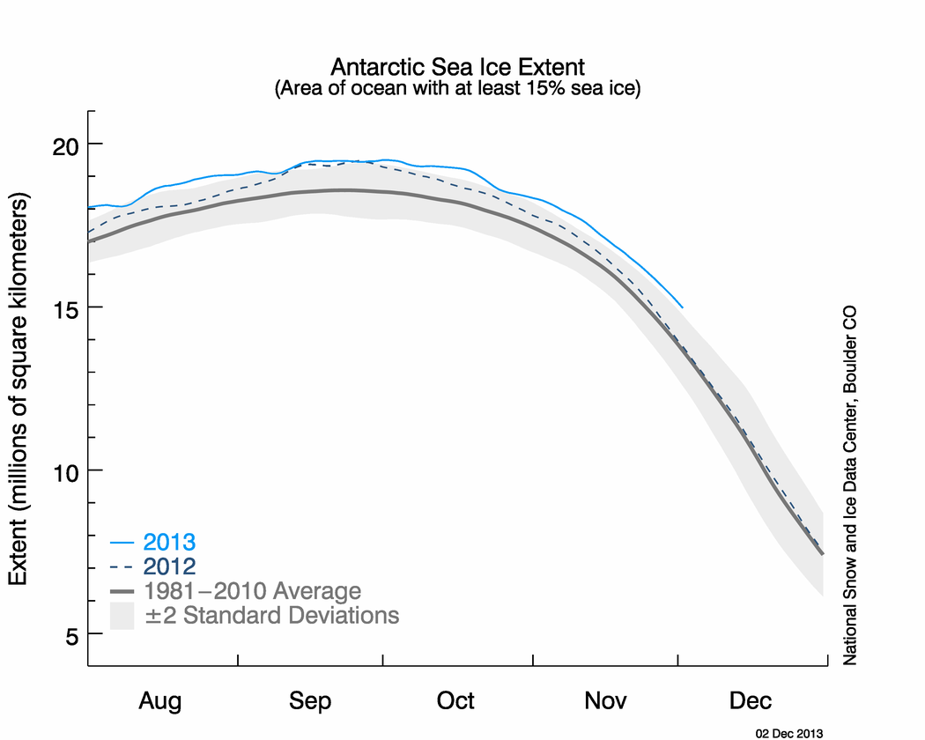
20.11 x10⁶ km²
19.71 ± 0.19x10⁶ km²
17.45 ± 0.25x10⁶ km²
16.93 ± 0.27x10⁶ km²
15.89 ± 0.29x10⁶ km²
New 2014 Record Maximum
Nimbus I -1964
The 1960’s Antarctic Variability was Much Greater Than Expected.
Nimbus II -1966
Nimbus III -1969

Slide 14
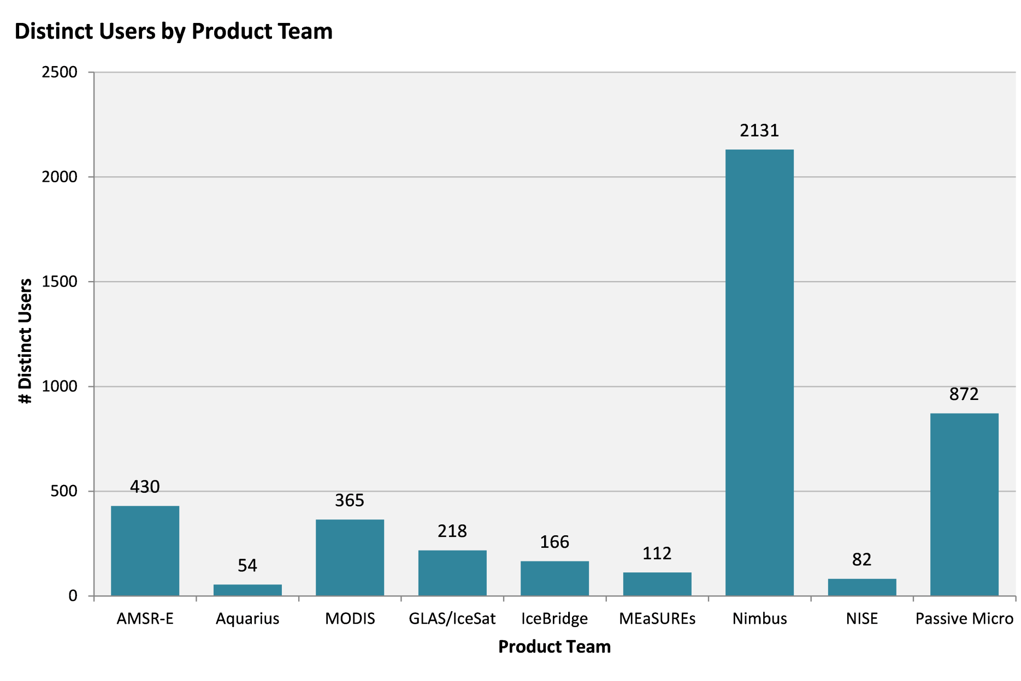
NSIDC Product Statistics. October 2014

Slide 15
Summary
Data from these 1960’s satellites is generally forgotten as a data source. We have found the data was of reasonable quality but the output products were limited due to the computer processing technology of the era. The Nimbus data represents the oldest digital satellite data in NASA’s data holdings (both visible and infrared).
These data are now stored in modern formats and are available for general use via NASA’s data access system: http://reverb.echo.nasa.gov/reverb, and at http://nsidc.org/data/nimbus/order-data.html
The Nimbus Data Rescue Project: Nimbus I, II, III was supported by NASA contract #NNG08HZ07C as a subtask to NSIDC at the University of Colorado.

Slide 16
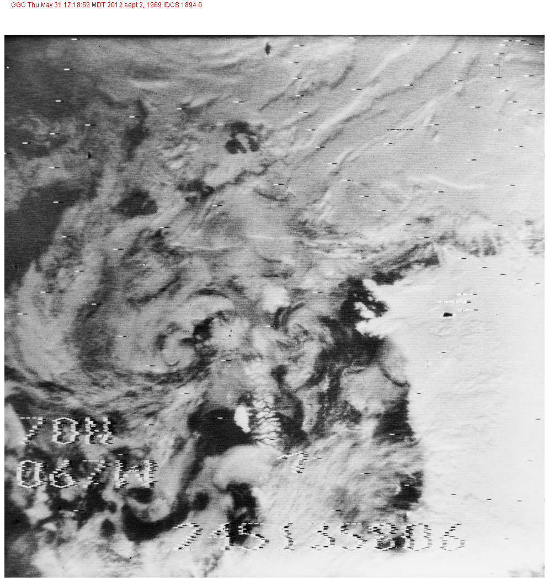
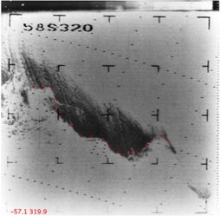
Thank You
Nimbus III IDCS Arctic image September 2,
1969 centered off NW Greenland
Nimbus I AVCS Antarctic image September 1964 with a distinct sea ice boundary
Notes:
Jorum Glacier, Antarctica. Photo courtesy Ted Scambos

