Slide 1
Data Preparedness for Disaster, Hazards and other Events
Sara Graves¹, Udaysankar Nair¹, Sandy Ebersole², Ken Keiser¹, Michael McEniry^{1,} John Beck¹
Information Technology and Systems Center at the University of Alabama in Huntsville, UAH Atmospheric Science Department¹, and the Geological Survey of Alabama²
2017 Winter ESIP Meeting (Jan 11, 2017)
Session: Data Driven Decision Making for Disaster Response User Community

Slide 2

Event-Driven Data Delivery (ED3) Framework
Facilitates planning for data needs
Improves data preparedness
Supports automated data aggregation
Provides reusable framework components
Supports any event type
“...the aftermath of a major disaster is no time to be exchanging business cards.” (GAO-06-467T, 2006)
ED3 is funded by the NASA Applied Science for Disasters Program
Notes:
Preparedness is the premise for our NASA Applied Science project to improve and demonstrate a framework for event-driven data delivery (ED3)
The Applied Science program is now focused on initial feasibility studies, followed by funding to fully develop and deploy if feasible.
Our focus with the framework is to provide the building blocks that can be reused by lots of decision systems and support specialized solutions

Slide 3
ED3 Services
Provides Loose Coupling of…
Handlers for event notifications/alerts/warnings
Data workflows/processes
Data access
Product Generation
Sensor tasking
Model Execution
Packaging/Formatting
Other as needed
Data Delivery – Event Albums

Slide 4
Event Albums
Event Albums are compiled virtual collections of information related to a specific event with links to relevant data and information from different sources
Curation allows the author of a Event Album to select the information to be aggregated (define the album)
An album is also a transportable container of relevant event information that can be available to multiple systems

Slide 5
Defining Virtual Collections
An event-based virtual collection (VC) is a collection of resources, relevant to a matching event, available on one or more computer systems, where a single interface to the collection is provided. It could be a living collection in that as more relevant data becomes available for an event, such as science data that is not available until days after the event or researchers analysis results, could be automatically added to the VC when available.
A VC can be published and managed by data centers for use by others.

Slide 6
REACT (Rapid Event Album CollecTions)
Provides a subscription services/application layered on the ED3 framework
Manages user subscriptions
Supports definitions of event types
Supports connection with pre-defined data processes
Science Data search/discovery
Data product generation/Process workflows
Model executions
Sensor tasking
Relevant social media
Creation and management of virtual collections (event albums)

Slide 7
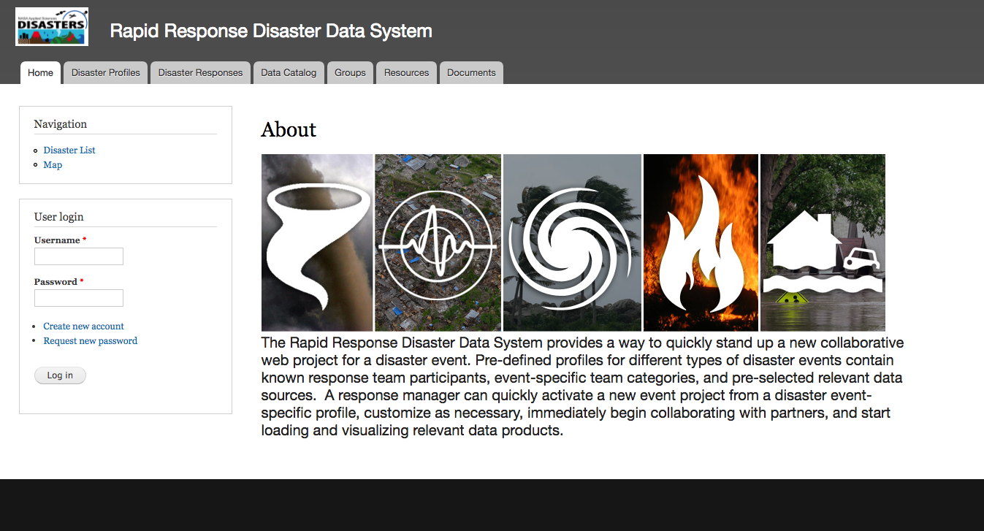
REACT (Rapid Event Album CollecTions)

Slide 8
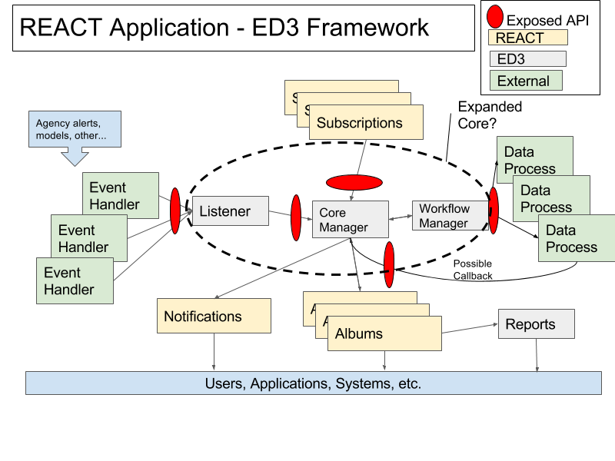
REACT (Rapid Event Album CollecTions)

Slide 9
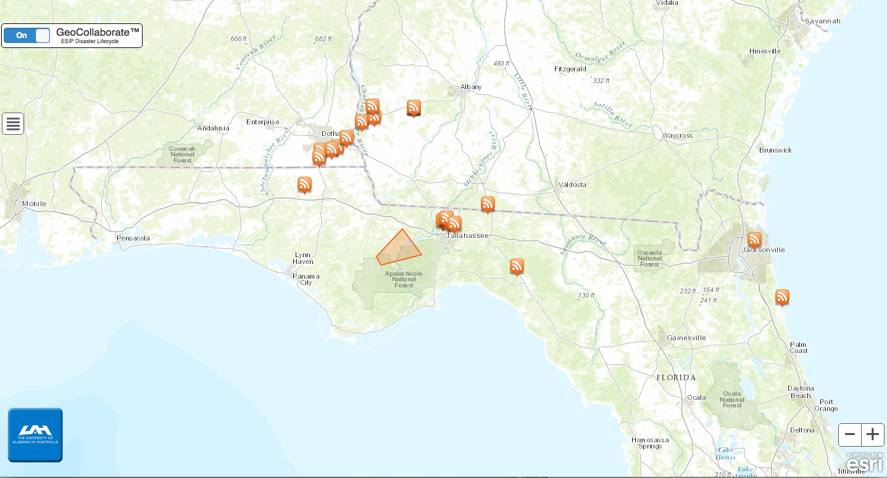
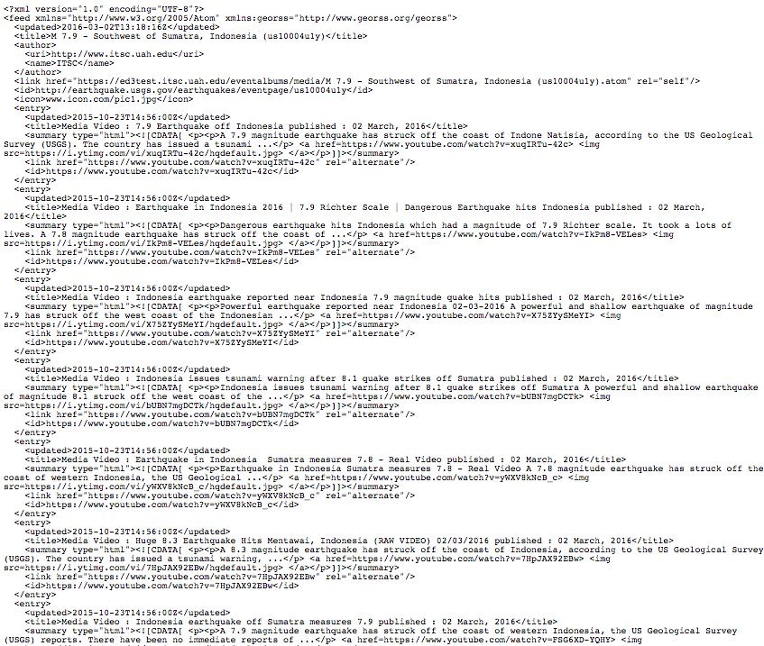
Integration with Applications
Event Album GeoRSS
Storm Center’s GeoCollaborate Visualization Application

Slide 10
Use Cases: Support phenomena research
For example a user could specify that for any (NWS-defined) severe thunderstorm in a selected 3 county area, create a virtual collection containing radar data for a specific spatial and temporal window relative to the event, as well as remote sensing data granules for specific wind and precipitation products, any twitter messages discussing storm impact/damage, any youTube videos of the storm, and relevant news media reports, etc.. Links to all of this information would be persisted in a virtual collection that a researcher could use as a starting place as a comprehensive package of information about a storm event. Provided as a GeoRSS formatted feed, the collection can also be automatically integrated with many existing visualization packages.
Customer: Any science researcher or entity working with specific types of events
Event Types: Severe Weather, Earthquakes, volcanoes, floods, wildfires, droughts, air pollution, etc. Essentially any event that can be monitored for notifications/alerts
Data products: NASA science data, any other products (models, etc) that can be generated based on an event occurrence, relevant social media content, research analyses
Entry point: from event-based subscription web app

Slide 11
Use Cases: Automatically pre-generated media packages for major weather events
Automatically pre-generated media packages for major weather events
Often when there is a major weather event, NASA PR folks ask for media-friendly items showcasing how NASA-funded activities can help society respond to the event. The general response seems to be a lot of scrambling to find relevant items. By having an event-based subscription that already pulls together the anticipated resources, GHRC can provide the request material much sooner and without having to scramble. Also, as we find better resources, we can add them to the existing subscriptions, so that what we can provide gradually becomes better over time. A further refinement is to incorporate this into the web site publication workflow, so that webteam can promote the material without requiring developers to support each individual event.
Customer: GHRC
Event Types: Major weather events, hurricanes, severe weather, etc
Data Products: lots?
Entry point: GHRC admin interface

Slide 12
Use Cases: (Future) Turning data search into an event-based subscription/request
While search for data in the GHRC system, the user is presented with event information coincident with their spatial/temporal searches and asked if they would like additional data/information related to that (and similar) events. The user could then be referred to the event-based subscription interface (along with current spatial/temporal settings) where they could complete a subscription request.
Customer: anyone
Event Types: any currently configured in the system to allow for coincidence with users searches.
Data products: NASA science data, any other products (models, etc) that can be generated based on an event occurrence, relevant social media content, research analyses
Entry point: GHRC data search - then redirected to event-based subscription interface

Slide 13








Contact Info
Ken Keiser
Information Technology and Systems Center
University of Alabama in Huntsville
email: keiserk@uah.edu
Phone: (256)-824-6825
http://www.itsc.uah.edu

