Slide 1
Earth Science Collaboratory
Chris Lynnes
Rahul Ramachandran
Kwo-Sen Kuo

Slide 2
Agenda
Description of Collaboratory
Problem Statement
Concept
Expected Benefits
Earth Science Collaboratory Cluster in ESIP
A Science Story

Slide 3
The Situation Today
Earth Science Stuff is (still) hard to use...
data
science tools / svcs
analysis results
knowledge about
data
tools
analysis methods
find
share
reuse
understand
put together
data + data
data + tool
tool + tool
desktop + online

Slide 4



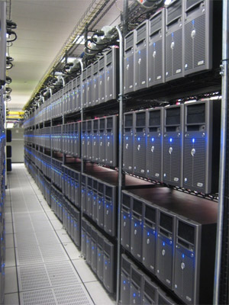

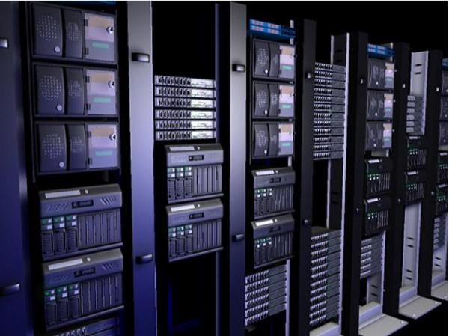



Currently: Islands of data and services with selective connectivity
Data Center A
Data Center C
Data Center B

Slide 5
Proposed: An Earth Science Collaboratory
A rich data analysis environment that:
Provides access across a wide spectrum of Earth Science data
Provides a diverse set of science analysis services and tools
Supports the application of services and tools to data
Supports collaboration on data analysis
Supports sharing of data, tools, results and knowledge
Two Key Tenets
Social collaboration
Federation

Slide 6
Why Now?
Rise of interdisciplinary science
Increasing interest in Earth system science
Rise in Data Intensive science
Data exploration vs. hypothesis-driven
Emergence of social networking
Especially amongst the young ‘uns

Slide 7

High-Level Conceptual View
Cyberinfrastructure
Laboratory Notebooks (Results)
Publications
Workflows + Analysis Processes
Mediator
Tools
Data
Data Centers

Slide 8
The Early-Career Researcher
An ESC Story

Slide 9
Stu, The Early-Career Researcher
B.S. in Earth Sciences from University of Michigan
Now a Master’s student in Atmospheric and Oceanic Sciences at the University of Maryland
Professor: “Find out why MODIS Aqua and Terra aerosols are anticorrelated over Tibet. I’m off on sabbatical.”
Stu: “What? They are? Hey, wait, how do I reach you?”
Exit Master’s thesis advisor, stage right.

Slide 10
Stu’s Story
Googles “MODIS Terra Aqua AOD Tibet anticorrelation”
Result comes back from within Earth Science Collaboratory.
Click...

Slide 11
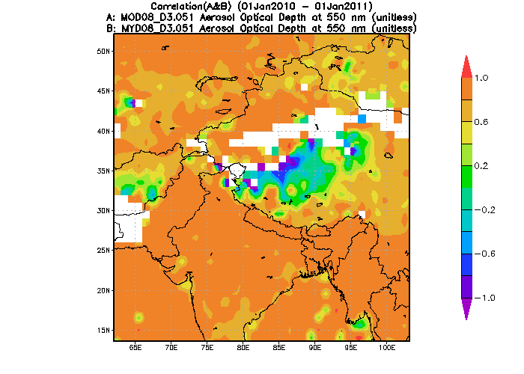
“Click”
“Odd, MODIS Aqua and Terra AOD are anticorrelated over Tibet for 2010” -- jpearson39, 29 May 2012
Read Journal Articles
Peruse Research Notebook
Rerun Analysis

Slide 12
Stu’s On His Way
Checks jpearson39’s research notebook for related results
Repeats jpearson39’s Correlation Map workflow with different years, filtering options, etc.
Decides he really needs to look at the higher resolution Level 2 satellite swath data, not nicely gridded Level 3.
Uh-oh...

Slide 13
Level 2 data is hard...
Not geographically gridded, hard to compare Aqua v. Terra pixels...
Stu searches for articles about MODIS L2 aerosols, locates a prolific author, cjones97
Starting from the most relevant article, Stu looks at the Research Notebook, then drills down on a workflow to see how the data are handled
Whoa, looks like Level 2 data needs quality filtering(!), and bias correction(!!)
Stu clones the workflow to get started, then modifies to meet his needs, etc.
Now he still needs to match up Aqua and Terra...

Slide 14
Finding coincident L2 MODIS Aqua and Terra aerosols
Matching up data from 2 satellites is hard and tedious
Stu searches to find a coincidence tool to match Aqua and Terra aerosol values within given time and space tolerance
Output is HDF
Finally, Stu finds a service to make an X-Y scatterplot
Input is netCDF
ESC locates an appropriate HDF->netCDF converter
Stu and ESC construct a workflow to matchup, filter, correct and plot MODIS Aqua and Terra aerosol values

Slide 15
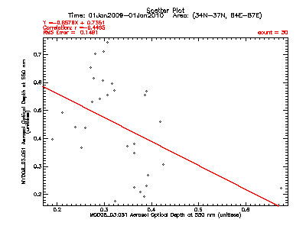
Stu gets his result!
ESC’s provenance shows it to trace back to cjones97’s workflow
Stu also links back to jpearson39’s original results with L3 correlation maps (easy as it is still in his ESC history)
Elapsed Time with ESC: < 2 days (most of it looking at prior results)
Elapsed Time before ESC: > 30 days

Slide 16
Lessons from the Scenario:
Tool availability is a force multiplier
More tools will be usable with more datasets
More tools will be easier to find and more available to more users
Knowledge sharing evolves from text on paper to a rich mixture of data, tools, workflows and articles
A “wikihow” for Earth Science data analysis will emerge
Incorporating live data, services and workflows
ESC maintains a record of the analysis process
Share, repeat, build upon analysis techniques
Transparency of the process is built in

Slide 17
Benefits
More/Better Science
Cross-disciplinary + Interdisciplinary
Research leveraging diverse data resources
Workforce development
Undergraduate, graduate students learn data analysis by example
Community Engagement
Scientific Transparency
Cost Reduction
Less effort on spent on tools
Less effort spent by scientists on data management
N.B.: not the only or even main point of ESC

Slide 18
Getting Involved

Slide 19
Earth Science Collaboratory Cluster in ESIP
Formed in 2011 in the Federation of Earth Science Information Partners
Clusters:
are informal special-interest working groups
have no budget
are staffed by mostly-unpaid volunteers
What can clusters do?
Formulate and articulate community goals
Coordinate community participation
Suggest solution frameworks
Provide a forum for networking
http://wiki.esipfed.org/index.php/Earth_Science_Collaboratory

Slide 20
ESC Cluster Activities
Articulate the vision
IEEE TGRS paper, presentations
Identify resources to get closer to the vision
Technologies
Programs
Projects
People
...
Participate in relevant community efforts
EarthCube
...

Slide 21
NASA Earth Science Data Systems Working Group: ESC Reference Architecture
https://wiki.earthdata.nasa.gov/display/ESDSWG/Earth+Science+Collaboratory+Working+Group
User Stories: http://wiki.esipfed.org/index.php/Earth_Science_Collaboratory_User_Stories
Key Features: https://docs.google.com/document/d/1UpLb9KtOaWqlkiZFXj6Ir_lPlHvJ6z8DVZYiHm-bSf8/edit?usp=sharing
Killer App: https://docs.google.com/document/d/1FpANLP92QMOEUDoM-kDxjjxytdm7JRdEOWzN9t98YiQ/edit?usp=sharing

Slide 22
The Ecosystem Strategy: Work toward an Ecosystem, not an Architected System
An Emergent, Meta-System that favors federation
Emphasizes grassroots adoption
The value proposition at the investigator / user level is critical to get right
Emphasizes inter-system interoperability
Brokering, mediation, gateways, shims, “polyglot” components
Emphasize rules and methods to fit cooperating and competing stuff together
Design “Selection Pressures” toward desired results
Funding calls
Proposal codicils (e.g., “...must be infused into collaboratory”)
Guidance for working groups
Recruiting desirable participants
etc.

Slide 23
The Convergent Evolution Strategy
Often, some tweaking early in a project + ongoing interactions produce results that are easier to fit together...
...But it does help to know the desired end state.
ESC

Slide 24
Deep Background

Slide 25
Prior Art
Talkoot, myExperiment.org – workflow sharing, virtual notebooks
Earth System Grid – provisioned tools, format standards/checkers
NASA Earth Exchange (NEX)
Land Information System – OPeNDAP as access infrastructure
Earth Science Modeling Framework – programmatic approach to integration
Giovanni, LAS – community services/tools
Canadian Space Science Data Portal (EOS, Feb. 22, 2011)
HubZero

Slide 26
Tool Library
Discovery
Social
Sharing
Tagging
Discussion
Configuration Management
Testing
Versioning
Packager
autoconf
RPM
Web wrapper
Provisioned
GrADS
IDL
MatLab
ncl
nco
cdat
Contributed
[Tool 1]
[Tool 2]
[Tool 3]
[Tool 4]
[Tool 5]
…
Community
Quality filter
Coincidence
Feature detection
Event service
Visualization
Personal
[Tool 1]
[Tool 2]
[Tool 3]
[Tool 4]
[Tool 5]
…

Slide 27
Data Library
Cache
Discovery
Social
Sharing
Tagging
Discussion
Configuration Management
Testing
Versioning
Packager
data probe
format check
metadata wizard
Provisioned
EOSDIS
Contributed
[Dataset 1]
[Dataset 2]
[Dataset 3]
[Dataset 4]
[Dataset 5]
…
Community
Field campaigns
MEaSUREs
ACCESS
Validation
Personal
[Dataset 1]
[Dataset 2]
[Dataset 3]
…

Slide 28
Workflow Library
Discovery
Social
Sharing
Tagging
Discussion
Configuration Management
Testing
Versioning
Packager
Workflow editor
Provisioned
Processing Algorithms
Contributed
[Workflow 1]
[Workflow 2]
[Workflow 3]
[Workflow 4]
[Workflow 5]
…
Community
GeoBrain
SciFlo
Data Mining
Giovanni
Personal
[Workflow 1]
[Workflow 2]
[Workflow 3]
…

Slide 29
Laboratory Notebook
Discovery
Social
Sharing
Tagging
Discussion
Configuration Management
Versioning
Packager
Project Manager
Experiment manager
Notebook editor
Provisioned
Tutorials
User guides
Example uses
Educational packages
Project
[Project 1]
[Project 2]
[Project 3]
[Project 4]
[Project 5]
…
Community
Project results
Publications
Example cases
Educational packages
Personal
Notes
Journals
…

Slide 30
Mediator
Mediates tool interaction with data
OPeNDAP – a common data model (accessible by most tools)
Custom modules reformat data for the rest of the tools
Ontology matches tools with data, and vice versa.

Slide 31
Cyberinfrastructure Services used by all other components
Security
authentication
authorization
code audit/padded cell
integrity checking
Social
tagging
sharing
discussions
groups
reputation
Cloud
elastic provisioned storage and computing
Discovery
data, tools, workflows, experiments
search by keyword, variable, time, author
Information Mgmt
provenance
identifiers
archive
Semantic Web
data ontology
tools ontology

