Slide 1



Emissions Data Needs, Issues, and Interoperability from the GEIA Perspective
Greg Frost
NOAA/ESRL/CSD & University of Colorado/CIRES
Boulder, Colorado, USA
Thanks to Claire Granier, Paulette Middleton, Ann Keane, Leonor Tarrasón, Rudy Husar, and the ECCAD and CIERA teams
http://www.geiacenter.org/
  http://pole-ether.fr/eccad
http://ciera-air.org/

Slide 2















Community Leadership Teams
Global Emissions InitiAtive
http://www.geiacenter.org/
Steering Committee: Leonor Tarrasón (Chair), Gregory Frost (Chair), Beatriz Cardenas, Hugo Denier van der Gon, Claire Granier (Past Chair), Alex Guenther (Past Chair), Greet Janssens-Maenhout, Johannes Kaiser, Terry Keating, Zbigniew Klimont, Jean-Francois Lamarque, Catherine Liousse, Paulette Middleton (Network Manager), Slobodan Nickovic, Toshimasa Ohara, Martin Schultz, Ute Skiba, John van Aardenne, Yuxuan Wang
Web Development: Ann Keane, Debra Hopkins
Emissions of atmospheric Compounds & Compilation of Ancillary Data
  http://pole-ether.fr/eccad
Claire Granier, Catherine Liousse, Sabine Darras, Aude Mieville, Vincent Pignot
Community Initiative for Emissions Research and Applications
http://ciera-air.org/
Gregory Frost, Stefan Falke, Claire Granier, Ann Keane, Terry Keating, Jean-François Lamarque, Megan Melamed, Paulette Middleton, Gabrielle Pétron, Steven Smith
Federation of Earth Science Information Partners
http://www.esipfed.org/
Carol Meyer, Erin Robinson

Slide 3
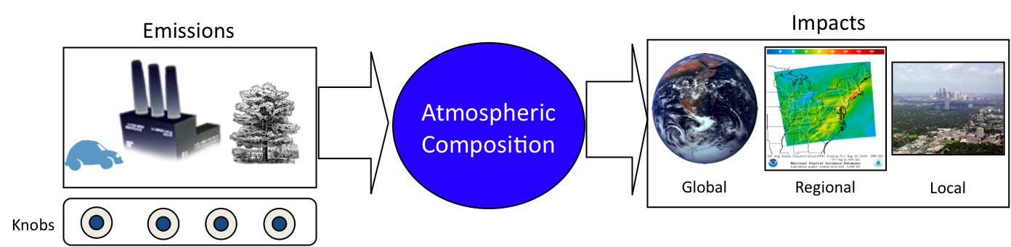
Motivation for Understanding Emissions
Actions and decisions about the atmosphere focus on emissions
Accurate emission information is needed to:
Quantify and predict atmospheric composition
Understand changes in air quality and climate
Make choices about emission controls
We are in the “Century of Accountability”
Emissions are also tools of economics, foreign policy, & international diplomacy
Emissions information presents unique challenges:
Complexity Consistency Timeliness Evaluation Communication
Need broadly accessible & high quality emissions information

Slide 4
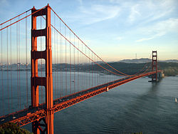
GEIA’s Vision and Activities
GEIA’s Vision
GEIA helps build a bridge between environmental science and policy, by bringing together people, data, and tools to create and communicate the highest quality information about emissions.
Science
Policy
Emissions
GEIA’s Activities
Analysis – Improve the scientific basis for emissions information and policy making
Access – Make information needed for key analyses more readily available
Community – Strengthen the science & policy relationships to improve analyses

Slide 5
GEIA Framework
Analysis
Evaluation
Clearinghouse
New Emissions Challenges
Projects
Interoperability
CIERA
Capacity Building
GEIA Communication Hub
GEIAcenter.org
Searchable Bibliography
Outreach
Emissions & Ancillary Data
ECCAD
Policy-Science Links
Access
Community

Slide 6
Examples of GEIA Activities
Ongoing & Future
Access
Consistent access to emission inventories for research & assessment efforts (MACC, CCMI, HTAP, field studies)
Access to ancillary (driver) datasets that inform inventories
Interoperability of emissions data
Build emissions literature bibliography
Analysis
Present emissions data in easy-to-use ways (mapping, comparisons, stats)
Facilitate building ensembles of inventories for comparisons/evaluations/uncertainty assessment
Enable assimilation of observations for emissions variability
Support working groups on specific emission topics
Community
Emissions expert network communication
Motivate network to pursue emissions research topics
Workshops/conferences/schools for emissions developers & users
Build emissions information capacity globally

Slide 7
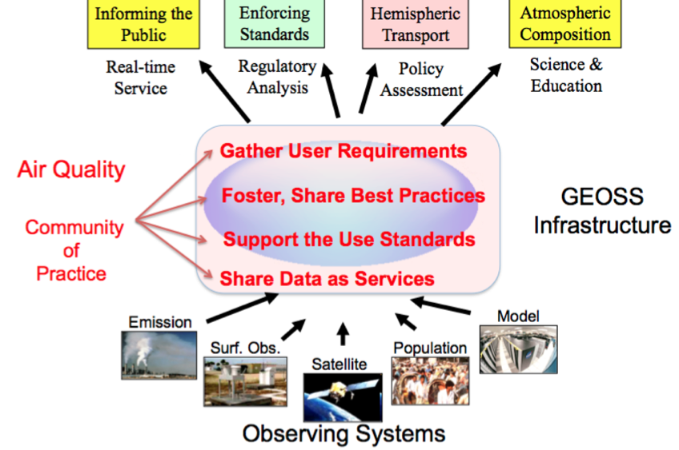

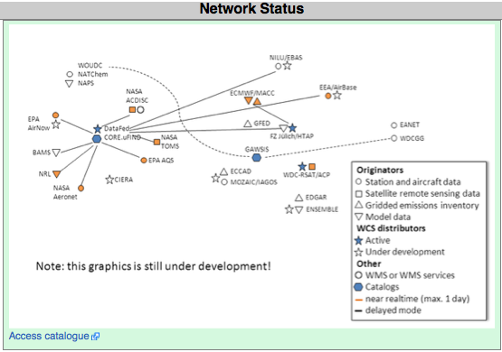

GEIA’s Partners in Interoperability Development
Communities
ESIP AQ Working Group
http://www.esipfed.org/
http://wiki.esipfed.org/index.php/GEO_AQ_CoP
Development Nodes
DataFed (Rudy Husar et al.)
http://datafed.net
FZ Jülich (Martin Schultz et al.)
http://ogc-interface.icg.kfa-juelich.de:50080

Slide 8
Emissions Data Issues and Needs
Emissions data are multi-dimensional: Space, Time, Pollutant, Source, Parameter
Data developed from/informed by science + regulation, policy, economics, …
Datasets lack consistency: Different developers, methodologies, applications
Other issues with emissions data: Accessibility, Documentation, Developer-User Interactions, Evaluation/Uncertainty Analysis
Metadata not generally compliant with standards for other types of earth science data
Approaches for handling distributed emissions data are in development…more generic approaches are needed
Need to learn from and link to other communities: air quality/climate modeling groups, monitoring/satellite/field observations, assessment/future scenarios, health, etc.

Slide 9
Some Technical Goals for Emissions Data
Metadata definitions and conventions
Translating between inventories: pollutants, units, sectors
Spatial projection and allocation
Visualization: maps, time series
Statistics: area or grid-box totals, sector partitioning
Dataset comparisons: arithmetic, plotting
Comments on data and on data comparisons
Best practice recommendations for data/metadata

Slide 10
Suggestions for Moving Forward
ESIP AQ WG and GEO AQ CoP
Stay connected, keep collaborating, and build connections
Identify common scientific interest areas
List existing resources (human, virtual)
Streamline documentation
Work on data/metadata guidance recommendations
Identify support needs (human, virtual)
Name change? Air Quality → Atmospheric Composition

