Slide 1


  Preserving the Scientific Record:
  Case Study 2 – Arctic Temperature Variability
Matthew Mayernik
National Center for Atmospheric Research
Version 1.0
Review Date
Notes:
Modules should be 3-7 minutes long

Slide 2
Overview
Preserving a record of environmental change involves preserving natural artifacts and any measurements gathered from them
Case study: Arctic climate variability data
  Collected proxy measurements of past temperatures
  Produced a study of past climate variability
  Archived data with the National Climatic Data Center (NCDC)
  Using that data as a base for further studies.
Data reuse requires long-term archiving and thorough documentation

Slide 3
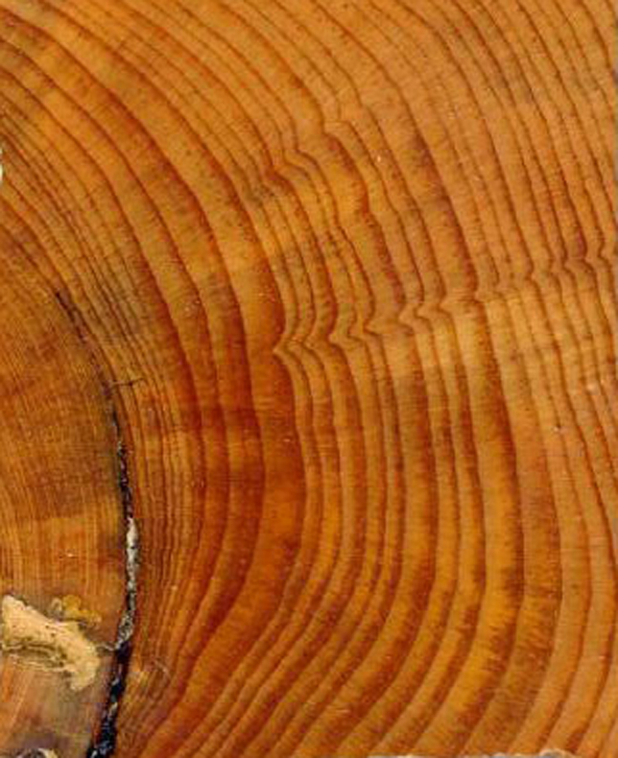
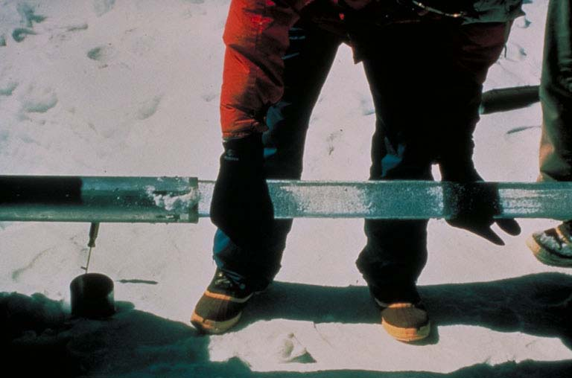
Arctic Climate Variability
Creating Arctic temperature records of the time prior to the era of modern science requires proxies:
  Tree rings
  Oxygen isotopes in ice cores
  Properties of glacial lake sediment layers
    organic content
    X-ray density
    Thickness
Once collected, these proxy data are useful for many purposes
Images from: http://www.ncdc.noaa.gov/paleo/about-collage.html

Slide 4
Case Study
The “2,000 Year Decadal Scale Arctic Temperature Synthesis” project
  Brought together Arctic temperature proxies from diverse studies
  Created an integrated data set
  Published a paper in Science
    Kaufman, Darrell S., et al. 2009. “Recent Warming Reverses Long-Term Arctic Cooling.” Science 325 (5945): 1236–1239. http://dx.doi.org/10.1126/science.1173983
  Made the data available via National Climatic Data Center (NCDC): http://www.ncdc.noaa.gov/paleo/pubs/kaufman2009/

Slide 5
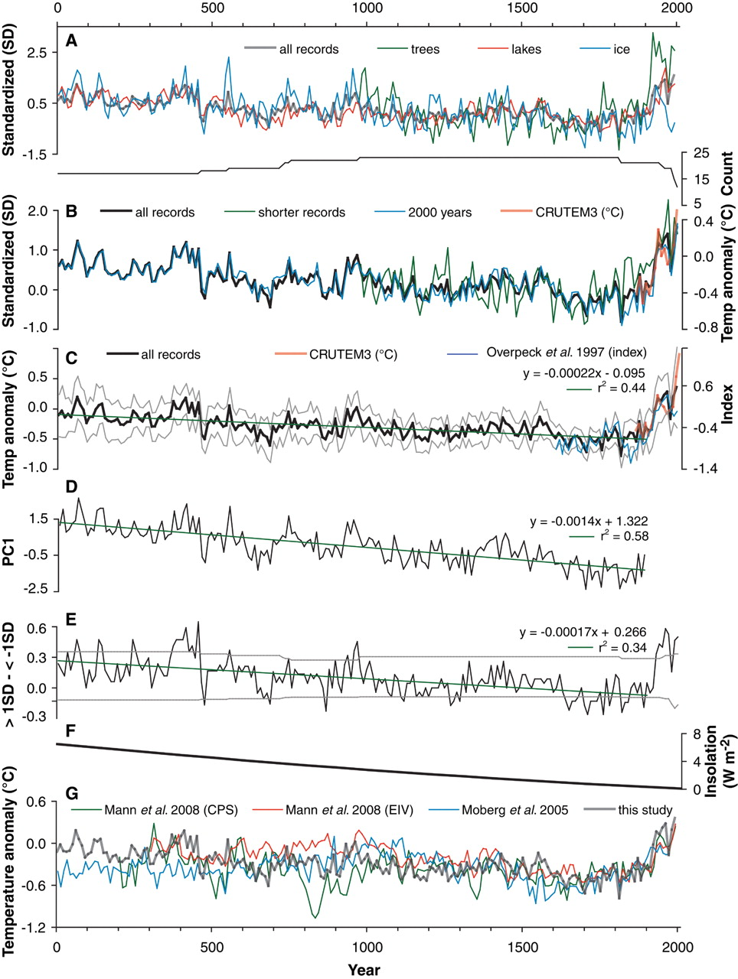

Main Finding: Recent Warming
Warming over the past 150 years reverses 1,800 year cooling trend.
From:
Kaufman et al. 2009
Fig. 3: Composites of 23 high-resolution proxy climate records from the Arctic.
Notes:
(A and B) Composite of 23 high-resolution proxy climate records from the Arctic. Values are 10-year means standardized relative to the reference period of 980 to 1800. (A) Records subdivided by source of proxy information: trees, ice, and lakes, with the running count of records. (B) Records subdivided by those that extend 2000 years (n = 17) versus shorter records (n = 6), along with the 10-year-mean Arctic-wide summer temperature through 2000 from the CRUTEM3 data series (14) (red line). (C) Mean of all records transformed to summer temperature anomaly relative to the 1961–1990 reference period, with first-order linear trend for all records through 1900 (green line), the 400-year-long Arctic-wide temperature index of Overpeck et al. (2) (blue curve; 10-year means), and the 10-year-mean Arctic temperature through 2008 (red line). Gray lines encompass ±2 standard errors of the proxy values as evaluated for each 10-year interval. (D) Time series of PC1 based on the 15 records that extend from 1 C.E. to 1900 C.E., showing a strong first-order trend. (E) Difference in the fractional proportion of records that exceed ±1 SD for each 10-year interval. Gray lines are 95th percentile of distributions determined by 10,000 Monte Carlo realizations of shifting the time series randomly in time [as in (15)]. (F) Change in summer (JJA) insolation at 65°N latitude relative to the 20th century (21). (G) Northern Hemisphere average proxy temperature anomalies (10-year means) reconstructed by Mann et al. (26) on the basis of two approaches (CPS, composite plus scale; EIV, error in variables) and by Moberg et al. (27). Our Arctic regional reconstruction is overlaid in gray.

Slide 6
Data Access and Documentation
Data can be downloaded from NCDC website in text or Excel format
Text and Excel data files include the same metadata:
  Data Contributor
  Reference to original paper
  Funding sources
  Abstract
  Spatial and temporal scope
  Description of the 23 proxies (including processing and data removal techniques)
  Description of data updates and revisions since original publication (including dates of data revision)

Slide 7
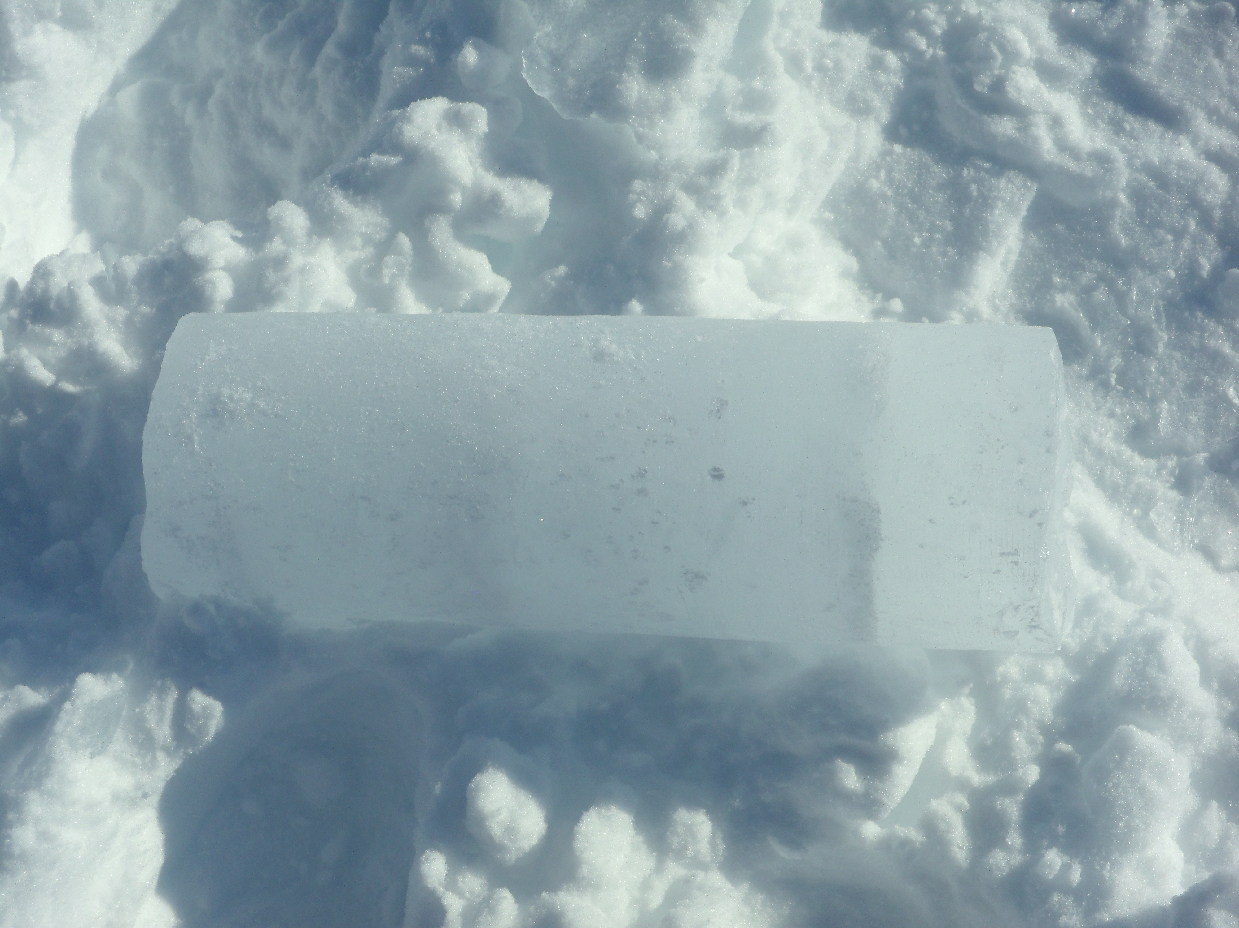
Conclusion
According to this study, the 1999-2008 decade was the warmest of the past 2,000 years
  These findings were cross-validated with climate models
  A follow-on project will build on this data set to extend it 6,000 years farther into the past
The data are now archived and available for further studies
Things done right:
  Data are well documented
  Preserved by a well-established archive
  Openly accessible
  Cross-linked with the original publication
Photo by Jim Pottinger (PolarTREC 2011), Courtesy of ARCUS.
http://media.arcus.org/displayimage.php?pos=-39971

Slide 8
References
Kaufman, Darrell S., et al. 2009. “Recent Warming Reverses Long-Term Arctic Cooling.” Science 325 (5945): 1236–1239. http://dx.doi.org/10.1126/science.1173983
  Some data sources for this project came from the Journal of Paleolimnology Special Volume, “Late Holocene Climatic and Environmental Change Inferred from Arctic Lake Sediments”, 41(1), 2009. Ed. by D. Kaufman. Accessible at: http://www.ncdc.noaa.gov/paleo/pubs/jopl2008arctic

Slide 9
Resources
Access the data from “Recent Warming Reverses Long-Term Arctic Cooling”: http://www.ncdc.noaa.gov/paleo/pubs/kaufman2009/
“2000 Years of Climate Variability from Arctic Lakes”: http://www.arcus.org/synthesis2k/index.php
Follow on project – “8000 Years of Climate Variability from Arctic Lakes”: http://www.arcus.org/synthesis8k/index.php

Slide 10
Other Relevant Modules
For background information and details on data management recommendations
  The case for data stewardship: Preserving the Scientific Record
  Local Data Management: Managing Your Data
  Local Data Management: Creating documentation and metadata
For information on how to work with data archives
  Local Data Management: Working with your archive organization
  Preservation strategies: Options for archiving your data
  Responsible Data Use: Citation and Credit

