Slide 1
VisKo: Enabling Visualization Generation Over the Web
Nicholas Del Rio – UTEP
Paulo Pinheiro - PNNL
http://trust.utep.edu/visko

Slide 2
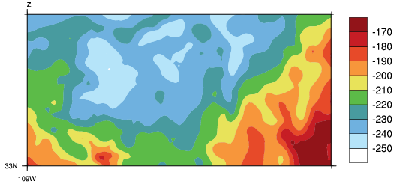


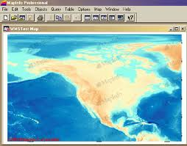

Sharing Visualizations Over the Web
Recipient may be unable to adjust any properties such as contour interval, color tables, projection and labels
1. Send image (contents or by URL)
Recipient may not have tools, capabilities, and expertise to regenerate visualization from data
2. Send data
These solutions have been implemented only for specific domains , for example OGC
3. Send URL of visualization embedded in viewer
VisKo queries address the limitations above
4. Send a VisKo Query specifying the visualization

Slide 3






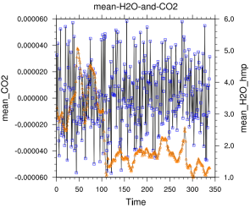
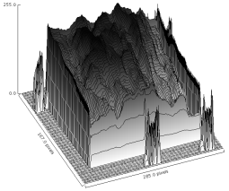
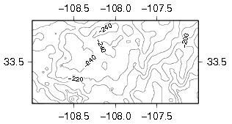
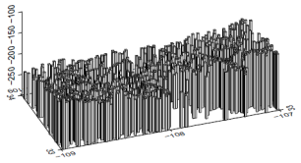
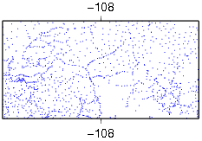


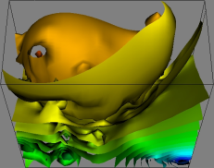
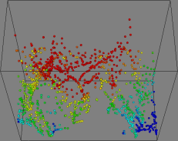
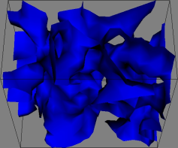
Enhancing Usage of Preferred Toolkits
VisKo
Users may also get other visualizations of the same dataset, generated by different registered toolkits

Slide 4
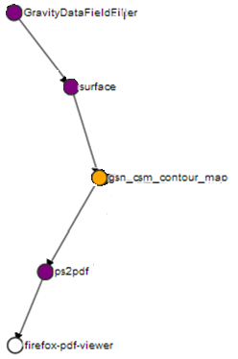
Supporting Hybrid Pipelines
VISUALIZE http://data.txt
AS contour-map IN firefox
WHERE
FORMAT = SSV
TYPE = d19 (gravity data)
Custom Code: column filter
GMT: surface
Combing the best of both worlds: GMT’s gridding techniques with NCL’s high quality contour map generation
NCL: gsn_csm_contour_map
GS: ps2pdf
Purple Nodes | Data Transformers
Yellow Node | Visualization Mapper
White Node | Viewer

Slide 5
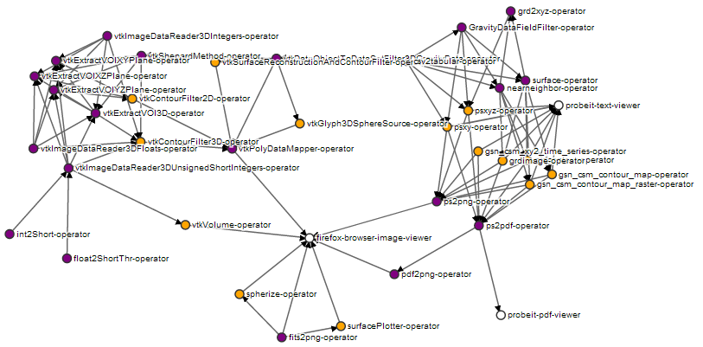
Help the Operator Graph Grow!
Snap shot of our current service knowledge base
Purple Nodes | Data Transformers
Yellow Nodes | Visualization Mapper
White Nodes | Viewers
Pipeline from slide (4) found above

Slide 6


Community Participation:
Registering /Services through Packages
VisKo
Jmol services are now registered with VisKo (i.e., registration)
VisKo will now consider Jmol services when answering queries (i.e., service discovery)

Slide 7
Extras

Slide 8
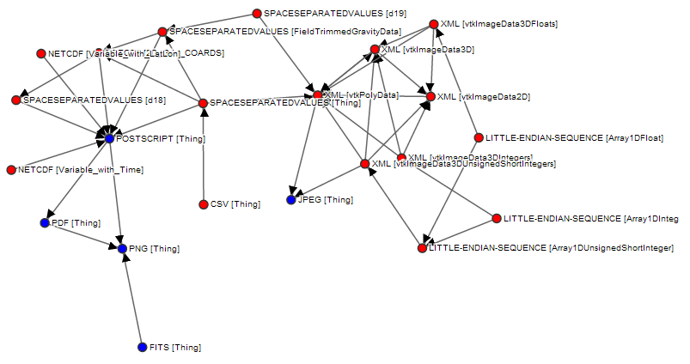
Data Transformation Paths

Slide 9
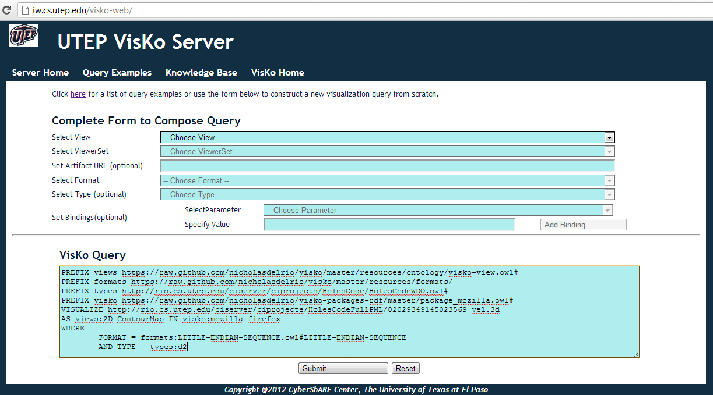
Query Submission

Slide 10
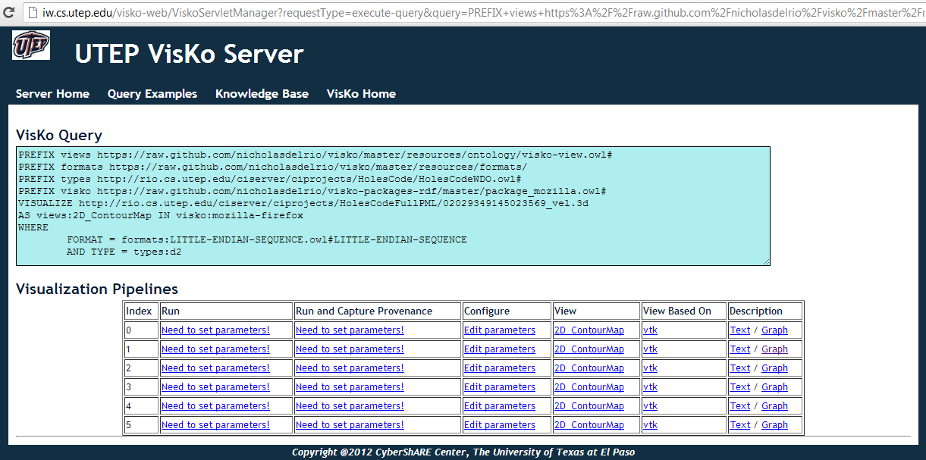
Query Results

Slide 11
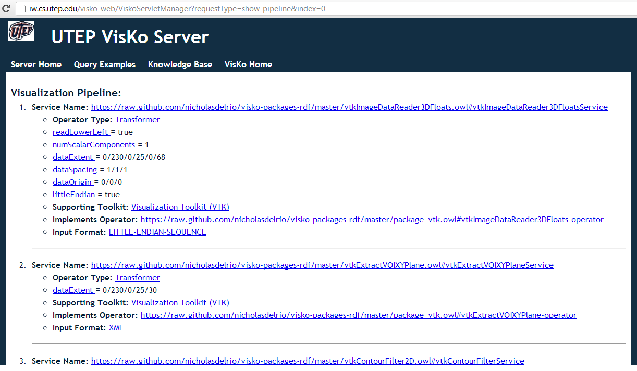
Pipeline Description

