Slide 1
The SERB Air Quality Course and the GEO Air Quality Community of Practice
Rudolf B. Husar
Washington University, St. Louis, MO
Indian Institute of Technology, Bombay (IITB)
Mumbai, India, December 6-7 2012

Slide 2
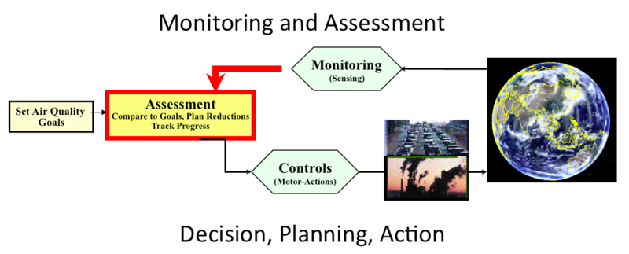
The ‘Wheel’ of Air Quality Management
This event focuses on Monitoring and Assessment

Slide 3
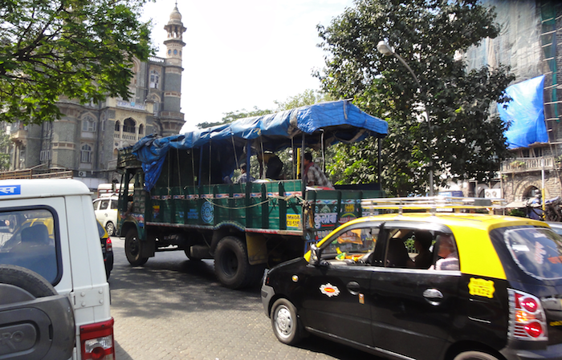
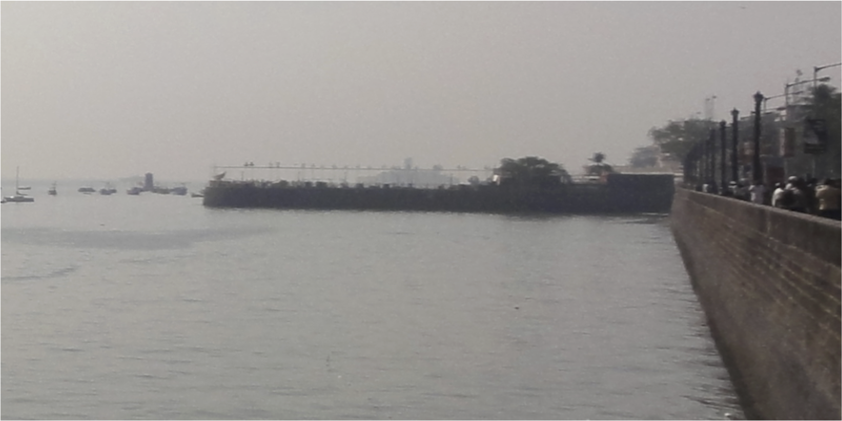
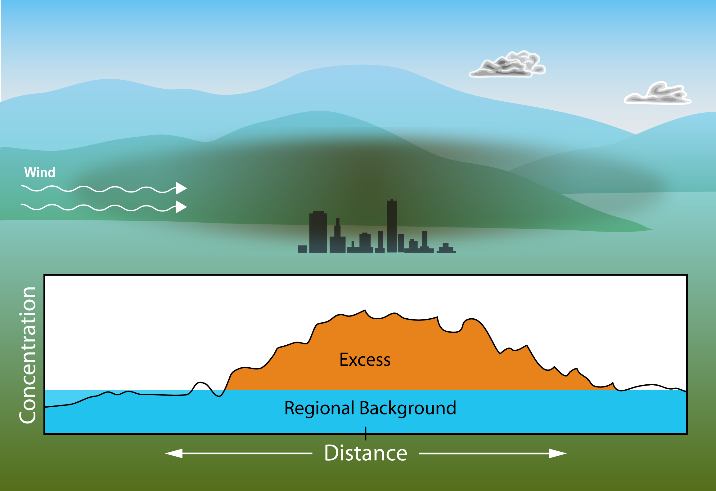
Air quality: Regional Background + Urban Excess
Urban Pollution - Local
Regional Pollution – Long Range
Visual Range < 5 km
Mumbai, December 3, 2012
Total Pollution =
Regional Background + Urban Excess
For effective management, both local and regional air quality needs to be understood.

Slide 4
Collaborating Groups:
Indian Air Quality Resource Group (IARG)
Expertise to support AQ management
MAGEEP Educational Network
Research and teaching at partner universities
Infrastructure support by:
GEO Air Quality Community of of Practice
For sharing of data and models though GEOSS
Their contributions are complementary and converging synergistically

Slide 5
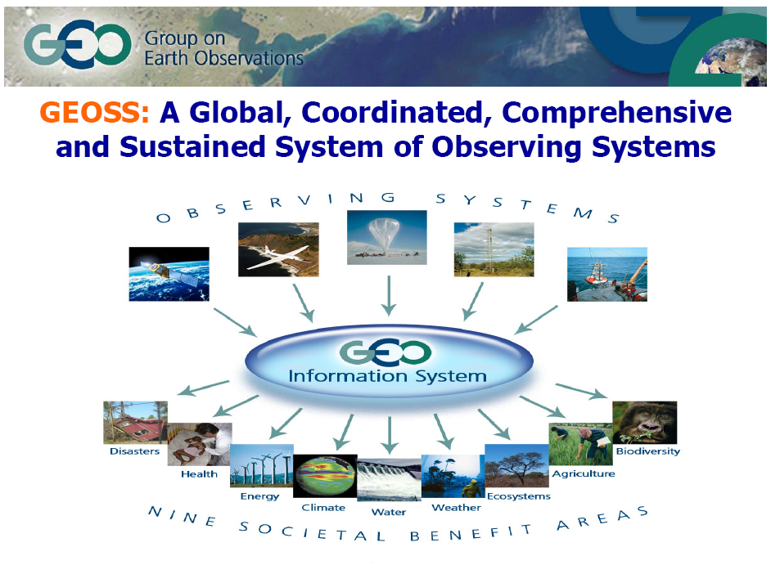
Group on Earth Observations (GEO) is to build
Global Observing System of Systems (GEOSS)
Any Single Data Set Can Serve Many Applications
Any Single Problem Requires Many Data Sets
US, EU, India, China and 80 other countries are part of GEO/GEOSS at the ministerial level
Notes:
First a recap of tree basic ideas for GEOSS.
Any single problem requires many datasets
Any dataset will serve many communities
The PULL by data users and the PUSH by data providers are driving forces for the flow of data

Slide 6
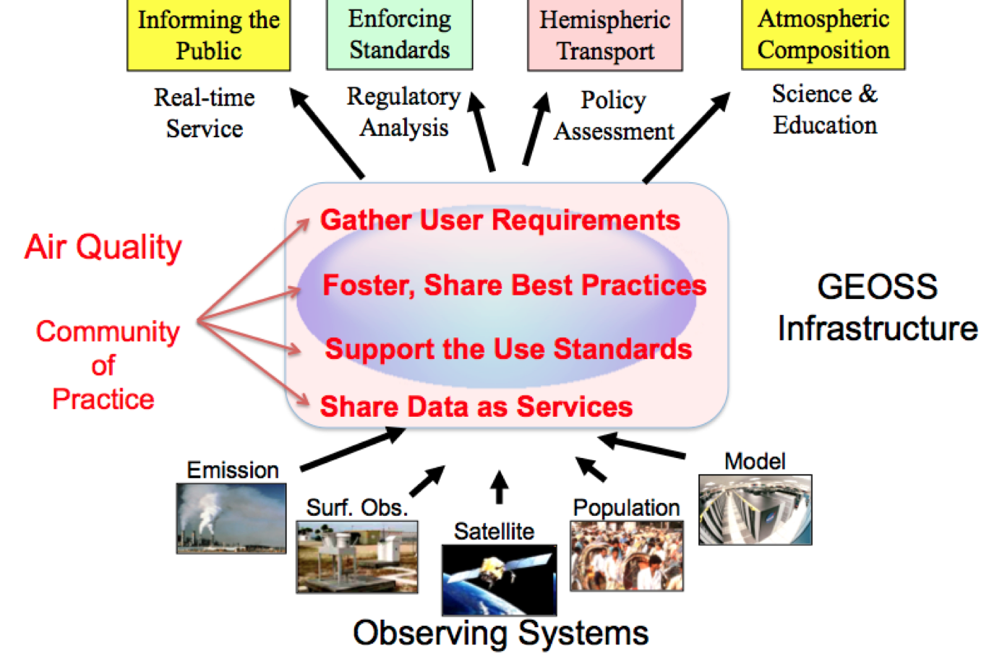
The access to satellite and model data and tools for this course are facilitated though the GEO AQ CoP
Notes:
The vision is to have these data available through an interoperability framework that allows them to be used via various subsets and combinations to support specific research and decision applications
There are numerous Earth Observations that are available and in principle useful for air quality applications such as informing the public and enforcing AQ standards. However, connecting a user to the right observations or models is accompanied by an array of hurdles.
The GEOSS Common Infrastructure allows the reuse of observations and models for multiple purposes
Even in the narrow application of Wildfire smoke, observations and models can be reused.

Slide 7
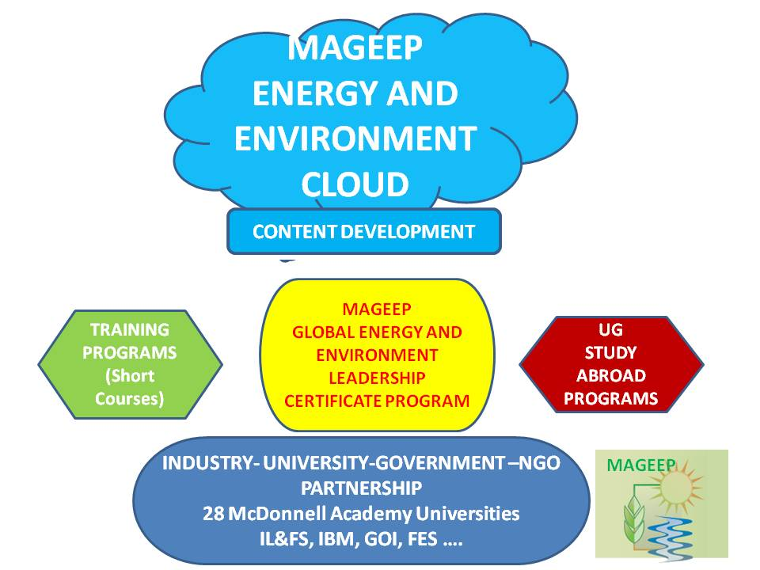
Enabling Collaborative Research and Teaching
Communication Cooperation (Sharing) Coordination
Participatory
“Wiki” Workspaces
Shared Resources e.g. data, tools
The MAGEEP Cloud is a web (cloud)–based infrastructure – an enabler of collaboration.

Slide 8
Long-Term Outputs of the Process:
In this Short Course:
Review AQ monitoring & assessment status (India)
Illustrate data resources, tools, analyses
Chart a 3 year roadmap of activities
Educational Modules
Research Contributions
Applications to AQ Management
The opportunities are here;
Its up to us ….

