Slide 1

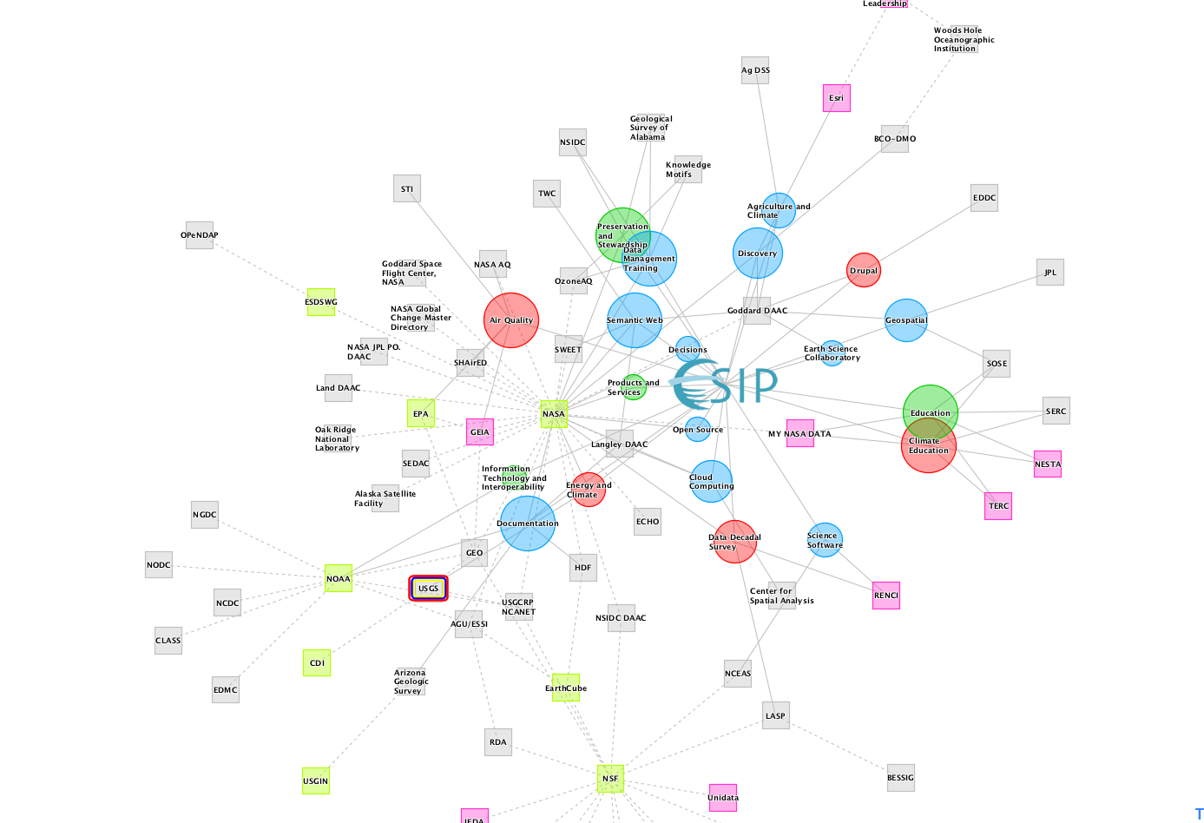







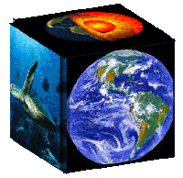


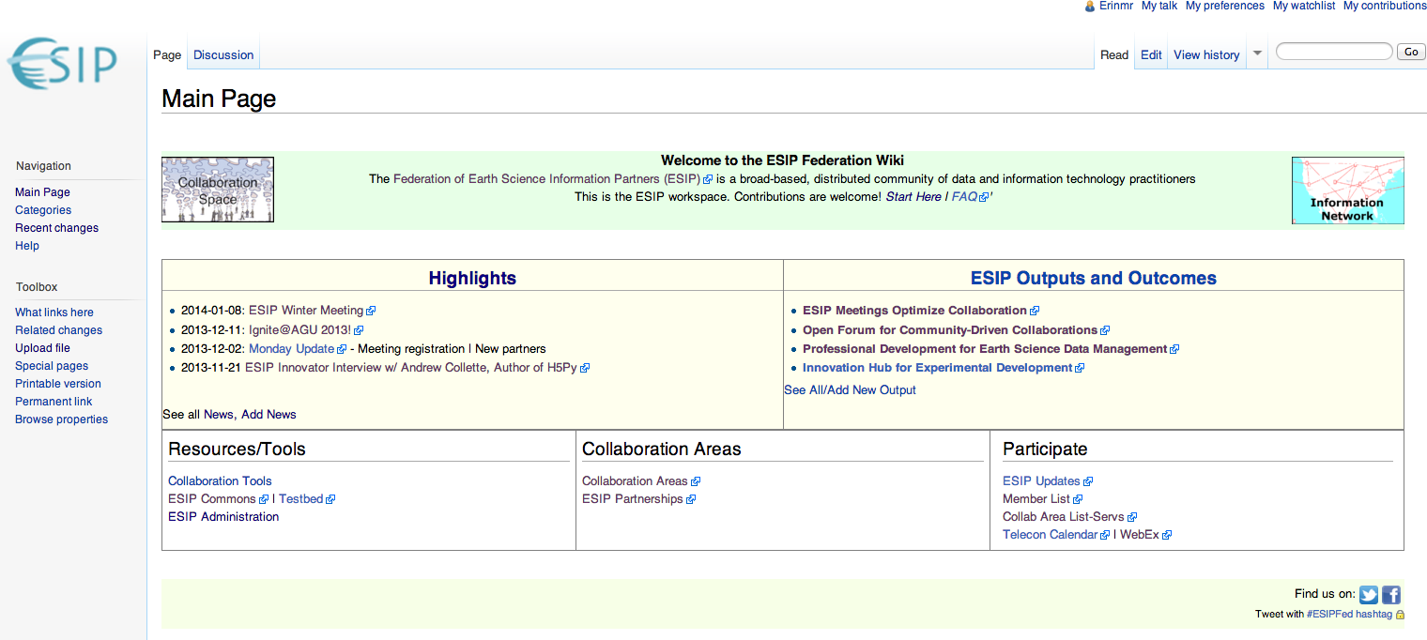
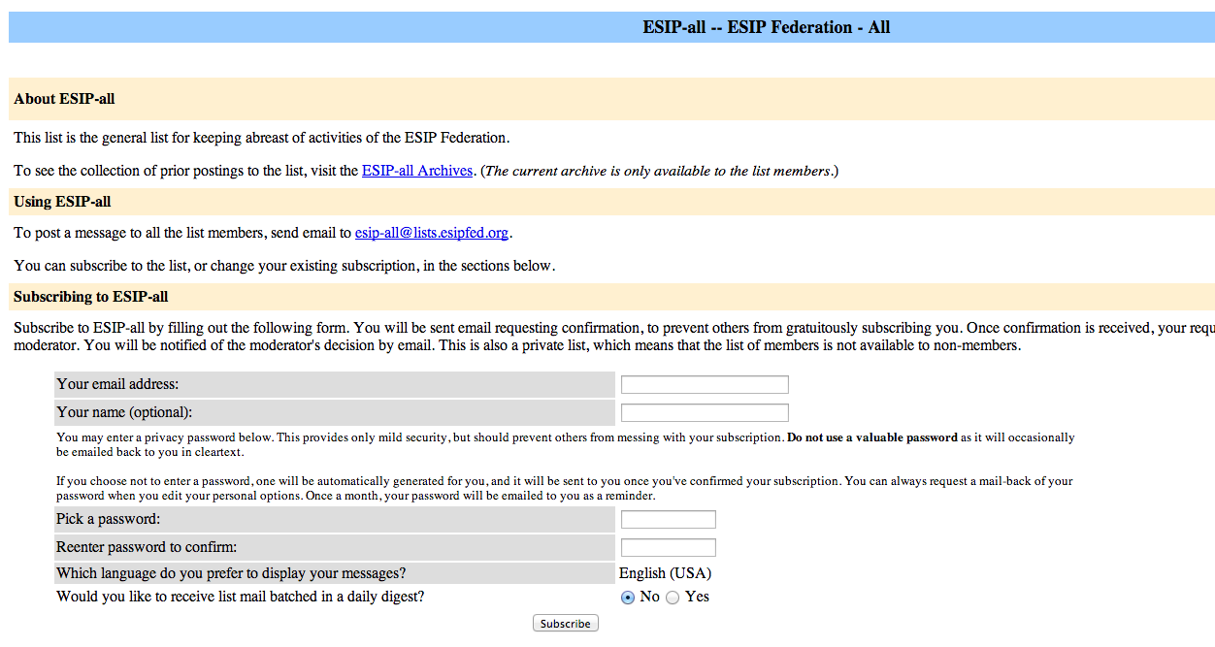
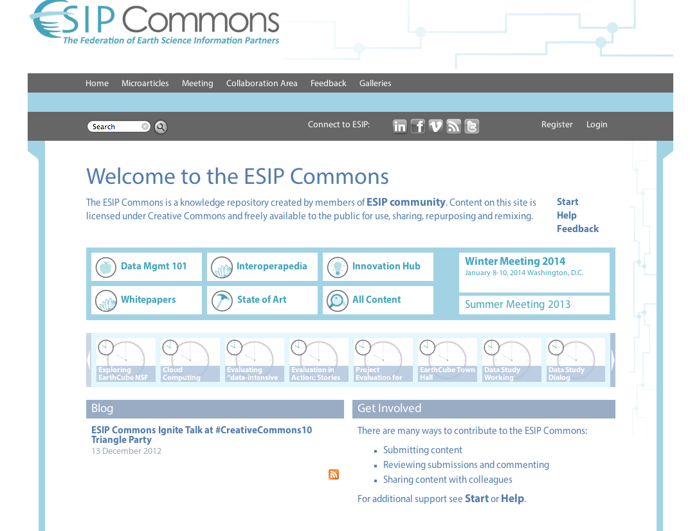


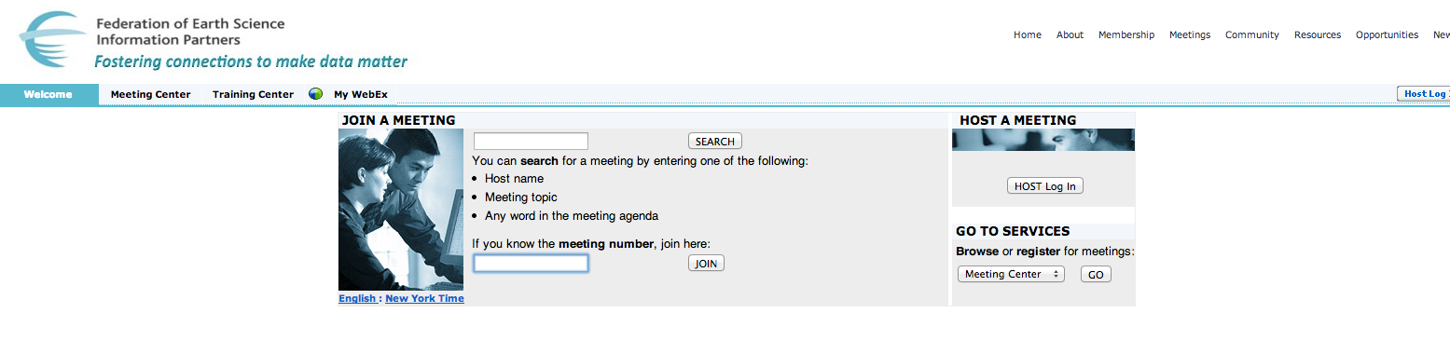




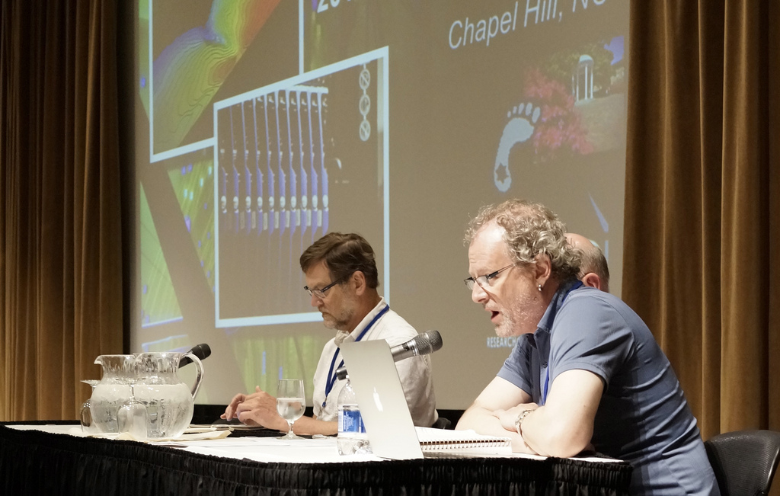


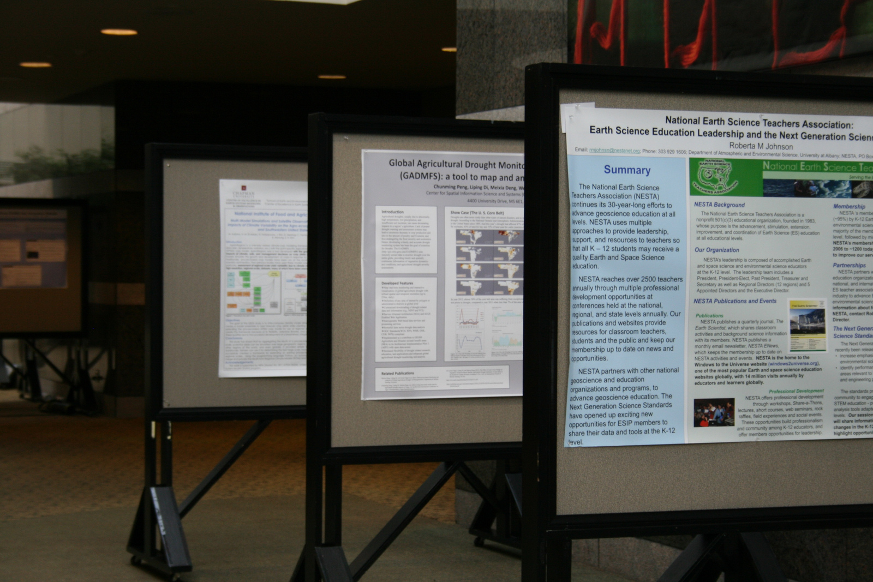
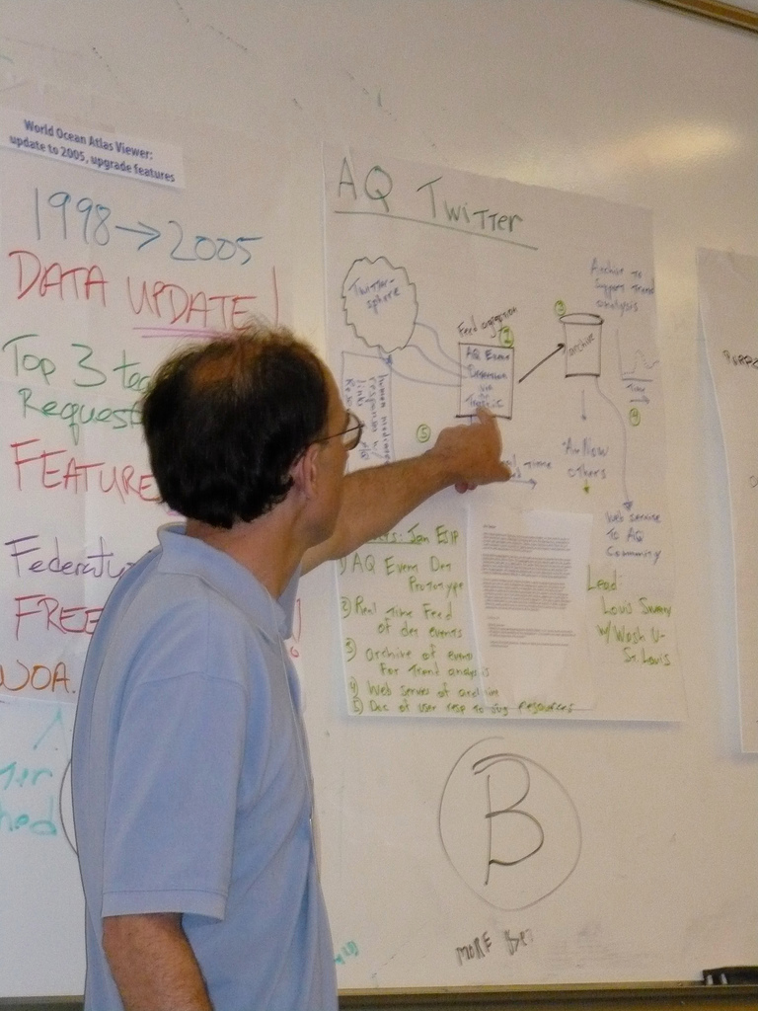


Federation: A Case Study on Enabling Collaboration Infrastructure to Support Earth Science Informatics Communities
Erin Robinson, FES, erinrobinson@esipfed.org, Carol B. Meyer, FES, carolbmeyer@esipfed.org, Karl Benedict, UNM, Kbene@unm.edu (IN23B-1430)
Abstract: A critical part of effective Earth science data and information system interoperability involves collaboration across geographically and temporally distributed communities. The Federation of Earth Science Information Partners (ESIP) is a broad-based, distributed community of science, data and information technology practitioners from across science domains, economic sectors and the data lifecycle. Over the last 15 years, ESIP has continually grown and attracted experts in the Earth science data and informatics field becoming a primary locus of research and development on the application and evolution of Earth science data standards and conventions. As funding agencies push toward a more collaborative approach, the lessons learned from ESIP and the collaboration services themselves are a crucial component of supporting science research.
ESIP’s Self-Governed Collaboration Areas
ESIP Achieves Sustainability through Partnerships
Defined in ESIP Constitution; Can evolve from Cluster or Working Groups; Chair elected from Assembly; Can submit budget requests.
Data Citation Guidelines
Created by the Stewardship Committee and adopted by many other organizations.
Committees
Working
Groups
Emergent on own or mature from Clusters. Task-oriented; Formed by ESIP Assembly or Committee. Can submit budget requests.
Clusters
Emerge around common Earth science data and information issues from community.
ESIP is the trusted community supporting the integration of science and data into mainstream use.
Summer Teacher Workshop
Partners with ESIP to get Earth science data in the classroom. Loan teachers iPads with member-generated educational resources for use in the classroom.
ESIP’s Collaboration Infrastructure
A platform for coordinating around common areas of interest, experimenting on innovative ideas and capturing best practices and lessons learned from across the network.
NESTA Silver Member & Support Share-A-Thons
Virtual Commodity Services:
Wiki, List-servs, Webex, AWS & GitHub
Freely available services to foster distributed real-time and asynchronous work.
These services lower the startup barrier for collaboration and enable automatic content preservation to allow for future work.
ESIP SACNAS Scholarship
ESIP is leading the development of the
Earth science informatics field
Quantifying Contributions
ESIP Commons (http://commons.esipfed.org)
A Drupal-based knowledge repository for non-traditional publications The Commons:
Preserves community products and outcomes like white papers, posters and proceedings.
Provides attribution to contributors
Allows those unfamiliar with ESIP a straightforward way to find information
Data Study Working Group
Research Priorities for the Science Data Enterprise
Working in collaboration with the Board on Research and Information, the ESIP Federation is urging the National Research Council to study the U.S. science data enterprise in 2014. The study would address longer-term agency needs and identify longer-term priorities for science data research and funding.
ESIP Meetings
In-person collaboration in January/July
All breakout sessions are developed by the community
Posters/Demos to share work
FUNding Friday Competition seeds ESIP collaboration
Dynamic exchange for knowledge and tech transfer

