Slide 1
ESIP Earth Science Data Analytics (ESDA) Cluster Breakout July 10, 2014 Lead by Steve Kempler, Tiffany Mathews Please sign attendance sheet

Slide 2

ESDA Cluster Mission (reminder)
Mission:
To promote a common understanding of the usefulness of and activities that pertain to Data Analytics and, more broadly, the Data Scientist.
To facilitate collaborations between organizations that seek new ways to better understand the cross usage of heterogeneous datasets.
To identify gaps that, once filled, will expand collaborative activities.

Slide 3
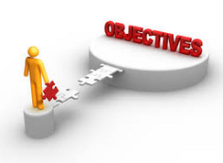
ESDA Cluster Objectives (reminder)
Objectives:
To provide a forum for ‘Academic’ discussions
Host guest speakers to provide overviews of external efforts
Perform activities that:
Compile specific community use cases (analytics needs) to cross analyze heterogeneous data
Compile experienced sources on the use of analytics tools to satisfy the needs of the above data users
Examine gaps between needs and expertise
Document specific data analytics expertise needed
Seek graduate data analytics/ Data Science student internship opportunities
Notes:
Academic discussions will allow ESIP members to be better educated and on the same page in understanding the various aspects of Data Analytics
Guest Speakers will expose attendees to broader uses of Data Analytics.

Slide 4
Relevant AGU Sessions
Teaching Science Data Analytics Skills Needed to Facilitate Heterogeneous Data/Information Research: The Future Is Here - Session ID#: 1879
Identifying and Better Understanding Data Science Activities, Experiences, Challenges, and Gaps Areas - Session ID#: 1809
Advancing Analytics using Big Data Climate Information System - Session ID#: 3022
Big Data in the Geosciences: New Analytics Methods and Parallel Algorithm - Session ID#: 3292
Leveraging Enabling Technologies and Architectures to enable Data Intensive Science - Session ID#: 3041
Open source solutions for analyzing big earth observation data - Session ID#: 3080
Technology Trends for Big Science Data Management - Session ID#: 2525

Slide 5
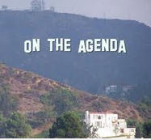
Today’s Roadmap (1)
Review: What we have accomplished
Guest Speaker: Peter Fox on the role of Data Scientist in facilitating the definition and subsequent usability of Data Analytics to enhance Earth science research
Summary of past speakers –
Data Analytics needs and/or tools and their targets
Defining types of data analytics users http://wiki.esipfed.org/index.php/Earth_Science_Data_Analytics/Telecom_Presentations
Use Case Matrix Analysis – Gleaning out Data Analytics needs http://wiki.esipfed.org/index.php/Use_Case_Collection
Data Analytics Tools Matrix – What tools can provide appropriate analytics capabilitieshttp://wiki.esipfed.org/index.php/Analytics_Tools

Slide 6
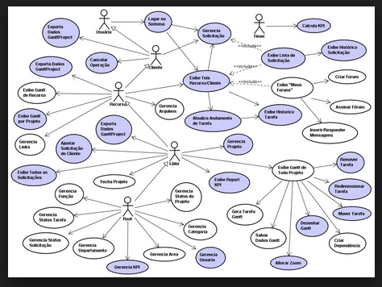
Use Case Matrix Analysis – Gleaning Out Data Analytics Needs
For each use case:
What specifically is to be done?
Which analytics types is the use case attempting?
What classes of users is represented by this use case?

Slide 7
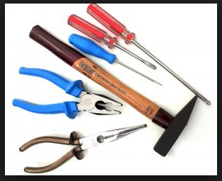
Data Analytics Tools Matrix – Gleaning out what tools can provide
For each tool:
What specifically does the tool provide?
Which analytics types does the tool address?
What classes of users would best benefit from use of this tool?

Slide 8
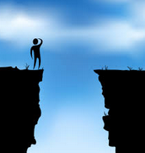

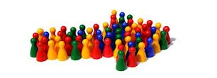
Today’s Roadmap (2)
Additional Discussion Topics:
Gap Analysis
Matching user needs with known available tools
Data Publications in Data Browsers for Earth System Science
Tool Matchup update
Matches tools with data
Note: User dependent: Who are the target users? Should we suggest that they also examine Data Analytics Tools?
Way Forward

Slide 9
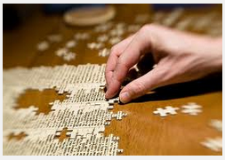
Review: What we have accomplished
Use Case Collection webpage
Currently has 10 use cases http://wiki.esipfed.org/index.php/Use_Case_Collection
Data Analytics Tools/Techniques Collection webpage
Currently has 11 tools/techniqueshttp://wiki.esipfed.org/index.php/Analytics_Tools
Initiated formulation of different data analytics types as well as types of data analytics users
Created the Earth Science Data Analytics Discussion Forum - http://wiki.esipfed.org/index.php/Earth_Science_Data_Analytics/Discussion_Forum
Guest Speakers
Hosted 8 speakers http://wiki.esipfed.org/index.php/Earth_Science_Data_Analytics/Telecom_Presentations
Notes:
1. Guest speakers have provided their experiences and expertise to describe data analytics, the data scientist, and their data analytics usage, needs, and tools -

Slide 10
Our Guest Speaker…
Dr. Peter Fox
Professor and Tetherless World Research Constellation Chair Climate Variability and Solar-Terrestrial Physics Rensselaer Polytechnic Institute

Slide 11
Summary of Past Speakers
Wo Chang (Data Architect): NIST Big Data Public Working Group & Standardization Activities
Focus of the (NBD-PWG), to form a community of interest from industry, academia, and government, with the goal of developing a consensus definitions, taxonomies, secure reference architectures, and technology roadmap.
Brand Niemann (Data Scientist): Sorting out Data Science and Data Analytics
The role of the Data Scientist and activities that evolve around having the Data Scientist at it’s core
John' Schnase (Data Producer): MERRA Analytic Services (MERRA/AS)
Enabling Climate Analytics-as-a-Service by combining iRODS data management, Cloudera MapReduce, and the Climate Data Services API to serve MERRA reanalysis products.
Bamshad Mobasher (Educator): Data Analytics Masters Program at DePaul University Overview
The importance of teaching Data Analytics at the graduate level

Slide 12
Summary of Past Speakers
Joan Aron (End User): Data Analytics Needs Scenario
The importance of the usage of data analytics from the end user point of view: Acquiring and using the best data
Rudy Husar (Tool Developer): User-Oriented Data Analytics and Tools using the Federated Data System DataFed
Techniques implemented to unify heterogeneous air quality datasets
Tiffany Mathews (Information archive/provider): Atmospheric Science Data Center Sample Analytics Use Cases
Insights on the breadth and depth of Data Analytics, providing a foundation for associating types of Data Analytics, Use Cases, and Tools.
Ralph Kahn (Research Scientist): Global, Satellite-Remote-Sensing Aerosol Studies: What We Do, and Why It Matters
Research that involves experimenting with ways of finding multii-data relationships… that may be original.

Slide 13
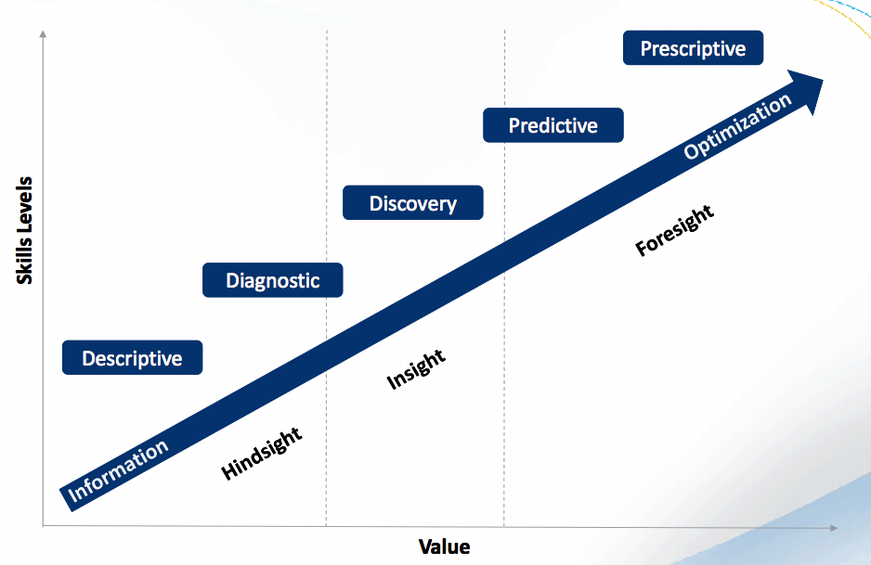
Discovery Analytics:
This is where people learn from the data.
http://www.informationbuilders.es/intl/co.uk/presentations/four_types_of_analytics.pdf

Slide 14
Type Descriptions
Descriptive Analytics: You can quickly understand "what happened" during a given period in the past and verify if a campaign was successful or not based on simple parameters.
Diagnostic Analytics: If you want to go deeper into the data you have collected from users in order to understand "Why some things happened," you can use … intelligence tools to get some insights.
Discovery Analytics: The use of data and analysis tools/models to discover information
Predictive Analytics: If you can collect contextual data and correlate it with other user behavior datasets, as well as expand user data … you enter a whole new area where you can get real insights.
Prescriptive Analytics: Once you get to the point where you can consistently analyze your data to predict what's going to happen, you are very close to being able to understand what you should do in order to maximize good outcomes and also prevent potentially bad outcomes. This is on the edge of innovation today, but it's attainable!
Modified from: http://www.ciandt.com/card/four-types-of-analytics-and-cognition

Slide 15
User Model (Subsetted from ESDSWG WG)
Classes | Definition
Public | interested user of no or limited scientific skill
Graduate student | person of moderate to high skill at a university or college working towards an advanced degree
Production Centers | large organization that handles/processes vast quantities of data
Science Team | group of scientists focused on a specific area of study or on a specific instrument type, can include cal/val scientists
QA/Testing | developers or scientists using data to test software operation or to determine quality of a product, can include cal/val scientists
Data Analyst | person using NASA data to perform a specific analysis.
Domain Scientist | person using data to do research and publish within a discipline, comes in with some expertise in using the data
Interdisciplinary Scientist | person using high-level data products from multiple sources
Operational User | Data analyst or tech using data for operational support (applications) and emergency response
Assimilation Modelers | persons or groups that routinely obtain vast quantities of data for incorporation into models, can have operational needs

Slide 16
Use Case Matrix Analysis – Gleaning Out Data Analytics Needs
For each use case:
What specifically is to be done?
Which analytics types is the use case attempting?
What classes of users is represented by this use case?

Slide 17
Data Analytics Tools Matrix – Gleaning out what tools can provide
For each tool:
What specifically does the tool provide?
Which analytics types does the tool address?
What classes of users would best benefit from use of this tool?

