Slide 1
Development of an Environmental Geoportal
Kremena Darmenova¹, Simon Cantrell¹, Dan Zimble², Glenn Higgins¹
¹Environmental Sciences and Engineering Department, ²ESRI

Slide 2
Today’s Agenda
Motivation and end-user needs
Environmental Geoportal - Concept
Overview – General Architecture and Products
Geoportal Demo

Slide 3
Motivation and goals
Gap between the scientific products that climate models produce and the “engineering” products that planners need to help their constituencies adapt to climate change
Existing online portals usually display static maps or partially interactive maps of climate data targeting the scientific community
Heterogeneous climate data is challenging to visualize: grid types, different time metrics, ensemble data
Develop a web-based geoportal for decision support that provides novel integration of science coupled with technology that addresses the decision-making needs for geo-referenced data:
Optimize the search and selection of value-added data products
Uses ESRI ArcGIS custom capabilities to visualize climate and weather data products (collaborative effort between ESRI and NG)
Provides ease of navigation to locate and display data products

Slide 4
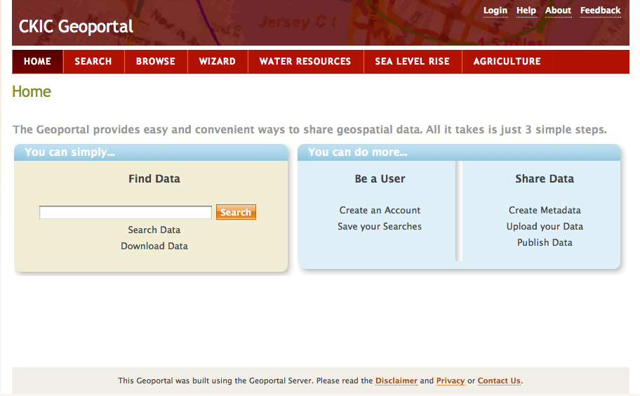
Environmental Geoportal - Concept
Designed to bridge the gap in communications of climate information between scientists and users
Accessible via a web portal, which provides the infrastructure for data acquisition, integration and management
Unique approach of blending technologies: ArcGIS server, and Internet2, thus allowing for fast transfer of large amounts of data over the Internet and dynamic display and visualization of multilayered environmental data
Unifies the management and access of large amounts of climate model data created through high performance computing and observations for use in climate-based decision-making

Slide 5
Geoportal Technology: Service-Oriented Architecture

Slide 6
Geoportal technology features
The geoportal enables the search and retrieval of geo-referenced environmental data, displayed over a base or terrain map
The map-based visualization system gives a versatile interface for map-based display, developed using Adobe Flex technology.
The data can also be viewed dynamically in a tabular or in a graph format, for any point in the data set
CCSM3/WRF Mean Monthly Temperature (2000-2009)
Geo-referenced Map Format
Tabular Format
Graph Format

Slide 7
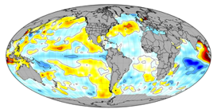
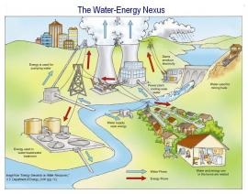
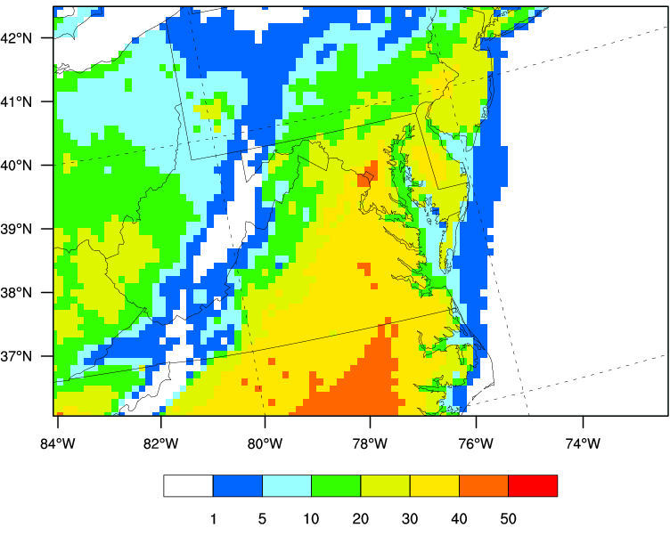
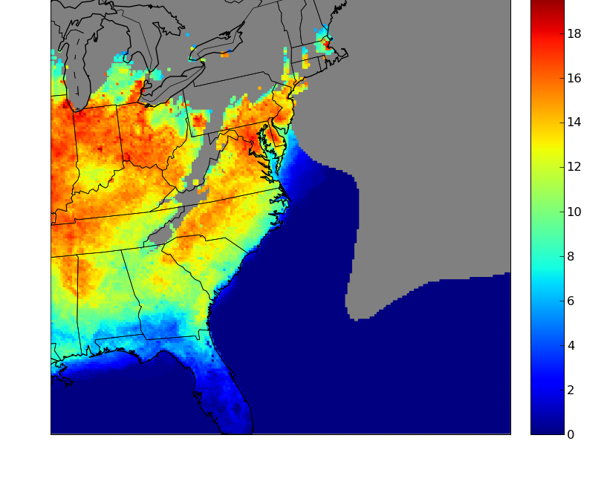
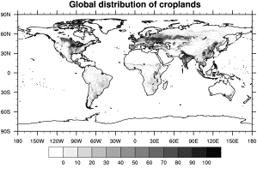
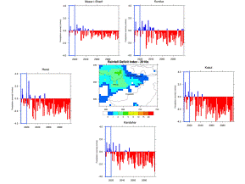
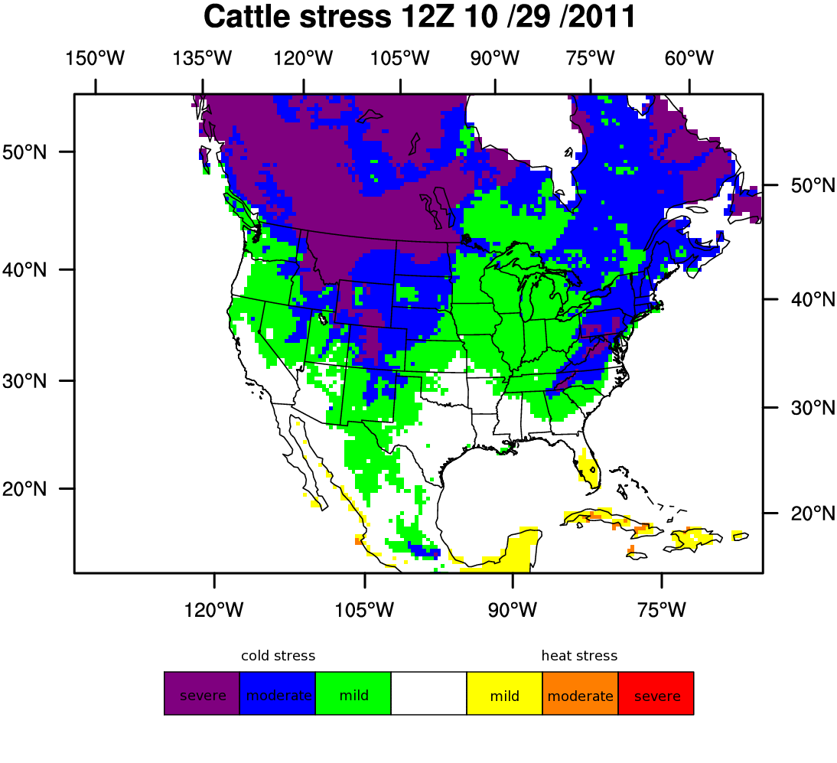
Climate Change Impact Areas (Examples)
Develop and productize climate decision aids to support end-user needs
The energy-water nexus
Sea-level rise
The continued security and economic health of the United States depends on a sustainable supply of both energy and water.
Two-thirds of all the World's population lives within 100 kilometers of a coastline.
Energy
On average thermoelectric power generation (coal, nuclear, natural gas, concentrating solar) accounts for 39% of all freshwater withdrawals in the U.S
Approximately 13% of the nation's total electricity use goes to pump, heat and treat water.
Sea level rise from 1950 to 2000 is already significant world-wide.
Image courtesy of U.S. Department of Energy
Sea level rise may accelerate during the 21st century and will possibly affect coastal infrastructure and ecosystems
Water
Climate change in addition to growing population is expected to exacerbate current stresses on water and energy resources
Health
Climate change is a significant and emerging threat to public health
Agriculture
Health Decision Aids
Climate Change provides stressors to many agricultural activities
Agriculture Decision Aids

Slide 8
Productization: Environmental Data Set Product examples
The Adobe Flex clients have been developed to enhance the ability to visualize a number of environmental data sets
Data Sets:
- Dynamically downscaled GCM data (i.e. CCSM/WRF, ECHAM5/WRF): temperature, precipitation, snow accumulation, heating and cooling degree days, heat stress;
- Hydrology Model output (i.e. SWAT, ModFlow, HydroTrend): streamflow, reservoir volume impacts
- Statistical Sea-Level Rise Model: inundation recurrence
- External datasets (remote sensing, in situ, statistical downscaling, GCM)

Slide 9
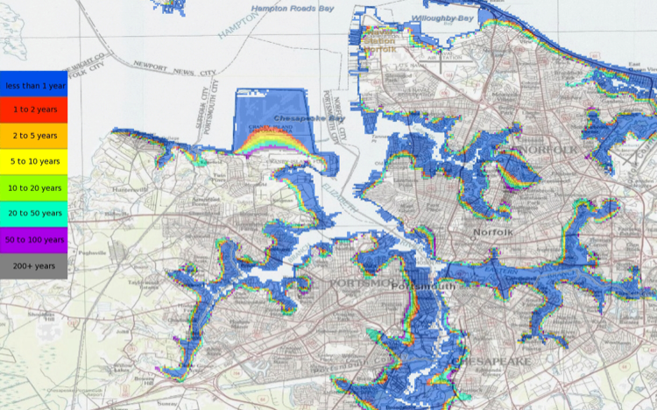
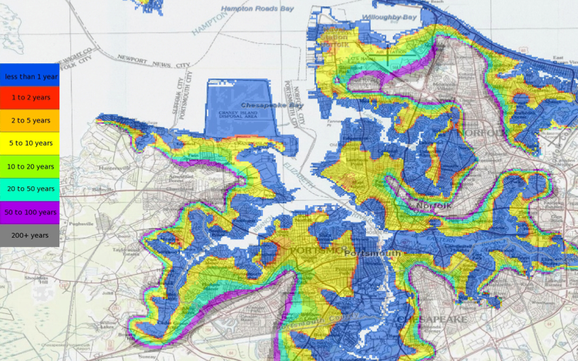
Norfolk Area Inundation Recurrence
The Hampton-Roads Economic Region supports the Newport News Shipyard and Norfolk Naval Station
Climate change impacts on the region affect the long term sustainability of the Shipyard beyond the direct flooding of the Dry-docks
Inundation of local and regional residences, businesses, transportation facilities, and other supporting infrastructure impact the long term operational sustainment of this critical national asset
Inundation recurrence in the Norfolk Region overlaid on infrastructure base-maps
Year 2000 at Nominal Sea Level
2100 with One Meter of Sea Level Rise

Slide 10
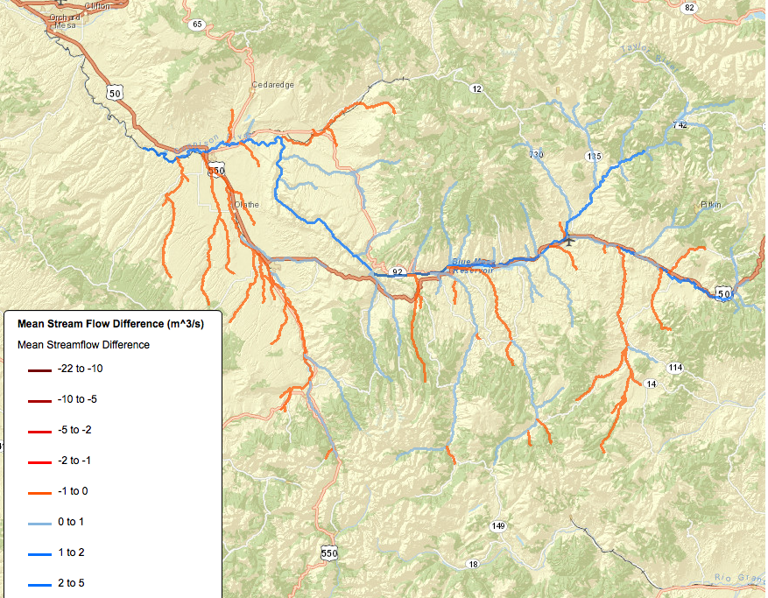
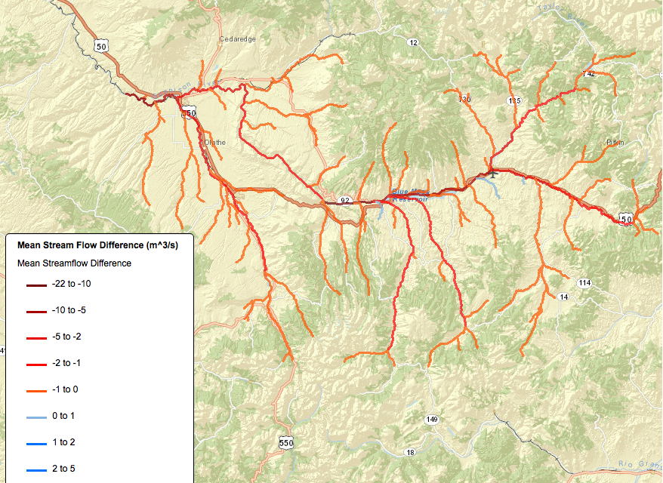
Gunnison river streamflow differences (future-current)
Blue indicates more water in the future while orange and brown indicates less water.
In January-March there is an increase in the riverflow in the future due to decrease in frozen precipitation fraction and earlier snowmelt.
During late summer and fall the basin experiences decreased river flow which will affect water resource planning and may alter the reservoir operations along the Gunnison river in the future.
January
July

