Slide 1


Preserving the Scientific Record: Case Study 1 – NSIDC Glacier Photos
Matthew Mayernik
National Center for Atmospheric Research
Version 1.0
Review Date
Notes:
Modules should be 3-7 minutes long

Slide 2
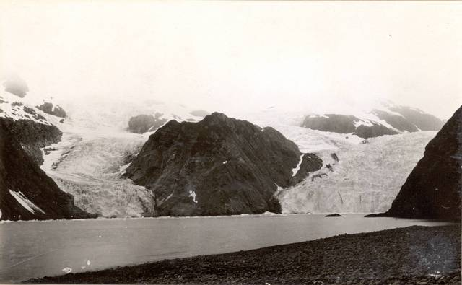
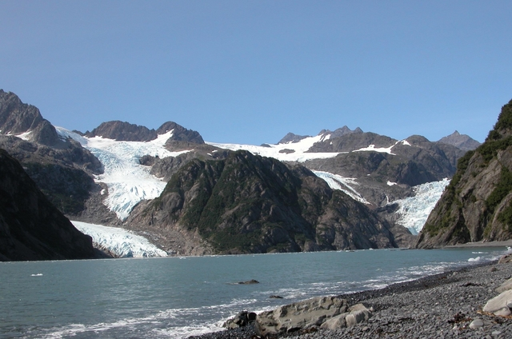
Overview
Glacier photos provide vivid demonstrations of climate change
1909¹
2004²
1. Grant, Ulysses Sherman. 1909. Holgate Glacier: http://nsidc.org/cgi-bin/gpd_deliver_jpg.pl?holgate1909072401
2. Molnia, Bruce F. 2004. Holgate Glacier: http://nsidc.org/cgi-bin/gpd_deliver_jpg.pl?holgate2004081301
From the Glacier Photograph Collection. Boulder, Colorado USA:
National Snow and Ice Data Center/World Data Center for Glaciology. Digital Media.

Slide 3
NSIDC Glacier Photo Collection
NSIDC curates and provides online access to more than 13,000 glacier photographs
Photos from 130+ photographers, U.S. government, military, and scientific agencies
Photographs date from the mid 1800s to the present
Collection has been growing since 1950’s
Many other NSIDC glacier photographs are not yet digitized
Full analog archive contains more than 20,000 glacier photograph prints and ~100,000 glacier images on microfilm
Digitization was a partnership with the NOAA National Climatic Data Center (NCDC) and private industry
If possible, more photos will be digitized in the future

Slide 4
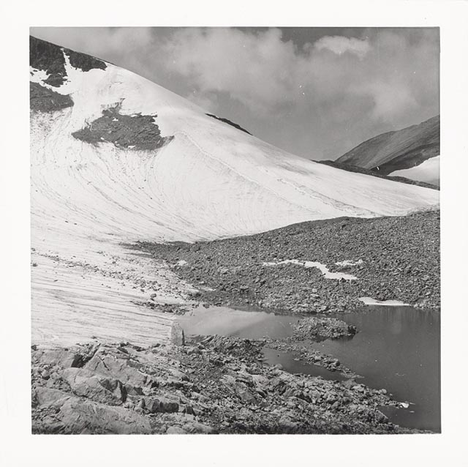
NSIDC Glacier Photo Documentation
Documentation includes
Contact information
Background information
Spatial and temporal coverage
Formats and file sizes
File naming conventions
Error sources and quality assessment
Collection organization
Access mechanisms
References and related publications
Acknowledgments
Location, science, and other topical keywords
How to cite the collection (and individual images)
Image: Morrison, Charles C. Jr. 1960. Grasshopper Glacier: From the Glacier Photograph Collection.
Boulder, Colorado USA: National Snow and Ice Data Center/World Data Center for Glaciology. Digital media.
http://nsidc.org/cgi-bin/gpd_deliver_jpg.pl?grasshopper1960080803

Slide 5
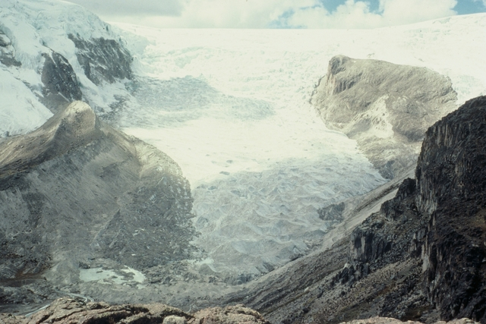
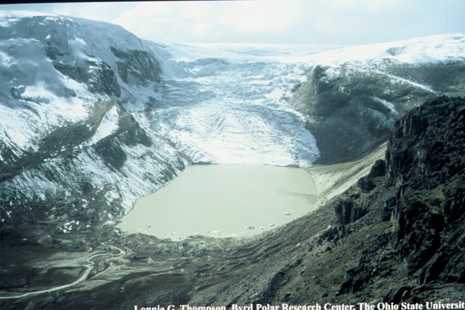
Conclusion
These photos are an invaluable scientific resource.
NSIDC’s active (and ongoing) curation makes this collection available to scientific and public communities
1978¹
2004²
1. http://nsidc.org/cgi-bin/gpd_deliver_jpg.pl?qorikalis1978070001
2. http://nsidc.org/cgi-bin/gpd_deliver_jpg.pl?qorikalis2004070001
Qori Kalis Glacier in Peru: From the Glacier Photograph Collection. Boulder, Colorado USA:
National Snow and Ice Data Center/World Data Center for Glaciology. Digital media.
Both photos by: Lonnie G. Thompson, Byrd Polar Research Center, the Ohio State University

Slide 6
References and Resources
NSIDC Glacier Photo Collection Home Page: http://nsidc.org/data/glacier_photo/
NSIDC Glacier Photo Collection Documentation: http://nsidc.org/data/docs/noaa/g00472_glacier_photos/index.html
Additional Information:
Beitler, J. The Dry Valleys of Antarctica: Data for Big Science. Data Conservancy press release, June 28, 2011. http://dataconservancy.org/DryValleysAntarctica
Molnia, B.F. 2010. Repeat photography of Alaskan glaciers and landscapes from ground-based photo stations and airborne platforms. In R.H. Webb, D.E. Boyer, R.M. Turner (eds.), Repeat Photography: Methods and Applications in the Natural Sciences, Washington, DC : Island Press, (pp. 59-76).

Slide 7
Other Relevant Modules
The case for data stewardship: Preserving the Scientific Record
Local Data Management: Managing Your Data
Local Data Management: Creating documentation and metadata
Local Data Management: Working with your archive organization
Preservation strategies: Options for archiving your data
Responsible Data Use: Citation and Credit

