Slide 1
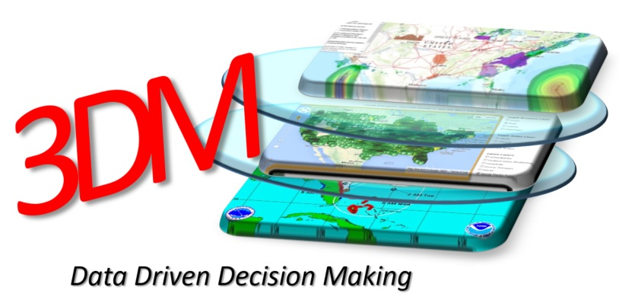
Workshop Report Out

Slide 2
3DM Initiative Process
Establish Work Group
Leverage SISE Trust Framework & Philosophy
Simple, Operational Benefit, Results
Develop Operational Use Cases
Identify & Integrate Data Sets
Short, Mid and Long-Term Data Sets
Leverage Technology Partners
Test, Validate and Operationalize

Slide 3
3DM Initiative Timeline
3DM WG Workshops
Monthly Call / Webinars
Oct 2016
Jan 2017
April 2017
July 2017
Washington, DC
Philadelphia, PA
New York City, NY
TBD
Define Stakeholders, Approach, Timelines,
Products,
Use Cases, Data Sets
Discuss Data Sets & Use Cases, Applications, Future Data Sets

Slide 4
Agenda
Time | Description
7:30am | Registration
8:00am | Opening Remarks & Welcome
8:15am | Session #1 – Why Are We Here? Where Are We Going?
8:45am | Session #2 – Better Decisions w/Better Data User Panel
10:00am | Session #3 - The Private Sector Disaster Challenge
12:00pm | Lunch
12:30pm | Session #4 – Defining What Are Usable and Un-Usable Data Sets
1:00pm | Session #5 – Applying Data to Real World Disasters
3:45pm | Wrap Up / Next Steps
4:00pm | Conclusion
5:00pm | Happy Hour Reception – Marriott Lobby Bar

Slide 5
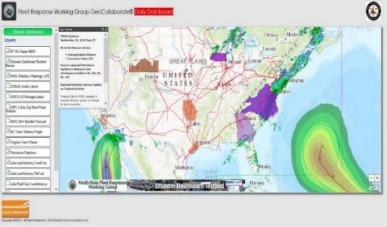
Use Case Methodology
Government Decisions
Private Sector Decisions
Decision Support Technology Viewers
SECTORS
Electric
Fuel
Telecom
Food
Finance
Transport
Operational Problems and Related People, Data, Security
People = Cultures, Perspectives, Intents, Terms/Language
Data = Timing, Formats, Reliable Sources, Formats, Labeling, Handling
Security – Legal, Governance, ID Vetting, Permissions, Credentials, Agreements
Sector Use Cases
Data Sets
Notes:
Three Use Cases:
Fleet movement
Situational Awareness
Damage Assessment

Slide 6

Use Case “Honeycomb” Approach
Universal Use Cases
Cross Sector Use Cases
Electric Sector
Fuel Sector
Food/Water Sector
Telecommunications Sector
Sector Use Cases

Slide 7
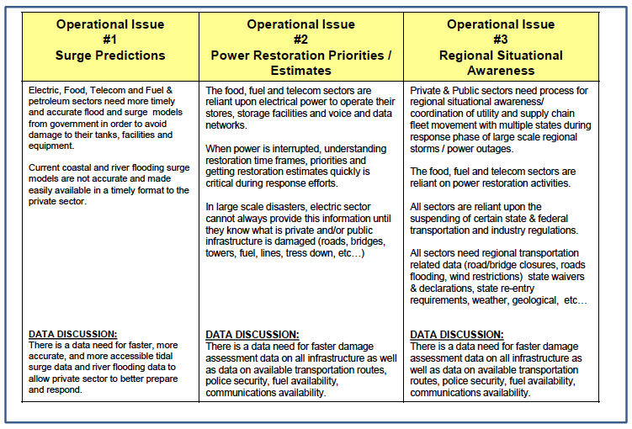
Use cases

Slide 8
Private Sector Experience
Transportation issues – roadway status
Identified that we need lodging stakeholders at table
Lodging details – meeting space, wifi, breakfast
Additional types of disasters – fire, earthquakes

Slide 9

The Data Decision-Making Process
Access
Format
Relevance
Content
Reliability
Latency
Rights
Scope
Extent
Discoverability
Hosting
Quality
Precision
Accuracy
Completeness
Resolution
Reputable Source
Timing

Slide 10
The Data Decision-Making Process
Access
Format
Relevance
Content
Reliability
Latency
Rights
Scope
Extent
Discoverability
Hosting
Quality
Precision
Accuracy
Completeness
Resolution
Reputable Source
Timing
Brian Wee, Neptune & Company, Inc.
Kari Hicks, Duke Energy
Notes:
* Brian brought up need for workflows and templates that can be used and connection

Slide 11
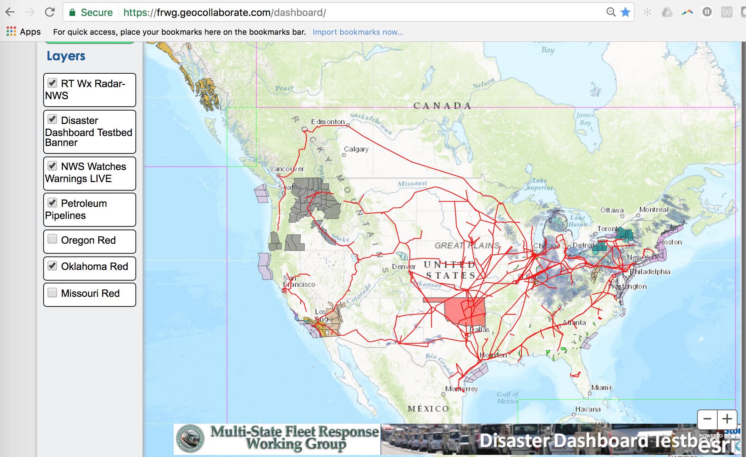
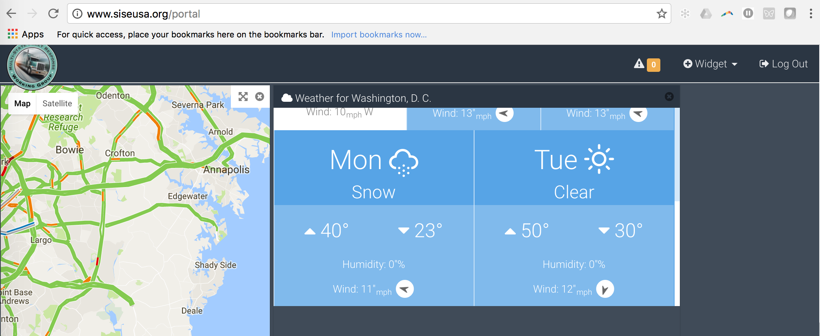
Tool Showcase
https://frwg.geocollaborate.com/
http://www.siseusa.org/portal
Notes:
SEDAC
Esri
HazardHub
Skyline Portal

Slide 12
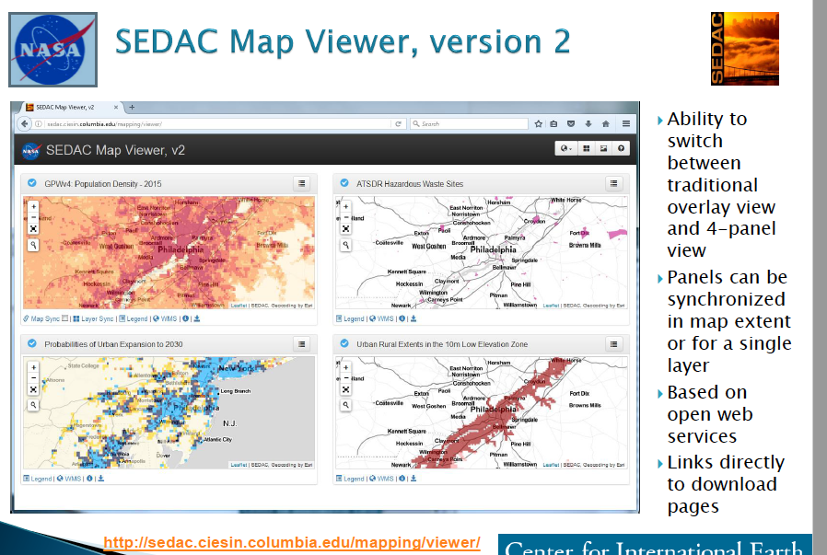
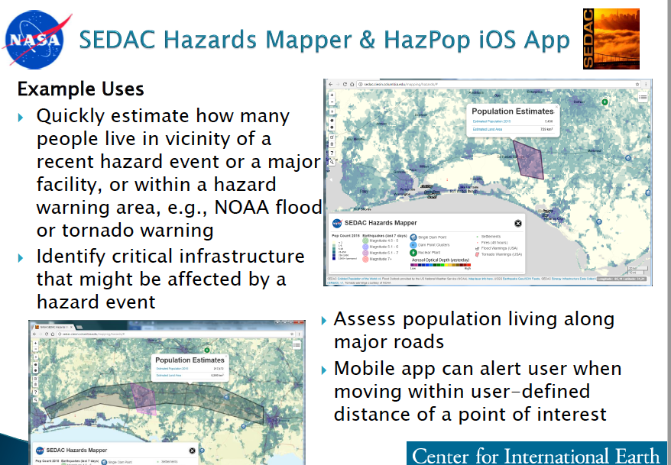
Data Overwhelm!
Science Data
SEDAC – Socioeconomic Data

Slide 13
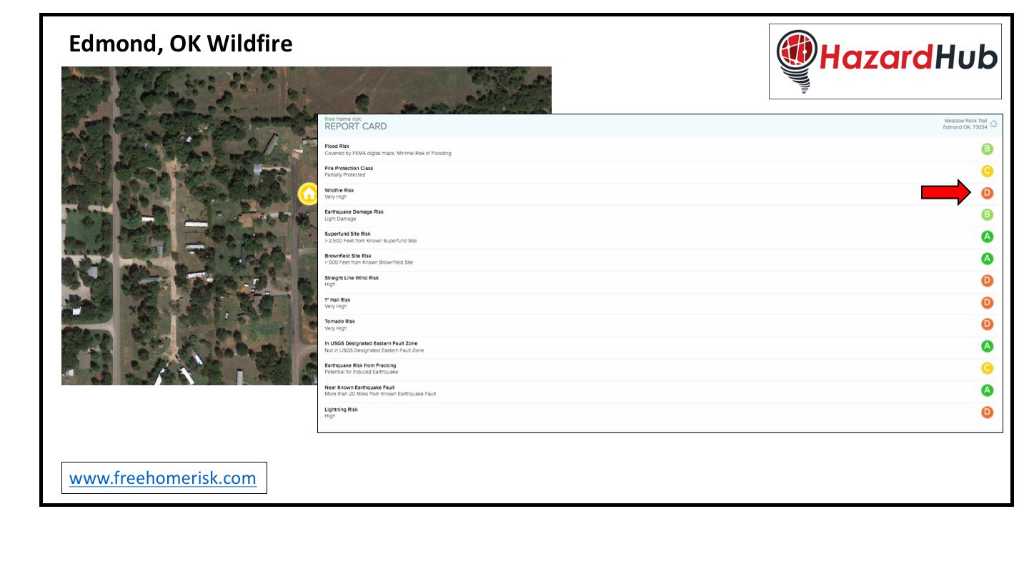
Data Overwhelm!
Science Data | Value Added Data
SEDAC – Socioeconomic Data | HazardHub – Risk probability

Slide 14



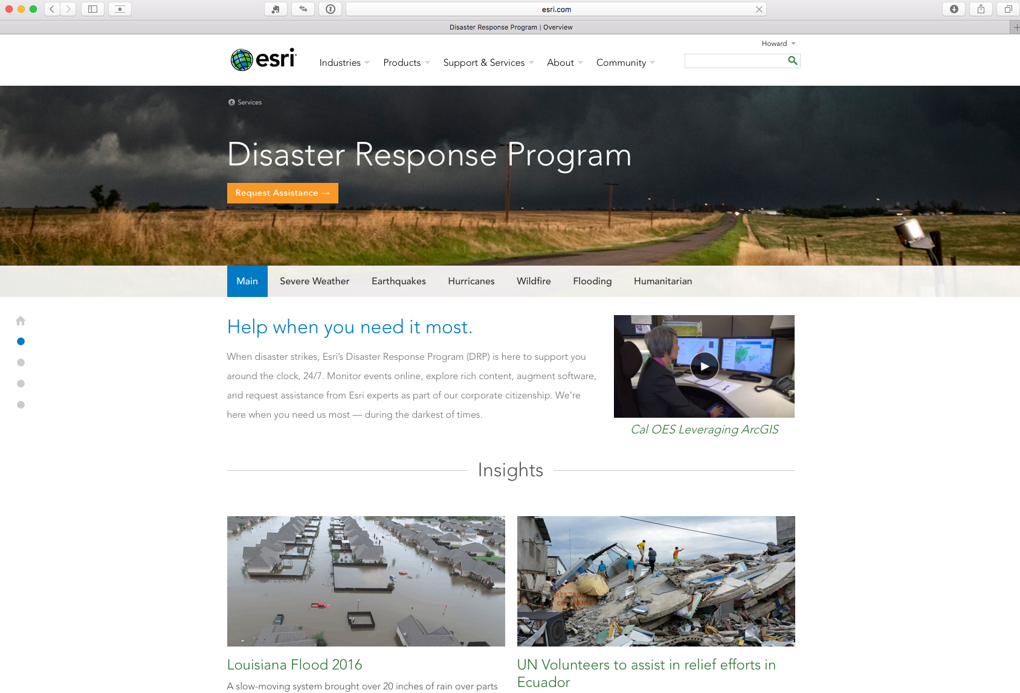
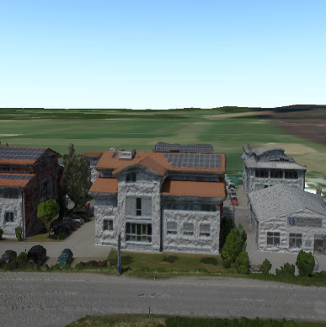
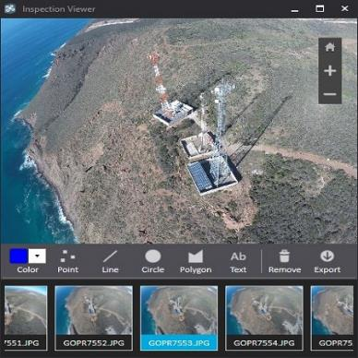
Data Overwhelm!
Science Data | Value Added Data | Commercial Tools
SEDAC – Socioeconomic Data | HazardHub – Risk probability | Esri
App configurations
Drone Data

Slide 15
Where Next?
Trusted data sources defined by ESIP Disaster Lifecycle Cluster
Promote trusted data with training through AHC tools
AHC-collaboratively defined Incubator projects (AKA Testbed) to partner ESIP members with private sector needs
Co-located meetings at ESIP Summer w/AHC?

Slide 16
3DM Initiative Timeline
3DM WG Workshops
Monthly Call / Webinars
Oct 2016
Jan 2017
April 2017
July 2017
Washington, DC
Philadelphia, PA
New York City, NY
TBD
Define Stakeholders, Approach, Timelines,
Products,
Use Cases, Data Sets
Discuss Data Sets & Use Cases, Applications, Future Data Sets
Testing w/in FRWG
Clarify Use case Template
Hone in on specific types of data
TDB

Slide 17
Thank You
In Coordination With:
Edison Electric Institute (EEI)
Earth Science Information Partners (ESIP)
DHS NPPD, Office of Infrastructure Protection (DHS-IP)
NOAA/ National Weather Service
Multi-State Fleet Response Working Group (FRWG)
East Coast Corridor Coalition (EC3)

Slide 18
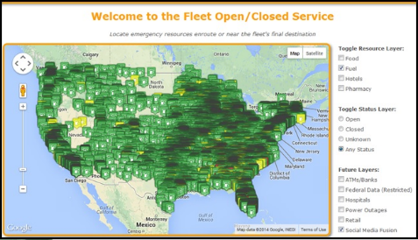
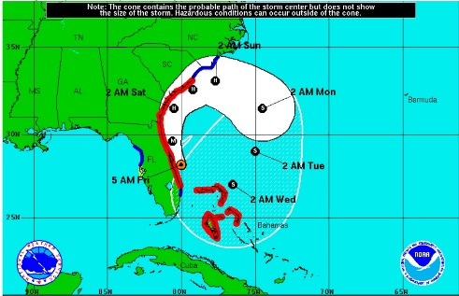
Questions?
3
M
D
Data Driven Decision Making

