Slide 1



Advertising your data:
Agency/Institution requirements for publishing metadata
Nancy Hoebelheinrich
Knowledge Motifs LLC
Version 1.0
[Reviewed
August 2012]
Notes:
Modules should be 3-7 minutes long

Slide 2

Agencies: “Allow me to persuade you!”
To make metadata (descriptive information) about your data available:
  National Science Foundation’s (NSF) Data Management Plan motivates
  National Aeronautics and Space Administration’s (NASA) Data & Information Policy encourages
  National Oceanographic And Atmospheric Administration’s (NOAA) Administrative Order 212-15 directs
  The E-Government Act of 2002 (44 U.S.C. 3602 et seq.) promotes
  Timeliness of metadata publication
Dissemination tools & techniques for
  making your metadata available
Image credit: http://www.martingover.com/wp-content/uploads/2010/04/Persuasion-Zip.jpg
Notes:
Overview Module: Voiceover Script for Slide 2
Just to give you an overview of what this module will cover, we have defined this module as:
We think the following information might be helpful for you to understand as background for the topics covered in this module:
As a high level overview, we'll touch upon these topics in this module:

Slide 3
NSF Data Management Plans
Must contain information about how a project will comply with the NSF policy on the dissemination & sharing of research results (Section j. of NSF Grant Proposal Guide, Chapter II)
Requires dissemination & sharing of research results (Award & Administration Guide. Section 4. )
  Investigators are expected to promptly prepare and submit for publication .. all significant findings from work conducted under NSF grants (Subsection a)
  NSF program management will implement these policies … through the proposal review process; through award negotiations and conditions; and through appropriate support and incentives for data cleanup, documentation, dissemination, storage and the like. (Subsection e)
Notes:
Specific NSF directorates and sometimes specific solicitations require that data and metadata in particular formats be deposited in particular catalogs.

Slide 4

NASA Data & Information Policy
“promotes the full and open sharing of all data with the research and applications communities, private industry, academia, and the general public”
Why?
  The greater the availability of the data, the more quickly and effectively the user communities can use it
  Supports the NASA mission to address basic Earth science questions
  Provides the basis for developing innovative practical applications to benefit all
http://www.diabetesmine.com/wp-content/uploads/2012/04/sharing.jpg
Notes:
NASA generally expects that metadata will be deposited in at least the GCMD.

Slide 5

NOAA Admin Order 212-15
Admin Order 212-15: Section 3. Policy
  “Environmental data will be visible, accessible and independently understandable to users…”
  “Conduct scientific data stewardship [activities] to address data content, access, and user understanding”
Cites the E-Government Act of 2002 which promotes enhanced access to Federal Government information (44 U.S.C. 3602 et seq.)
Photo courtesy of furiousgeorge81, Josh Harper.
http://www.flickr.com/photos/furiousgeorge81/177926979/

Slide 6
Timeliness of making data available
NSF Data Management & Sharing FAQ:
9. Does this policy mean that I must make my data available immediately, even before publication?
Not necessarily. The expectation is that all data will be made available after a reasonable length of time. However, what constitutes a reasonable length of time will be determined by the community of interest through the process of peer review and program management.
“NASA Earth observing satellites, sub-orbital platforms and field campaigns [data shall be shared] with all users as soon as such data become available”
NOAA Environmental Data Management Committee (EDMC) Procedural Directive addresses timeliness
Environmental data and information collected under grants / cooperative agreements will be made visible…in a timely manner (typically no later than 2 years after data are collected or created)
Notes:
Best practice is to make the metadata for the data available at the same time as the data are made available, else it will be difficult to find!

Slide 7
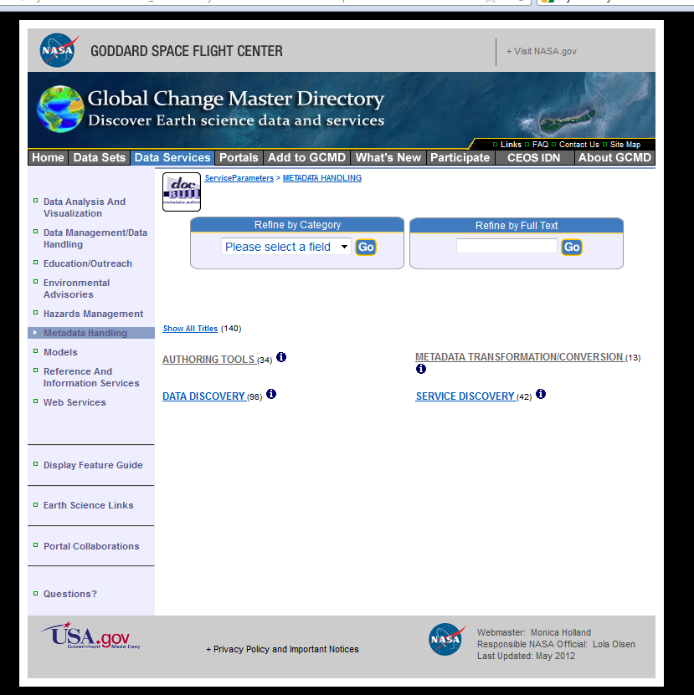
Metadata dissemination tools
& destinations
Options for authoring & converting
your metadata

Slide 8
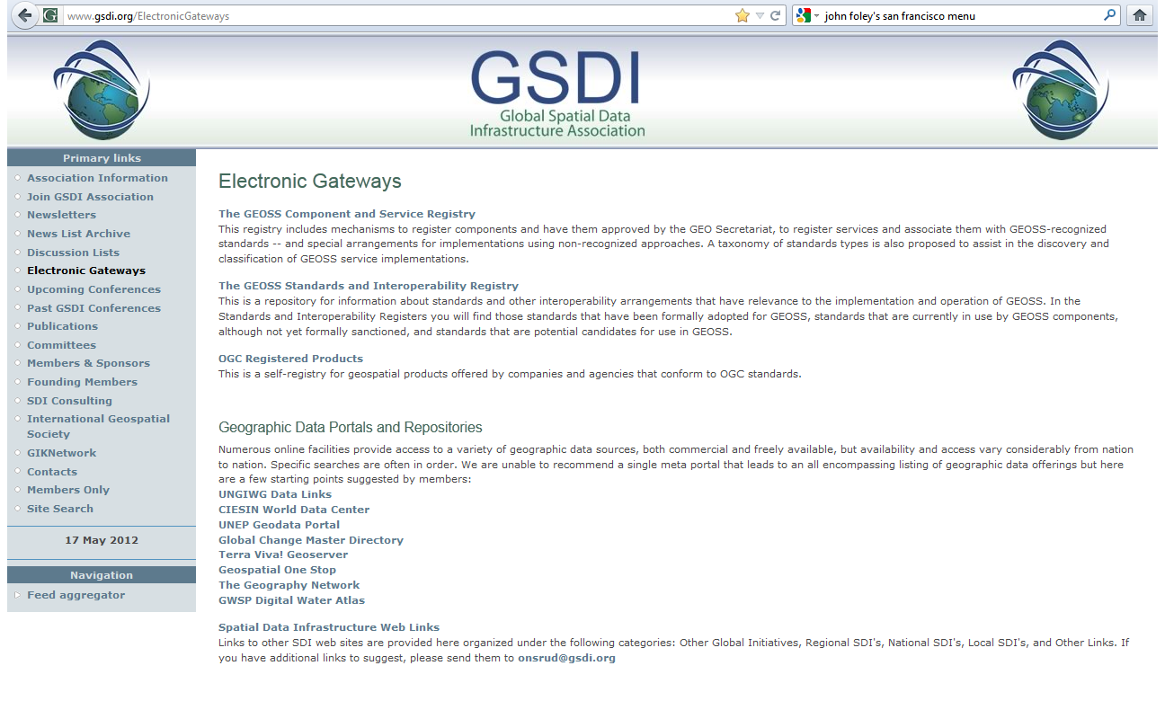
Metadata dissemination tools
& destinations
Submitting your metadata to data portals & metadata registries
http://www.gsdi.org/ElectronicGateways
Notes:
An excellent source of information about data portals and metadata registries to which you could submit information about your data is the Global Spatial Data Infrastructure Association website which contains a list of likely candidates for geographic and spatial data.

Slide 9
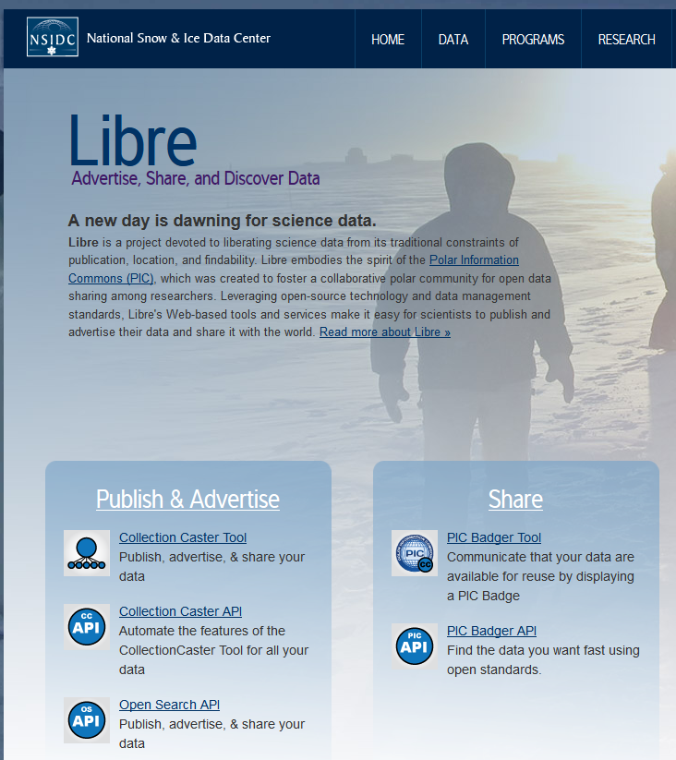
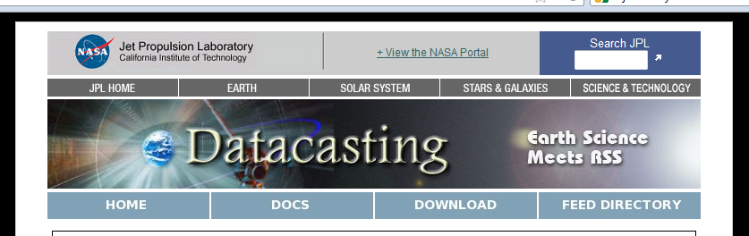
Metadata dissemination tools
& destinations
Direct submission of your metadata to the web using casting
NASA JPL Datacasting feed
http://datacasting.jpl.nasa.gov
NSIDC Libre Collection Casting tool
http://nsidc.org/libre/apps/cast/dataset/
Notes:
Datacasting is an RSS-based technology used for distributing your Earth Science data.
Using a web-based submission form, you publish the availability of your data through a web-feed along with some minimal information about the data
Users subscribe to the web feeds to find & download data of interest, including yours! Data aggregators can also find your data using this method.
The JPL data caster advertises information about newly archived individual items within a data set whereas the Libre Collection Caster advertises collections as a whole.

Slide 10
References
NSF Award & Administration Guide, Chapter VI http://www.nsf.gov/pubs/policydocs/pappguide/nsf11001/aag_6.jsp#VID4
NSF FAQ http://www.nsf.gov/bfa/dias/policy/dmpfaqs.jsp#15
NASA Data & Information Policy http://science.nasa.gov/earth-science/earth-science-data/data-information-policy/
NOAA Administrative Order 212-15 http://www.corporateservices.noaa.gov/ames/administrative_orders/chapter_212/212-15.html
NOAA EDMC Procedural Directive https://www.nosc.noaa.gov/EDMC/documents/EDMC_PD-DSPNG_transmittal_v1.pdf
Notes:
References Module: Voiceover script
Within this module, we've made reference to a number of published information sources that we think you may want to review when you want more in-depth information. The most relevant references are listed here.

Slide 11

Resources
GCMD Metadata Handling Search Query: http://gcmd.nasa.gov/KeywordSearch/Keywords.do?Portal=GCMD_Services&KeywordPath=ServiceParameters|METADATA+HANDLING&MetadataType=1&homepg
Global Spatial Data Infrastructure (GSDI) Association Electronic Gateways: http://www.gsdi.org/ElectronicGateways
More about datacasting: http://datacasting.jpl.nasa.gov/docs/read_more.php
NSIDC Libre Collection Casting tool: http://nsidc.org/libre/share/collectioncaster.html
Image Credit: ttp://2.bp.blogspot.com/-x7oCNtb7-Os/T0cDPUEjKQI/AAAAAAAAEHs/yXEJy9ojRXM/s1600/Wheel-of-Time.jpg
Notes:
Resources Module: Voiceover script
We've collected some additional resources that might you might find helpful should you need more information about some of the areas that we've covered briefly. We'd also like to explain why we think they might be useful.

Slide 12

Other Relevant Modules
Advertising Your Data – the wherefores & wherefore-nots of advertising your data
Advertising Your Data: Using portals and registries – more specifics on how to publish metadata to these destinations
Introduction to Metadata & Metadata Standards – to learn basic information about what metadata & for what it’s used
Publishing Metadata to GCMD – tips on how to submit your metadata to the Global Change Master Directory
Casting Your Data – more information about some open source tools that help you publish your data to the Web
http://4.bp.blogspot.com/-7iahAzMP614/Tz_QfmlWwDI/AAAAAAAAAW8/vOc1mGE2l4g/s1600/Internet+Advertising+Methods.jpg
Notes:
Other Relevant Modules Module: Voiceover script
The modules of the ESIP Data Management Course have been designed to complement and supplement each other. In light of this plan, we think you might find the following, related modules relevant to you and why as you gain a better understanding of data management:

