Slide 1
Introduction to GEO Air Quality Community of Practice GEO AQ CoP - Wiki Workspace
Rudolf Husar, Washington University, MO
Stefan Falke, Northrop Grumman, VA
Erin Robinson, ESIP, Internet
David McCabe, Terry Keating, Gary Foley, EPA
….
ESIP Winter Meeting, Jan 10, 2013, Washington DC

Slide 2
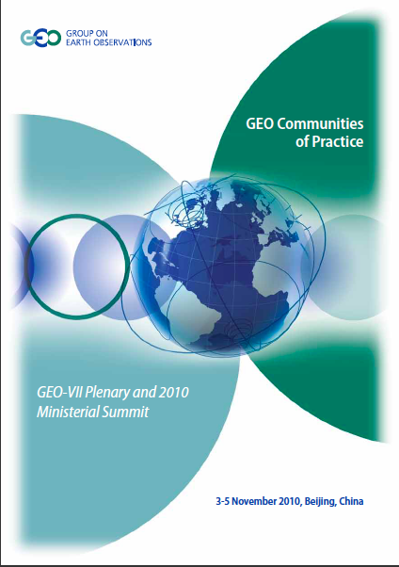
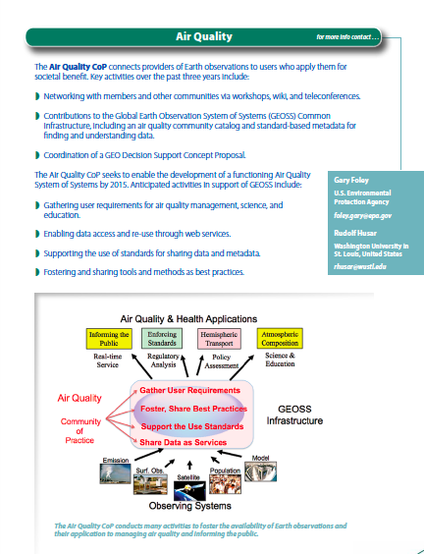
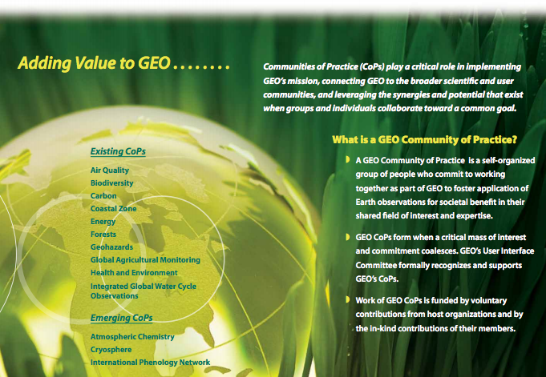
GEO CoP Brochure

Slide 3
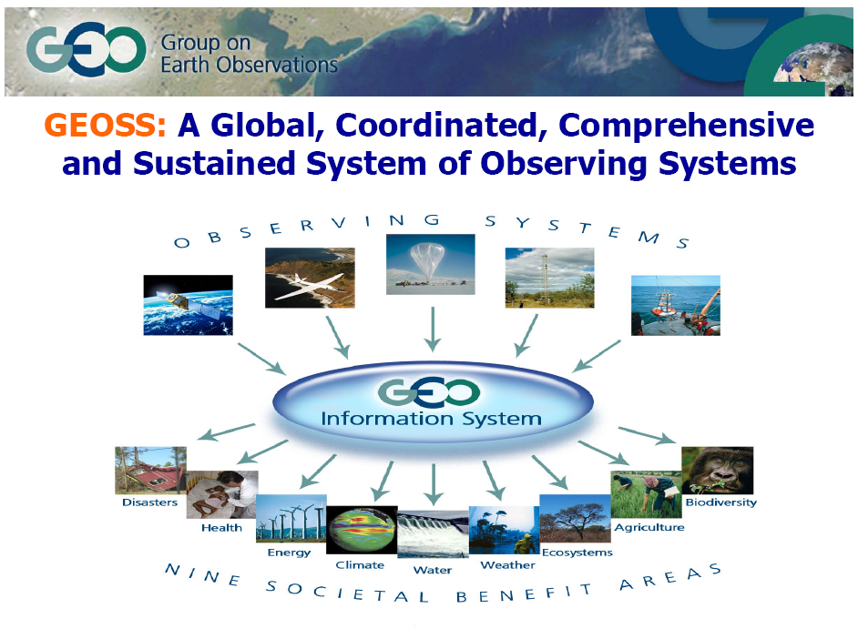
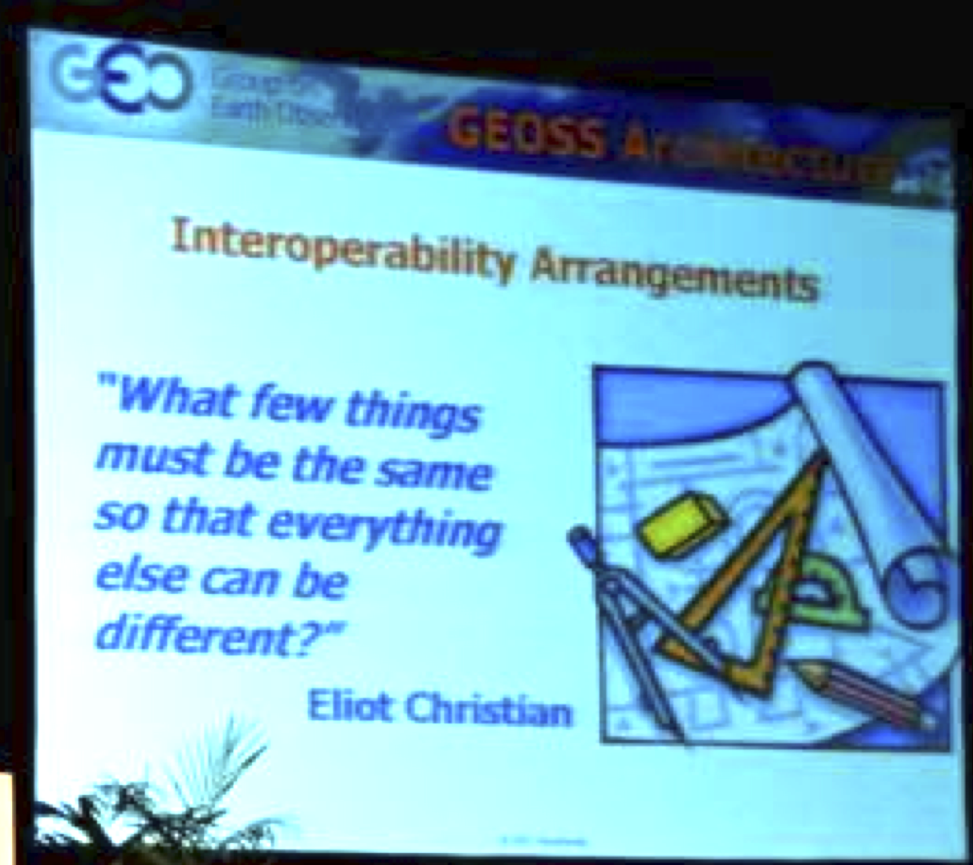
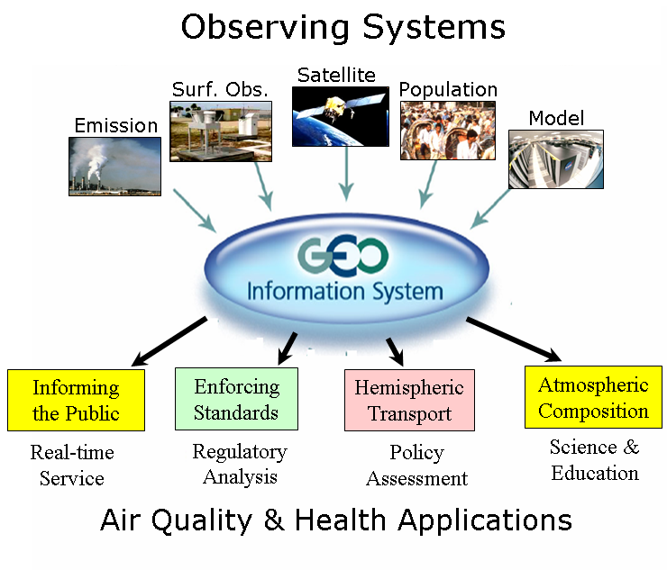
Guiding Principles by
Global Observing System of Systems (GEOSS)
Any Single Data Set Can Serve Many Applications
Any Single Problem Requires Many Data Sets
Interoperability!
Notes:
First a recap of tree basic ideas for GEOSS.
Any single problem requires many datasets
Any dataset will serve many communities
The PULL by data users and the PUSH by data providers are driving forces for the flow of data

Slide 4
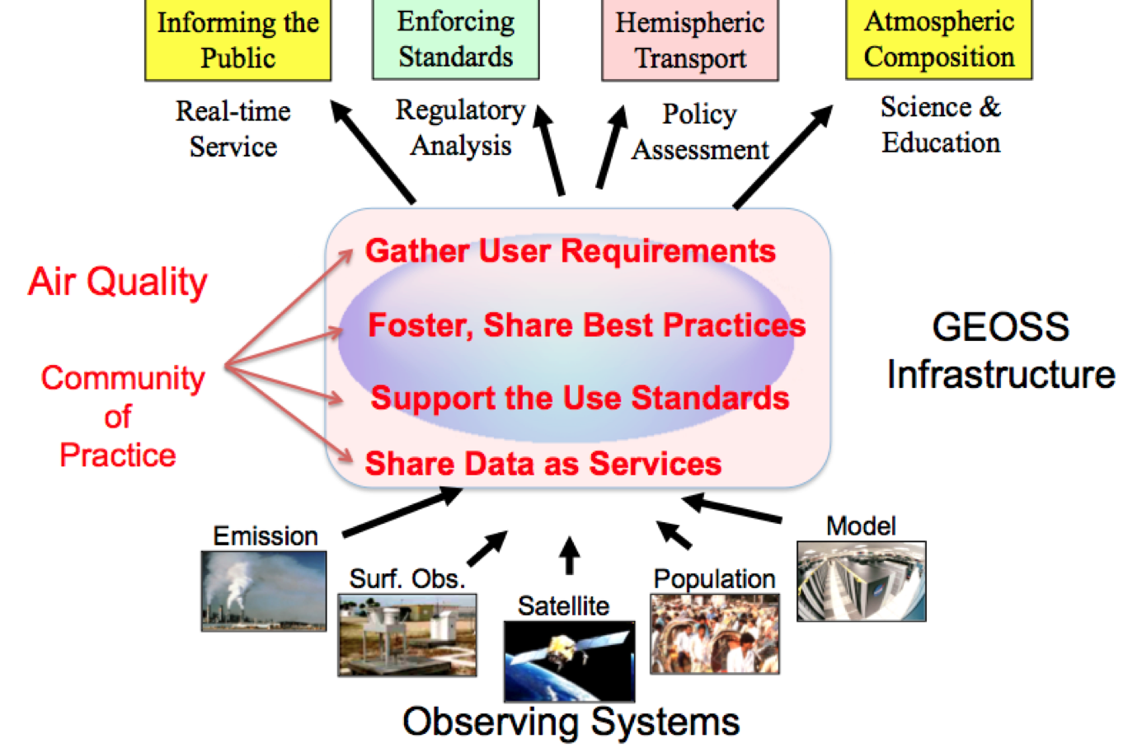
Air Quality & Health Applications
Notes:
The vision is to have these data available through an interoperability framework that allows them to be used via various subsets and combinations to support specific research and decision applications
There are numerous Earth Observations that are available and in principle useful for air quality applications such as informing the public and enforcing AQ standards. However, connecting a user to the right observations or models is accompanied by an array of hurdles.
The GEOSS Common Infrastructure allows the reuse of observations and models for multiple purposes
Even in the narrow application of Wildfire smoke, observations and models can be reused.

Slide 5
GEO Air Quality CoP Regional Clusters
N. America: ESIP AQ Workgroup, since 2008
Europe: MACC Project, since 2010
India: India AQ Resource Group since 2011
Major Outputs
Registered AQ data in GEOSS Common Infrastructure
Prepared AQ user requirement document
Organized topical workshops: Solta, Dublin, Mumbai
Facilitating an interoperable Air Quality Data Network
Co-developed the AQ Community WCS server software
See the AQ CoP Wiki wokspace for more details

Slide 6
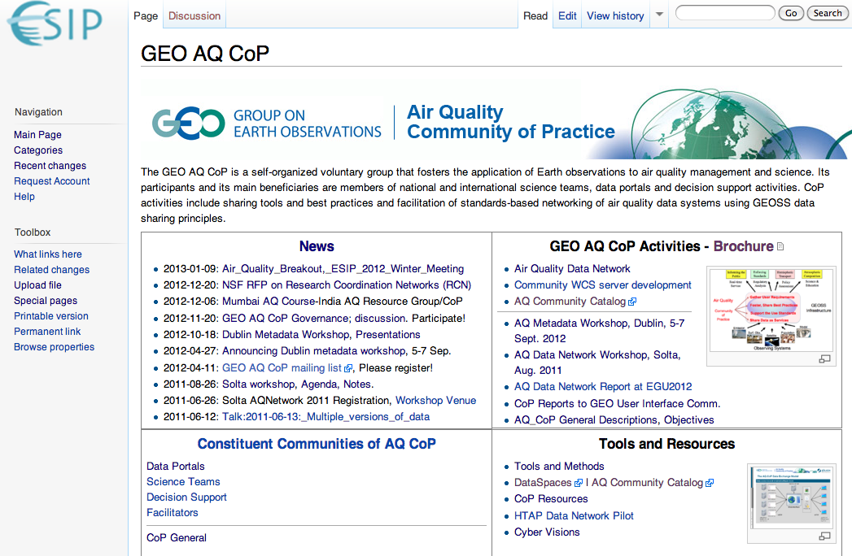
GEO AQ CoP Workspace: ESIP wiki

