Slide 1


Using Portals and Registries: Publishing Metadata to GCMD
Lola Olsen¹ , Tyler Stevens²,
1 National Aeronautics and Space Administration (NASA)
2 Wyle Information Systems (NASA Contractor)
Notes:
Modules should be 3-7 minutes long
Voiceover script:
This training module is part of the ESIP Federation's Data Management Course for Scientists. The subject of this module is “Using Portals and Registries". The title of this module is “Publishing Metadata to GCMD” authored by Lola Olsen and Tyler Stevens from NASA. Besides the Earth Science Information Partners (ESIP) Federation, sponsors of this Data Management Course are the Data Conservancy and the United States National Oceanographic and Atmospheric Administration, NOAA.

Slide 2
Overview
Introduction to the GCMD
Publishing Metadata using docBUILDER
Overview of docBUILDER Functionality
Notes:
Overview Module: Voiceover Script for Slide 2
As a high level overview, we'll touch upon these topics in this module:
(1) An Introduction to the GCMD; (2) Publishing metadata using docBUILDER; (3) and An overview of docBUILDER functionality

Slide 3
Global Change Master Directory (GCMD)
The GCMD enables the scientific community to discover and access over 25,000 Earth science data sets and services.
The GCMD uses the Directory Interchange Format (DIF), a discovery level metadata standard that is used by NASA and the Committee on Earth Observation Satellites (CEOS).
The DIF contains several fields, allowing users to easily find and determine the data set and/or service that is useful to their needs.
Notes:
Voiceover Script for Slide 3
The Global Change Master Directory (GCMD) enables the scientific user community to discover and access earth science data sets and services.
The Directory Interchange Format is an international discovery level metadata standard that is used by NASA and the Committee on Earth Observation Satellites (CEOS) community
The DIF contains several crucial fields that are used for discovery, allowing users to easily find, understand data, and determine if the data set is useful for their needs. The DIF has evolved over 20 years and has been flexible enough to evolve with growing metadata requirements.

Slide 4
Publishing Metadata
docBUILDER is a free, online tool for creating, updating, and publishing DIF metadata entries to the GCMD.
Provides a “visual” check-list of required, highly recommended, and recommended fields to populate.
Performs validation (checks controlled fields and syntax).
Allows for templates when creating entries with repeatable information.
Users can register for an account at https://urs.eosdis.nasa.gov/
Users can access docBUILDER at http://gcmd.nasa.gov/User/authoring.html
Notes:
Voiceover Script for Slide 4
docBUILDER is a free online metadata authoring tool for creating, updating, and publishing DIF metadata entries to the GCMD. The tool allows users to easily contribute their metadata.
The tool gives users a visual checklist of required, highly recommended, and recommended fields to populate. The more fields populated, the better and more useful the metadata will be to users to seek, find, and understand the data.
The tool performs validation of the controlled keyword fields and the syntax of the information being entered. This ensures quality and consistent content that enhances a normalized search of the metadata.
To access docBUILDER, users need an account and can create one at the NASA User Registration System (URS) website. If users already have an account via the NASA URS, no new account is needed. Once users have their account, they can log into docBUILDER with their credentials at http://gcmd.nasa.gov/User/authoring.html

Slide 5
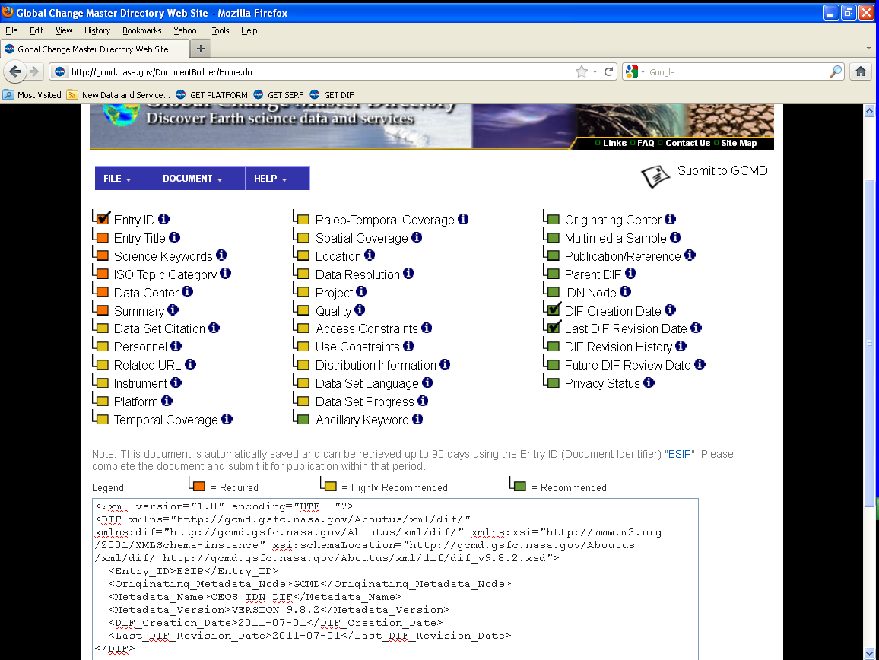
Using docBUILDER
Submit Your Document
to the GCMD
Validate Your Document
and/or Get Help
Field is checked when completed
Populate Metadata Fields
Notes:
Voiceover Script for Slide 5
Here is a view of the docBUILDER interface that highlights the features mentioned in the previous slide.
The menu at the top of the tool gives users many options. The file menu allows users to save and/or add a new metadata record. The Document menu allows users to validate, preview, and submit their metadata document. The Help menu allows users to access the docBUILDER and metadata tutorials. Users can also contact the GCMD staff if they have additional questions.
Please note that as users populate the fields, they are checked indicating that the field is complete.
When users are finished editing their metadata record, they can click “Submit to GCMD” to submit their metadata where it will get approved by the science coordinators.
Users can also use docBUILDER to create templates when creating multiple records that have repeatable information in a set of fields is required. The online tutorials give users step-by-step directions on how to create and edit templates.

Slide 6
Relevance to Data Management
Creating and maintaining metadata is part of the data management lifecycle.
docBUILDER makes it easy for users to update/maintain their metadata entries.
DIF entries provide a direct link (i.e. http://gcmd.nasa.gov/getdif.htm?GES_DISC_AIRI2CCF_NRT_V005) to metadata that can be added to data management reports.
Notes:
Voiceover Script for Slide 6
Now that you have seen what this module has covered, you might be wondering why these topics are important for data management. To answer that question, please consider the following:
Creating and maintaining metadata is part of the data management lifecycle. The docBUILDER metadata authoring tool can play a big part in that process because docBUILDER makes it easy and free for users to create and contribute metadata for their Earth science data sets.
Since docBUILDER and the GCMD only contain metadata, the user or agency creating the metadata still has control of their data, their processes, and the methods in how their information is maintained and updated.
Once users submit their metadata record and it is added to the GCMD database, users can link directly to their metadata record. This makes it easy for users to insert into their data management reports and other documentation that is required by their agency.

Slide 7
References and Resources
National Aeronautics and Space Administration (NASA). 2010. “Directory Interchange Format (DIF) Writer's Guide”. Global Change Master Directory. http://gcmd.nasa.gov/User/difguide/
National Aeronautics and Space Administration (NASA). Global Change Master Directory (GCMD). http://gcmd.nasa.gov/
National Aeronautics and Space Administration (NASA). docBUILDER: http://gcmd.nasa.gov/User/authoring.html
Notes:
Voiceover Script for Slide 7
We've collected some additional resources that might you might find helpful should you need more information about some of the areas that we've covered briefly.
[see text in document]

Slide 8
Other Relevant Modules
Metadata for discovery
Advertising your data
Using portals and registries
Notes:
Voiceover Script for Slide 8
The modules of the ESIP Data Management Course have been designed to complement and supplement each other. In light of this plan, we think you might find the following, related modules relevant to you and why as you gain a better understanding of data management:
The modules are as follows: Metadata for discovery and Advertising your data: Using portals and registries

