Slide 1
Educating Data Scientists: a view from the trenches
Karen Stocks
Geological Data Center
Scripps Institution of Oceanography

Slide 2

My Lens
    Academic oceanography projects, mainly extramurally-funded.

Slide 3
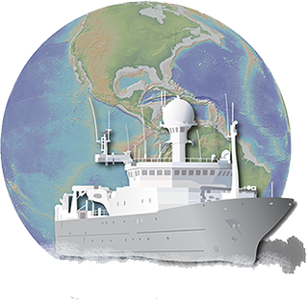
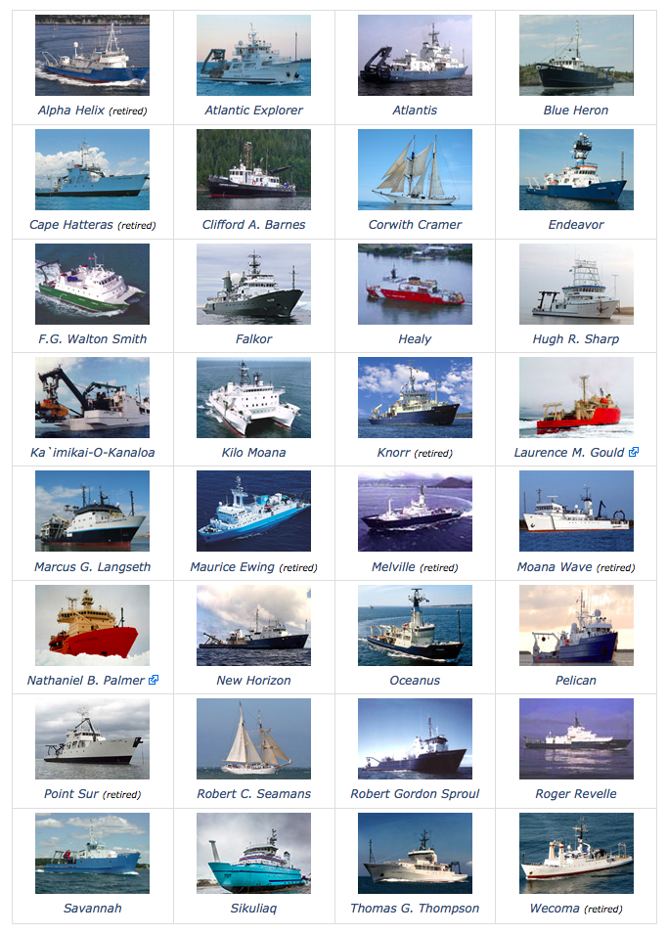
Rolling Deck to Repository (R2R)
Program
Mission:
  Stewardship of routinely-acquired environmental sensor data and documentation from the U.S. Academic Research Fleet
Funded by NSF
A Collaboration of LDEO, SIO, WHOI, and FSU
The Fleet:
  ~400 Cruises/year from 25 In-service Vessels

Slide 4
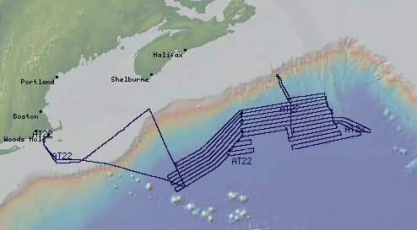
R2R Data Analysis Example
Quality control data from the US academic research fleet, and provide standard products (e.g. downsampled or merged)
Write code to run QC tests, reformat/downsample/merge data
  →Programming
  →Data Handling

Slide 5
But also…understand the instruments & data
Create tests & set appropriate test thresholds
  deep understanding of the nature of the data and the instrument(s) collecting it

Slide 6
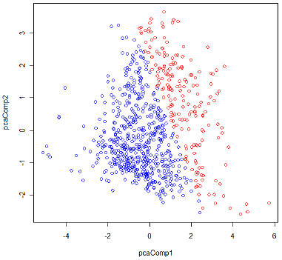
My PCA Caution
Not the real data!
Graph source: https://onlinecourses.science.psu.edu/stat857/node/135

Slide 7
But also…understand the instruments, data, and user needs
Create tests & set appropriate test thresholds
  deep understanding of the nature of the data and the instrument(s) collecting it
  Assess requirements…through a community process.
Troubleshoot odd results
  deep understanding of the instrument function, maintenance, proper deployment

Slide 8
And…manage the data and the systems they are on
Transfer large data from ship operators, store locally, move to national data centers, ensuring no corruption or loss.
  →sys admin
  →backup
  →security
  →data curation principles
Create and manage metadata
  →formal metadata standards
  →relational database design

Slide 9
Bottom Line
I have a hard time hiring because I can’t find people broad enough.

Slide 10
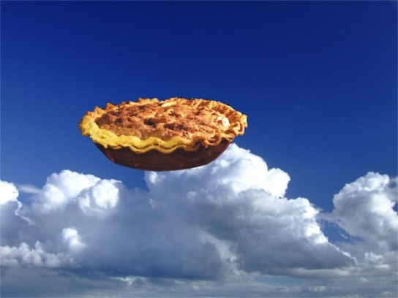
My Ideal Training Program
Include training from collection through archive. Draw from computer science, library/information science, statistics.
Require cross training in a specific domain.
Focus on processes as much as on tools (e.g. requirements assessment, user testing.)

Slide 11
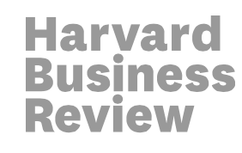

Parting thought – does this worry anyone else?
Data Scientist: The Sexiest Job of the 21st Century
#1 Worst Master’s Degrees for Jobs: Library and Information Science

Slide 12
Thank you
kstocks@ucsd.edu

