Slide 1




Providing Access to Your Data:
Tracking Data Usage
Local Data Management
Robert R. Downs, PhD
NASA Socioeconomic Data and Applications Center (SEDAC)
Center for International Earth Science Information Network (CIESIN)
Columbia University
Version 1.0
Review Date
Copyright 2012 Robert R. Downs.
Notes:
Modules should be 3-7 minutes long
Voiceover script:
This training module is part of the ESIP Federation's Data Management Course for Scientists. The subject of this module is [name of category / name of subcategory, if any, e.g., "The case for data stewardship / Agency Requirements"]. The title of this module is [Subtitle]authored by [Author Name] from [full Organization Name, no acronyms]. Besides the Earth Science Information Partners (ESIP) Federation, sponsors of this Data Management Course are the Data Conservancyand the United States National Oceanographic and Atmospheric Administration, NOAA.

Slide 2
Overview
Background and context
Relevance to data management
What can data usage tell me about my data?
Where can I find usage information about my data?
Tracking data citations
Notes:
Overview Module: Voiceover Script for Slide 2
Just to give you an overview of what this module will cover, we have defined this module as:
We think the following information might be helpful for you to understand as background for the topics covered in this module:
As a high level overview, we'll touch upon these topics in this module:

Slide 3
Background and context
Scientific data can be used for purposes other than those originally planned
  New products, such as maps, can be created and distributed
  Data may be integrated with other data to create new data
  Studies may be published about the use of the data
  Policies, plans, and reports may result from using the data
Tracking scientific data usage
  Identifies how they have been used
  Reveals any benefits and impacts of their use
  Can be used to justify previous and future data efforts
Notes:
Background and context: Voiceover Script for Slide 3
Now that you have an idea of what this module will cover, you might be wondering why these topics are important for data management. To answer that question, please consider the following:
At this point, it might seem that managing your data involves a lot more effort than may be warranted. If so, there are both incentives and warnings to share that might help motivate you to do your part for data management. As incentives, think about these possibilities:
On the other hand, a few warning thoughts might be in order. For instance:

Slide 4

Relevance to data management
Data producers, distributors, stewards, and sponsors need to know how the data have been used
  Producers learn whether the data are useful to others
  Distributors learn which communities are being served
  Stewards can document prior use of the data
  Sponsors learn whether their investment in the data paid off
Knowledge of data use may identify opportunities for new data collection and distribution efforts
Tracking data use can justify efforts of collecting data and of developing and distributing data products or services
Evidence of beneficial data use demonstrates accomplishments for those who contributed to the effort
Notes:
Relevance to Data Management: Voiceover Script for Slide 4
Now that you have an idea of what this module will cover, you might be wondering why these topics are important for data management. To answer that question, please consider the following:
At this point, it might seem that managing your data involves a lot more effort than may be warranted. If so, there are both incentives and warnings to share that might help motivate you to do your part for data management. As incentives, think about these possibilities:
On the other hand, a few warning thoughts might be in order. For instance:

Slide 5
What can data usage tell me about my data?
Who your data users are by discipline or level of expertise
  discipline (oceanography, geology, etc.)
  level of expertise (graduate students, experienced climate scientists, etc.)
Why your data are used
  Scientific research
  Education
  Policy-making
  Planning
Uses of similar data could inform data development and dissemination plans
Past and current uses can be used to
  Inform enhancements for data products and related services
  Identify the impacts of the resources
Notes:
Relevance to Data Management: Voiceover Script for Slide 4
Now that you have an idea of what this module will cover, you might be wondering why these topics are important for data management. To answer that question, please consider the following:
At this point, it might seem that managing your data involves a lot more effort than may be warranted. If so, there are both incentives and warnings to share that might help motivate you to do your part for data management. As incentives, think about these possibilities:
On the other hand, a few warning thoughts might be in order. For instance:

Slide 6
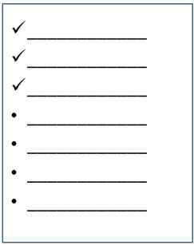
Where can I find usage information about my data
Data citations
  Citations of data are evidence of data use for a publication
  Scientific publication services now publish data citations indexes
Metrics for access and support (describe in privacy policy)
  Web metrics for initial and repeat visits, downloads
  Contact information of users who request assistance
Registration
  Request contact information from data recipients
User surveys (with approval of ethics board)
  Administer questionnaires to data webpage visitors
Notes:
Relevance to Data Management: Voiceover Script for Slide 4
Now that you have an idea of what this module will cover, you might be wondering why these topics are important for data management. To answer that question, please consider the following:
At this point, it might seem that managing your data involves a lot more effort than may be warranted. If so, there are both incentives and warnings to share that might help motivate you to do your part for data management. As incentives, think about these possibilities:
On the other hand, a few warning thoughts might be in order. For instance:

Slide 7
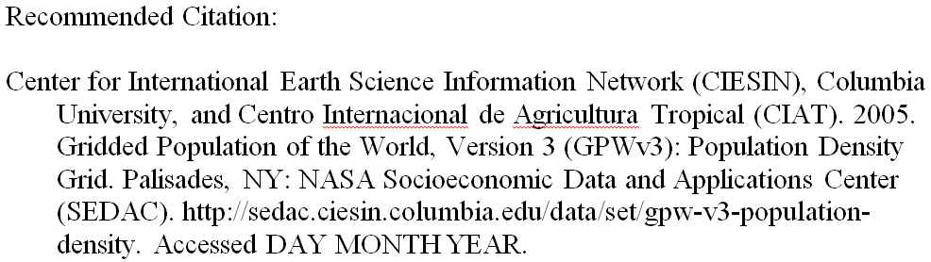
Tracking data citations
Encourage users to cite your data
  Similar to citing articles
Provide a recommended citation for your data
  Include author, publication date, title and version, publisher or distributor, and locator or identifier
  Display recommended citation with your data
Subscribe to citation alerts from publishers
  References in published scientific literature (articles, books, etc.)
  References in gray literature (presentations, reports, blogs, etc.)
  References in popular media (magazines, newspapers, radio, television, etc.)

Slide 8
Resources
DataONE Best Practices Database. 2012. DataONE. Available online at http://www.dataone.org/best-practices
Force11 (the Future of Research Communications and e-Scholarship). http://force11.org/
Geospatial Data Preservation Resource Center. 2011. CIESIN, Columbia University. Available online at http://geopreservation.org/
Notes:
Resources Module: Voiceover script
We've collected some additional resources that might you might find helpful should you need more information about some of the areas that we've covered briefly. We'd also like to explain why we think they might be useful.

Slide 9
References
Chen, R. S. & Downs, R. R. 2010. Evaluating the Use and Impact of Scientific Data. NFAIS Workshop on Assessing The Usage and Value of Scholarly and Scientific Output: An Overview of Traditional and Emerging Metrics. Philadelphia, PA. Nov. 10, 2010 http://info.nfais.org/info/ChenDownsNov10.pdf
Database Bonanza. 2012. Nature Climate Change 2, 703. http://dx.doi.org/10.1038/nclimate1713
Heather A. Piwowar, H. A., Carlson, J. D., Vision, T. J. 2011. Beginning to track 1000 datasets from public repositories into the published literature. Proceedings of the American Society for Information Science and Technology 48(1), 1–4. DOI: 10.1002/meet.2011.14504801337. Available online at: http://www.asis.org/asist2011/posters/337_FINAL_SUBMISSION.pdf
Notes:
References Module: Voiceover script
Within this module, we've made reference to a number of published information sources that we think you may want to review when you want more in-depth information. The most relevant references are listed here.

Slide 10
Other Relevant Modules
Preservation strategies: What do long-term archives do with my data?
  Archives may promote and track the use of data that they maintain
Providing access to your data: Broadening your user community
  Results from tracking data use will help broaden your user community
Providing access to your data: Determining your audience
  Determine your audience to understand their data needs
Responsible data use: Citation and credit
  Data citations are beneficial and can be used to track data usage
Notes:
Other Relevant Modules Module: Voiceover script
The modules of the ESIP Data Management Course have been designed to complement and supplement each other. In light of this plan, we think you might find the following, related modules relevant to you and why as you gain a better understanding of data management:

