Slide 1



The WDS/RDA Assessment of Data Fitness for Use Working Group
Jonathan Petters (Virginia Tech)
Marina Soares e Silva (Elsevier)
Claire Austin (Department of the Environment, Government of Canada)
Michael Diepenbroek (PANGAEA)
ESIP Information Quality Cluster - February 2019

Slide 2
Problem: I have the data but can’t use it
I have found data in a domain/generic repository that I can access but…
I can’t be sure it’s complete
The metadata contains conflicting information
I am having issues with the format
… and I just wasted 6 hours of my time figuring out I can’t use it!
ESIP Information Quality Cluster - February 2019

Slide 3

Problem: I have the data but can’t use it
Provider gives access to a dataset which is FAIRly deposited by creator
BUT
The same dataset might not be fit for the data user!
ESIP Information Quality Cluster - February 2019

Slide 4
Problem: I have the data but can’t use it
Provider gives access to a dataset which is FAIRly deposited by creator
BUT
The same dataset might not be fit for the data user!
Challenge
How to make research data fit for the widest possible use?
ESIP Information Quality Cluster - February 2019

Slide 5
Our working group’s approach
Data fitness for use
Assessment of the fitness of use for individual data sets should consolidate current efforts and be
thorough & comprehensive
reliable & of efficient application
high impact & visibility
ESIP Information Quality Cluster - February 2019

Slide 6
Our working group’s approach
Data fitness for use RDA/WDS Working Group
Specify criteria of reusability expanding on FAIR to support providers in assessing data quality
Our target group:
Data repositories
ESIP Information Quality Cluster - February 2019

Slide 7
Our working group’s approach
Data fitness for use RDA/WDS Working Group
Specify criteria of reusability expanding on FAIR to support providers in assessing data quality→ a checklist
Our target group:
Data repositories
ESIP Information Quality Cluster - February 2019

Slide 8

Our working group’s approach
Data fitness for use RDA/WDS Working Group
Specify criteria of reusability expanding on FAIR to support providers in assessing data quality → a checklist
Our target group:
Data repositories → for use by repository managers/external evaluator such as CoreTrustSeal
ESIP Information Quality Cluster - February 2019

Slide 9
Our working group’s approach
Data fitness for use RDA/WDS Working Group
Specify criteria of reusability expanding on FAIR to support providers in assessing data quality → a checklist + rating system!
Our target group:
Data repositories → for use by repository managers/external evaluator such as CoreTrustSeal
ESIP Information Quality Cluster - February 2019

Slide 10
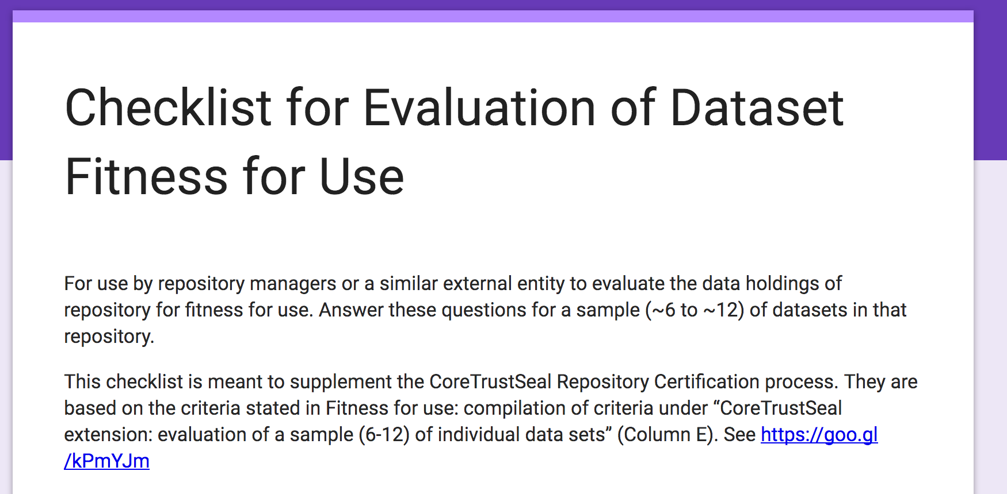

Slide 11
Criteria to assess data fitness for use
Categories
Metadata completeness (R)
Accessibility (A)
Data completeness and correctness (R)
Findability & interoperability (F, I)
Curation (leading to FAIRness)
→ Expanding on reusability of FAIR
ESIP Information Quality Cluster - February 2019

Slide 12
Assessing data fitness for use (data correctness)
Repository hosts weather observation data in a spreadsheet
Spreadsheet is findable, accessible
But is it fit for use?
ESIP Information Quality Cluster - February 2019

Slide 13
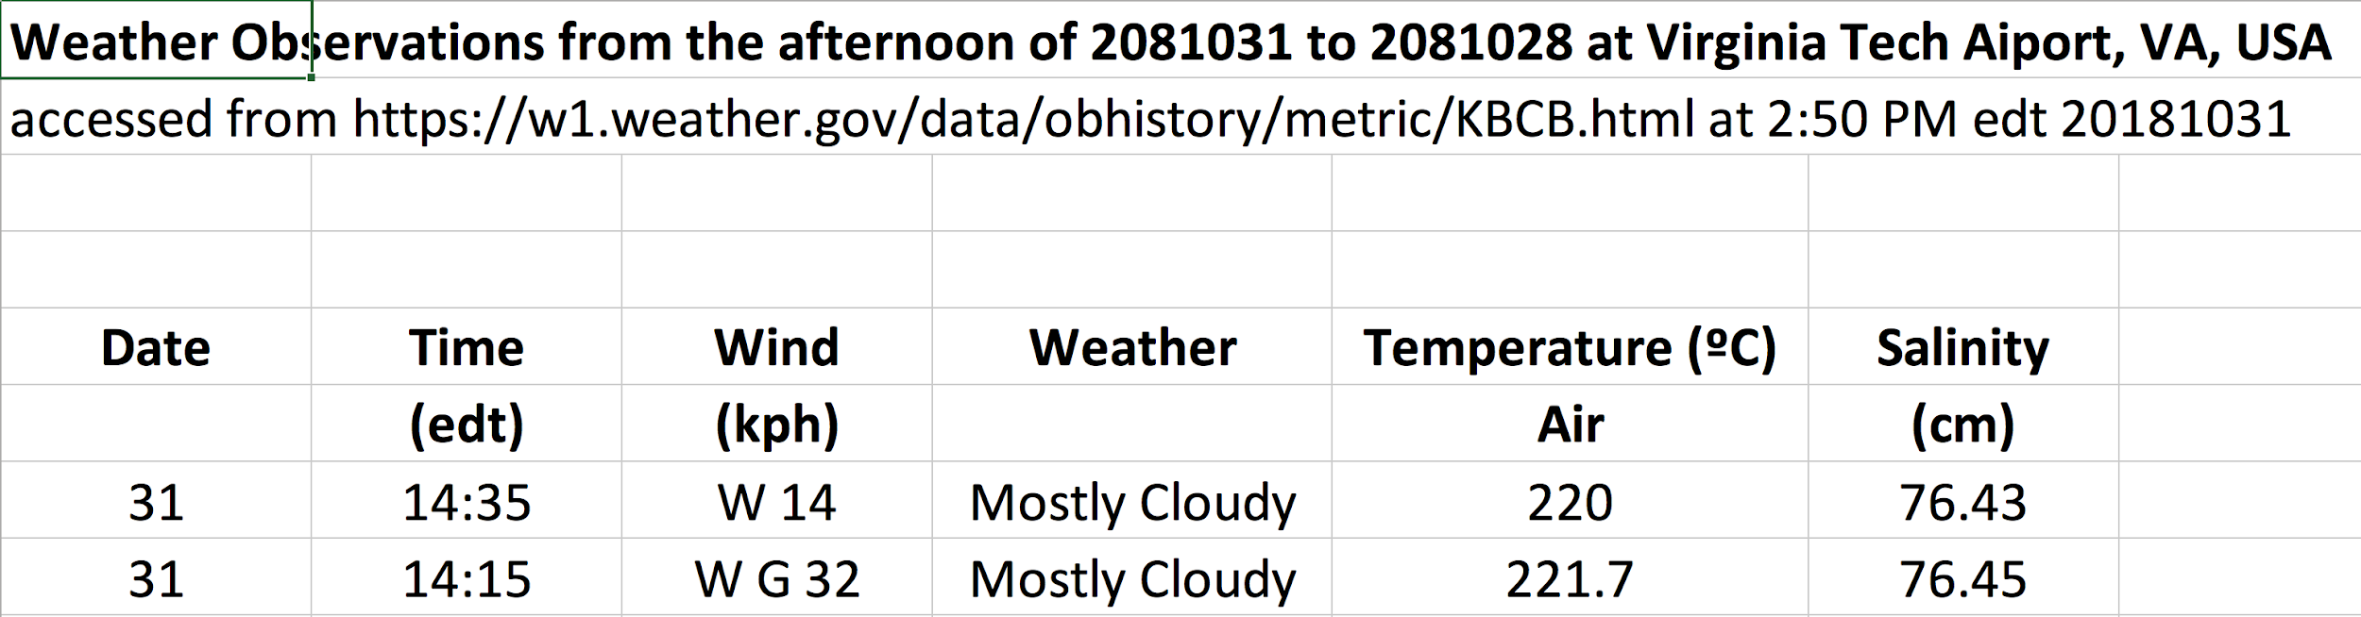
Assessing data fitness for use (data correctness)
ESIP Information Quality Cluster - February 2019

Slide 14
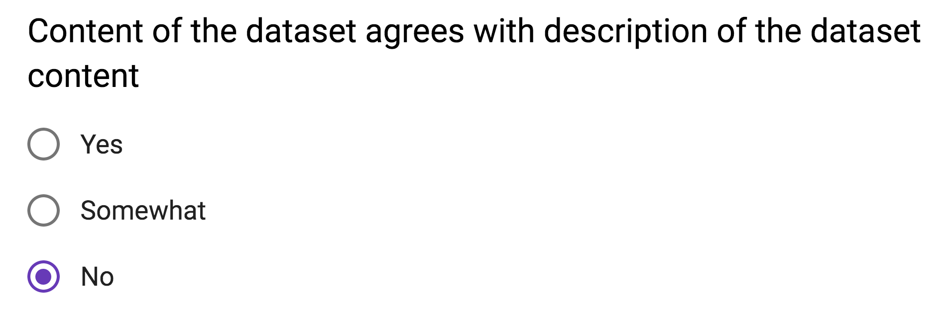
Assessing data fitness for use (data correctness)
ESIP Information Quality Cluster - February 2019

Slide 15
Initial Feedback on Checklist - ICPSR
ESIP Information Quality Cluster - February 2019

Slide 16
Initial Feedback on Checklist - ICPSR
How to evaluate level of curation for dataset?
ESIP Information Quality Cluster - February 2019

Slide 17
Initial Feedback on Checklist - ICPSR
How to evaluate level of curation for dataset?
Through standard curation procedures for repository
ESIP Information Quality Cluster - February 2019

Slide 18
Initial Feedback on Checklist - ICPSR
How to evaluate level of curation for dataset?
Through standard curation procedures for repository
Some questions are general, making it hard to evaluate
ESIP Information Quality Cluster - February 2019

Slide 19
Initial Feedback on Checklist - ICPSR
How to evaluate level of curation for dataset?
Through standard curation procedures for repository
Some questions are general, making it hard to evaluate
Might envision multiple reviewers ala CoreTrustSeal certification
ESIP Information Quality Cluster - February 2019

Slide 20
Initial Feedback on Checklist - ICPSR
How to evaluate level of curation for dataset?
Through standard curation procedures for repository
Some questions are general, making it hard to evaluate
Might envision multiple reviewers ala CoreTrustSeal certification
Evaluation (and time to evaluate) dataset properties will vary with heterogeneity of dataset – how to address?
ESIP Information Quality Cluster - February 2019

Slide 21
Presented at Domain Repositories IG
Heterogeneity of datasets leads to difficulty in evaluating datasets with domain expertise (not just a time sink)
Sampling 6 to 12 datasets is not representative for a repository with 40,000 datasets
Should we expect the same level of curation for all datasets? Not all have the same perceived value
For some repositories, use analytics for datasets are available and should be used
Need for agreement on data/metadata standards within communities – could roll out of this work
ESIP Information Quality Cluster - February 2019

Slide 22
Challenges
Volunteer effort
Inherent to our approach
Level of expertise of repository manager matters
How do repository managers currently evaluate data fitness?
Sample size might influence result of assessment
Manual labor
ESIP Information Quality Cluster - February 2019

Slide 23
Challenges
Rating system
How to weigh criteria to determine
How to implement: potential automation
Resources to implement
ESIP Information Quality Cluster - February 2019

Slide 24
Outlook
Implementation of rating system
Maybe (semi) automation of assessment
→ refer https://fairshake.cloud/ as an example of something that could work for semi automated assessment (users evaluate datasets)
Draft article for peer-reviewed journal
ESIP Information Quality Cluster - February 2019

Slide 25
Outputs
Terminology for data fitness
Creation and comparisons of data fitness criteria (spreadsheet)
Checklist for evaluation of dataset for fitness for use (form) (pdf)
designed as a CoreTrustSeal certification add-on
Minimal testing
ESIP Information Quality Cluster - February 2019

Slide 26
Outlook
Complete RDA recommendation/adoption before RDA13 in April
Work considered in FAIR Data Maturity Model WG
Rolloff new WG from Domain Repositories IG on data/metadata standards in communities (?)
FAIRsFAIR project ($10M project, M. Diepenbroek is a participant)
ESIP Information Quality Cluster - February 2019

Slide 27
The WDS/RDA Assessment of Data Fitness for Use Working Group
Jonathan Petters - jpetters@vt.edu
data-fitness@rda-groups.org
ESIP Information Quality Cluster - February 2019

