Slide 1

NGDC Geoportal
ISO-2 and more
david.neufeld@noaa.gov
January 4th, 2012

Slide 2

Highlights
  Progress
    Current workflow
    Common property meanings eases multiple dialects
    Improving metadata content
    Federated searches
    ISO DS_Series Support
  Collaboration
    Wiki
    Locator services
    Google code shared repository?
  Next steps
    Integrating ontology services for ocean communities
    Keywords tag cloud

Slide 3
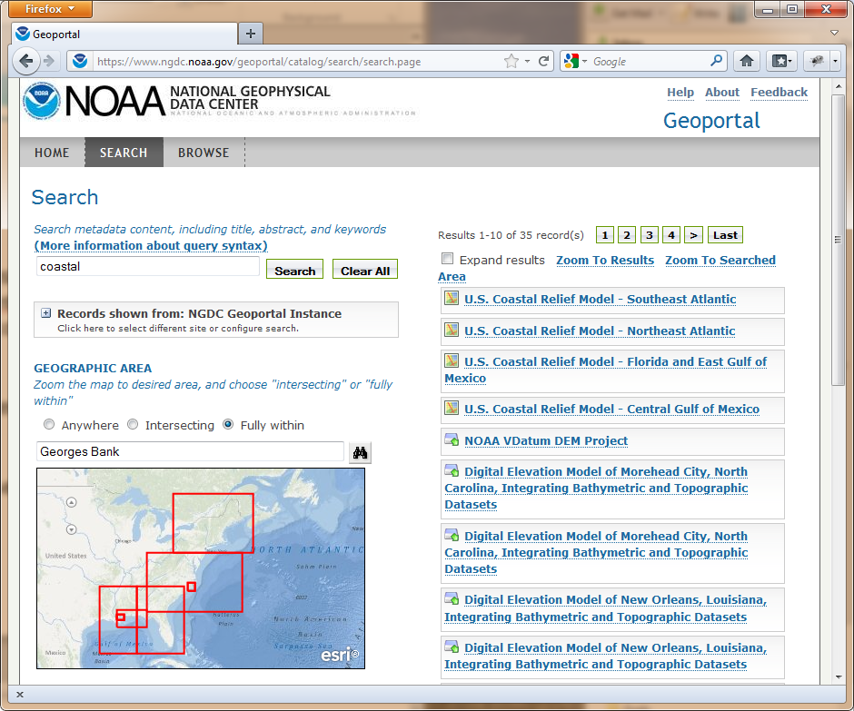

Current Workflow
  NGDC Geoportal went ‘live’ on December 22nd, 2011
    Over 15,000 records
    Mixed content RDF, FGDC,
    and ISO-2
    Web Accessible Folder
    (WAF) centric model
F
WAFs
FGDC
ncISO
ISO-2

Slide 4
Common Property Meanings
  Expanding the shared conceptual model
    property-meanings.xml
  Simplifies modifications to search page
  Enhances customized links in results
keywords
startDate
endDate
title
Service
Types
distributionLinks
geometry

Slide 5
Common Property Meanings
  Example startDate / endDate:
FGDC
<property meaning="startDate"
xpath="/metadata/idinfo/timeperd/timeinfo/rngdates/begdate"/>
<property meaning="endDate"
xpath="/metadata/idinfo/timeperd/timeinfo/rngdates/enddate"/>
ISO-2
<property meaning="startDate"
xpath="/gmi:MI_Metadata/../gmd:extent/gml:TimePeriod/gml:beginPosition"/>
<property meaning="endDate"
xpath="/gmi:MI_Metadata/../gmd:extent/gml:TimePeriod/gml:endPosition"/>

Slide 6
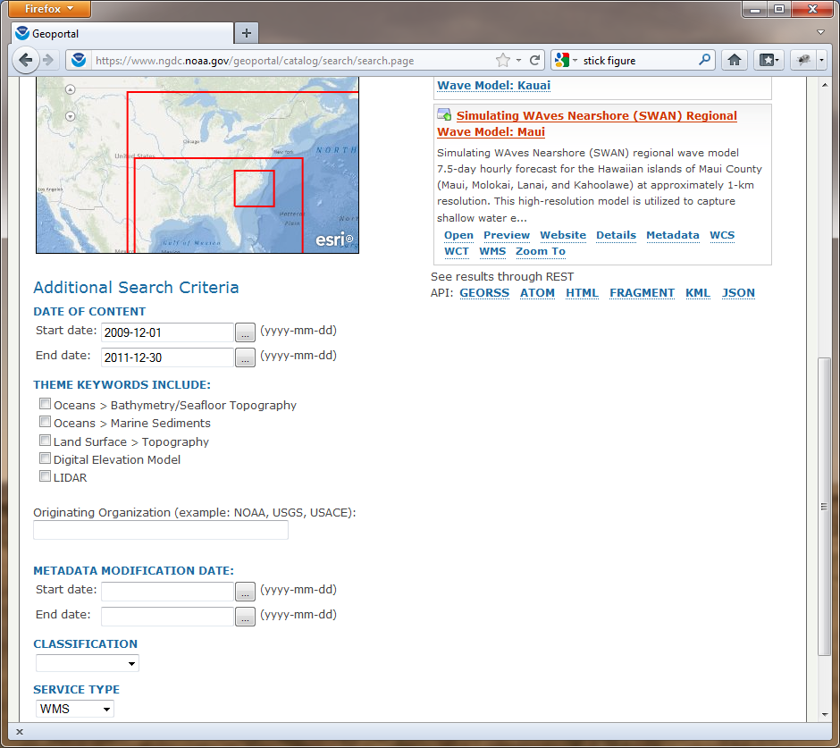
Common Property Meanings

Slide 7
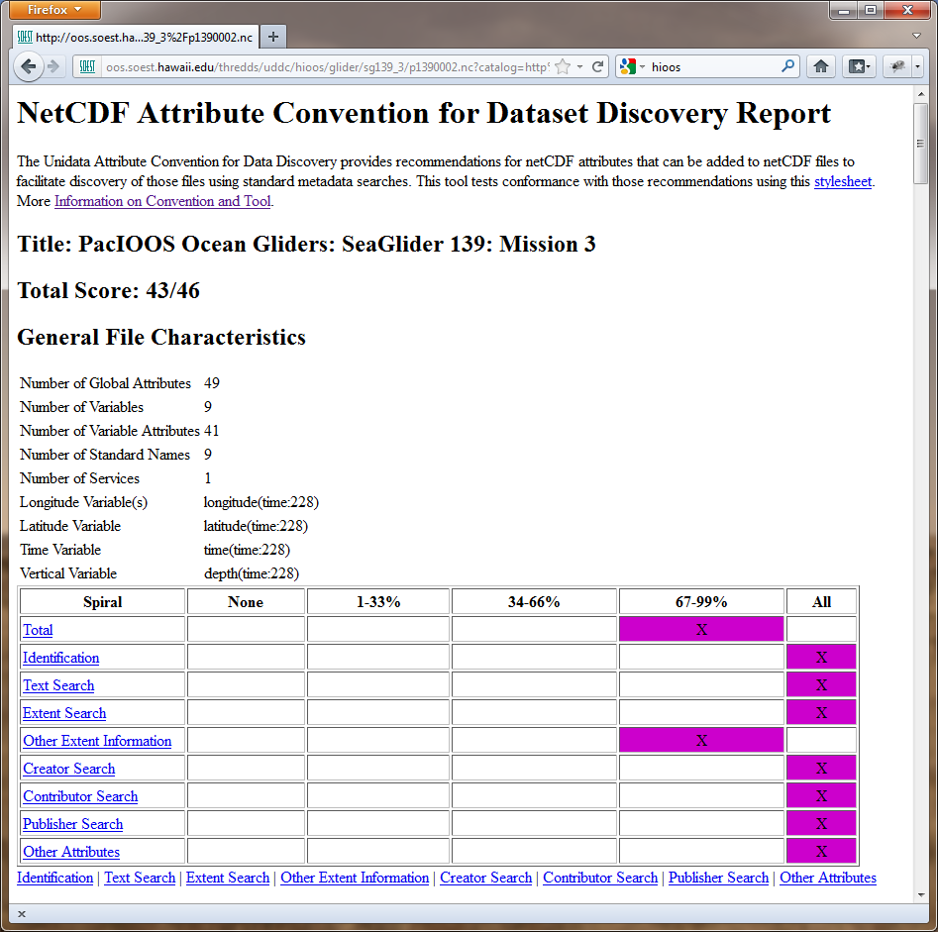
Metadata Improvements
  Working with data
  providers key
  to success!
  IOOS
  OceanSITES
  UAF

Slide 8
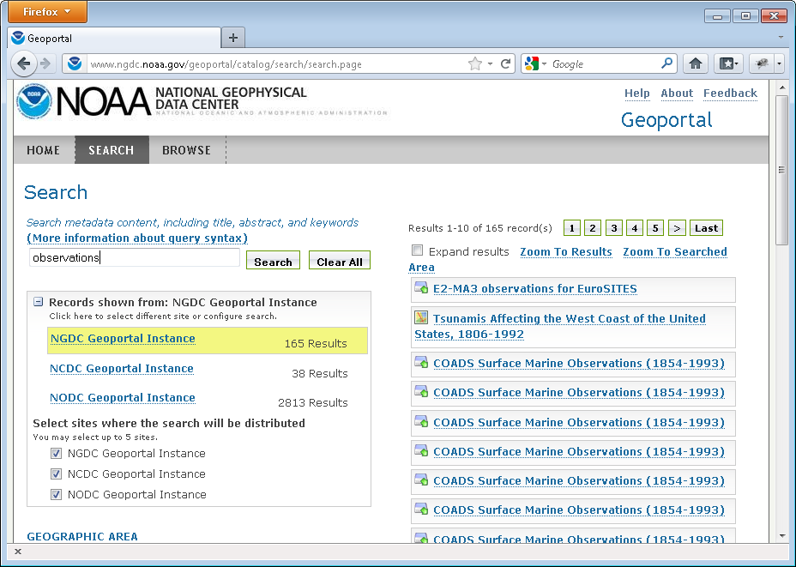
Federated Searches

Slide 9
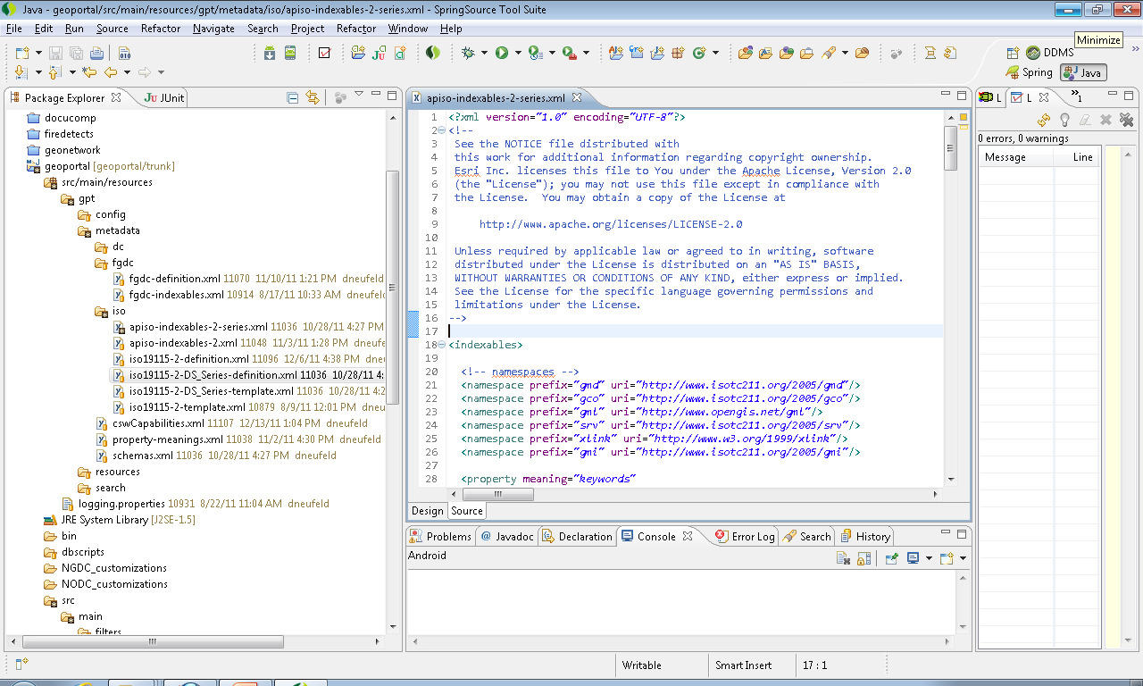
DS_Series – (indexables/definition xml)
Network/Collection Level Metadata

Slide 10
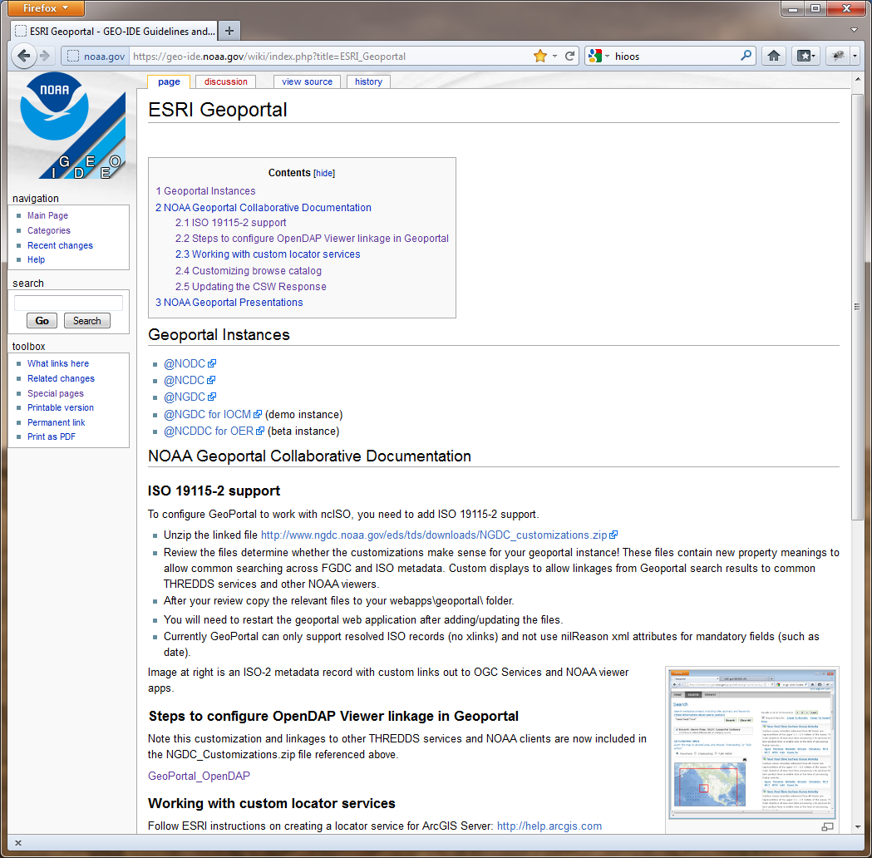
Collaboration
http://geo-ide.noaa.gov/wiki/
  Information sharing
  with NODC speed
  deployment process
  Working with ESRI/USGS
  on ISO-2 and THREDDs
  GEO-IDE wiki to share
  Progress
  Improved locator services
  Google code base

Slide 11
Next steps
  Collaborate with OOI for ocean ontology services
  Continue work with ESRI on improved THREDDs
  harvesting
  Integrating metadata tag clouds
  Focus on lineage and sensor metadata

Slide 12
Questions / Demo

