Slide 1
User-Oriented Data Analytics and Tools using the Federated Data System DataFed
Rudolf Husar,
Director, Center for Air Pollution Impact and Trend Analysis, CAPITA
Washington University in St. Louis
1970s – AQ science & EPA decision support – Fortran & spreadsheet analytics
1980s - Developed ‘Voyager’ data exploration and analysis software; K Hoijarvi
1990s - Applied Voyager for AQ pattern analysis, for large - GByte ES data
2000s - Developed distributed DataFed; WCS Access; SOA process/vis; K Hoijarvi
2005s - Co-lead ESIP AQ WG; GEO AQ Comm. Practice (CoP); S. Falke, E Robinson
2010s - Use DataFed, TB ES data for EPA and science; N Frank (EPA) + State analysts
ESIP Earth Science Data Analytics Discussion Forum, April 17, 2014

Slide 2
Air Quality Decision Systems
EOs. & Modeler
EO Service Provider
Discipline Scientist
Health & Env. Analyst
AQ Manager
Decision Maker
Air Quality Management is an intensely human process and includes a spectrum of participants (G. Foley, EPA).
The Decision Maker is the AQ Manager who uses multiple sources of information to make decisions and initiate actions.
She relies on Env. Health Analyst for information and guidance.
The Analysts use observations and knowledge from Discipline Scientists
The Analysts and Scientists get the data from the EO Service Provider
Notes:
Air Quality Management is an intensely human process. It includes a spectrum of participants as emphasized by EPA’s Gary Foley.
The Decision Maker is the Air Quality Manager who uses multiple sources of information to make decisions and initiate actions.
For information and guidance she relies on health and environmental Analysts.
The Analysts in turn uses AQ observations as well as Scientific knowledge provided the Air Quality scientist
Both the Analysts and Scientists require access air quality observations and models which is provided by the EO Service Provider

Slide 3
Air Quality Decision Systems
EOs. & Modeler
EO Service Provider
Discipline Scientist
Health & Env. Analyst
AQ Manager
Decision Maker
Find, Access, Manipulate Eos.
Information System for EOs
These Users need to find, access and manipulate EO and models.
They need support from a suitable Information System (IS)
Traditionally, the IS was a ‘stovepipe’ dedicated to each application

Slide 4
Air Quality Decision Systems
(G. Foley, EPA)
EOs. & Modeler
EO Service Provider
Discipline Scientist
Health & Env. Analyst
AQ Manager
Find, Access, Manipulate Eos.
Information System for EOs
EOS and Models
Actionable Knowledge
Decision Support System
DSS is the combination of humans AND the supporting IS.
The inputs to this system are Earth Observations and Models.
The output is Actionable Knowledge for the Manager/Decision Maker.
Notes:
So
Traditionally, the IS was a ‘stovepipe’ dedicated to each application

Slide 5
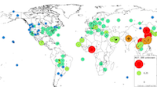



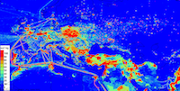

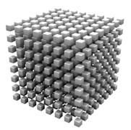
Air Quality Decision Systems
EOs. & Modeler
EO Service Provider
Discipline Scientist
Health & Env. Analyst
Policy & Manager
Observ.
Benefits
Monitorig Network
Informing the Public
Protecting Health
Satellite
Shared
Data Pool
Atmosph. Science
Model
Global Policies
Emission
In the new GEOSS paradigm, EOs should be accessible from a shared virtual data pool
Notes:
In a new paradigm, introduced through GEOSS, Earth Observations should be accessible from a shared virtual data pool and offered as web services through standard interfaces
The distributed data system DataFed developed and maintained at Washington University in Stl. Louis, MO is an implementation of the GEOSS service oriented data sharing architecture.
Data are accessible from the Air Quality Data Network (ADN) by the AQ Community Catalog
ADN is facilitated by the GEO AQ Community of Practice (GEO AQ CoP), including R. Husar’s group.
The generic client tools (red boxes) are for processing and visualization; used in many applications
Specialized Application Tools are dedicated to specific applications, e.g. event detection

Slide 6
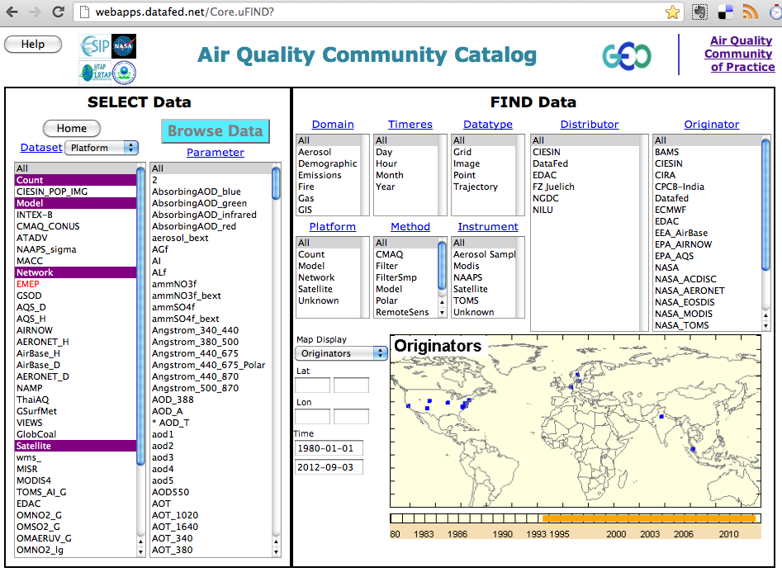
AQ Community Catalog (AQ ComCat)
FIND Data
AQ ComCat is the access point to the datasets in the Air Quality Data Pool
ComCat was co-developed by the GEO Air Quality Community of Practice (AQ CoP)
The AQ CoP also maintains a community-developed data server software.
Notes:
The Air Quality Community Catalog (ComCat) is the access point to the datasets in the Air Quality Data Pool
The accessible data include the NAAPS and MACC global models and the CMAQ regional model,
data from US, European and Indian AQ monitoring networks
as well as satellite data from MODIS and OMI sensors.

Slide 7
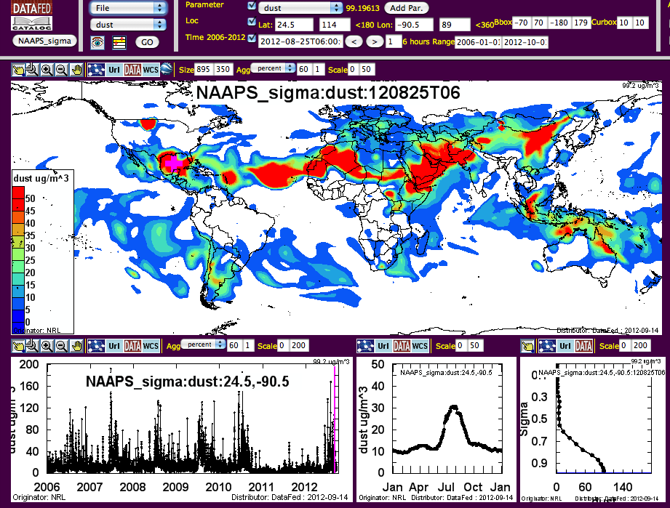
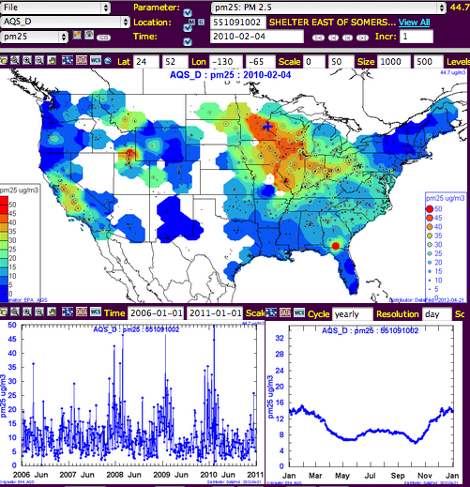
Tools: Data Browser
Every shared dataset can be browsed for spatial and temporal pattern
Notes:
Once an observation parameter is selected, the data can be accessed by any suitable client software, such as the generic DataFed data browser.

Slide 8
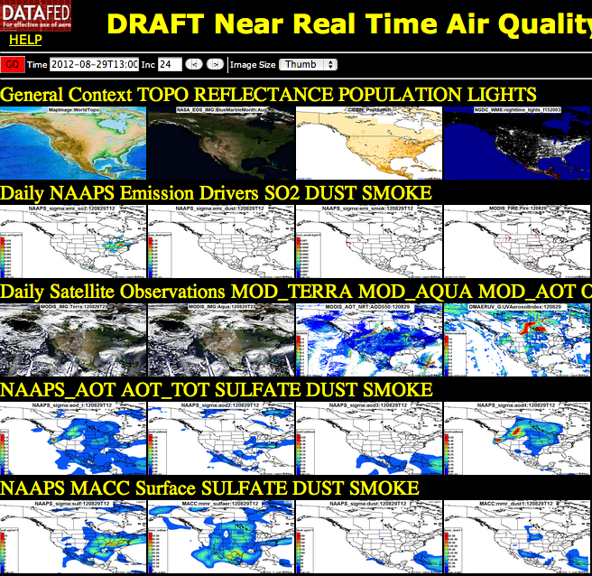

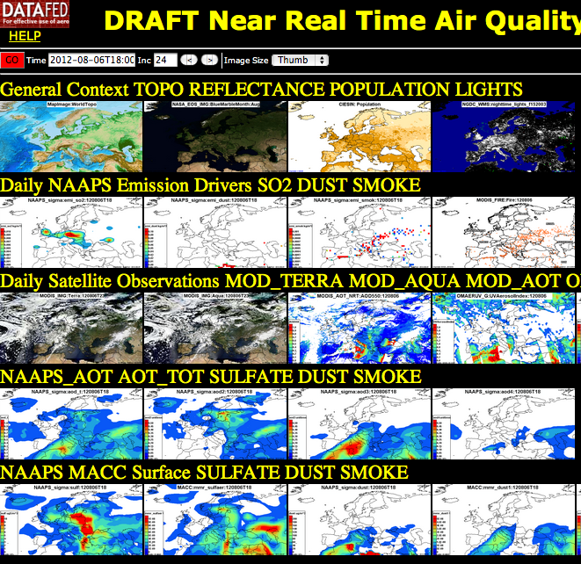
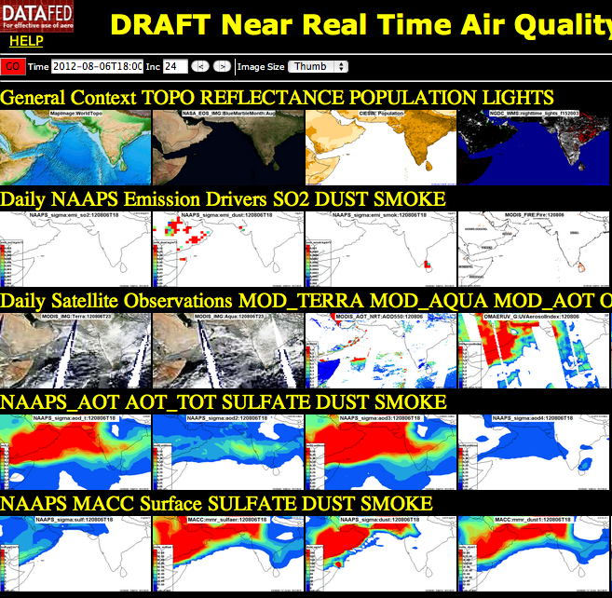
Tools: Near Real Time Consoles
Consoles are spatial representations of observations, emissions and models.
All maps are synchronized spatially and in time, and moved by the user
Provide rich multisensory context to illuminate complex atmospheric situations
Notes:
Consoles are spatial representations of multisensory Observations, emissions and models.
All the maps are synchronized spatially and in time, so the user can move the searchlight of her attention to any region or time.

Slide 9
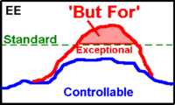
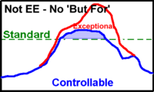
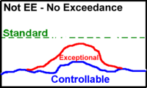
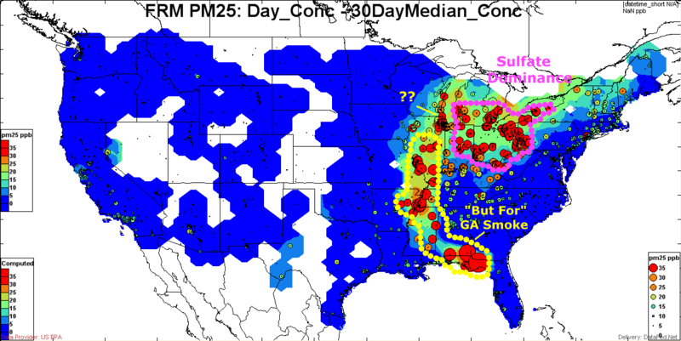
The Exceedance would not Occur, But For the Exceptional Event

Slide 10
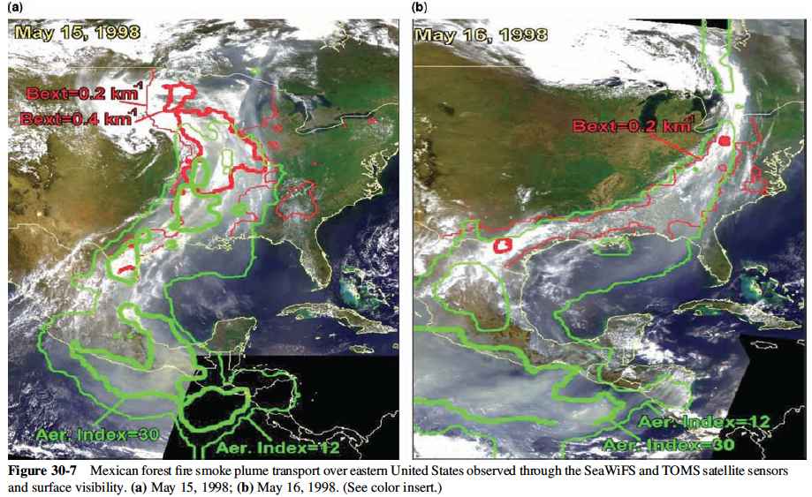
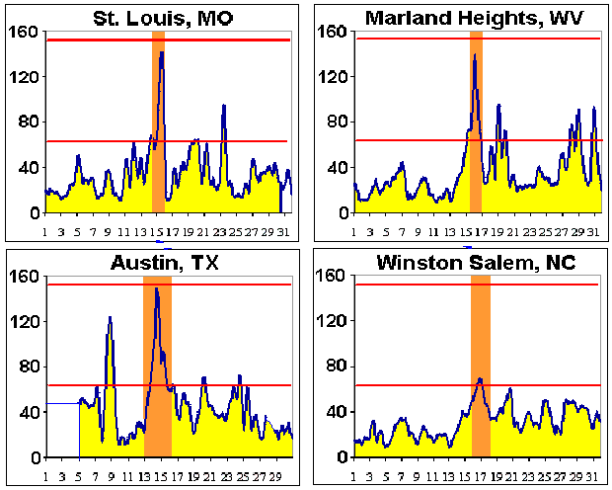
AQ Exceptional Events: EPA Regulatory Support
Smoke Event
Notes:
An exceptional event (EE) is when an uncontrollable or extra jurisdictional source causes violation of the National Ambient Air Quality Standard.
The granddad of EEs is the 1998 Mexican Smoke event that caused the highest measured regional PM concentrations over the Eastern US.
------------------------
Since time immemorial, smoke from forest fires, wind-blown dust storms and other ‘exceptional events’ have punctuated the air quality with extreme concentrations of atmospheric particulates and gases.
However, historically the spatio-temporal pattern of air quality during such events was sparse and patchy. This has changed dramatically during the sensing revolution of the 1990s, in particular through the near-real-time availability of color satellite images. Satellites the became the primary sensory inputs for event detection and spatio-temporal characterization.
Satellite observations were also responsible for formally including Exceptional Events into the AQ management process. When combined with routine surface-based monitoring data …
In the past, the definition and documentation of events has been subjective, dependent on the analyst, the is event type etc.
The routine overall characterization of detected events is accomplished by the rich real-time data through delivered through the Analysts Consoles
Objective event definition is now possible through spatio-temporal statistical parameters derivable from routine monitoring data
Scenario:
Smoke form Mexico causes record PM over the Eastern US.
Goal:
Detect smoke emission and predict PM and ozone concentration
Support air quality management and transportation safety
Impacts:
PM and ozone air quality episodes, AQ standard exceedance
Transportation safety risks due to reduced visibility
Timeline:
Routine satellite monitoring of fire and smoke
The smoke event triggers intensified sensing and analysis
The event is documented for science and management use
Science/Air Quality Information Needs:
Quantitative real-time fire & smoke emission monitoring
PM, ozone forecast (3-5 days) based on smoke emissions data
Information Technology Needs:
Real-time access to routine and ad-hoc data and models
Analysis tools: browsing, fusion, data/model integration
Delivery of science-based event summary/forecast to air quality and aviation safety managers and to the public
and their causes is still poorly understood and largely unpredictable.

Slide 11
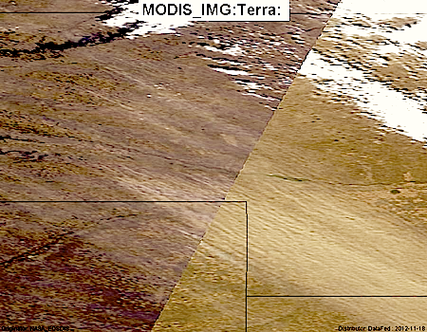
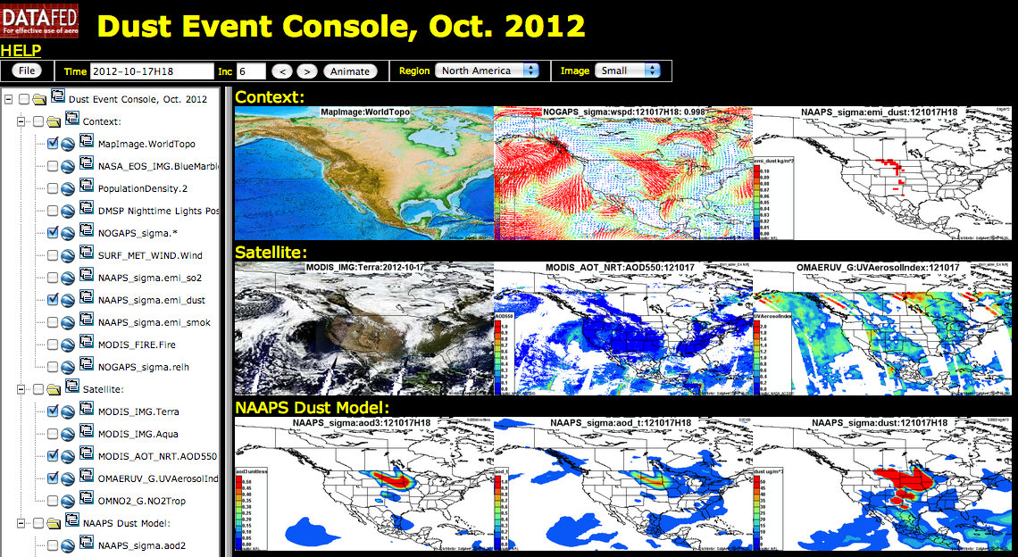
EE DSS Tools: Event Consoles
An array of space-time synced maps of EE-relevant data.
Similar to the weather forecaster’s "meteorological wall”
For any data layer in the pool, user selects region, time range
Animations and Google Earth displays for exploration, comparisons.

Slide 12
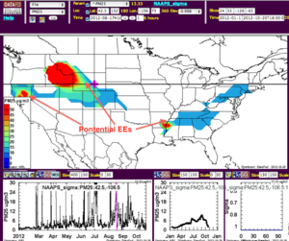
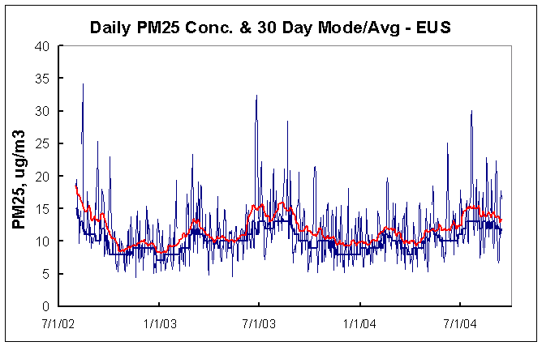
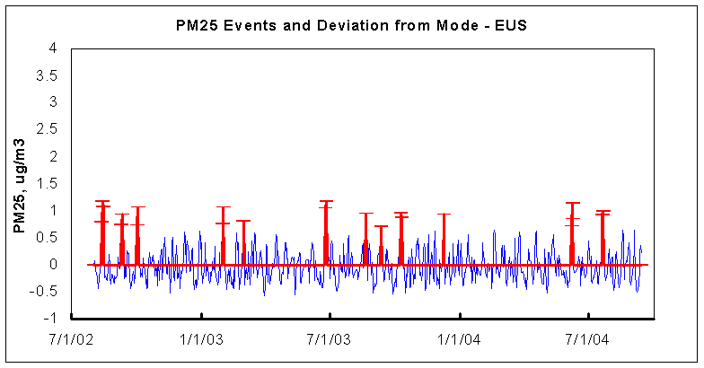
EE DSS Tools: Automatic Event Screening & Detection
EUS Daily Average
50%-ile, 30 day 50%-ile smoothing
Event : Deviation > x*percentile
Deviation from %-ile
Spatial event screening: e.g. smoke surface conc. > 10 ug/m3
Temporal event screening: e.g. smoke surface conc. > x percentile of ‘normal’ values.

Slide 13
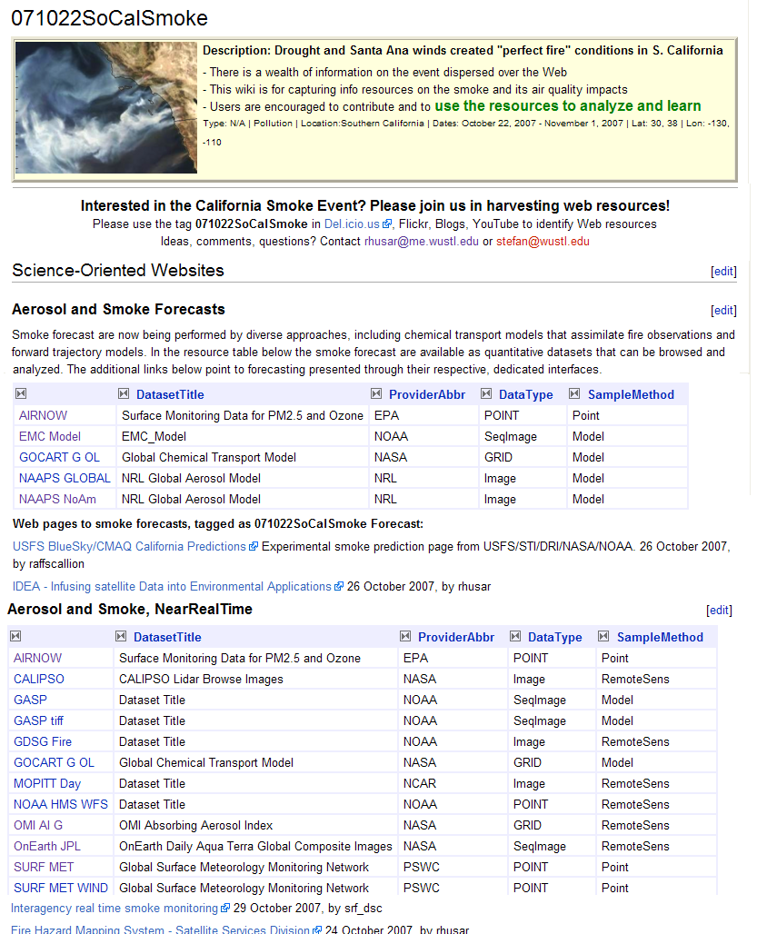
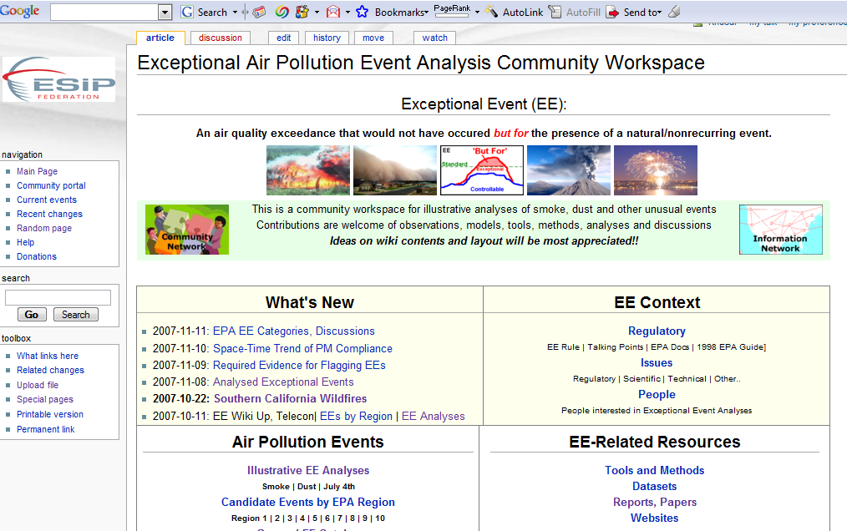
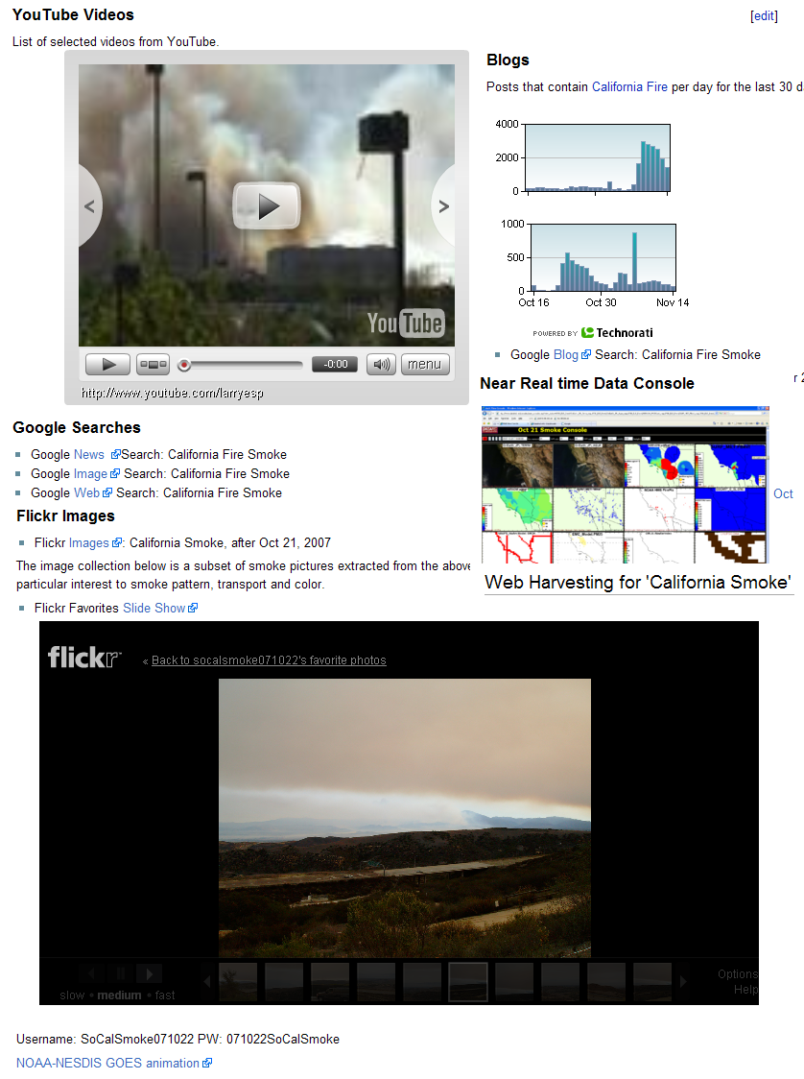
Application-Task-Centric Workspace Example: EventSpaces
Specific Exceptional Event
Catalog - Find Dataset
Harvest Resources

Slide 14
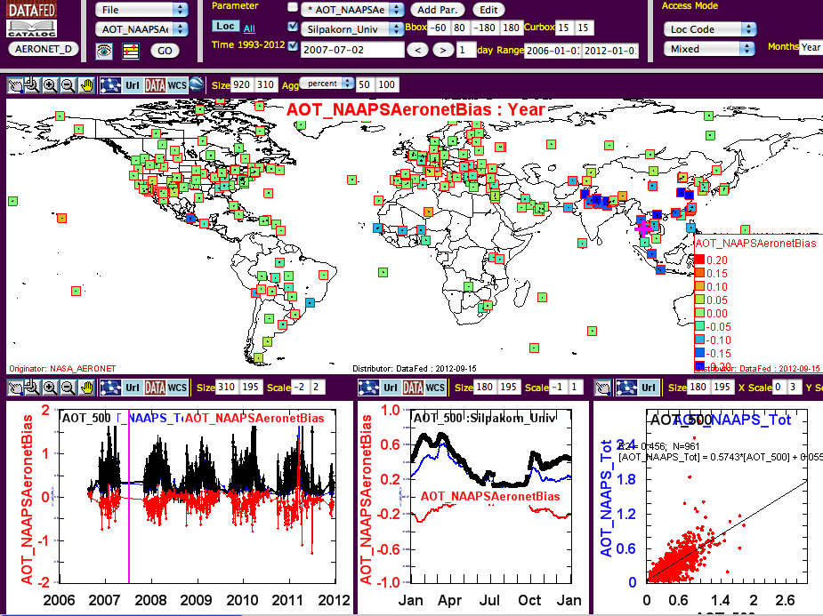
Tools: Model Evaluation Tool
Model bias can be evaluated using any space-time-compatible observational data sets
Example: NAAPS model AOT compared to AERONET AOT.
Notes:
A more specific tool was developed to evaluate models. Specifically model-observation bias spatially and by season.
Here we show the calculated bias of the NAAPS model total Aerosol Optical Thickness as compared to the Aeronet AOT.

Slide 15
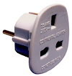




EE DSS Built on Federated Data System. DataFed:
Data Sharing Infrastructure
Std. Servers
Adaptors
Data Pool
Std. Tools
User Tools
Benefits
Monitorig Network
AQ status & Trends
EE DSS
Satellite
Health Effects
Model
Climate Impact
Science & Education
Emission
DataFed is an implementation of the GEOSS data sharing paradigm
DataFed also includes client applications for data browsing, exploration and analysis
These flexible tools can be used on any dataset form anywhere on the Web.
Notes:
DataFed also includes a set of client applications for browsing, exploring and analyzing air quality observations. These cloud-based tools can be used on any of the datasets in the Data Pool.
By design such web-based tools can also be created by any other client in this interoperable air quality data data network (ADN).
I will spare you ….

Slide 16
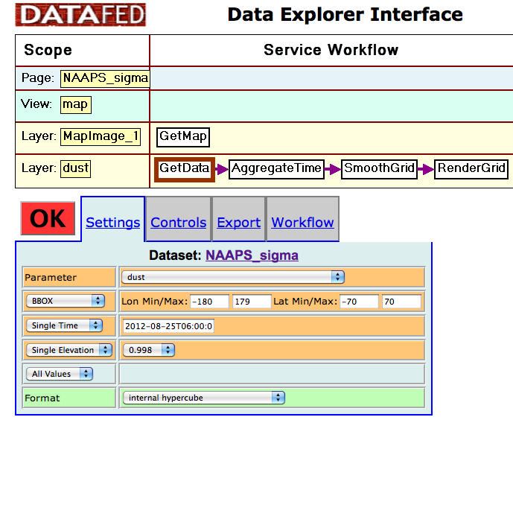
Service Oriented Programming
The flexibility of the client software is facilitated by Service Oriented Architecture.
Data are accessed, processed and displayed by a set of service modules.
An Application (App) is a chain of services orchestrated by a workflow program
Notes:
The flexibility of the DataFed client software facilitated by Service Oriented Architecture.
Data are accessed, processed and displayed by a set of service modules chained together in a workflow program.
Each DataFed Tools is a specific workflow program within the same programming environment.

Slide 17
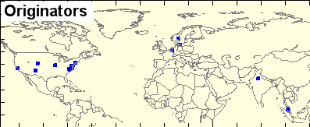
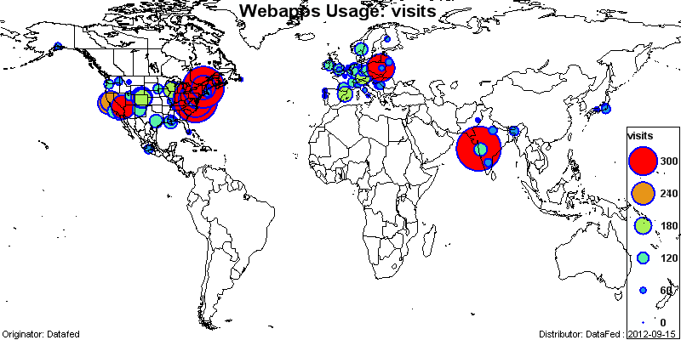
Distributed Data System DataFed
An implementation of the GEOSS paradigm at Washington University
Data Users
Data Providers
DataFed
Data Types:
Surface Obs: AirNOW, AQS, AirBase
Satellites: MODIS, OMI
Emissions: NAAPS, EDGAR
Models: NAAPS, MACC, CMAQ
Applications:
Forecasting: NE US
AQ Managm.: ESs – GA,
Atm. Science: IIT Bombai
Inform Public: ?? Web users

Slide 18
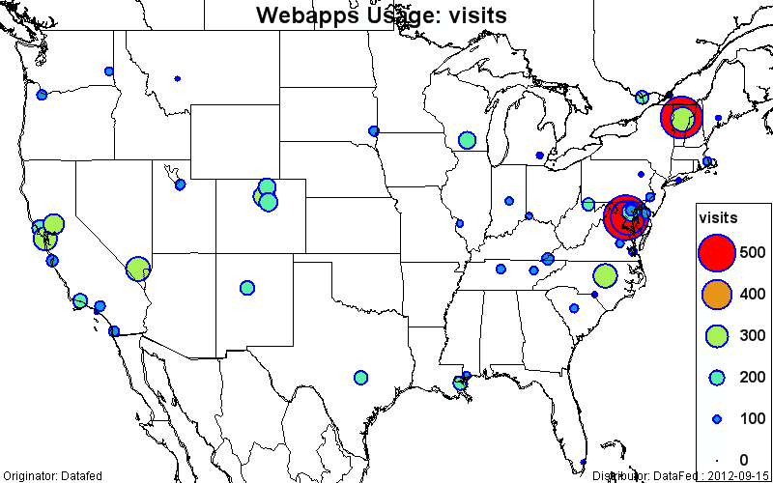
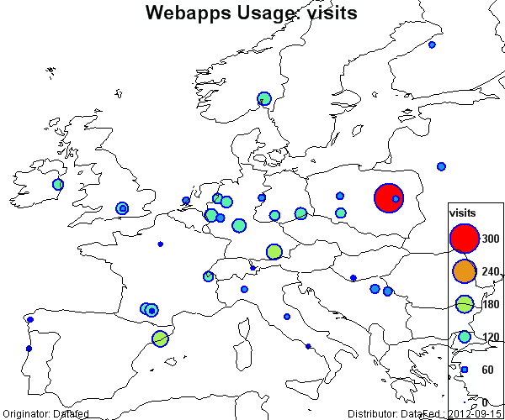
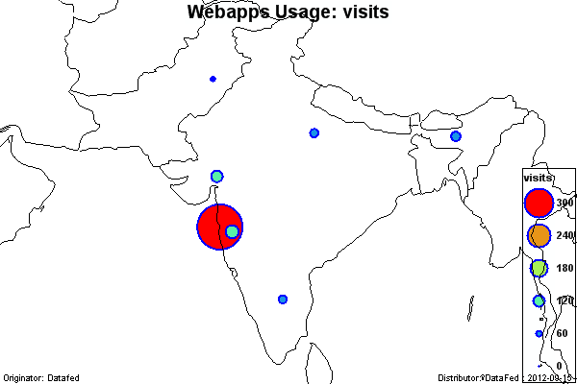
Since 2008, DataFed is used globally
DataFed Usage Metric by Google Analytics: Data Access by top 100 Users
Top 100 user averages: 70 visits; 6:20 minutes per session; 4.5 per pages/session
Top User Sites, Visits
Mumbai, India, 742 : AQ analysis, research
Washington DC, 736: ?
Waterbury, VT, 642: AQ Forecasting, NE Greenbelt, MD, 429: ?
Warsaw, PL, 242: AQ Analysis, research
Las Vegas, NV, 211: ?
Raleigh, NC, 202: ?

Slide 19
AQ Data Analytics Matrix – Status & Trend Analysis Data Sources, Tools for Analysis and Collaboration, Products and Decision Support
 | Real-time Analysis Days | Retrospective Anal. Months-years | Near-Forecasts Days | Long-Forecasts Years
Data Sources & Types | EPA PM2.5Mass NWS ASOS Visibility, WEBCAMs NASA MODIS, GOES, TOMS etc. NOAA WEATHER & Wind NAAPS MODEL Simulation | All the Real-Time data + NPS IMPROVE Aer. Chem. EPA Speciation EPA PM10/PM2.5 EPA CMAQ Full Chem. Model | NAAPS MODEL Forecast NOAA/EPA CMAQ? | EPA & RPO CMAQ?
Data Analysis Tools & Methods | Spatio-temporal overlays Multi-sensory data integration Back & forward trajectories Pattern analysis | Full chemical model simulation Diagnostic & inverse modeling Chemical source apportionment Multiple event statistics | Emission and met. forecasts Full chemical model Data assimilation Parcel tagging, tracking | Emission and met. forecast Full chemical model
Communication Collaboration Coordination Methods | Analyst and managers consoles Open, inclusive communication Data assimilation methods Community data & idea sharing | Tech Reports for reg. support Peer reviewed scientific papers Science-AQ mgmt. interaction Reconciliation of perspectives | Open, public forecasts Model-data comparison Modeler-data analyst comm.
Analysis Products | Current Aerosol Pattern Evolving Event Summary Causality (dust, smoke, sulfate) | Quantitative natural aer. concr. Natural source attribution Comparison to manmade aer. | Future natural emissions Simulated conc. pattern Future location of high conc. | Future natural emissions Simulated conc. pattern
Decision Support | Jurisdiction: nat./manmade Triggers for management action Public information & decisions | Jurisdiction: nat./manmade State Implementation Plans, (SIP) PM/Haze Crit. Documents, Regs | Management action triggers Public info. & decisions | Statutory & policy changes Long-term planning Progress tracking
sagfsdh

Slide 20
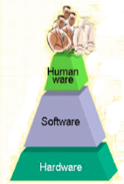
Connecting HUMANS AND their Machines
Connect and Enable Data Providers, Consumers Serendipitous connections
Collaborative Info Sharing Improve individual mandates by learning from others
Increase Data Value Easily find and access data allows data reuse
Image modified from Air Force Scientific Advisory Board (2005)
Notes:
Ref: United States Air Force Scientific Advisory Board (2005); Report on System-of-Systems Engineering for Air Force Capability Development; Public Release SAB-TR-05-04

Slide 21
Vision of Earth Observation Information Network
A robust EO information network optimized through hardware, software and ‘humanware’, with a set of standards at each level of the interoperability stack.
Connect and Enable Data Providers, Consumers Serendipitous connections
Collaborative Info Sharing Improve individual mandates by learning from others
Increase Data Value Easily find and access data allows data reuse
Image modified from Air Force Scientific Advisory Board (2005)
Notes:
Ref: United States Air Force Scientific Advisory Board (2005); Report on System-of-Systems Engineering for Air Force Capability Development; Public Release SAB-TR-05-04

Slide 22
Partnerships, Linkages
ESIP Air Quality Workgroup 2006-2012, Community Building
GEO AQ Community of Practice, 2008-2012, WCS Server Software
Collaborative Projects
NASA, Westphal, NRL 2009-13: NASA NAAPS products for AQ Decision Making.
NASA, McHenry, BAMS, 2008-12: CMAQ model
EPA, Tools for HTAP Model Evaluation Network 2010-12
EPA, States, Exceptional Event Decision Support

Slide 23
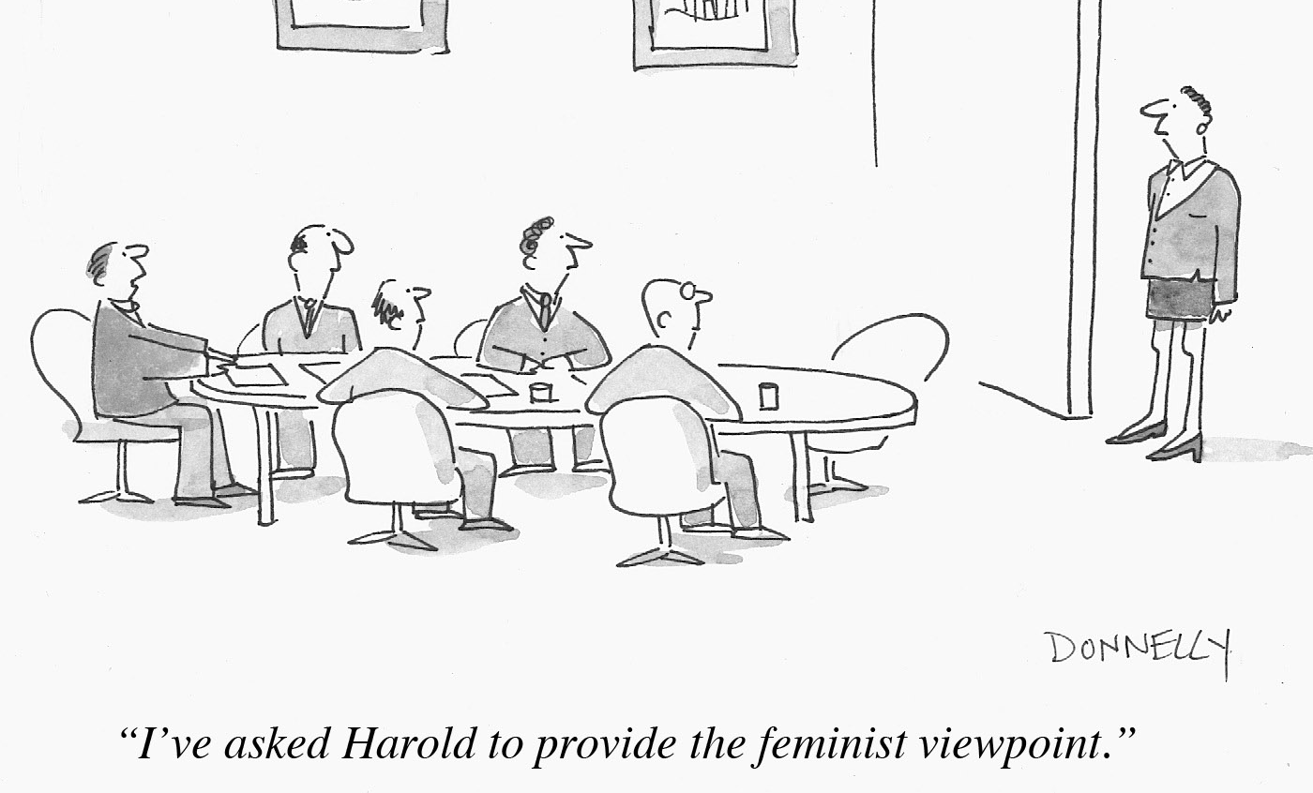
Persistent challenge: How to connect and enable Data Providers and Users

