Slide 1


Elements of a Data Management Plan: Identifying the materials to be created
Section: Data Management Plans
Ruth Duerr
National Snow and Ice Data Center
Version 0.1.0
Review Date
Notes:
This training module is part of the ESIP Federation's Data Management Course for Scientists. The subject of this module is Data Management Plans. The title of the module is Elements of a Data Management Plan: Identifying the materials to be created. The module was authored by Ruth Duerr from the National Snow and Ice Data Center at the University of Colorado in Boulder. Besides the Earth Science Information Partners (ESIP) Federation, sponsors of this Data Management Course are the Data Conservancy and the United States National Oceanographic and Atmospheric Administration, NOAA.

Slide 2
Overview
Your data management plan needs to discuss the type(s) of data produced during your research
Notes:
As discussed in the module “Data Management Plans: Elements of a Plan” your data management plan needs to discuss the type or types of data that will be produced over the course of your research.

Slide 3
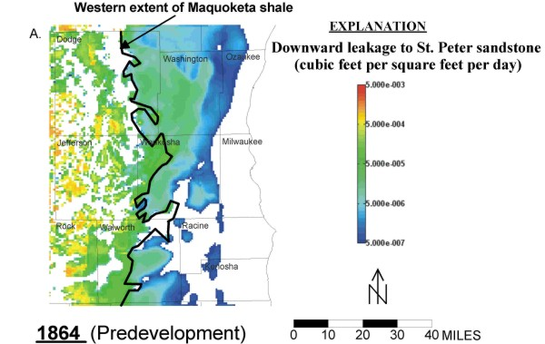
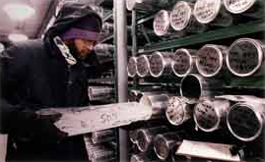


What is data?
Some types of data are obvious
Data about samples
Model output
Photo by Scott Bauer
Data from laboratory experiments
Remotely sensed data
Data from field experiments
Notes:
That naturally leads to the question “What counts as data?” The answer to that is not straightforward. Some types of data are obvious.
For example, the output of your computer model, that counts as data. In this case a historical model of freshwater recharge into an aquifer.
So are measurements made during a field experiment, - in this case my friend and colleague Mark Parsons setting up a weather station during the 2011 Arctic Observing Network (Snownet) project in Alaska
for that matter an experiment conducted in the lab – in this case a lab at the USGS.
Measurements taken from a sample, that counts as data – in this case data from an ice core stored at the National Ice Core Lab in Colorado
All sorts of remote sensing data – that counts too

Slide 4
What is data?
Other types of data may not be so obvious:
Blueprints
Multimedia Files
Documents
Software
Course Materials
Notes:
But other things which may count as data may not be so obvious. For example, if you are building an instrument or observatory or some sort of facility, your blueprints and other materials may count as data.
If you are developing software as part of your project, it may count as data – For example, this web application was developed to help people advertise their data holdings by simply filling out a form and saving it to a publicly accessible web site. That counted as data for my project, and as a result the source code is available out on gitHub.
If your project produces other forms of documentation or multimedia materials – they may well count as data too.
Even course materials, curricula, or other training materials may be data.

Slide 5
What is data?
Your program manager, the solicitation you are responding to, or your community may dictate this!
Notes:
How do you know exactly what counts? You need to talk to your program manager, read that solicitation, and be aware of standards within your community. That’s the only way to tell for sure.

Slide 6
For example:
For NASA’s Earth Science program data “includes observation data, metadata, products, information, algorithms including scientific source code, documentation, models, images, and research results”
For NSF “What constitutes such data will be determined by the community of interest through the process of peer review and program management. This may include, but is not limited to: data, publications, samples, physical collections, software and models.”
Notes:
And guidance varies from agency to agency. Here are the overall statements of guidance from both NASA and NSF. You can see that they are not quite identical, which makes sense given the different missions of each agency. So familiarize yourself with the guidance from your funding agency.

Slide 7
Resources
Data & Information Policy – NASA Science, http://science.nasa.gov/earth-science/earth-science-data/data-information-policy/, accessed 2/29/2012
US NSF – About, http://www.nsf.gov/bfa/dias/policy/dmpfaqs.jsp#1, accessed 2/29/2012
NOAA Administrative Order 212-15: http://www.corporateservices.noaa.gov/ames/administrative_orders/chapter_212/212-15.html
USGS National Climate Change and Wildlife Science Center guidance: https://nccwsc.usgs.gov/?q=content/data-policies-and-guidance
NIH Data Sharing Policy and Implementation Guidance: http://grants1.nih.gov/grants/policy/data_sharing/data_sharing_guidance.htm
Notes:
To help you get started, here are links to high level guidance to many of the agencies that deal with Earth Science or Human health data in the US.

Slide 8
Other Relevant Modules
For a high level overview of the content of a Data Management Plan see Data Management: Elements of a Plan
For details of other sections of a Data Management Plan see:
Organization and standards
Data access, sharing and re-use policies
Backups, archives, and preservation strategy
Roles and responsibilities
Notes:
I’ve also included a list of other modules in the Data Management Plan section of this course that you might find helpful as you go about creating your data management plans.

