Slide 1


Exceptional Event Decision Support System (EE DSS) Illustration for PM2.5 Exceedances
The EE DSS is a screening tool for EE flagging. It uses the regulatory data (PM2.5 and Ozone) from AQS, dust and smoke concentrations (NAAPS model) and an array of satellite observations.
The tool detects exceedances, eliminates those that fall within normal values, and identifies those that can be attributed to dust and smoke events.
In preparation for the webinar, the following slides illustrate the EE DSS for PM2.5 exceedances during the period, 2010-2012.
While the EE DSS can screen for potential flags, detailed analysis and EE flag documentation is to be prepared by the States.

Slide 2
Approach for supporting EE flagging process
There is an exceedance of the NAAQS
The event concentration is in excess of the ”normal" values
There is an exceptional source and a clear causal relationship between the exceedance and the exceptional source
The cause of the event is not reasonably controllable or preventable
The exceedance would not have occurred, ‘but for’ the exceptional source
Flag Screening

Slide 3
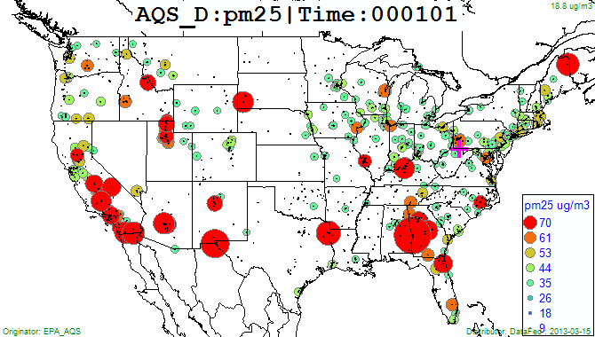
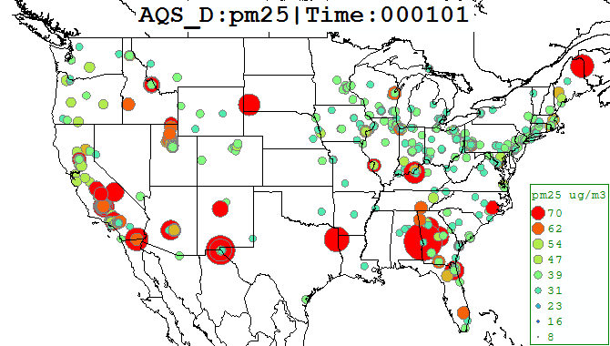
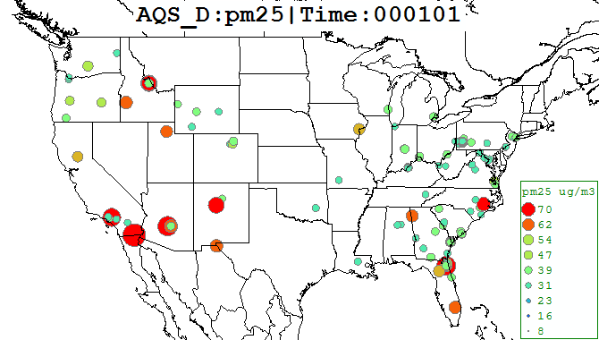
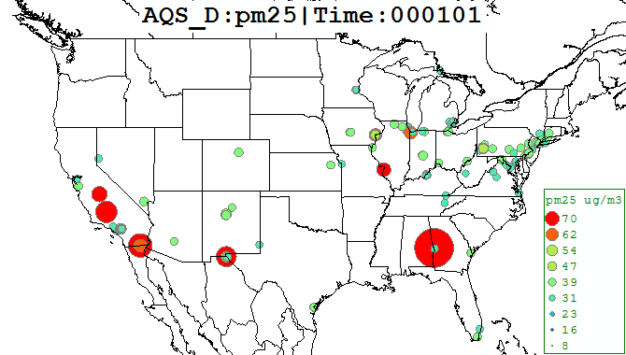
Classification of PM 2.5 Exceedances of Daily NAAQS (35ug), 2010-2012
The circles only show the largest exceedance at a site.
Total Exceedances (1500)
Exceedance Over Normal (879)
Locations of all PM2.5 exceedances, 1500 samples during 3-year period.
Samples excluding those below normal (e.g. 95th perc.) 879 samples
Exceedances due to smoke (164)
Exceedances due to dust (170)
Remaining exceedances attributable to smoke (NAAPS), 164 samples
Remaining exceedances attributable to dust (NAAPS), 170 samples

Slide 4
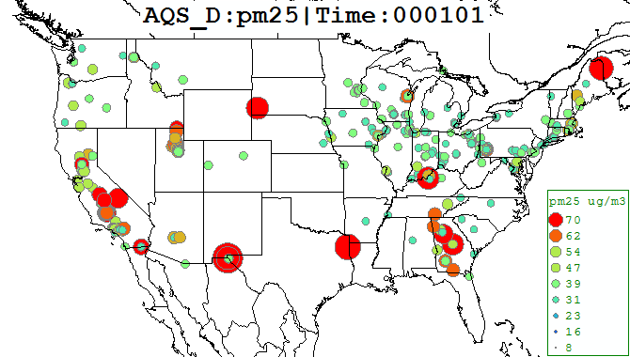
Remaining Exceedances of Daily PM2.5 Standard
These remaining 599 PM2.5 exceedances are not attributed through the EE DSS screening
Possible causes may be pollution, nitrate, undetected smoke or dust or other sources
These exceedances to be assessed with more data and tools such as the EE Consoles

Slide 5
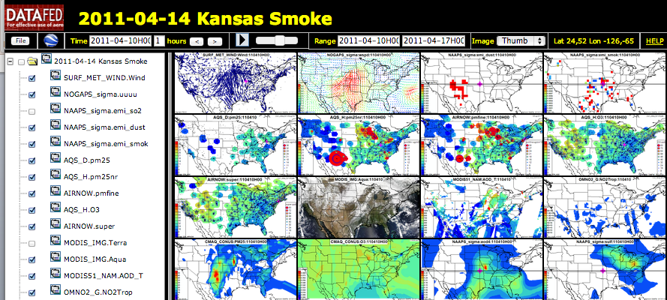
Event Console
Consoles are spatial representations of observations, emissions and models
All maps are synchronized spatially and temporally, and navigated by the user
Provide rich multisensory context to illuminate complex atmospheric situations

Slide 6
EE Flag Preparation and Submission Timeline
April – EE Webinar #1 –Explanation and Application of EE DSS screening tool
May – EE Webinar #2 – User Feedback and Application Examples
July 1, 2013 – EE Flag Submission
July 9-10 – EE Documentation Workshop (ESIP)
Dec 12, 2013 – EE Documentation Submission
Contacts:
R. Husar, Washington University, Stl. rhusar@wustl.edu
E. Robinson, Foundation for Earth Science, erinrobinson@esipfed.org
Neil Frank, EPA, Frank.Neil@epa.gov;
Mark Evangelista, EPA, Evangelista.Mark@epamail.epa.gov

