Slide 1

Developing a Curriculum for the Earth Science Data Scientist
Wade Bishop, Ph.D., M.L.S.
School of Information Sciences
University of Tennessee
July 14, 2015
The Institute of Museum and Library Services is the primary source of federal support for the nation’s 123,000 libraries and 17,500 museums. Through grant making, policy development, and research, IMLS helps communities and individuals thrive through broad public access to knowledge, cultural heritage, and lifelong learning.
Teaching Science Data Analytics Skills, and the Earth Science Data Scientist
Notes:
Changed to Integrated Library Systems* (plural)

Slide 2
Outline
Review of the IMLS Geographic Information Librarianship project
ESIP DACUM *Friday, 10:45– Room 4*
Discussion

Slide 3
Software, Policy and Data
The Occupational Outlook Handbook states that employment in fields which use GIS are expected to increase at a rate faster than the average rate of growth for all occupations between 2012 and 2022; at a rate of 16 percent as compared to the average of 11 percent (U.S. Dept. of Labor, 2014).
At least 100,000 or more job openings over the next decade are expected.
Some will be information professional jobs.

Slide 4

Two thirds of GIS is IS!
Geodatabases
Geolibraries
ArcCatalog (ESRI)
Organizing and disseminating information
Metadata (CSDGM; ISO)
  Added value
  Makes it easier to share and retrieve data
Two thirds of GIS is GI!
Notes:
Environmental Systems Research Institute

Slide 5
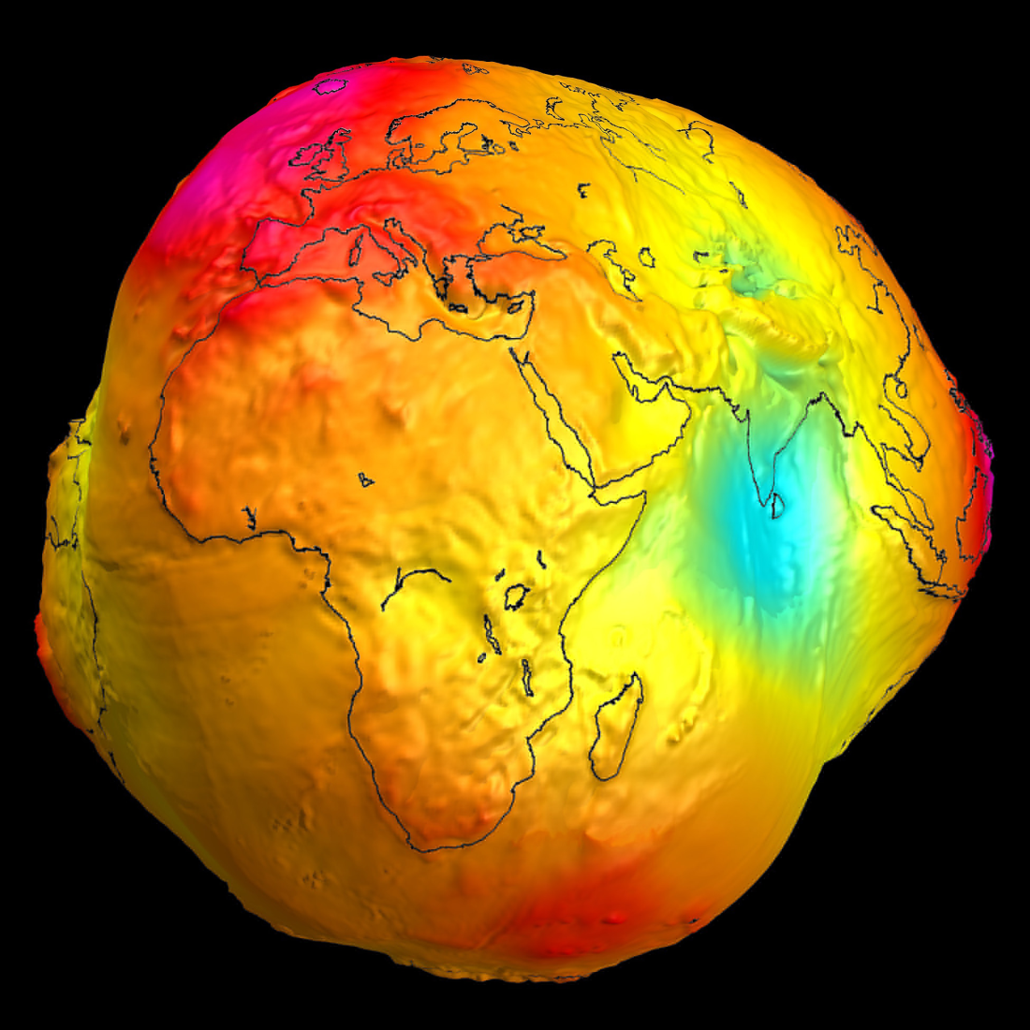
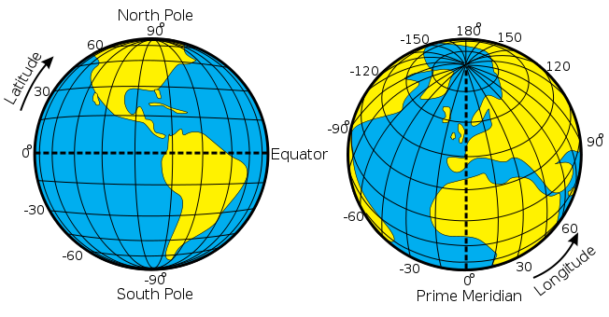
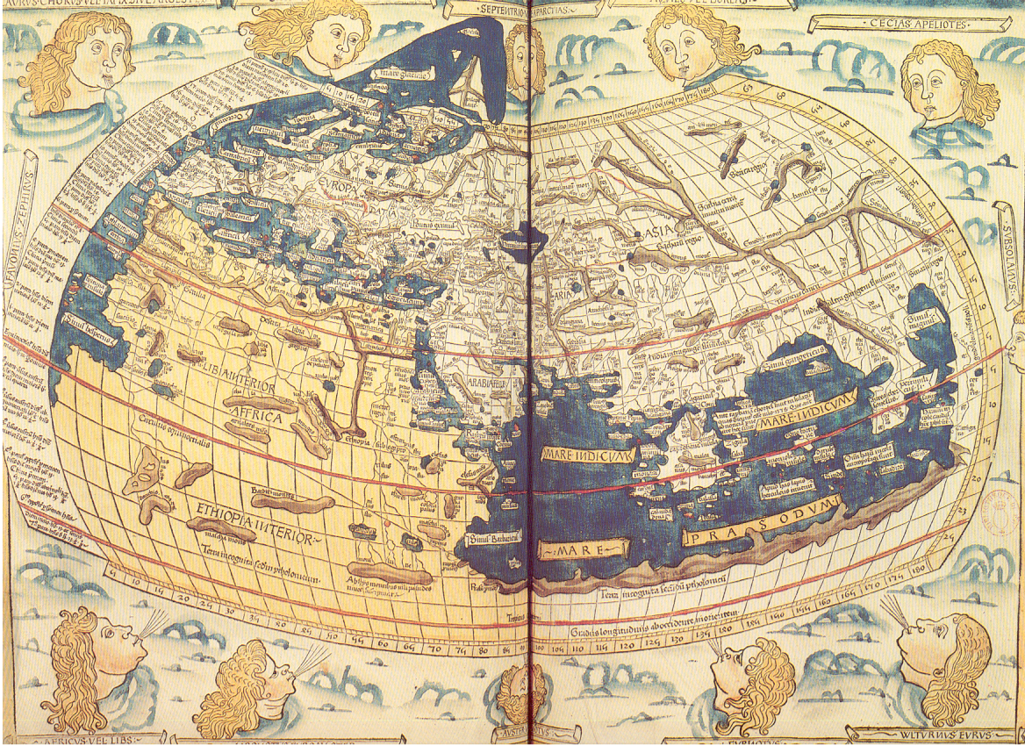




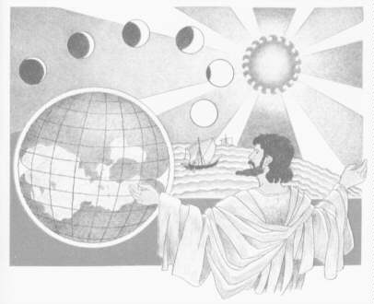
Notes:
Johannes de Armsshein, published in 1482 in Ulm/Germany Historical Map of the Old World, as Ptolemy knew it. Policy makers think the Earth is perfect, a sphere than can be controlled caged inside a graticule, but scientists know how complex data collection is on an oblique spheriod, and all residents of Earth sharing VGI probably think more like Ptolemy that the world beyond your knowledge doesn’t exist even if it is under your feet

Slide 6
Careers and Collaborations
Geographic Information Librarianship (2012-2015) Co-principal investigator: Tony H. Grubesic (University of Arizona) & Bradley Wade Bishop. Building Institutional Capacity. Institute of Museum and Library Services. $345,270.
The IS in GIS
  Bolster librarian management and preservation of resources created by an array of geospatial tools;
  Create and deliver two online GIL courses at two institutions;
  Develop and use a survey validation study of the knowledge, skills, and abilities to inform curricula

Slide 7
GIL – Phase I (Fall 2012)
In 2008, the American Library Association's Map and Geospatial Information Round Table (MAGIRT) education committee developed core competencies required to perform GIL, circulated the core competencies to the round table’s members (~360), and made suggested changes into a final core competencies document.

Slide 8
MAGIRT Core Competencies 2008 (75 of them)
General Geographic/Cartographic Competencies
Collection Development/Records Appraisal
Collection Maintenance and Organization
Reference and Instruction/Data Discovery
Technological Infrastructure
Metadata Creation/Bibliographic Record Creation

Slide 9
Survey validation
The survey validation approach has been used by a variety of other professions such as teaching, nursing, and law to inform curricula with empirical data from actual practice.
The curriculum development plan for the IMLS GIL project includes a survey of practicing GIS and map librarians, archivists, and other information professionals to weigh the importance of listed knowledge, skills, and abilities (KSAs) from their real-world library experience to inform curriculum development.
Notes:
Despite the value of these survey findings for GIL curriculum development, the core competencies from 2008 do not explicitly mention how to handle geoweb data.
Update the CORE

Slide 10
GIL – Phase II (Spring 2013)
Developed GIL course that reflected only those 23 CC’s that rated 2.3 and above out of 3
Those were revised into thirteen student learning outcomes for the GIL courses
Also, we included new developments related to the Geoweb not in 2008 CC’s and some learning outcomes for the University Consortium for Geographic Information Science's (UCGIS) Geographic Information Science and Technology Body of Knowledge (BoK).
Notes:
Some overlap in content exists between GIS and LIS

Slide 11
Course Section | Student Learning Outcome
1. Geography and Cartography | 1.1 Students will demonstrate geographic and cartographic principles, including geographic and cartographic scale, projection, grids, and geographic coordinate systems
2. Collection Development /Records Appraisal/ Collection Maintenance | 2.1 Students will demonstrate knowledge of local, state/provincial, federal and international mapping agencies and private map publishers, map series and similar publication patterns, and gazetteers, data portals, volunteered geographic information, and aspects of the FDLP 2.2 Students will select strategies to obtain different types of maps, imagery, and other geospatial data 2.3 Students will describe copyright considerations and the ability to negotiate licensing agreements for databases and collections of geographic information 2.4 Students will explain how to assess the strengths and specialties in a collection and the needs of users to inform collection development 2.5 Students will describe proper materials handling, especially for rare and fragile materials

Slide 12
Course Section | Student Learning Outcome
3. Reference and Instruction | 3.1 Students will demonstrate the ability to locate geospatial data and software support 3.2 Students will gain awareness of GIS tutorials & training 3.3 Students will develop and deliver geographic information consultations
4. Metadata/ Cataloging | 4.1 Students will explain metadata standards, schemas, and issues 4.2 Students will understand and interpret existing metadata in geospatial records 4.3 Students will define projections, coordinate systems, and other physical characteristics of cartographic items to create metadata 4.4 Students will interpret and calculate cartographic scale

Slide 13
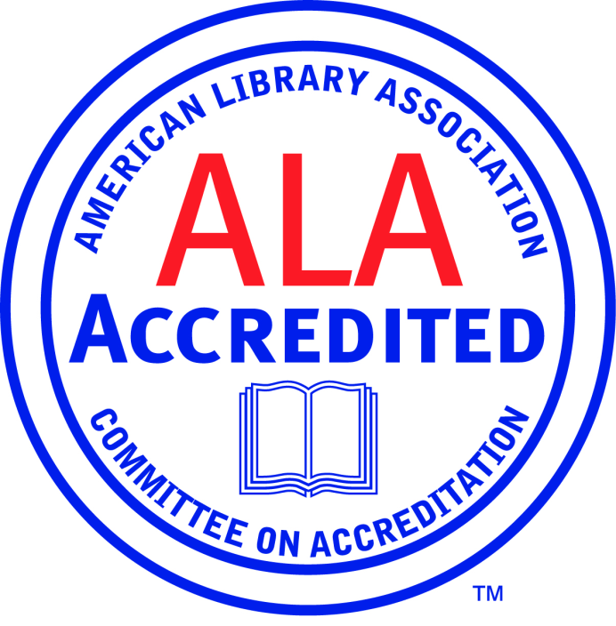

Careers
IS 543 Geographic Information in Information Sciences
Other master’s coursework to earn an ALA accredited degree.

Slide 14
Year 1 Papers
Bishop, B. W., Cadle, A. W., & Grubesic, T. H. (2015). Job Analyses of Emerging Information Professions: A Survey Validation of the American Library Association's Map and Geospatial Information Round Table (MAGIRT) Core Competencies to Inform Geographic Information Librarianship (GIL) Curriculum. Library Quarterly, 85(1), 64-84.
Lingel, J. F. & Bishop, B. W. (2014). The Geoweb and Everyday Life: An Analysis of Spatial Tactics and Voluntary Geographic Information. First Monday, 19(7). doi.org/10.5210/fm.v19i7.5316
Bishop, B. W., Grubesic, T. H. & Prasertong, S. (2013). Digital Curation and the GeoWeb: An Emerging Role of Geographic Information Librarians (GILs). Journal of Map and Geography Libraries, 9(3), 296-312.
Notes:
157 started it and 95 completed it. I would report “approximately 100 individuals completed the survey”.

Slide 15
Year 2 Papers
Bishop, B. W., Moulaison, H. L. & Burwell, C. L. (in press). Geographic Information Organization: Critical Cataloging and Place-Names in the Geoweb. Knowledge Organization.
Bishop, B. W., Parrish, T., & Grubesic, T. H. (2015). Collaborative development and assessment of Student Learning Outcomes for LIS electives. Journal of Education for Library and Information Science, 56(4).
Wei, F., Grubesic, T. H., & Bishop, B. W. (2015). Exploring the GIS Knowledge Domain Using CiteSpace. The Professional Geographer, 67(2). doi: 10.1080/00330124.2014.983588
Notes:
Some overlap in content exists between GIS and LIS

Slide 16
Developing a Curriculum (DACUM)
A DACUM is a job analysis process at a lower cost and time commitment compared to direct observation.
A DACUM is based on three core principles.
  Job incumbents know their job better than anyone else! They are currently working in the field and are not necessarily leaders or educators in the field!
  The best way to define a job is by describing the specific tasks that are performed on the job. Professionals who are actually performing the jobs currently should be best able to clearly explain what those tasks are in terms of task statements.
  All tasks performed on a job require the use of knowledge, skills and abilities (KSA) that enable successful performance of those tasks.

Slide 17
ESIP DACUM *Friday, 10:45– Room 4*
A sample of convenience will be used and only participants who are currently employed as data scientists, 18 years or older, and attending the Federation of Earth Science Information Partners (ESIP) Summer and Winter meetings will be recruited.
The first focus group will conduct a scope statement focus group at the ESIP Summer meeting with approximately 10-12 individuals.
A scope statement is the first step in a DACUM job analysis. Put simply, a scope statement defines what the job of a typical earth data scientist is.
Does ESIP need a KSA?
What steers continuing education at present?

Slide 18

?
April 4th, 2013 – Coffee with Mike;
“The only metadata I need is the phone number of the guy who created the data”
Comments, Questions
wade.bishop@utk.edu
April 8th, 2014 he reiterated the comment and said he can look at data and instantly know all the metadata elements. Creators and advanced users of geographic information do not need their own metadata.

