Slide 1
Moving forward on toolmatch
ESIP Semantic Web Working Group
2013 ESIP Winter Meeting
3:30PM EST, Wednesday, January 9

Slide 2
What is ToolMatch?
Dual-purpose framework for discovering tools commonly used with (or otherwise compatible with) datasets
Likewise, can be used by tool developers for finding test case datasets
Use linked data and other Semantic Web technologies to automate repetitive aspects of annotating tools and datasets
Notes:
Overview of ToolMatch

Slide 3
2012 ESIP Summer Meeting
Experiment:
Put a bunch of people in a room and write triples regarding tool and dataset compatibility
Results:
A handful of “good” triples were produced
Some automated the process and began writing scripts to harvest datasets and create mappings
Questions arose, e.g., “Why map datasets directly to tools when you can map datasets to types and types to tools?” (i.e., an inferred model)
Notes:
Discuss what was learnt from the ESIP Summer Meeting Hack-a-thon.

Slide 4
Use Cases for ToolMatch
Contributors caught on quickly that an inferred model was the way to go*.
A set of (natural language) rules have been developed to serve as seed use cases for ToolMatch
*Caveat: however, due to bugs, incomplete standards compliance and other shortcomings in software and data, exceptions to the rules may sometimes be necessary
Notes:
The following 4 slides list Chris’s pseudo-natural language ToolMatch use cases / rules.

Slide 5
Rule 1 (Natural Language)
If a data product:
is netCDF OR is available via OPeNDAP
AND follows CF-1 conventions for coordinates
AND is on a regular lat/lon grid OR contains auxiliary coordinates for a lat/lon grid
Then the following tools can visualize it on a map:
Panoply
IDV
McIDAS-V

Slide 6
Rule 2 (NL)
If a data product:
is netCDF OR is available via OPeNDAP
AND follows CF-1 conventions for coordinates
AND is on a regular lat/lon grid
Then the following tools can visualize it on a map:
GrADS
Ferret

Slide 7
Rule 3 (NL)
If a data product:
is netCDF OR is available via OPeNDAP
AND follows CF-1 conventions for coordinates
AND contains auxiliary coordinates for a lat/lon grid
Then:
Ferret can visualize it as a grid.

Slide 8
Auxiliary Rule 1 (NL)
If a data product is offered through:
Hyrax
OR THREDDS Data Server
OR GrADS Data Server
OR erddap
Then:
It is available through OPeNDAP

Slide 9
Rules Authoring from Use Cases
Description Logics can accommodate each of these rules using only type inference and subsumption.
For those versed in description logics, these rules use SHOI DL expressivity.
There are various means of authoring DL rules, shown as follows…
Notes:
The following six slides show what the rules look like in Turtle, CMAP, and Protégé Ontology Editor.

Slide 10
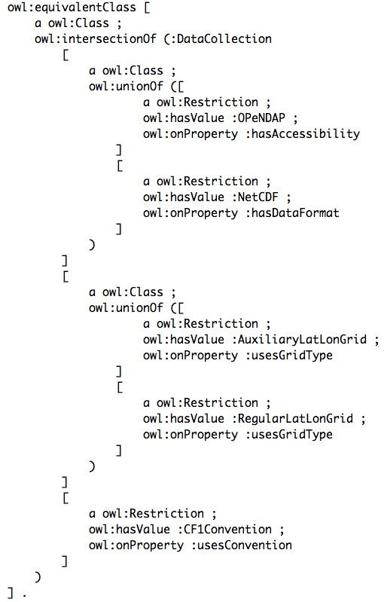
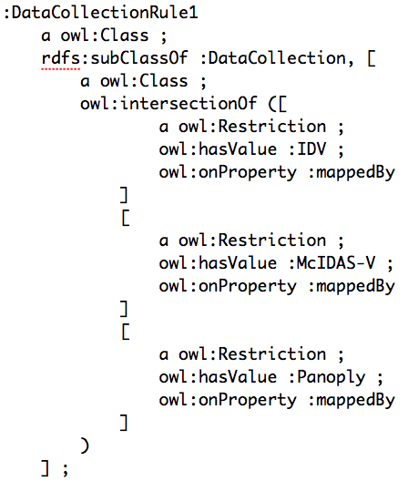
Rule 1 (Turtle)

Slide 11
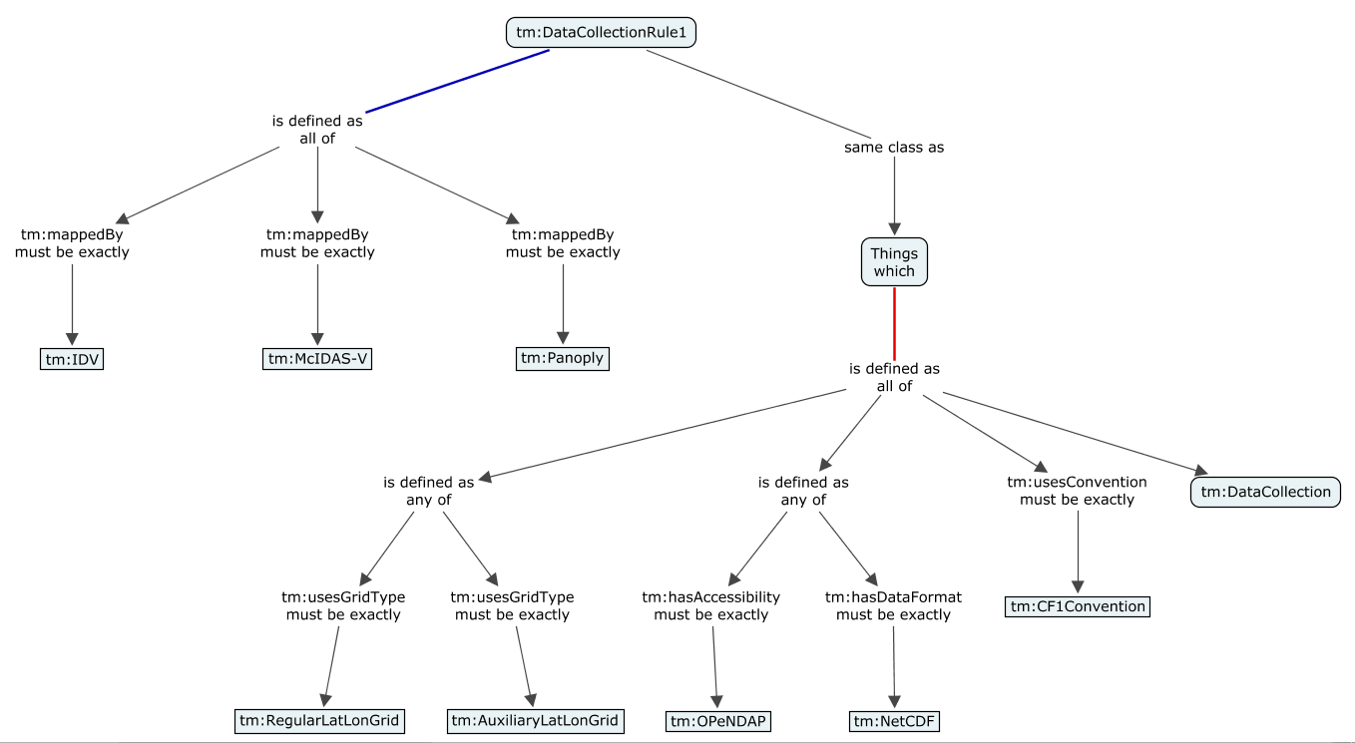
Rule 1 (Graphical)

Slide 12
Rule 1 (Graphical)

Slide 13
Rule 1 (Graphical)

Slide 14
Rule 1 (Protégé Editor)
Equivalent Class
DataCollection
and (hasAccessibility value OPeNDAP)
or (hasDataFormat value NetCDF)
and (usesGridType value AuxiliaryLatLonGrid)
or (usesGridType value RegularLatLonGrid)
and usesConvention value CF1Convention
Subclass Of
mappedBy value IDV
and mappedBy value McIDAS-V
and mappedBy value Panoply

Slide 15
Rule 2 (Protégé Editor)
Equivalent Class
DataCollection
and (hasAccessibility value OPeNDAP)
or (hasDataFormat value NetCDF)
and usesConvention value CF1Convention
and usesGridType value RegularLatLonGrid
Subclass Of
mappedBy value Ferret
and mappedBy value GrADS

Slide 16
Rule 3 (Protégé Editor)
Equivalent Class
DataCollection
and (hasAccessibility value OPeNDAP)
or (hasDataFormat value NetCDF)
and usesConvention value CF1Convention
and usesGridType value AuxiliaryLatLonGrid
Subclass Of
griddedBy value Ferret

Slide 17
Aux. Rule 1 (Protégé Editor)
Equivalent Class
DataCollection
and (hasAccessibility value GrADSDataServer)
or (hasAccessibility value Hyrax)
or (hasAccessibility value ThreddsDataServer)
or (hasAccessibility value erddap)
Subclass Of
hasAccessibility value OPeNDAP

Slide 18
Reasoner in Action (Demo)
Type inference
Rule-chaining
Higher-level reasoning via query (not shown in following slides)
Notes:
The following six slides walk through the process of inferring additional triples on a DataCollection instance.

Slide 19
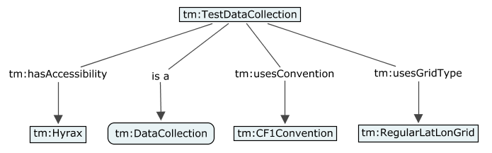
Reasoner in Action

Slide 20
Aux. Rule 1 (Protégé Editor)
Equivalent Class
DataCollection
and (hasAccessibility value GrADSDataServer)
or (hasAccessibility value Hyrax)
or (hasAccessibility value ThreddsDataServer)
or (hasAccessibility value erddap)
Subclass Of
hasAccessibility value OPeNDAP

Slide 21
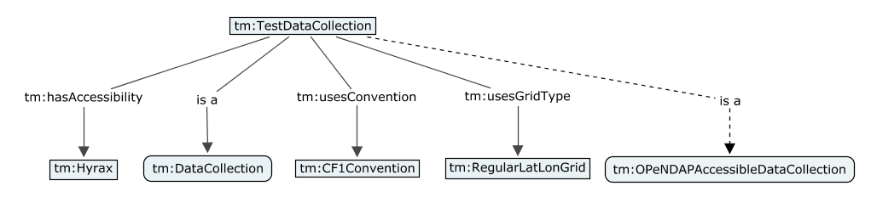
Reasoner in Action

Slide 22
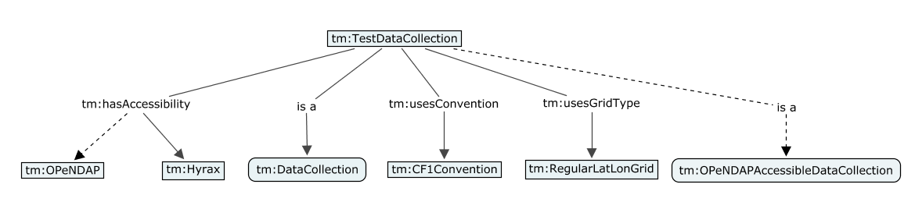
Reasoner in Action

Slide 23
Rule 1 (Protégé Editor)
Equivalent Class
DataCollection
and (hasAccessibility value OPeNDAP)
or (hasDataFormat value NetCDF)
and (usesGridType value AuxiliaryLatLonGrid)
or (usesGridType value RegularLatLonGrid)
and usesConvention value CF1Convention
Subclass Of
mappedBy value IDV
and mappedBy value McIDAS-V
and mappedBy value Panoply

Slide 24
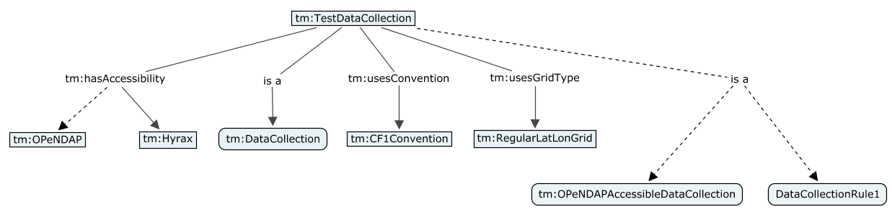
Reasoner in Action

Slide 25
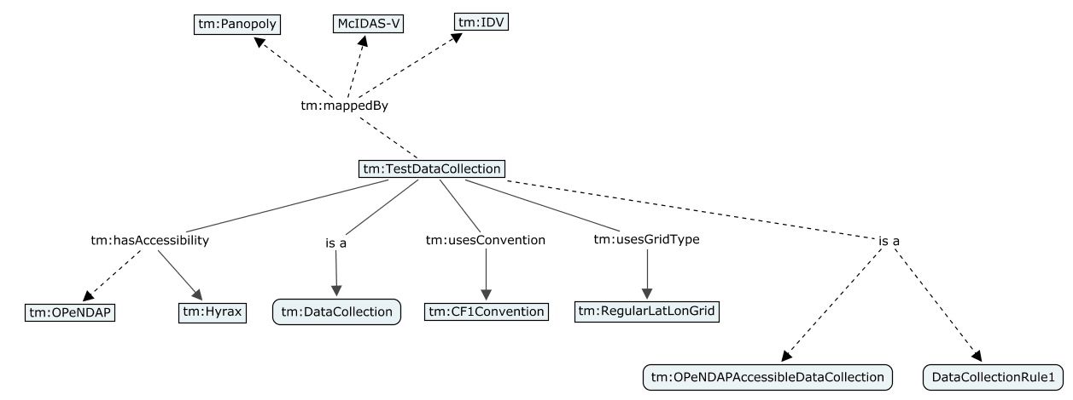
Reasoner in Action

Slide 26
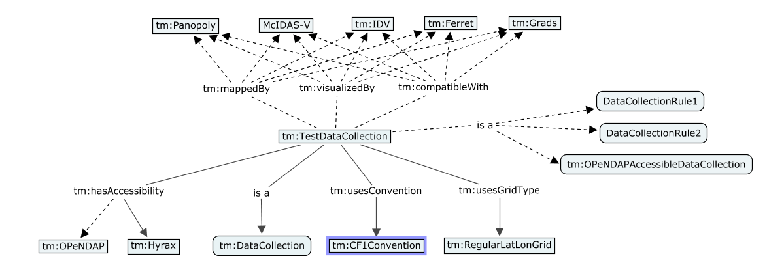
Reasoner in Action
*Additional triples (not shown) would be inferred for inverse relationships from tools to datasets

Slide 27
Instance Authoring
Use Cases
ToolMatch works at the data collection level (i.e., what tools work with a collection). Must accommodate mapping of entire catalogs.
Lay users: Web forms? Natural language authoring?
Expert users (e.g., submission via SPARQL, POST RDF triples via REST)
Notes:
The primary purpose of this slide is to develop a feeling for the types of authoring interfaces that will be required.
What sorts of APIs could be provided to accommodate mapping of entire catalogs?
Will lay users flock to Web forms, or will natural language be their preference?
Would expert users want to submit via SPARQL update, or POST triples directly?
Are there additional authoring scenarios we have not yet considered?

Slide 28
Other Use Cases
Most “rules” are not so clean-cut, there are usually cases where collections meet all the criteria but are still incompatible.
Rules mapping entire classes of tools to classes of data collections.
Notes:
This slide

Slide 29
What’s Your Role?
Would you like to…
Contribute data collections?
Annotate the tools you commonly use?
Write new rules?
Extend the ontology with common data formats, access protocols, or conventions?
Brainstorm new use cases? (negation, class-to-class mappings, etc.)
Build authoring tools? (see SADL, CLCE, …)
Incorporate ToolMatch into client applications?

Slide 30
Resources
ToolMatch Wiki
http://wiki.esipfed.org/index.php/ToolMatch
SADL (Semantic Application Design Language)
http://sadl.sourceforge.net/

