Slide 1
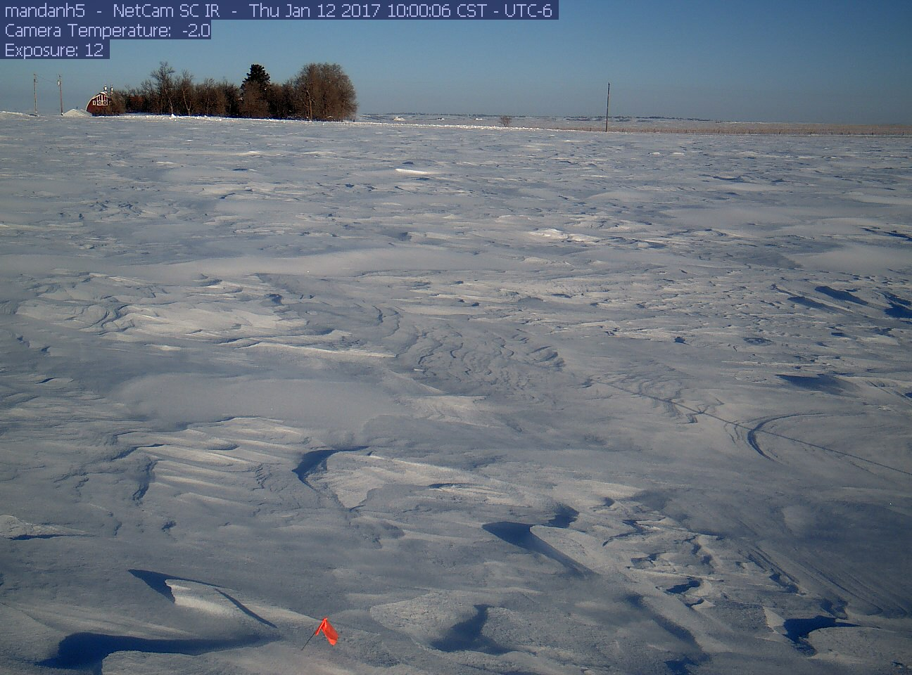
Information Quality Cluster Panel
Agricultural Research Perspectives
Jeffrey D. Campbell, Ph.D.
National Agricultural Library
January 12, 2017
Northern Great Plains Research Lab

Slide 2
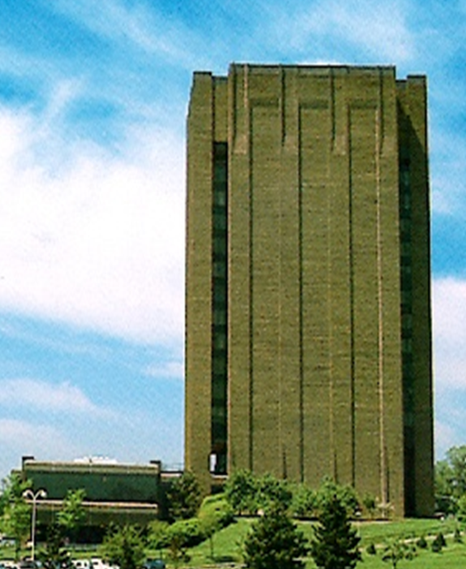
Overview
Introduction
Scientist data quality topics
Library (archive) data quality topics
8.1 million items
1.9 giga-in³ physical storage

Slide 3
Introduction
Knowledge Services Division
  acquisition, preservation, description, and discovery of scientific datasets
  Add value with data management and visualization tools
  Agricultural Research Service (ARS) Projects – Long-term Agroecosystem Research network, Rainfall Simulation, Life Cycle Assessment, Insect 5000 Genome, Ag Data Commons.

Slide 4
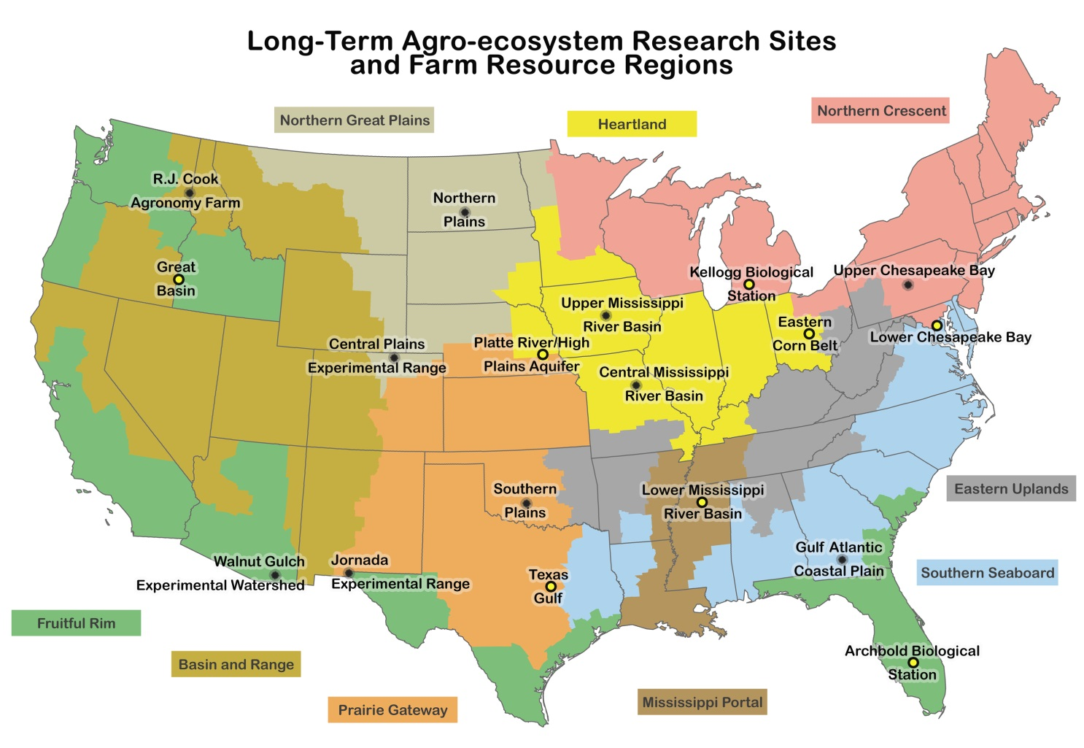
Long Term Agroecosystem Research
Have significant historical and on-going data

Slide 5
Agricultural Research Oversimplified
Improve quality and quantity of ag outputs while minimizing potential negative e/affects
Agriculture is local
  Different crops, animals, climates, soils, history, everything
  Different research methods in different locations even for similar measures.
Network / Data Sharing benefits
  Scaling results from plot to field to landscape is non-trivial.
  Model calibration and validation
    Water/Carbon/Nitrogen cycle balance - data quality!

Slide 6
Research Data
Current and historical
  Meteorology, Hydrology – flow, quality
  Eddy flux of CO₂ and non-CO₂ gasses
  Soil characteristics, temperature, moisture, wind and water erosion
  Land management practices (crop details, grazing patterns)
  Biological outputs, diversity
  Remote sensing – satellite, aerial, UAV
  Socio-economic

Slide 7
Perspectives on Info Quality from Scientists
Controlled experiment paradigm is common.
Many values for related factors that cannot be controlled in the experiment.
Differing expertise in the QA/QC for those factors.
Consistency between plots/years is important
Widely different levels of precision/accuracy of a particular measurement are acceptable for different research questions.
Collection methods differences larger than sensor uncertainty
Extreme events often have large impact.
How similar do the methods have to be to have directly comparable results? Difficult to achieve consensus!
Microclimate is important → Many sensors
  But also provide opportunity for QC comparison between stations

Slide 8
NAL Data Management
Simple sFTP of csv files to reduce IT security risk
File hash comparison, record counts and hashed values in data compared to database
Every change in data value (QA/QC or unintended) is logged in secured database.
Post Doc planning upgrades for Trusted Digital Repository status.

Slide 9
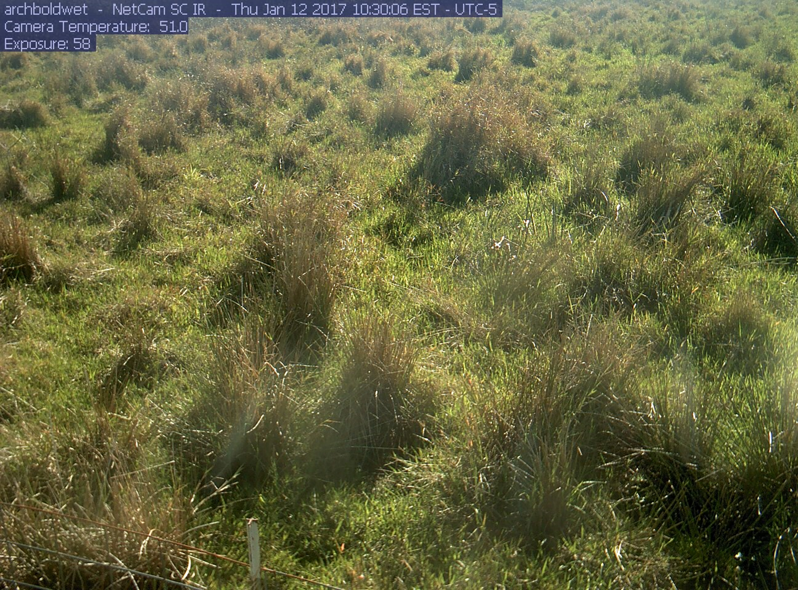

Extra Slides
Consistent QA/QC for Meteorological data
Metadata, metadata, metadata
Putting the Long-Term in Data
NAL
Big Data

Slide 10
Consistent QA/QC for Met Data
Responsibility for quality is with lead scientist for data.
Automated (range check, rate of change, check, missing values, sensor error codes) has to be reviewed by person on site.
No consensus yet on QC method details, reason codes (local and/or network-wide).

Slide 11
Metadata, Metadata, Metadata
To support future re-use for unanticipated purpose:
Station and methods documentation (e.g. WMO station metadata standard under development)
Sensor characteristics (SensorML2)
“Station events” records for routine maintenance, recalibration, natural disruptions (animal, weather damage, etc.)
ISO 19115 since most data has geospatial component. Other formats included as resource.
ISO 19110 for “data dictionary”

Slide 12
Putting the “Long-Term” in LTAR Data
50 years from now, someone should be able to
discover that the data exist,
find the data,
obtain and read the data,
determine suitability of data for use
In order to use data of known quality in a manner unanticipated by the data creator

Slide 13
NAL KSD Current Projects
Ag Data Commons
  general catalog and repository for agricultural data which can promote effective discovery of and add value to often widely distributed and seemingly disparate datasets
i5K (Insect 5000 genomes)
  sequence the genomes of all insect species known to be important to worldwide agriculture, food safety, medicine, and energy production

Slide 14
NAL/KSD Value-Added Functions
Neutral independent source
Preparing information to facilitate use
Discovering that information exists
Obtaining information
Providing customer service
Enhancing consistency – standards, guidelines
Proper citation of sources
Long-term preservation

Slide 15
NAL KSD Current Projects
Life Cycle Assessment (LCA) Commons
  open access to LCA datasets and tools for researchers studying sustainable methods in crop and livestock production.
LTAR data …

Slide 16
Big Data
Cultivating future big data
Large data volume, complexity
Satellite/aerial imagery, remote sensing
Photographs (single, time series)
Complex data integration issues
Variation between LTAR sites in methods, instruments, data formats, all of which change over time
Sub-setting based upon potentially complex computations (e.g. degree day variants)

Slide 17
It takes a village to grow Big Data
Data management for small data will mature into robust, rich, easy to use Big data
Collaborative partnerships taking advantage of strengths
  Right people performing right portions of raising data

