Slide 1

Data Quality Perspectives from the ESIP Information Quality Cluster
David Moroni₁(David.F.Moroni@jpl.nasa.gov),
Hampapuram “Rama” Ramapriyan₂, Ge Peng₃
Jet Propulsion Laboratory, California Institute of Technology, Pasadena, CA
NASA Goddard Space Flight Center and Science Systems and Applications, Inc.
NOAA’s Cooperative Institute for Climate and Satellites - North Carolina (CICS-NC) and NOAA’s National Centers for Environmental Information (NCEI)
Presented at the 2019 E2SIP C3DIS ‘19 Workshop, Canberra, Austrailia, 8 May 2019.
Acknowledgements: These activities were carried out across multiple United States government-funded institutions (noted above) under contracts with the National Aeronautics and Space Administration (NASA) and the National Oceanic and Atmospheric Administration (NOAA). Government sponsorship acknowledged. Reference herein to any specific commercial product, process, or service by trade name, trademark, manufacturer, or otherwise, does not constitute or imply its endorsement by the United States Government or the Jet Propulsion Laboratory, California Institute of Technology.

Slide 2
Outline
ESIP Information Quality Cluster
  About ESIP IQC
  Overview of IQC Objectives
  Many players around the world
  Data and Info Quality Perspectives
  Maturity Models Supporting each Stage
  Fostering Efforts within each Perspective
Collaboration with the ESDSWG Data Quality WG
  Operational Solutions Master List
  Current and Forthcoming Publications of Standards and Practices

Slide 3
About ESIP IQC
Vision
  Become internationally recognized as an authoritative and responsive information resource for guiding the implementation of data quality standards and best practices of the science data systems, datasets, and data/metadata dissemination services.
Closely connected to Data Stewardship Committee
Open membership (as with all Collaboration Areas in ESIP)
ESIP Information Quality: http://wiki.esipfed.org/index.php/Information_Quality

Slide 4
IQC Objectives
Share Experiences.
Actively evaluate best practices and standards for data quality from the Earth science community.
Improve collection, description, discovery, and usability of information about data quality in Earth science data products.
Consistently provide guidance to data managers and stewards on the implementation of data quality best practices and standards as well as for enhancing and improving data maturity.
Support:
  Data producers with information about standards and best practices for conveying data quality; provide mentoring as needed
  Data providers/distributors/intermediaries establish, improve, and evolve mechanisms to assist users in discovering, understanding, and applying data quality information properly.

Slide 5




















































Many Players Around the World
  US
  Foreign/Inter-national
NCEI

Slide 6
Data and Info Quality Perspectives
Scientific quality
  Accuracy, precision, uncertainty, validity and suitability for use (fitness for purpose) in various applications
Product quality
  How well the scientific quality is assessed and documented
  Completeness of metadata and documentation, provenance and context, etc.
Stewardship quality
  How well data are being managed, preserved, and cared for by an archive or repository
Service Quality
  How easy it is for users to find, get, understand, trust, and use data
  Whether archive has people who understand the data available to help users.
Ramapriyan, H K, Peng G, Moroni D, Shie C-L, Ensuring and Improving Information Quality for Earth Science Data and Products. D-Lib Magazine, 23 (7/8), July/August 2017, DOI: https://doi.org/10.1045/july2017-ramapriyan

Slide 7
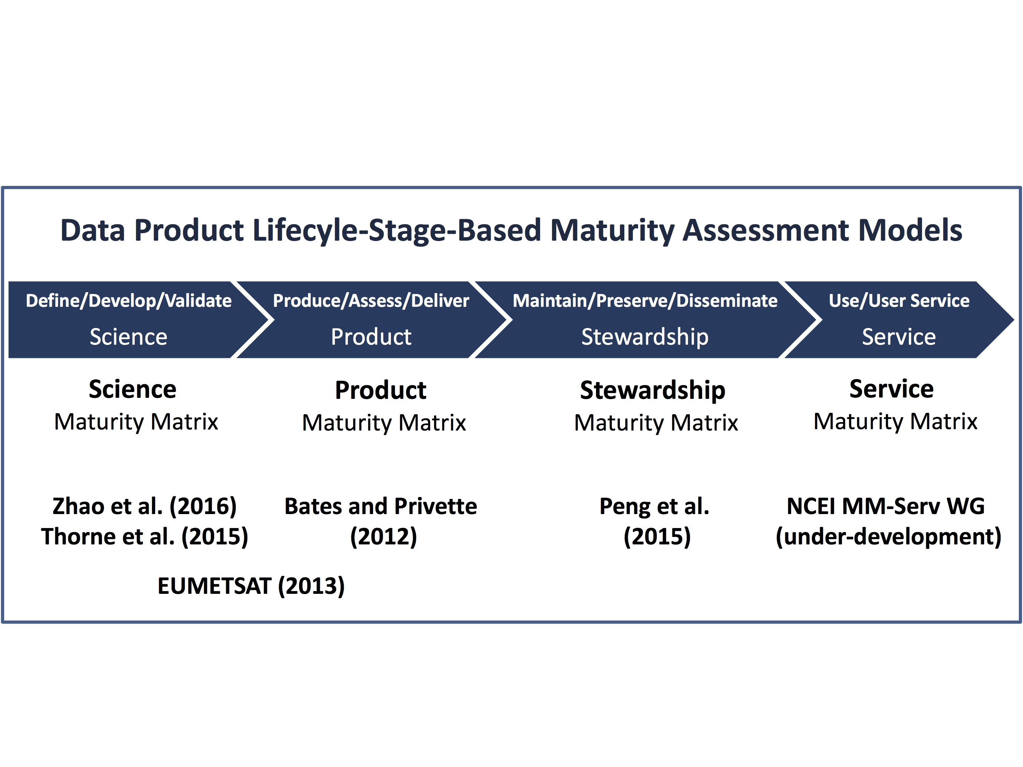
Data and Info Quality Perspectives
Perspective: Based on different data product lifecycle stages
Accuracy
Precision
Uncertainty
fitness for purpose
how well the product has been produced and assessed;
Completeness of product metadata and documentation
how well the data are being managed, preserved, and stewarded;
How well are metadata and documentation for access
how well the data are being serviced;
user support
customer engagement
Ramapriyan, H K, Peng G, Moroni D, Shie C-L, Ensuring and Improving Information Quality for Earth Science Data and Products. D-Lib Magazine, 23 (7/8), July/August 2017, DOI: https://doi.org/10.1045/july2017-ramapriyan

Slide 8
Maturity Models Supporting each Stage
Scientifically sound and utilized
Fully documented and transparent
Well-preserved and integrated
Readily obtainable and usable
(Peng 2018, Data Science Journal)

Slide 9
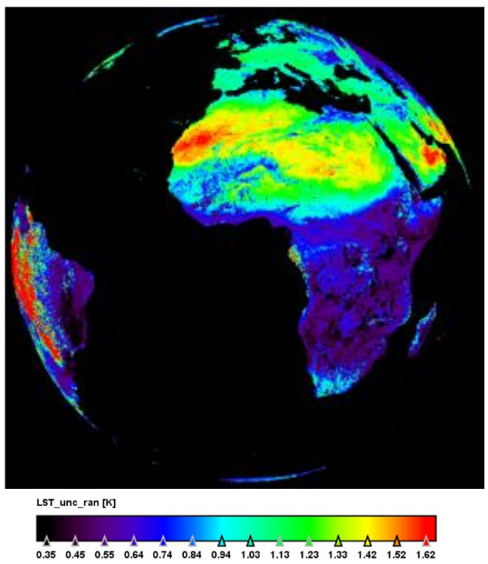
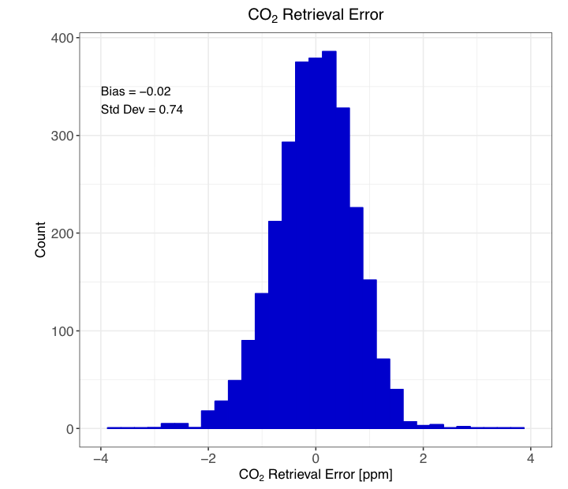
Fostering Science Quality
Science maturity models: GAIA-CLIM (Thorne et al. 2015), NOAA STAR Algorithm Maturity (Reed 2013; Zhou et al. 2016), CORE-CLIMAX Production System Maturity (EUMETSAT, 2013).
Convened sessions on the topic of Earth science data uncertainty: ESIP 2017 Summer Meeting, AGU Fall 2017 Meeting, ESIP 2018 Summer Meeting AGU Fall 2018 Meeting.
Internationally collaborated white paper entitled “Understanding and Communicating Uncertainty in Earth Science Data Informatics” (in draft). Est. pub. June 2019.
Monthly IQC-organized telecons featuring experts on data calibration/validation, uncertainty quantification/characterization, quality assurance, and codification of quality information and metadata.
Land Surface Temperature Uncertainty (Merchant et al. 2018)
CO2 Retrieval Error (Hobbs et al. 2018)

Slide 10

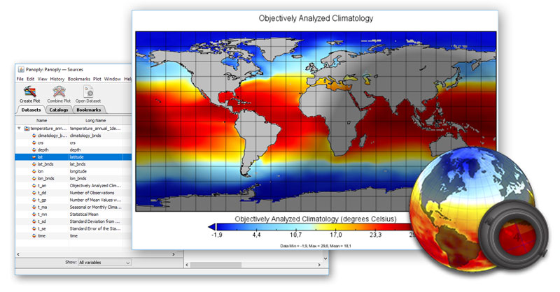





Fostering Product Quality
Product maturity models: NOAA CDR Maturity Matrix (Bates and Privette 2012), CORE-CLIMAX Production System Maturity (EUMETSAT, 2013).
Metadata standards and models promoting interoperability: Climate and Forecast (CF), ACDD, ISO 8601/19115-x/19157-x.
Metadata models for preservation (also relevant provenance), such as ISO-19165-1:2018 (Part 1, fundamentals; Wolfgang Kresse – Project Leader) and ISO-19165-2 (content specifications; in development; Ramapriyan - Project Leader).
Data Model Cluster (Davis, 2019): http://wiki.esipfed.org/index.php/Data_Model
Monthly IQC-organized telecons featuring experts on data production, metadata formatting/validation, interoperability, and provenance.

Slide 11
Fostering Stewardship Quality
Stewardship maturity models: NCEI/CICS-NC Stewardship Maturity (Peng et al. 2015), CEOS WGISS Data Management and Stewardship Maturity (WGISS DMSMM 2017), WMO Stewardship Maturity for Climate Data (SMM-CD Working Group, 2018).
Metadata models for preservation, such as ISO-19165-1:2018 (Part 1, fundamentals; Wolfgang Kresse – Project Leader) and ISO-19165-2 (content specifications; in development; Ramapriyan – Project Leader).
Leveraging open-source technologies and standards:
  ESIP Semantic Technologies (SemTech) Committee (McGibbney et al., 2019), http://wiki.esipfed.org/index.php/Semantic_Technologies
  ESIP Documentation Cluster (Gordon and Bugbee, 2019), http://wiki.esipfed.org/index.php/Category:Documentation_Cluster
  ESIP Web Services Cluster (Gallagher, 2019), http://wiki.esipfed.org/index.php/WebServices
  ESIP Usability Cluster (Hou and Langseth, 2019), http://wiki.esipfed.org/index.php/Usability
Monthly organized IQC telecons featuring all of the above topics.

Slide 12
Fostering Service Quality
Service maturity models: NSIDC Level of Services (Duerr et al. 2009), NCEI Tiered Scientific Data Stewardship Services (Peng et al., 2016a), GCOS ECV Data and Information Access Matrix, Global Ocean Observing System (GOOS) Framework, NCEI Data Monitoring and User Engagement Maturity (Arndt and Brewer, 2016).
Keeping up with Big Data challenges: Velocity, Variety, Veracity.
Leveraging input from other ESIP clusters:
  Agriculture and Climate (Hoebelheinrich and Teng, 2019), http://wiki.esipfed.org/index.php/Agriculture_and_Climate
  Disaster Lifecycle (Moe and Jones, 2019), http://wiki.esipfed.org/index.php/Disasters
  Data to Decisions (Wee, 2019), http://wiki.esipfed.org/index.php/Data_to_Decisions
Monthly organized IQC telecons featuring all of the above topics.

Slide 13
Collaborations with the ESDSWG DQWG
Data Quality Working Group (DQWG) was one of NASA’s Earth Science Data System Working Groups (ESDSWG).
Formed at the annual meeting of the ESDSWG in 2014 as a result of interest expressed by the ESDIS Project and MEaSUREs investigators.
DQWG officially ended in March 2019.
Mission Statement
  Evaluate and make recommendations to the ESDIS Project and HQ’s Earth Science Data Systems (ESDS) Program for improvements in capturing, representing and enabling the use of data quality information describing accuracy, precision, uncertainty and applicability (“fitness for use”) stewardship in the NASA Earth science domain.
https://earthdata.nasa.gov/community/
ESDSWG: earth-science-data-system-working-groups-esdswg

Slide 14
Operational Solutions Master List
Intended to identify operational solutions (26) relevant to the Implementation strategies identified by the DQWG.
https://wiki.earthdata.nasa.gov/x/2pASBg
Solutions can either be software, documentation, or standards/practices.
Solutions cover the following implementation categories:
  Data Quality Information (representation/dissemination)
  Facilitate Data Center and Provider/PI Communication
  Metadata Creation
  Standards Compliance Checking and Reporting
  Guidance and Instruction
  User Services
  Knowledgebase

Slide 15

  Forthcoming Publications of Standards and Practices
ESDS-RFC-031: Data Management Plan Template for Distributed Active Archive Centers (Convention)
ESDS-RFC-032: Data Management Plan Template for Data Processing Systems (Convention)
ESDS-RFC-033: Comprehensive Data Quality Recommendations for Data Producers and Distributors (Suggested Practice)
ESDS-RFC-034: High-Priority Data Quality Recommendations for Data Producers and Distributors (Suggested Practice)
Submitted to ESO (under review): Assessment of Recommended Data Quality Software Products (Technical Note)
Preparing Submission to ESO: Report of Data Call Pilot Study (Technical Note)
https://earthdata.nasa.gov/about/esdis-project/esdis-standards-office-eso

Slide 16
Thank you!
Primary Contacts:
  David Moroni (JPL, David.F.Moroni@jpl.nasa.gov)
  Yaxing Wei (ORNL DAAC, weiy@ornl.gov)
  H. K. “Rama” Ramapriyan (SSAI/GSFC – ESDIS, hampapuram.ramapriya@ssaihq.com)
  Ge Peng (NOAA/CICIS-NC/NCEI, ge.peng@noaa.gov)
Learn more about the IQC: http://wiki.esipfed.org/index.php/Information_Quality
Access to DQWG Master List of Solutions: https://wiki.earthdata.nasa.gov/x/2pASBg
Access to NASA’s ESO Standards and Technical Notes: https://earthdata.nasa.gov/about/esdis-project/esdis-standards-office-eso

