Slide 1

Atmospheric Organic Aerosol: More Than Primary Emissions
Brent J. Williams
Raymond R. Tucker ICARES Career-Development Assistant Professor
Washington University in St. Louis
Department of Energy, Environmental, & Chemical Engineering
PI: Atmospheric Chemistry & Technology (ACT) Laboratory
Mumbai: December 7, 2012

Slide 2
Organic Aerosol
2 main questions to discuss today:
1) Why do we care?
2) Where does it come from?

Slide 3
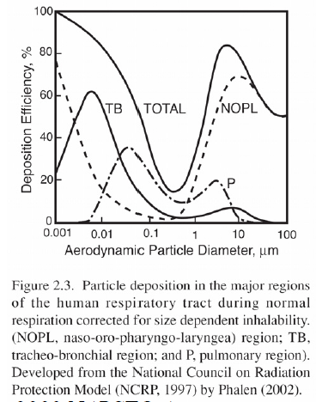
Why Do We Care: Size-dependent Health Effects
Course aerosols deposit by impaction in nose and throat.
Ultrafine aerosol deposit by diffusion deeper in lungs in smaller pathways.
Fine aerosol has a minimum in deposition efficiency at approximately 0.5 micron diameter.
Many organic species in Fine PM are classified as toxins, mutagens, and carcinogens.
[NARSTO, 2003]

Slide 4
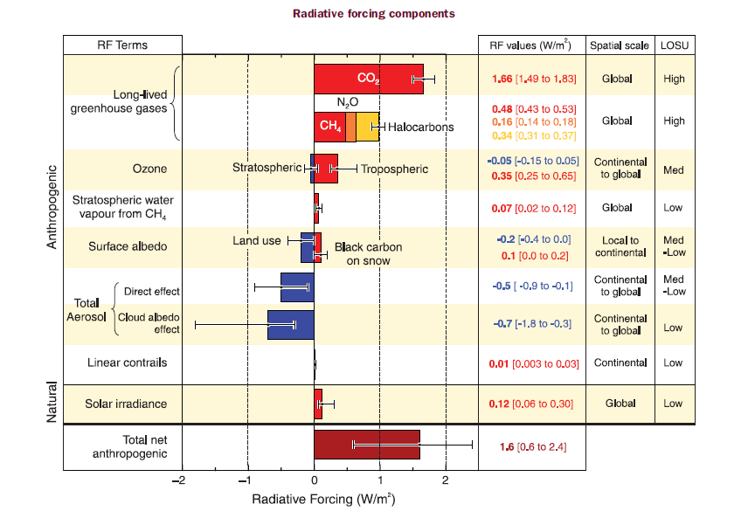
Why Do We Care: Climate Effects
Radiative forcing components
Not accounting for many aerosol indirect effects.
Changes since 1750 (preindustrial)
IPCC-Climate Change, 2007

Slide 5
Sulfate
Primary Organic Carbon from Fossil Fuels
Black Carbon from Fossil Fuels
Biomass burning
Nitrate
Mineral Dust
IPCC-Climate Change, 2007

Slide 6
Not Accounting for Secondary Organic Aerosol (SOA). Is there enough SOA to make a difference?
Sulfate
Primary Organic Carbon from Fossil Fuels
Black Carbon from Fossil Fuels
Biomass burning
Nitrate
Mineral Dust
IPCC-Climate Change, 2007

Slide 7
Organic Aerosol
2 main questions to discuss today:
1) Why do we care?
2) Where does it come from?
-primary vs. secondary

Slide 8
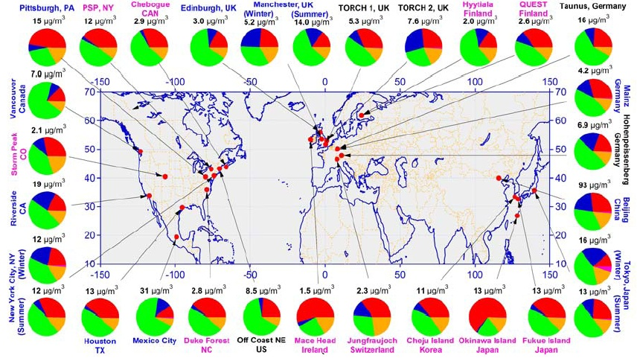
Organic Aerosol is Most Abundant Fine PM Component Globally
organics
sulfate
nitrate
ammonium
Zhang et al., 2007

Slide 9
Major Atmospheric Species (fine PM)
Northern Hemisphere Average (37 studies)
More Summer data than Winter
Non-Refractory Only (doesn’t include metals and elemental carbon)
Sulfate and Nitrate are formed through secondary processes
Organics previously thought of as mostly primary emissions, but that view has changed.
Zhang et al., Geophys Res Lett, 2007

Slide 10
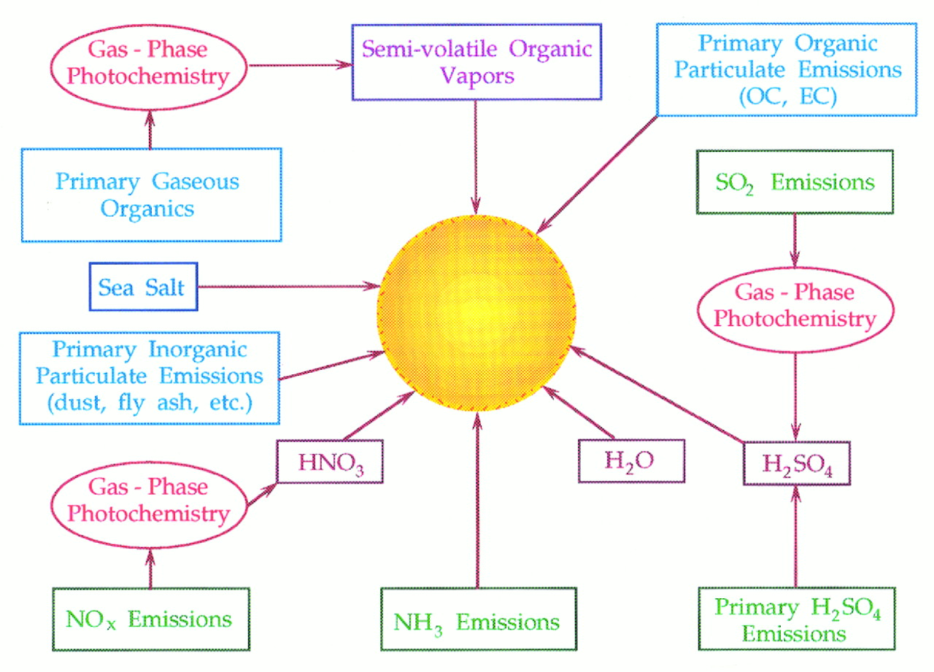
Sources of Atmospheric Aerosols
aerosol
Meng et al. 1997, Science, 277, 116.

Slide 11
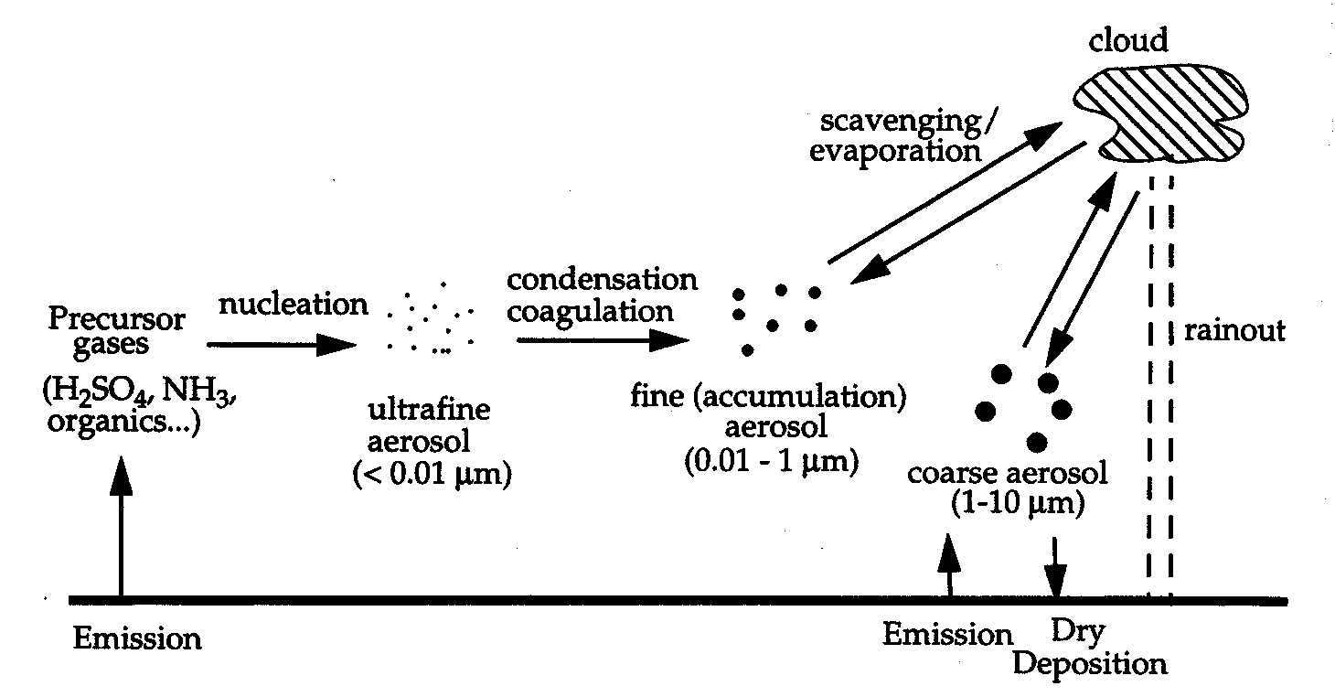
ORIGINS OF ATMOSPHERIC AEROSOL
Combustion
Soil/dust/Sea salt

Slide 12
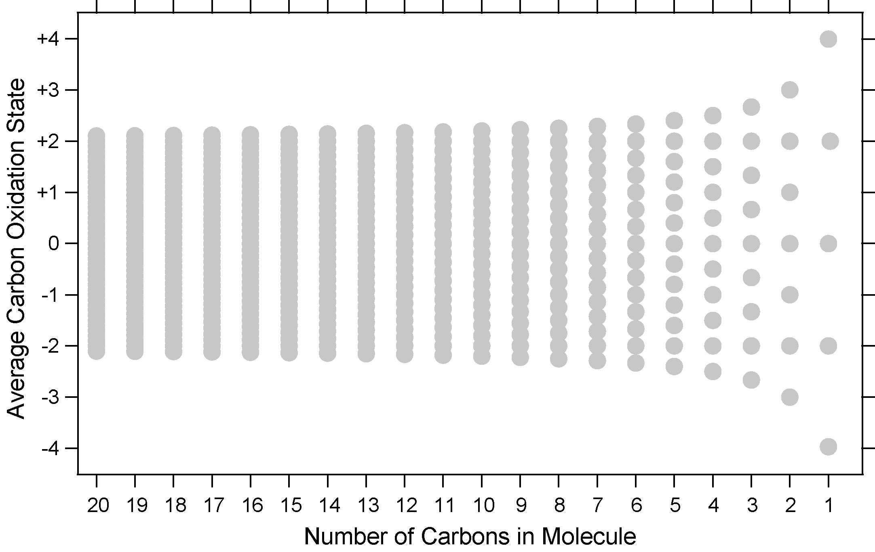
Atmospheric Organic Matter: Oxidation state and carbon numbers
Ox. State ≈ 2 (O/C) – (H/C)
CO₂
oxalic
acid
CO
glyoxal
dimer
glyoxal
fulvic
acid
elemental
carbon
sucrose
C8
triacid
levoglucosan
methyl
glyoxal
CH₂O
phenanthrene
pinic
C5 tetrol
pinonic
toluene
MVK
acetaldehyde
oleic acid
sesquiterpene
monoterpene
isoprene
dodecane
octane
CH₃OH
butane
ethane
CH₄
C₄₀
Kroll, Nature Chemistry, 2011.

Slide 13
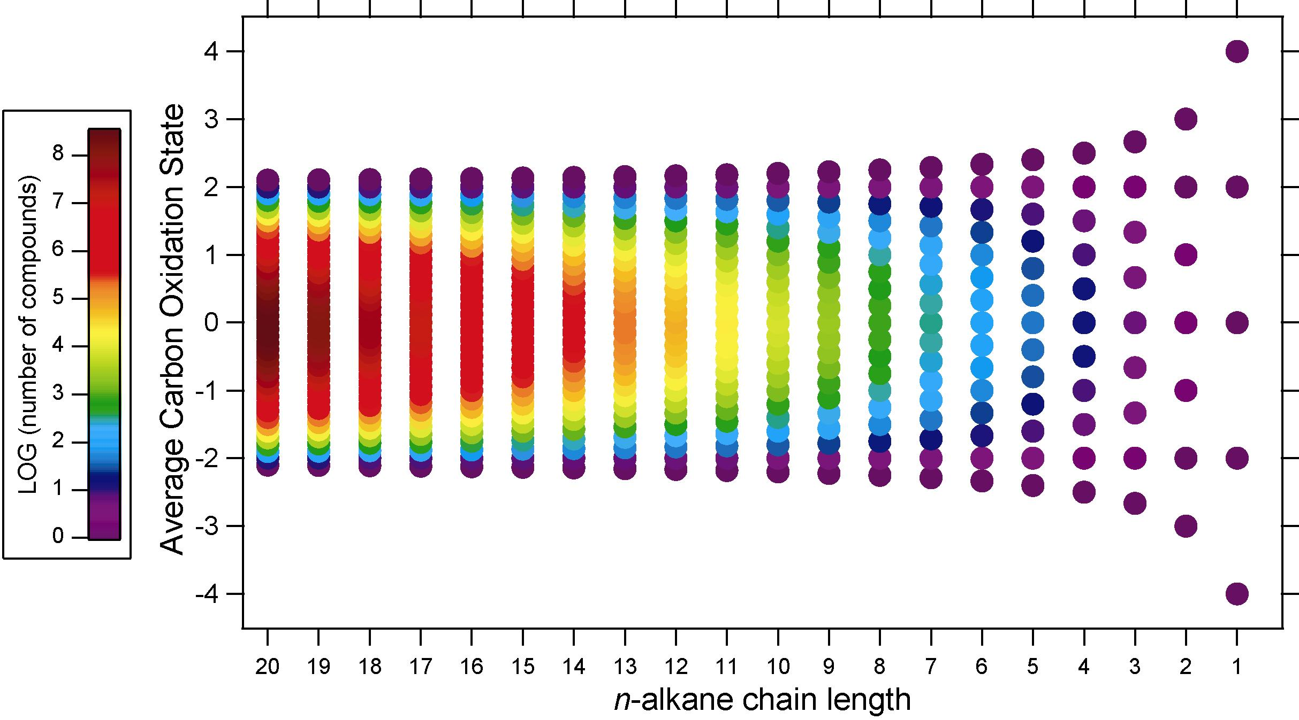
Chemical complexity of atmospheric organics
carbonyls, alcohols, acids only
Ambient Mass Concentrations Decrease
Ox. State ≈ 2 (O/C) – (H/C)
C₄₀
Kroll, Nature Chemistry, 2011.

Slide 14
Oxidation state of organic aerosol
Organic Aerosol
CO₂
CO
particle
gas
Organic aerosol is an intermediate in the oxidation of most organics to CO₂
C₄₀
Kroll, Nature Chemistry, 2011.

Slide 15
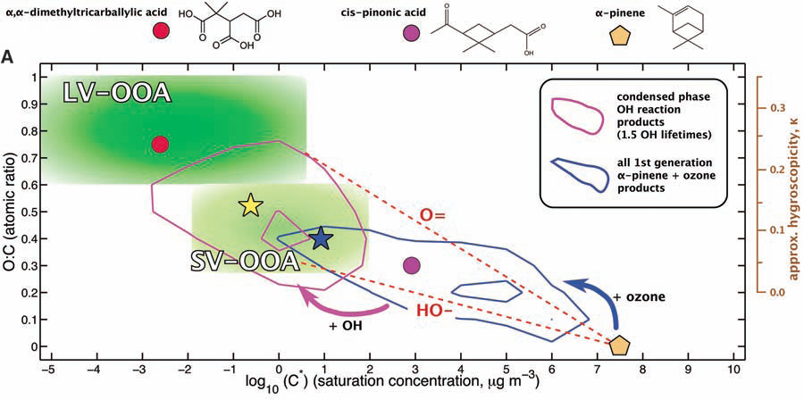
2D – Volatility Basis Set space
Jimenez, Canagaratna, Donahue, et al., Science, 2009
Illustration of SOA evolution through 2D-VBS space

Slide 16
Secondary Organic Aerosol (SOA) Formation: Example
Naphthalene: C₁₀H₈ (mostly in Gas-phase)
Phthalic acid: C₈H₆O₄ (In both Gas- and Particle-phase)
Particle-Phase Concentrations
- 10 days of measurements from thermal desorption aerosol gas chromatograph (TAG)
- PAR = visible light
Williams et al., PNAS, 2010

Slide 17
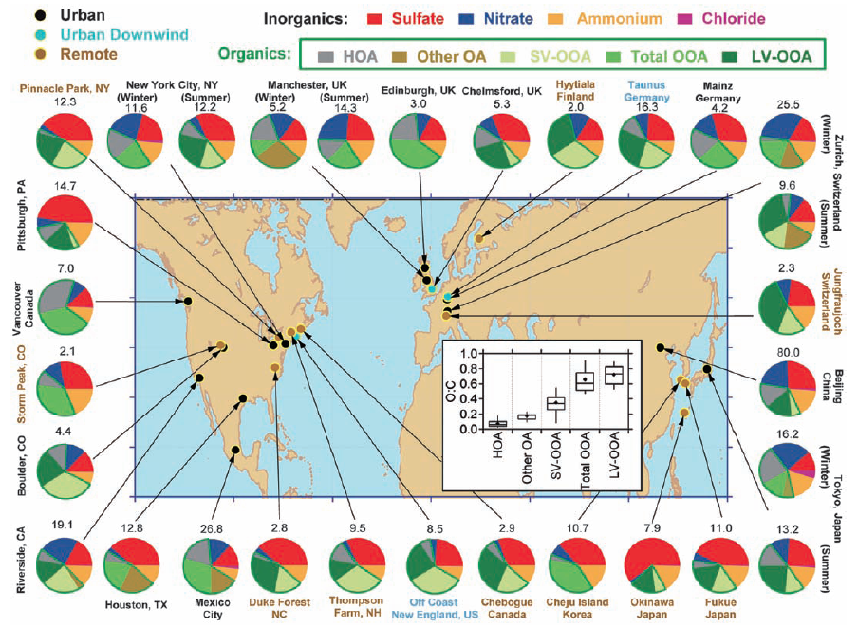
Major Chemical Composition of Atmospheric Fine Particulate Matter
Jimenez et al, Science, 2009

Slide 18
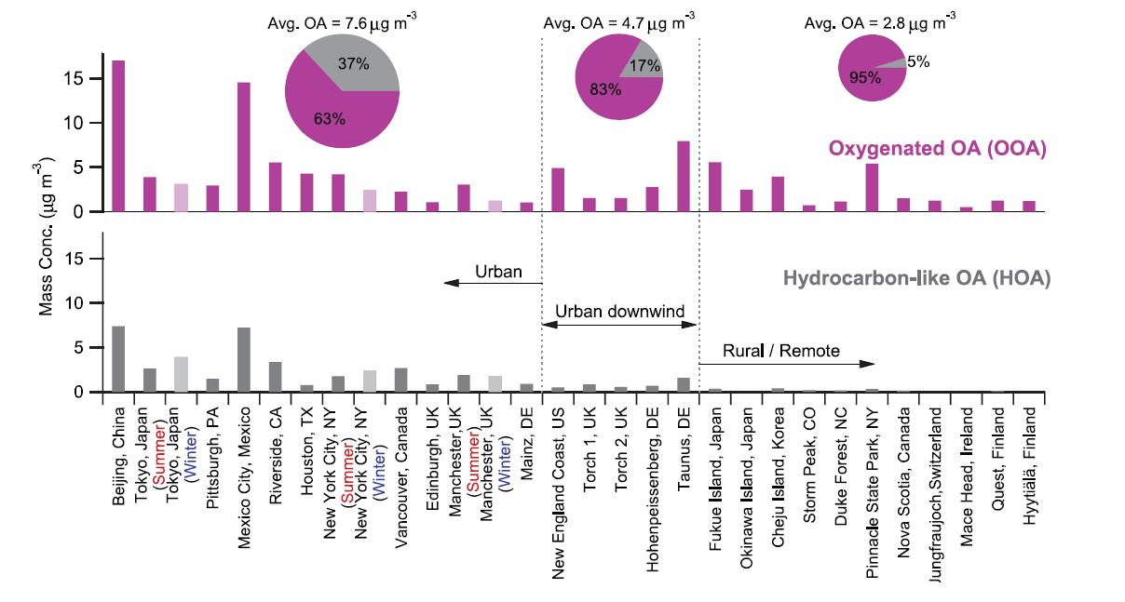
Primary vs Secondary Organic Aerosol (OA)
Zhang et al., Geophys Res Lett, 2007
Secondary OA > Primary OA
Effects of organic gases and organic particles can NOT be thought of as separate issues.

Slide 19
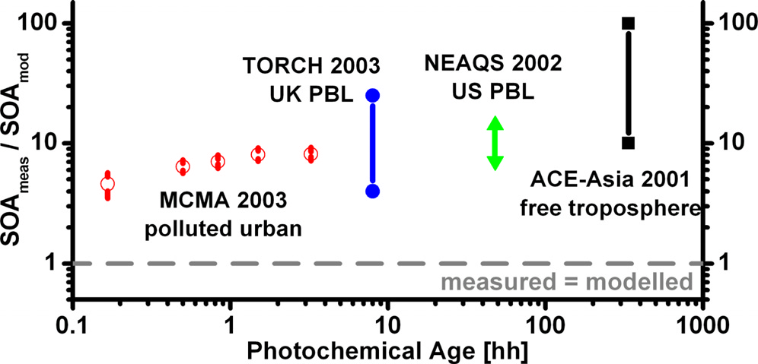
Major discrepancy between measured and modeled SOA
Volkamer et al., Geophys Res Lett, 2006.
Observed SOA > modeled SOA
Lack in our fundamental knowledge of SOA formation and transformation.
At least partially due to lack of measurements for semivolatile compounds.

Slide 20
Organics make up 20-90% of fine particle mass and contain tens of thousands of compounds that can be used to determine sources and transformations (much is Secondary).
What we need to know about atmospheric organic matter:
-Physical Properties of Particles
-Chemical Properties
-composition and concentrations (gases and particles)
-composition transformations as air masses age
-Want to determine all sources and fate of atmospheric gases and particles.
-What effects do these particles and gases have on the environment?
-What can be done about it? (Policy and Management)

Slide 21
General Speciation: AMS Speciation (PM₁)
Northern Hemisphere Average (37 studies)
More Summer data than Winter
Non-Refractory Only (doesn’t include metals and elemental carbon)
Zhang et al., Geophys Res Lett, 2007

Slide 22
More Specific: AMS Speciation (w/ PMF of OA)
Hydrocarbon-like OA (HOA)
x%
y%
z%
Semivolatile OOA (SV-OOA)
Low Volatility Oxygenated Organic Aerosol (LV-OOA)
x, y, z% varies (x > y > z in urban locations, z > y > x in remote locations)
Can also provide estimate of Biomass OA, but some interference exists
Still lacks specifics on sources of OA
Specifics are crucial for Regulation and Modeling Efforts

Slide 23

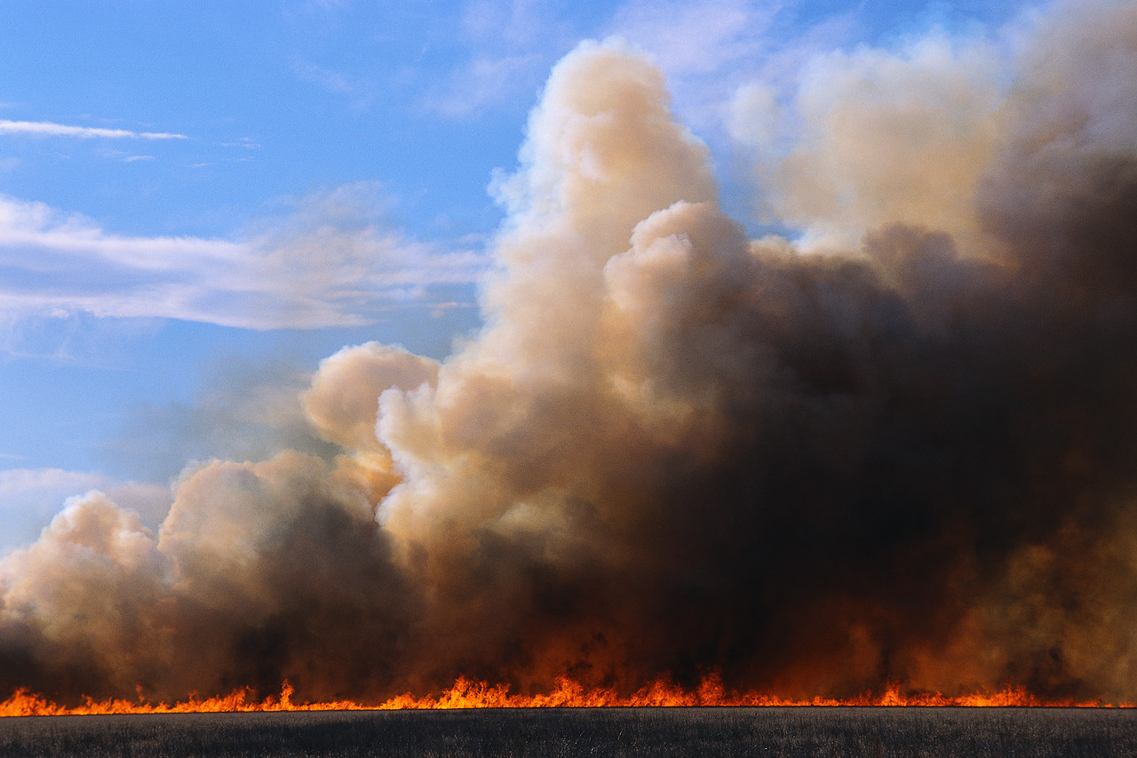
More Specific Yet: TAG
Thermal Desorption Aerosol Gas Chromatograph (TAG)
An in-situ instrument used to study the
Sources and Transformation of Organic Particulate Matter
Hourly measurements of organic aerosol molecular composition
Williams et al., Aerosol Sci Technol, 2006
TAG

Slide 24
Cyclone Precut
(PM_{2.5})
Filter
(field blank)
x
Humidifier
(adhesion)
1. Collection technique:
Inertial Impaction (30⁰C)
2. Sample transfer:
Thermal Desorption (50-300⁰C)
3. Chemical separation:
Gas Chromatography
4. Compound identification and quantification:
Electron Impact Mass Spectrometry
Factor Analysis
to group compounds
1
Aerosol Collector
&
Thermal
Desorption Cell
2
Gas
Chromatograph
Heated
valve
Mass
Spectrometer
4
3
Note: many particles will be internally mixed.

Slide 25
Organic portion (20-90% of total mass) is helpful in determining and understanding:
- Particle sources
- Particle formation processes
- Particle transformations
Abundance
Various forms of Petroleum Combustion
TIC: 33702-12.D
5000000
TIC: 33702-13.D (*)
4500000
Secondary Organic Aerosol
4000000
Coffee
3500000
3000000
Relative Abundance
2500000
2000000
Plant Waxes
1500000
1000000
Residential Wood Combustion
500000
Williams et al., Aerosol Sci Technol, 2006
0
Retention Time
15.00
20.00
25.00
30.00
35.00
40.00
45.00
Time-->

Slide 26
More Specific Yet: TAG Speciation
(scaling to AMS OA mass)
Primary Vehicle Emissions
Food Cooking
Plant Waxes
Pharmaceuticals
Biomass Burning:
Softwood
Biomass Burning:
Hardwood
Pesticides
Plasticizers
Anthropogenic Secondary Organic Aerosol (SOA)
Further Aged Anthro-SOA
Biogenic SOA: Terpene SOA
Biogenic SOA: Isoprene SOA
Example Sources
Positive Matrix Factorization of Molecular Marker Compounds
Multivariate fit of TAG PMF factors to total OA from AMS

Slide 27
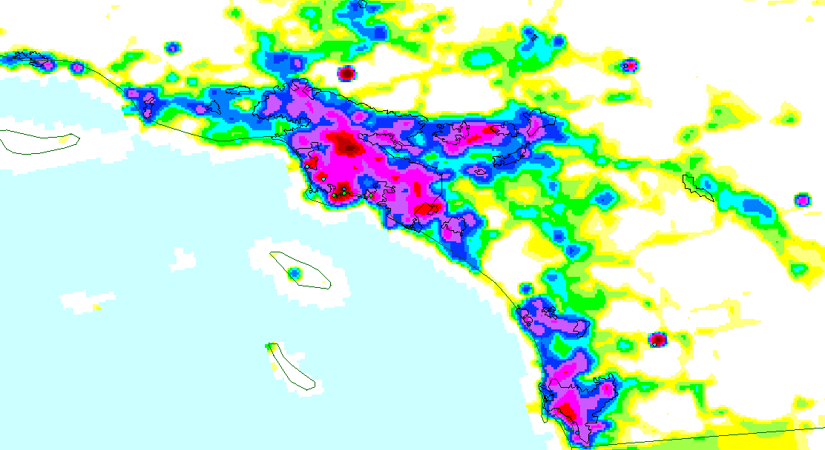
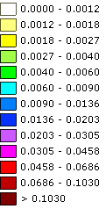
Example TAG Field Study:
Study of Organic Aerosol at Riverside (SOAR)
N
80 km
Los Angeles
Riverside
135 km
San Diego
PM_{2.5} Gridded Emissions (short tons/ozone season day/grid cell)
TAG’s 1-hour time resolution provides diurnal trends
SOA Marker
Vehicle Marker
7/30/2005
8/02/2005
7/29/2005
8/06/2005
8/07/2005
8/08/2005
8/04/2005
8/09/2005
8/01/2005
8/03/2005
8/05/2005
7/31/2005
Use hundreds of TAG compound timelines in Positive Matrix Factorization (PMF)
Determine major OA components (sources)
Scale TAG factors to AMS OA mass
Williams et al., Atmos Chem Phys Discuss, 2010

Slide 28



Main methods to determine particle sources:
Chemical Mass Balance:
Schauer and Cass, ES&T, 2000
c_{ik}= concentration of chemical species i in the fine particles at receptor site k
a_{ij =} relative concentration of species i in the fine particle emissions from source j
s_{jk} = increment to total fine PM concentration at receptor site k originating from source j
m= # of source types
Factor Analysis (e.g., Positive Matrix Factorization):
Ulbrich et al., Atm Chem Phys, 2009
G and F are determined by minimizing sum of least squares between residuals and errors:
X = concentration of chemical species
G = Factor Profile
F = Factor Time Series
E = Residuals
p = Factor#
= estimated errors (uncertainty)
Q = quality of fit parameter

Slide 29
TAG PMF Components (SOAR)
Biogenic Particles
Bio
Biomass Burning
BB
Food Cooking
FC
Local Vehicles
LV
Contribution to Factor (each factor profile sums to 1)
Regional Primary Anthropogenics
RPA
Aged SOA + Biogenic SOA
SOA4
+SV
Aged SOA
SOA3
Regional Fresh SOA
SOA2
Local Fresh SOA
SOA1
Hydrocarbon
Oxygenated
Biogenic
N-Containing
Other
Williams et al., Atmos Chem Phys Discuss, 2010

Slide 30
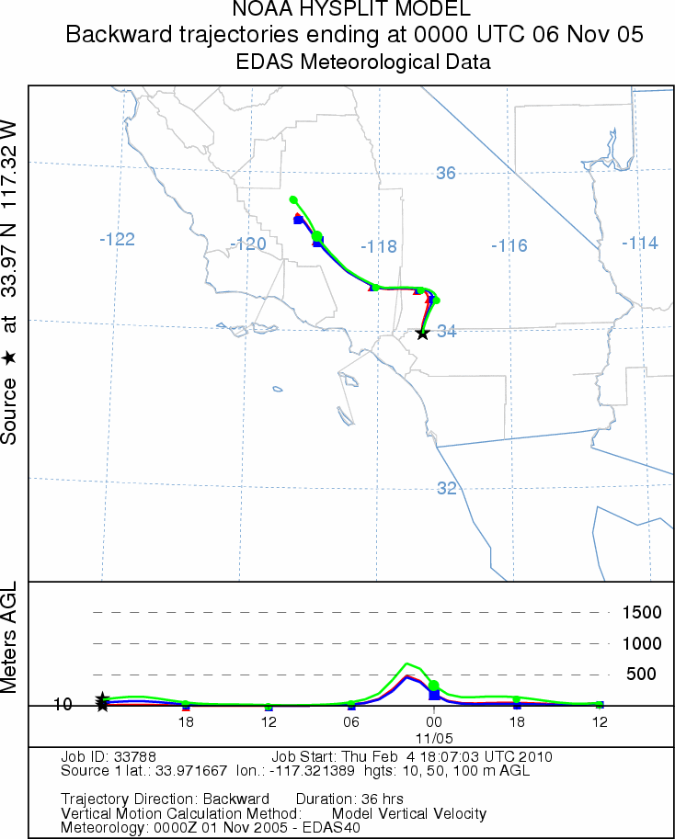
Supporting Information
Local Meteorology
Backward Trajectory Modeling
Correlations
RH
Temp
O₃
CO
OC/EC
gas-phase organics
AMS species
ATOFMS (single particles)
Etc.

Slide 31

TAG PMF Components (summer)
9.5
6.8 μg m⁻³
SOA~70% of fine OA
Immediately downwind of large urban area
Previous Studies: SOA~20-50% of fine OA
5.3
8.0
22:00
0:00
2:00
8.0
20:00
4:00
8.6
18:00
6:00
11.7
16:00
8:00
10.0
14:00
12:00
10:00
SOA1 = Local Fresh SOA
SOA2 = Regional Fresh SOA
SOA3 = Aged SOA
SOA4 = Aged SOA + Biogenic SOA
10.1
13.0
10.7
11.6
SOA1
SOA4+Semivolatile
Food Cooking
SOA2
Regional Primary Anthropogenic
Biomass Burning
SOA3
Local Vehicle
Primary Biogenic
Measured OA
Williams et al., Atmos Chem Phys Discuss, 2010

Slide 32
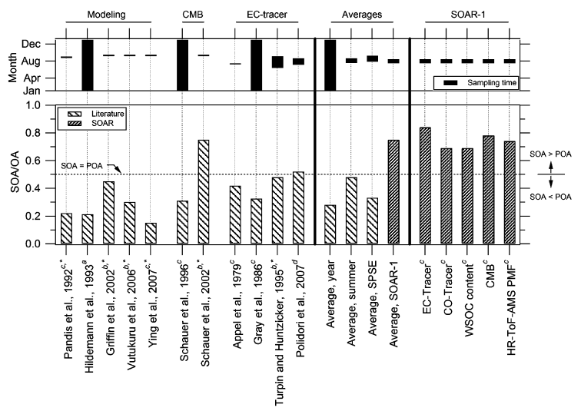
Docherty et al., ES&T, 2008

Slide 33
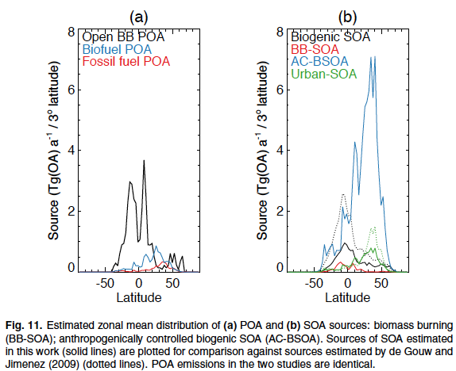
What Models are still missing
Spracklen et al., ACPD, 2011

Slide 34
