Slide 1
Usage-Based Discovery
Can we link data to how it is used?
Can that help data discovery?
Can that help other things (e.g., strategizing)?

Slide 2
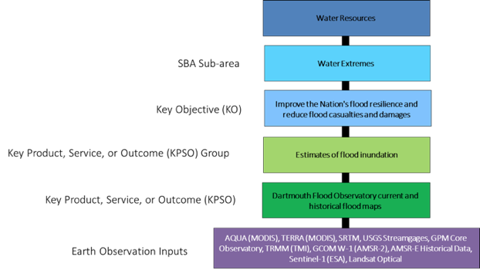
OSTP Earth Observation Assessment

Slide 3
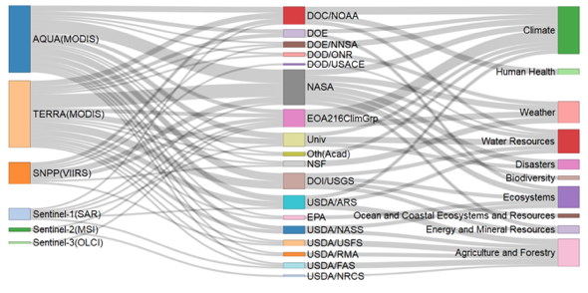
NOAA Satellite Instrument Dept/Agency Societal Benefit Area

Slide 4
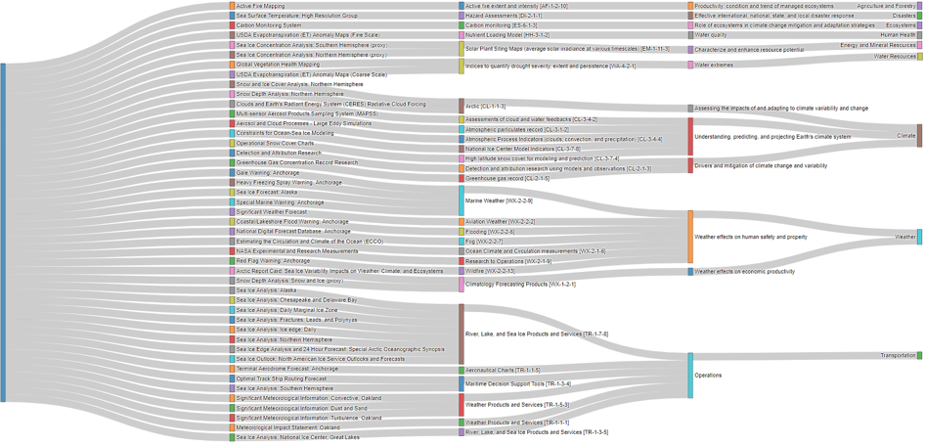
STPI - NASA (Doane): Impact of Land Imaging

Slide 5
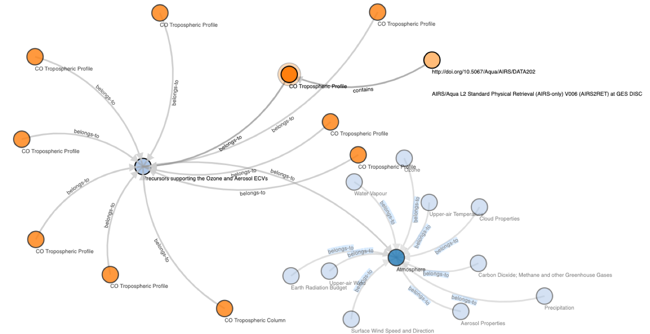
Newman (NASA): Essential Climate Variables

Slide 6
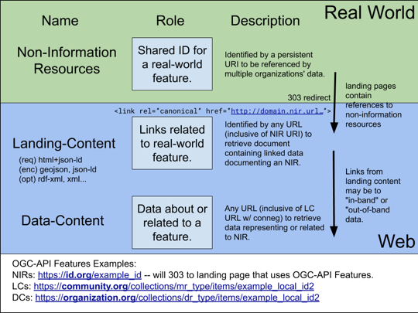
Shared IDs

Slide 7
Proposed Phase #1
Link datasets to data-usage-related concepts
Publications
Essential Climate Variables (ECV)
Key Product, Service or Outcome Group (KPSO)
Societal Benefit Areas (SBA)
UN Sustainable Development Goals (SDG)
Missions + instruments
Other
Look at options for representing relationships (Prov model, cf. nano-publications)
Each org externalizes relationships, either via API or export
Convert formats as necessary to instantiate cross-org links
Look into Linked Data Notifications (emerging standard)
Start with a subset of Earth Observations to keep it tractable:
Precipitation data?
Link to phenomena: Landslide, flooding, soil moisture
Load into...Neptune? Neo4J? Other?
Visualize
Conceive Usage-Based Discovery Applications (Maybe start this in parallel?)
Design Phase #2 (Summer ESIP - focus on Vermont, see L. Barbieri)
Notes:
Ethan: add Tools?
Look at W3C Provenance model (Jonathon will share work on this)
Mark: cf. nano-publication model
Karen: LANCE datasets -> disaster response support; flood extent is a good area to start with, looking at it from the user end

