Slide 1



Advertising your data: Using data portals and metadata registries
Nancy Hoebelheinrich
Knowledge Motifs LLC
Version 1.0
[Reviewed
August 2012]
Notes:
Modules should be 3-7 minutes long

Slide 2

Gateways to Your Data: Data Portals & Metadata Registries
What’s a data portal & what’s a metadata registry?
Submitting information about my data – what do I need?
Some relevant data portals & metadata registries for science data
http://www.besthomeschooling.org/images/Gateways.jpg

Slide 3
What’s a data portal?
A web site that pulls together information about data sets on a subject area from diverse sources in a unified way to:
Inform viewers of the existence of data sets from public & private sources
Inform viewers of the availability of these data sets, i.e., whether free & public or accessible given privacy, confidentiality & security concerns
Provide applications, services, news & other information about the data that is collected

Slide 4
What’s a metadata registry?
An information system that supports the registration of metadata for purposes of:
Identification – to differentiate your data from others, often by assigning a unique identifier
Provenance – to establish the source of the data & metadata
Quality monitoring of the metadata - usually by requiring or recommending metadata standards to use in describing the data
Source Publication:
ISO/IEC International Standard 11179-3 - Information technology - Metadata registries (MDR) - Part 1: Framework, March 2004.

Slide 5

Submitting information about your data
New at this? -- No need to panic
What do you need to know?
An idea about how best to represent your data to your community
Project documentation that would help you describe your data
High level descriptive information in hand about your data
http://images.colourbox.com/thumb_COLOURBOX3906460.jpg

Slide 6
Key high level descriptive information to know about your data
What: Title of Data Set and Keywords Describing the Data Set
Why: Description and Purpose of the Data Set
When: Temporal Coverage of the Data Set
Who: Data Set Creator and Contact
Where: Geographic Extent and Location of Data Set Coverage
How: How the Data Set was Created and How to Access the Data

Slide 7
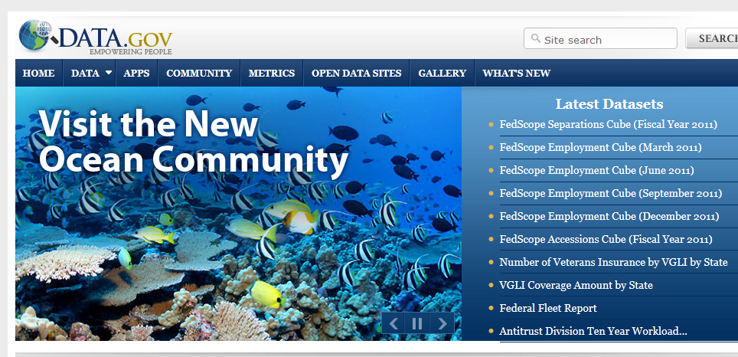
Information submission tools
Data portal / metadata registry submission tools
Most / many have submission tools that help you walk through the submission process
Metadata standards may be required depending upon the portal / registry for the information submitted
If required, metadata standards are usually built into tools with required & optional information requested,
As an example, Data.gov (for U.S. Federal data of all kinds) http://www.data.gov/

Slide 8
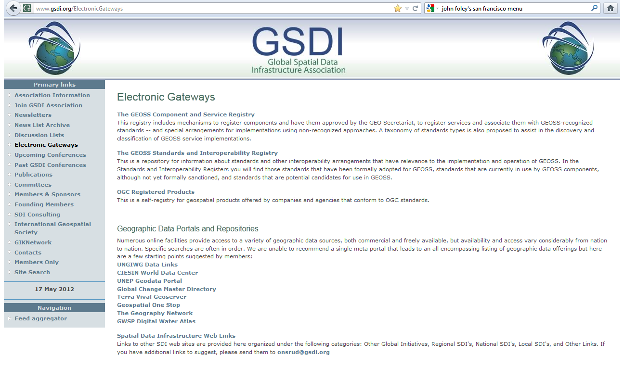
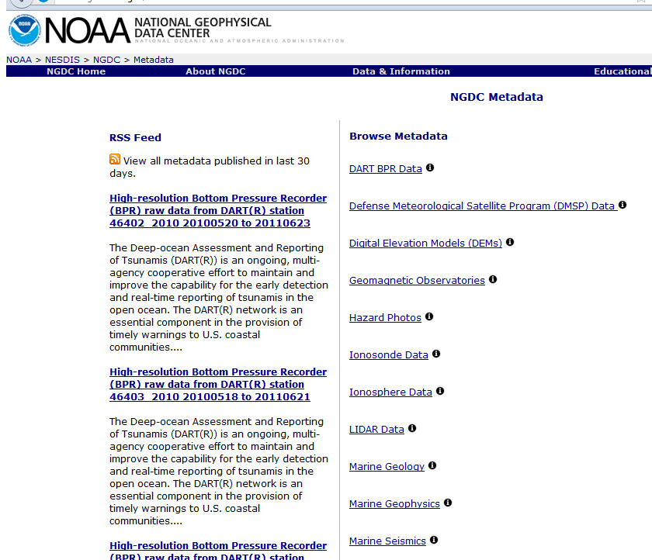
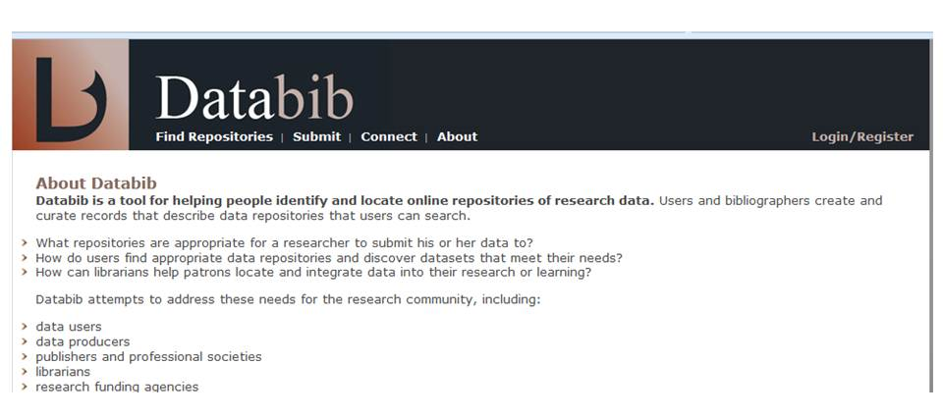
Other relevant data portals / metadata registries for science data
Global Spatial Data Infrastructure
http://www.gsdi.org/ElectronicGateways (international)
NOAA National Geophysical Data Center
http://www.ngdc.noaa.gov/metadata (metadata registry)
Global Change Master Directory
http://gcmd.nasa.gov/index.html
Databib
http://databib.org/ (annotated bibliography for finding data
portals, metadata registries & repositories for all kinds of data)

Slide 9

Resources
http://2.bp.blogspot.com/-x7oCNtb7-Os/T0cDPUEjKQI/AAAAAAAAEHs/yXEJy9ojRXM/s1600/Wheel-of-Time.jpg
Global Spatial Data Infrastructure
http://www.gsdi.org/ElectronicGateways
NOAA National Geophysical Data Center
http://www.ngdc.noaa.gov/metadata
Global Change Master Directory
http://gcmd.nasa.gov/index.html
Data.gov
http://www.data.gov/
Databib
http://databib.org/
Notes:
Resources Module: Voiceover script
We've collected some additional resources that might you might find helpful should you need more information about some of the areas that we've covered briefly. We'd also like to explain why we think they might be useful.

Slide 10

Other Relevant Modules
Advertising Your Data – the wherefores & wherefore-nots of advertising your data
Advertising Your data: Agency Requirements - more info about what some U.S. Federal agencies require for data / metadata dissemination
Developing a citation for your data – tips on what information is necessary to create a citation for your data
Publishing Metadata to GCMD – more specific info on using publishing to the Global Change Master Directory
Casting your data – more information about some open source tools that help you publish your data to the Web
Image credit: http://terrylynnmeyer.com/wp-content/uploads/2011/05/modern-advertising-methods.jpg
Notes:
Other Relevant Modules Module: Voiceover script
The modules of the ESIP Data Management Course have been designed to complement and supplement each other. In light of this plan, we think you might find the following, related modules relevant to you and why as you gain a better understanding of data management:

