Slide 1
Summary of day 1
6th December, 2012

Slide 2
Inaugural: Key Messages
Welcome : Invitation to the process of development of Air Quality Community
Major Lessons Learnt from 6 city studies: What next
Why we are here??

Slide 3
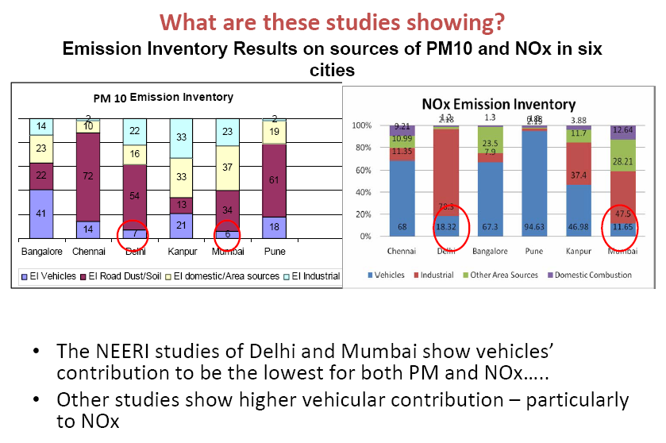
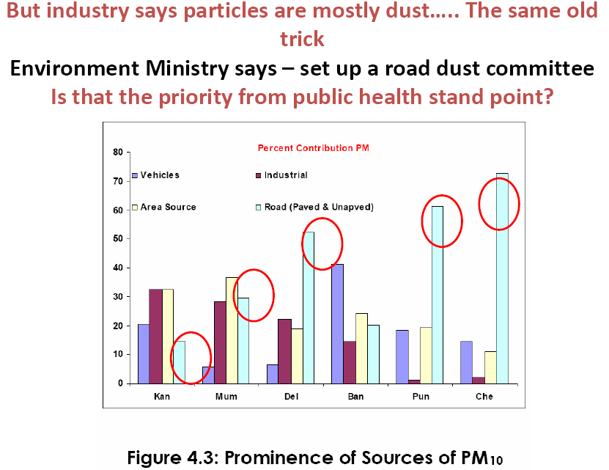
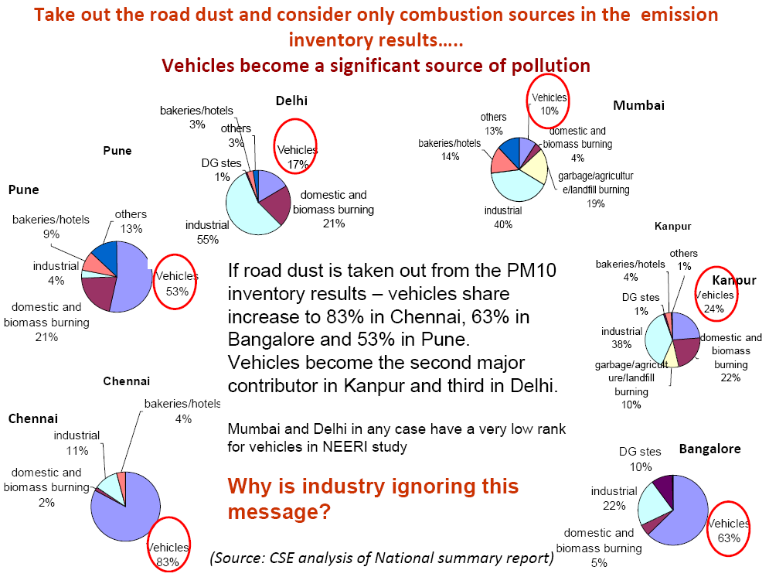
Air Quality Monitoring, Emission Inventory and
Source Apportionment Study for Indian Cities
Snapshot of some of the comments by CSE

Slide 4
Emission Loads
EL PM (T/d) | Mumbai | Pune | Kanpur | Delhi | Chennai | Banglore
Area | 26.89 | 6.20 | 3.69 | 27.75 | 1.20 | 13.20
Point | 20.62 | 0.40 | 2.39 | 32.48 | 0.22 | 7.80
Line | 4.23 | 5.90 | 1.92 | 9.70 | 1.58 | 22.38
Pav.&UnPav. Dust | 21.71 | 19.75 | 1.35 | 77.28 | 8.01 | 10.90
Total | 73.45 | 32.25 | 9.36 | 147.20 | 11.01 | 54.28
EL NOx (T/d)
Area | 88.07 | 1.33 | 3.52 | 15.33 | 2.51 | 53.89
Point | 102.41 | 0.89 | 8.41 | 360.53 | 1.38 | 17.19
Line | 25.13 | 39.19 | 10.57 | 83.83 | 8.25 | 146.33
Total | 215.60 | 41.41 | 22.50 | 459.69 | 12.14 | 217.41
Registered Vehicles (Millions) | 1.50 | 1.45 | 0.59 | 5.20 | 2.27 | 2.53
Area (KM)2 | 468 | 243.84 | 230 | 1500 | 176 | 565
Population | 1600000 | 254000 | 257000 | 1380000 | 434000 | 570000
Mumbai and Delhi City inventory included about 10 to 11 area source categories as compared to 4-8 in other cites.
The emission load of area and industries in these cities is much higher as compared to other cities.
Therefore the percentage share of vehicles is less but absolute numbers are high.

Slide 5
Prof.Virendra Sethi
Real Accomplishment
Report to submitted to the parliament BUT ALSO UNDERSTOOD AIR QUALITY REAL ISSUE OF INDIA
60 people from 7 institutes (TERI, IITK, IITM, NEERI Nagpur, NEERI Mumbai, ARAI and IIT B) worked together with the CPCB for 3 years and built the capacity for air quality management work
Real “NON-Accomplishment”
7 institutes worked together for 3 years and built the capacity, with no FUTURE
There is no platform for researchers to continue the work
Resolution of source apportionment through PM10 adequate ? Need for PM2.5 based source apportionment ?
Potential for societal benefit – but no structure for participants to engage
DECISION MAKER NOT USING THE KNOWLEDGE !!!!

Slide 6
Future Activities
Build and connect the air quality community across the Indian subcontinent and GEO AQ CoP
Moving from Earth Observations to Societal Benefits through Collaboration via Communities of Practice
Fostering a Culture of Collaboration in GEO via Communities of Practice
“First, think about collaboration as both an attitude that prompts people to approach their work in the spirit of proactive cooperation and a shared effort that leads to better, more creative outcomes.”
Leapfrogging for Air Quality Management in India by engaging with recent developments of new tools and practices

Slide 7
Mr.Rajeev Mital
Expectations from the community of academician and researchers:
Share what will happen in future
Move away from compliance
Benchmarking of technologies/equipment

Slide 8
Prof.Rudy Husar
Purpose of the Meet
Major interconnectivity: leading to balanced air quality management
Combining tools and techniques: complementing and enhancing the knowledge

Slide 9
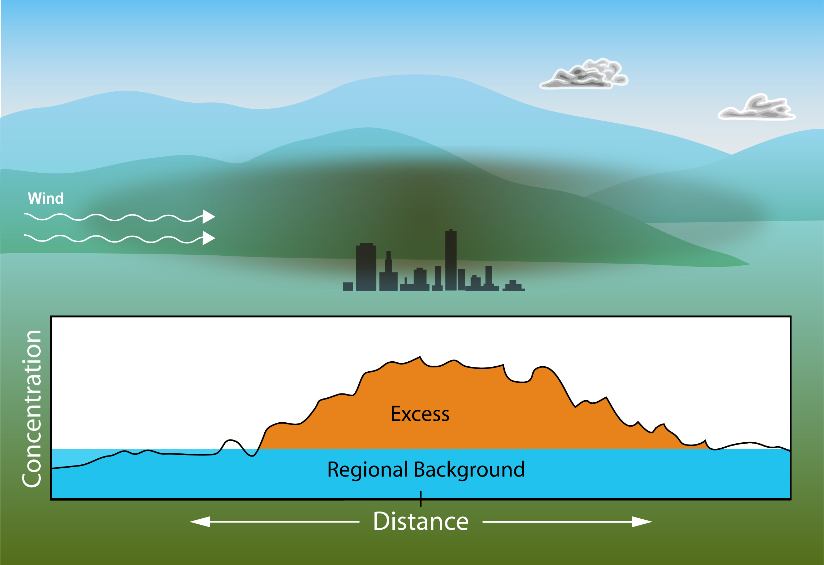
Urban and Regional Pollution:
Total Pollution =
Regional Background + Urban Excess
Challenge to air quality management, science and education:
Combining local and regional/global observations, models and science. data, datasets allow the estimation of the regional background concentrations and the urban excess
Notes:
Spatial patterns,
Result from emissions patterns (SO2 map, biomass burning map)
And residence time and transport patterns
rudi residence time piece my dilution piece
Chemical formation and loss rates (atmospheric lifetimes)
SOA
Transport patterns
Geography – elevation and cartoon of blocking

Slide 10
Session 1: Dr.CVC Rao Dr.Ajay Deshpande
Development and Augmentation of Ambient Air Quality Network in Maharashtra
Bring about a paradigm shift in monitoring system through combination of efforts from SPCB, CPCB and Industries
Analysis and interpretation of data for development of action plans and linkage to health studies, traffic management, source inventory etc.

Slide 11
Dr.Gurfan Beig
System of Air Quality Weather Forecasting and Research (SAFAR)
Major effort of MOES in Delhi and later in Pune to carry out large scale monitoring, modelling and Forecasting
Extending the process to other cities

Slide 12
Dr.R.N.Singh
Future of Air Quality Modelling for Sustainable Development
Moving through Bird to Frog View, future would be interdisciplinary, coupled, nonlinear, uncertain
Future lies in mastering ODE( economic growth) /PDE( air pollution field) / algebraic( chemical reactions) constrained optimization, numerical way for nonlinear stochastic models
Air pollution community need to interact computational scientists and economists for sustainable developmental issues.

Slide 13
Discussion Outcome
Availability of climate and air quality data in public domain: for its use by researchers and policy groups
Standard protocol for monitoring
Combining multiple websites to enhance visibility, transparency and accountability
Learn from mistakes of the past in many other countries and move forward to do things better
Forecasting needs to be done with utmost care and calibration of models
Indoor Air Quality Integration

Slide 14
Discussion Session: Dr.A.L.Aggarwal Needs and Purpose of being here
Research Areas: What to study? Who Needs them??
Health exposure study, Data use and interpretation and integration of air quality community
Availability of resources: stakeholders not interested ??
Enough awareness: Its time to act

Slide 15
Dr.Orhan Yenigun
SURFACE OZONE IN URBAN, SEMI-RURAL AND RURAL SITES IN ISTANBUL, TURKEY
Clear seasonal variation exhibiting a maximum in summer and a minimum in winter.
Higher O₃ levels at the rural site compared to the semi-rural and the traffic sites.
The lowest O₃ mixing ratios measured at the traffic site (titration effect of local high NO_{x} emissions).
The sharp decrease in the morning rush hour O₃ levels during weekdays were not observed in weekends.

Slide 16
Dr.Jay Turner
Future of Air Quality Modelling for Sustainable Development
Status and perspectives on U.S. networks
Emphasis on particulate matter
Case Studies of Hong Kong, Ulaanbaatar
Opportunities to learn from other networks, possibly leapfrog portions of the evolution path
Contemporary Network Design: Multiple purpose !!!

Slide 17
Dr.Harish Gadhavi
Aerosol Characterization in Rural Environment
Biomass sources from rural areas have become significant
Need to use multiple techniques to arrive at their sources and their charcatrisation
Black Carbon information and AOD properties can be very useful to undersatnd the process and possible management techniques
Also discussed various instrumental techniques and their output data handling

Slide 18
Prof. Rudolf Husar and Ratish
Remote sensing and Modelling Results for PM over India
Comprehensive talk on basics of aerosols and satellite data view and interpretation
Aerosol properties: physical, optical
Illustration of pattern of AOT
Usage of model to estimate composition,
Finally, Examine aerosol events

Slide 19
What is expected today?
Look for Mentor today
Look for your resource person: research, planning or any random issue ☺
Put your point of view to us…… didn’t get a chance to talk, write and give ☺

