Slide 1
Improving Information Quality for Earth Science Data and Products – An Overview
H. K. (Rama) Ramapriyan
Science Systems and Applications, Inc. & NASA Goddard Space Flight Center
David Moroni
Jet Propulsion Laboratory, California Institute of Technology
Ge Peng
North Carolina State University
December 14, 2015
H. K. Ramapriyan’s work was supported by NASA under contract NNG15HQ01C. David Moroni’s work is supported by a NASA contract with the Jet Propulsion Laboratory, California Institute of Technology, Pasadena, CA. Ge Peng is supported by NOAA under Cooperative Agreement NA14NES432003. Government sponsorship acknowledged.
Paper #IN14A-01 - Presented at AGU Fall Meeting, San Francisco

Slide 2
ESIP Information Quality Cluster - Objectives
Bring together people from various disciplines to assess aspects of quality of Earth science data
Establish and publish baseline of standards and best practices for data quality for adoption by inter-agency and international data providers
Become an authoritative and responsive resource of information and guidance to data providers on how best to implement certain data quality standards and best practices for their datasets
Build framework for consistent capture, harmonization, and presentation of data quality for the purposes of climate change studies, Earth science and applications
(Objectives evolve with participant inputs)

Slide 3
Information Quality
Scientific quality
Accuracy, precision, uncertainty, validity and suitability for use (fitness for purpose) in various applications
Product quality
how well the scientific quality is assessed and documented
Completeness of metadata and documentation, provenance and context, etc.
Stewardship quality
how well data are being managed and preserved by an archive or repository
how easy it is for users to find, get, understand, trust, and use data
whether archive has people who understand the data available to help users.
Information Quality is a combination of all of the above

Slide 4
Background
QA4EO
ISO 19157:2013 Standard “Geographic information -- Data quality”
NOAA Climate Data Record (CDR) Maturity Matrix
NOAA Data Stewardship Maturity Matrix
NCAR Community Contribution Pages
NASA Making Earth System Data Records (ESDRs) for use in Research Environments (MEaSUREs) Product Quality Checklists
NASA Earth Science Data System Working Groups (ESDSWG) Data Quality Working Group
Much related work has occurred in recent years

Slide 5
QA4EO
Established and endorsed by the Committee on Earth Observation Satellites (CEOS) in response to a Group on Earth Observations (GEO) Task DA-06-02 (now Task DA-09-01a)
Four International Workshops - 2007, 2008, 2009, and 2011
Key Principles (from http://qa4eo.org/docs/QA4EO_guide.pdf)
“In order to achieve the vision of GEOSS, Quality Indicators (QIs) should be ascribed to data and products, at each stage of the data processing chain - from collection and processing to delivery
A QI should provide sufficient information to allow all users to readily evaluate a product’s suitability for their particular application, i.e. its “fitness for purpose”.
To ensure that this process is internationally harmonized and consistent, the QI needs to be based on a documented and quantifiable assessment of evidence demonstrating the level of traceability to internationally agreed (where possible SI) reference standards.”
Framework and 10 Key Guidelines established (e.g., establishing Quality Indicator , establishing measurement equivalence, expressing uncertainty)
A few cases studies are available that illustrate QA4EO-compliant methodologies [e.g., NOAA Maturity Matrix for CDRs, WELD: Web - Enabled Landsat Data (NASA-funded MEaSUREs Project), ESA Sentinel-2 Radiometric Uncertainty Tool]
Notes:
http://qa4eo.org/resources/
http://qa4eo.org/case-studies/

Slide 6
ISO 19157:2013 - Geographic information -- Data quality*
Establishes principles for describing the quality of geographic data
Defines components for describing data quality
Specifies components and content structure of a register for data quality measures
Describes general procedures for evaluating the quality of geographic data
Establishes principles for reporting data quality
Defines a set of data quality measures for use in evaluating and reporting data quality
Applicable to data producers providing quality information to describe and assess how well a data set conforms to its product specification
Applicable to data users attempting to determine whether or not specific geographic data are of sufficient quality for their particular application
Examples of DQ Elements: Completeness, Thematic Accuracy, Logical Consistency, Temporal Quality, Positional Accuracy
* From: http://www.iso.org/iso/home/store/catalogue_tc/catalogue_detail.htm?csnumber=32575

Slide 7
CDR Maturity Matrix
NOAA NCEI Climate Data Record (CDR) Maturity Matrix assesses readiness of a product as a NOAA satellite CDR
Bates, J. J. and Privette, J. L., “A Maturity Model for Assessing the Completeness of Climate Data Records”, Eos, Vol. 93, No. 44, 30 October 2012
Assesses maturity in 6 categories (software readiness, metadata, documentation, product validation, public access, utility) at 6 levels
Provides consistent guidance to data producers for improved data quality and long-term preservation
EUMETSAT’s CORE-CLIMAX Matrix – based on CDR Maturity Matrix; contains guidance on uncertainty measures
http://www1.ncdc.noaa.gov/pub/data/sds/cdr/Guidelines/Maturity_Matrix_Template.xlsx
Notes:
http://qa4eo.org/docs/maturity_matrix_2012EO440006_for.pdf

Slide 8
Data Stewardship Maturity Matrix
NOAA NCEI/CICS-NC Scientific Data Stewardship Maturity Matrix (SMM) provides a unified framework for assessing the maturity of measurable stewardship practices applied to individual digital Earth Science datasets that are publicly available
Assesses maturity in 9 categories (e.g., preservability, accessibility, data quality assessment, data integrity) at 5 levels
Provides understandable data quality information to users including scientists and actionable information to management
Peng, G. et al, 2015. “A unified framework for measuring stewardship practices applied to digital environmental datasets”, Data Science Journal, 13. doi:10.2481/dsj.14-049
More details in paper #IN14A-05

Slide 9
NCAR Climate Data Guide*
Community contributed datasets, reviews
Focuses on “limited selection of data sets that are most useful for large-scale climate research and model evaluation”
Contributed reviews answer 10 key questions; Examples of topics addressed
strengths, limitations, and typical applications of datasets
Comparable datasets
Methods of uncertainty characterization
utility for climate research and model evaluation.
*From Schneider, D. P., et al (2013), Climate Data Guide Spurs Discovery and Understanding, Eos Trans. AGU, 94(13), 121. [article] - See more at: https://climatedataguide.ucar.edu/about/contribute-climate-data-guide#sthash.zaOUYP3j.dpuf

Slide 10
NASA MEaSUREs - Product Quality Checklists
Making Earth System Data Records for Use in Research Environments (MEaSUREs)
NASA-funded, typically 5-year projects generating long-term consistent time series
Product Quality Checklists (PQC) indicate completeness of Quality Assessment, metadata, documentation, etc.
PQC templates - developed in 2011 and adopted in 2012
Questions asked address science quality, documentation quality, usage and user satisfaction

Slide 11
NASA Earth Science Data System Working Groups (ESDSWG) – Data Quality Working Group (DQWG)
Mission: “Assess existing data quality standards and practices in the inter-agency and international arena to determine a working solution relevant to Earth Science Data and Information System Project (ESDIS), Distributed Active Archive Centers (DAACs), and NASA-funded Data Producers.”
Initiated in March 2014
2014-2015:
16 use cases analyzed, issues identified from users’ points of view and ~100 recommendations made for improvement
Consolidated into 12 high-priority recommendations
2015-2016:
Extracted 4 “Low Hanging Fruit” (LHF) recommendations from previous 12
Implementation strategies for comprehensive integration across NASA ESDIS have been scoped out for LHF rec’s.
Details will be covered in paper #IN14A-08

Slide 12
ESIP Information Quality Cluster Activities
Coordinate use case studies with broad and diverse applications, collaborating with the ESIP Data Stewardship Committee and various national and international programs
Identify additional needs for consistently capturing, describing, and conveying quality information
Establish and provide community-wide guidance on roles and responsibilities of key players and stakeholders including users and management
Prototype innovative ways of conveying quality information to users
Evaluate NASA ESDSWG DQWG recommendations and propose possible implementations.
Establish a baseline of standards and best practices for data quality, collaborating with the ESIP Documentation Cluster and Earth Science agencies.
Engage data providers, data managers, and data user communities as resources to improve our standards and best practices.

Slide 13
Thank you for your attention!
Hampapuram.ramapriyan@ssaihq.com
David.F.Moroni@jpl.nasa.gov
Ge.Peng@noaa.gov

Slide 14
NOAA CDR Maturity Matrix
Maturity | Software Readiness | Metadata | Documentation | Product Validation | Public Access | Utility
1 | Conceptual development | Little or none | Draft Climate Algorithm Theoretical Basis Document (C-ATBD); paper on algorithm submitted | Little or None | Restricted to a select few | Little or none
2 | Significant code changes expected | Research grade | C-ATBD Version 1+ ; paper on algorithm reviewed | Minimal | Limited data availability to develop familiarity | Limited or ongoing
3 | Moderate code changes expected | Research grade; Meets int'l standards: ISO or FGDC for collection; netCDF for file | Public C-ATBD; Peer-reviewed publication on algorithm | Uncertainty estimated for select locations/times | Data and source code archived and available; caveats required for use. | Assessments have demonstrated positive value.
4 | Some code changes expected | Exists at file and collection level. Stable. Allows provenance tracking and reproducibility of dataset. Meets international standards for dataset | Public C-ATBD; Draft Operational Algorithm Description (OAD); Peer-reviewed publication on algorithm; paper on product submitted | Uncertainty estimated over widely distributed times/location by multiple investigators; Differences understood. | Data and source code archived and publicly available; uncertainty estimates provided; Known issues public | May be used in applications; assessments demonstrating positive value.
5 | Minimal code changes expected; Stable, portable and reproducible | Complete at file and collection level. Stable. Allows provenance tracking and reproducibility of dataset. Meets international standards for dataset | Public C-ATBD, Review version of OAD, Peer-reviewed publications on algorithm and product | Consistent uncertainties estimated over most environmental conditions by multiple investigators | Record is archived and publicly available with associated uncertainty estimate; Known issues public. Periodically updated | May be used in applications by other investigators; assessments demonstrating positive value
6 | No code changes expected; Stable and reproducible; portable and operationally efficient | Updated and complete at file and collection level. Stable. Allows provenance tracking and reproducibility of dataset. Meets current international standards for dataset | Public C-ATBD and OAD; Multiple peer-reviewed publications on algortihm and product | Observation strategy designed to reveal systematic errors through independent cross-checks, open inspection, and continuous interrogation; quantified errors | Record is publicly available from Long-Term archive; Regularly updated | Used in published applications; may be used by industry; assessments demonstrating positive value

Slide 15
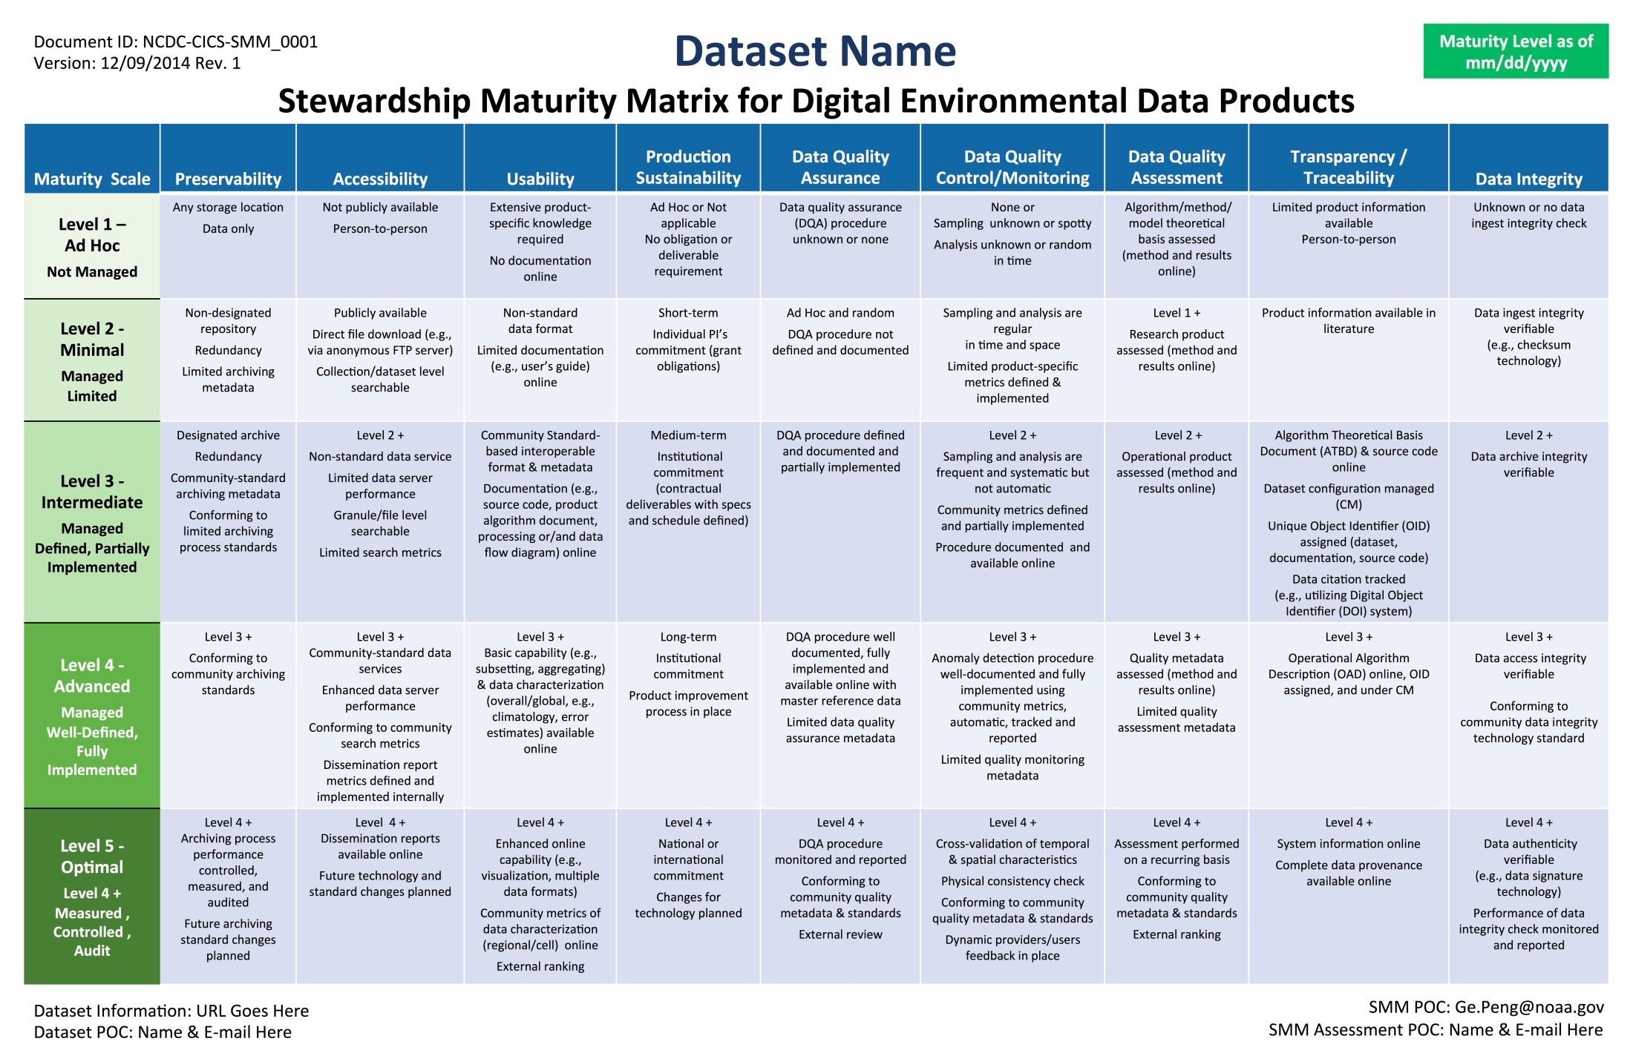
Data Stewardship Maturity Matrix

